Slide 1
Usable code verification: balancing costs and benefits
Two nuggets: User-defined verifiers Crowd-sourced verification
Michael D. Ernst University of Washington
with: Mahmood Ali, Steph Dietzel, Werner Dietl, Kivanc Muslu, Matt Papi, Todd Schiller, …
Notes:
My context: program verification

Slide 2
Goals for usable verification: scalability to real programs and programmers
Natural: fits into developer mindset and IDE
Usable by first-year college students
Comprehensible, predictable success/failure
Incremental benefit: instant gratification
Fast verification
Partial correctness
domain-specific properties
loopholes (hand-checked)
Partial programs: modular
Customizable: user can create/extend verifiers

Slide 3
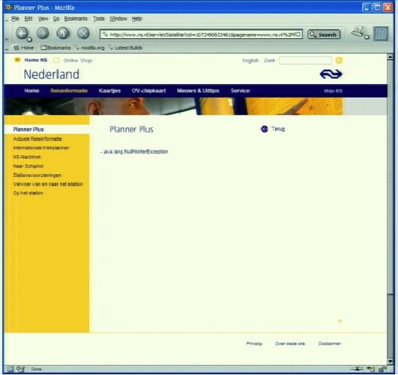
Type systems
The (only) shining success of formal verification
The built-in type system prevents too few bugs
java.lang.NullPointerException

Slide 4
Solution: Pluggable type systems
Design a type system to solve a specific problem
Write type qualifiers in code (or, use type inference)
@Immutable Date date = new Date(0);
date.setTime(70); // compile-time error
Type checker warns about violations (bugs)
% javac -processor NullnessChecker MyFile.java
MyFile.java:149: dereference of possibly-null reference bb2
allVars = bb2.vars;
^

Slide 5
What bugs can you detect & prevent?
The property you care about:
The annotation you write:
Null dereferences @NonNull
Mutation and side-effects @Immutable
Concurrency: locking @GuardedBy
Security: encryption, @Encrypted tainting @Untainted
Aliasing @Linear
Equality tests @Interned
Strings: localization, @Localized regular expression syntax, @Regex signature format @FullyQualified
Typestate (e.g., open/closed files) @State
Users can write their own checkers!

Slide 6
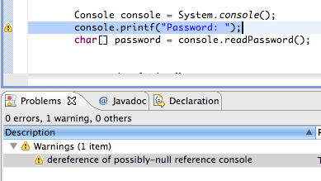
Using a checker
Run in IDE or on command line
Works as a compiler plug-in (annotation processor)
Uses familiar error messages
% javac –processor NullnessChecker MyFile.java
MyFile.java:9: incompatible types. nonNullVar = nullableValue; ^ found : @Nullable String required: @NonNull String

Slide 7
Features Tool support
Full type system
Inheritance
Overriding
Type and qualifier polymorphism
Pre-/post-conditions
Local type inference
Qualifier defaults
Warning suppression
Tool integration: javac, Eclipse, Ant, Maven, …
Global inference tools: nullness, mutability
Type annotations planned for Java 8
Write in comments today

Slide 8
Taint checker
Writing a new checker:
The complete code
@TypeQualifier
@SubtypeOf(Unqualified.class)
@ImplicitFor(trees = {STRING_LITERAL})
public @interface Untainted { }
To use it:
Write @Untainted in your program
List getPosts(@Untainted String category) {…}
Compile your program
javac -processor BasicChecker -Aquals=Untainted MyProgram.java
Simple type-checkers are very easy to write; complicated ones are possible to write

Slide 9
Results: Effective and easy to use
Easy to use
Used by students in the first CS majors class at UW
In use industrially
My group has annotated 3 million lines of code
Effective: found >300 bugs, in the JDK, Google Collections, Lucene, Xerces, ASM, SVNKit, …
Annotations are not verbose
Fewer than 1 per 75 lines
Few false positive warnings

Slide 10
Verification from the genesis
Post-hoc annotation and verification is painful
Writing annotations with the code is painless
Must both write and verify from the beginning
(A generalized approach: Ductile subsumes hybrid and gradual typing: http://code.google.com/p/ductilej/)

Slide 11
Type systems complement other verification strategies
There is a place for both
Types are more limited in expressiveness
cf. arbitrary assertions, first-order logic
Many important properties are expressible

Slide 12
Nugget 2: Making software correctness profitable
Leveraging comparative advantage in software engineering tools

Slide 13

Software bugs cost the US economy an estimated $59.5 billion annually
Testing and verification are labor intensive
Skilled labor is expensive

Slide 14
An Abundance of Cheap(er) Labor
Average software developer | $43.00 / hr
Average Mechanical Turk worker | $1.40 / hr

Slide 15
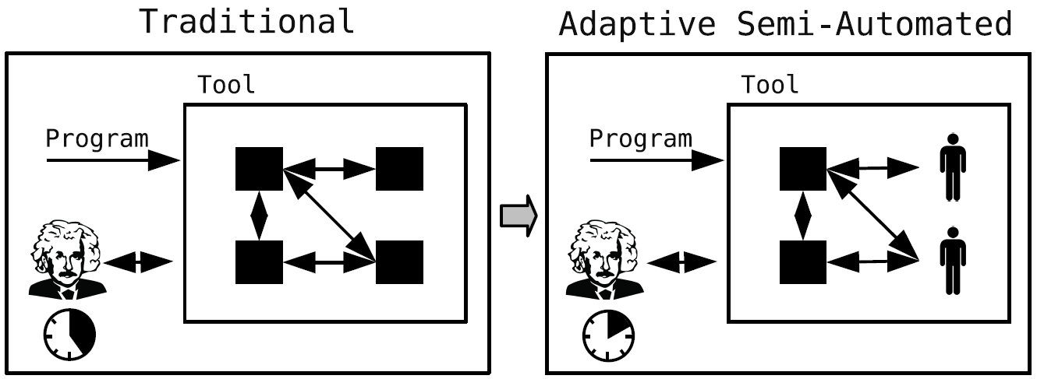
Adaptive Semi-Automated (ASA) tools use less-skilled, less-expensive, workers
Decompose large tasks into automated and human-performed subtasks

Slide 16
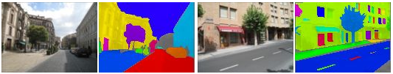
Using less-skilled labor can be clean and simple
What happens when you can’t cleanly create simple subtasks?
http://labelme.csail.mit.edu/mechanicalturk.html

Slide 17
Design Principles
Target well-defined skill sets
Exploit parallelism between subtasks
Create labor markets to minimize costs

Slide 18
Research Questions
What skill sets are required for Einstein and John to use the tool?
What is the learning curve for Einstein and John to use the tool?
Given a task and salaries, how much time and money is saved by using the tool?
Given a fixed resource budget, can the tool provide benefits beyond those provided by other methods?

Slide 19
Tool design is an optimization problem
ASA tool design requires empirical studies

Slide 20
Balancing costs and benefits for widespread verification:
Natural, incremental, customizable
Pluggable type systems
Adaptive semi-automated verification
Checker Framework for creating type checkers
Featureful, effective, easy to use, scalable
Prevent bugs at compile time
Create custom type-checkers
Ask me for a demo, or download: types.cs.washington.edu/
Reduce the cost of software engineering by using less-skilled labor
Adaptive to make up for imperfect task decomposition
Tool analysis is an optimization problem

