Slide 1
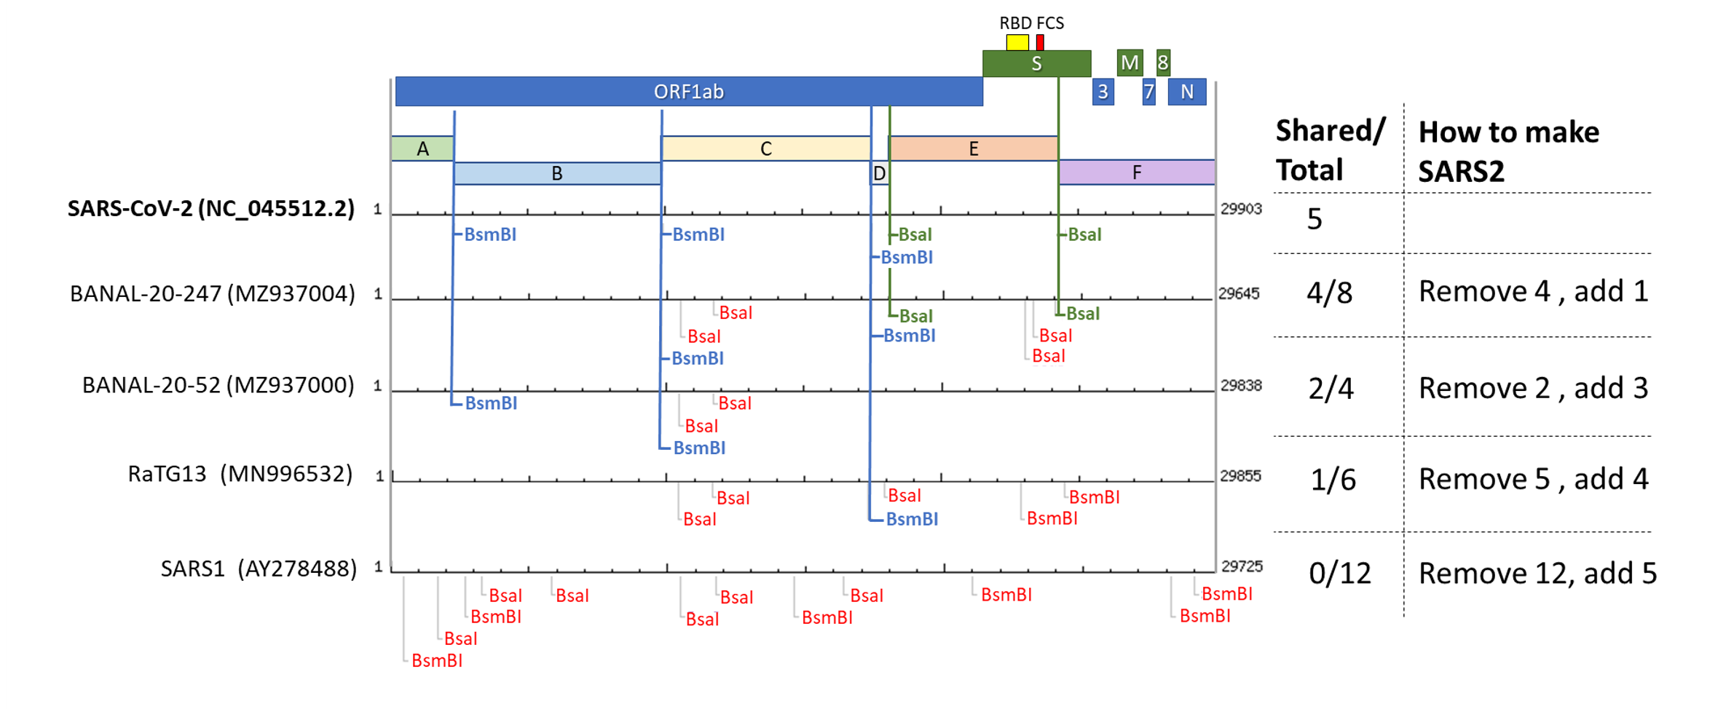
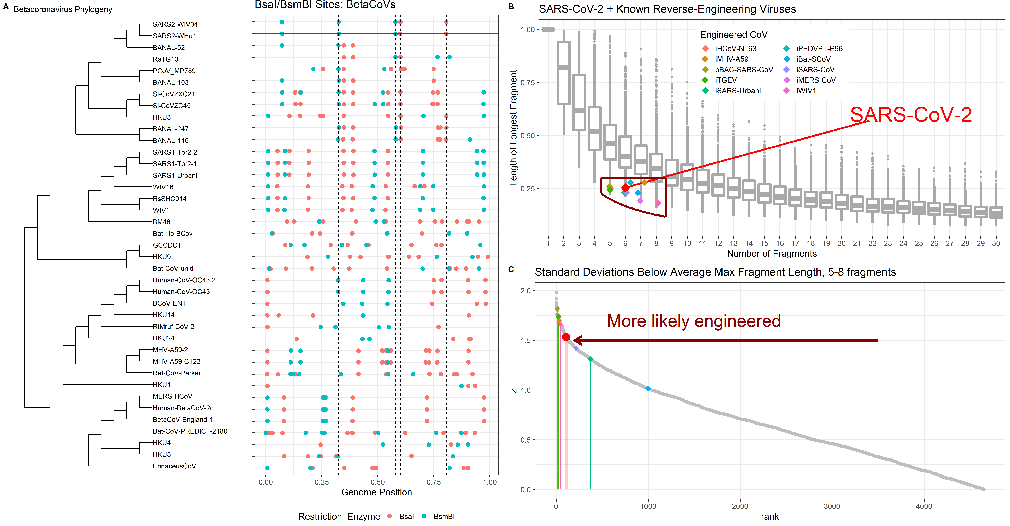
(A) SARS-CoV-2 BsaI/BsmBI restriction map
(B) SARS CoV BsaI/BsmBI Restriction maps
(C) Max fragment lengths: SARS-CoV-2 + known Engineered CoVs
(D) Standard deviations below wild type expectation
Restriction Ezyme: BsaI BsmBI

