Slide 1
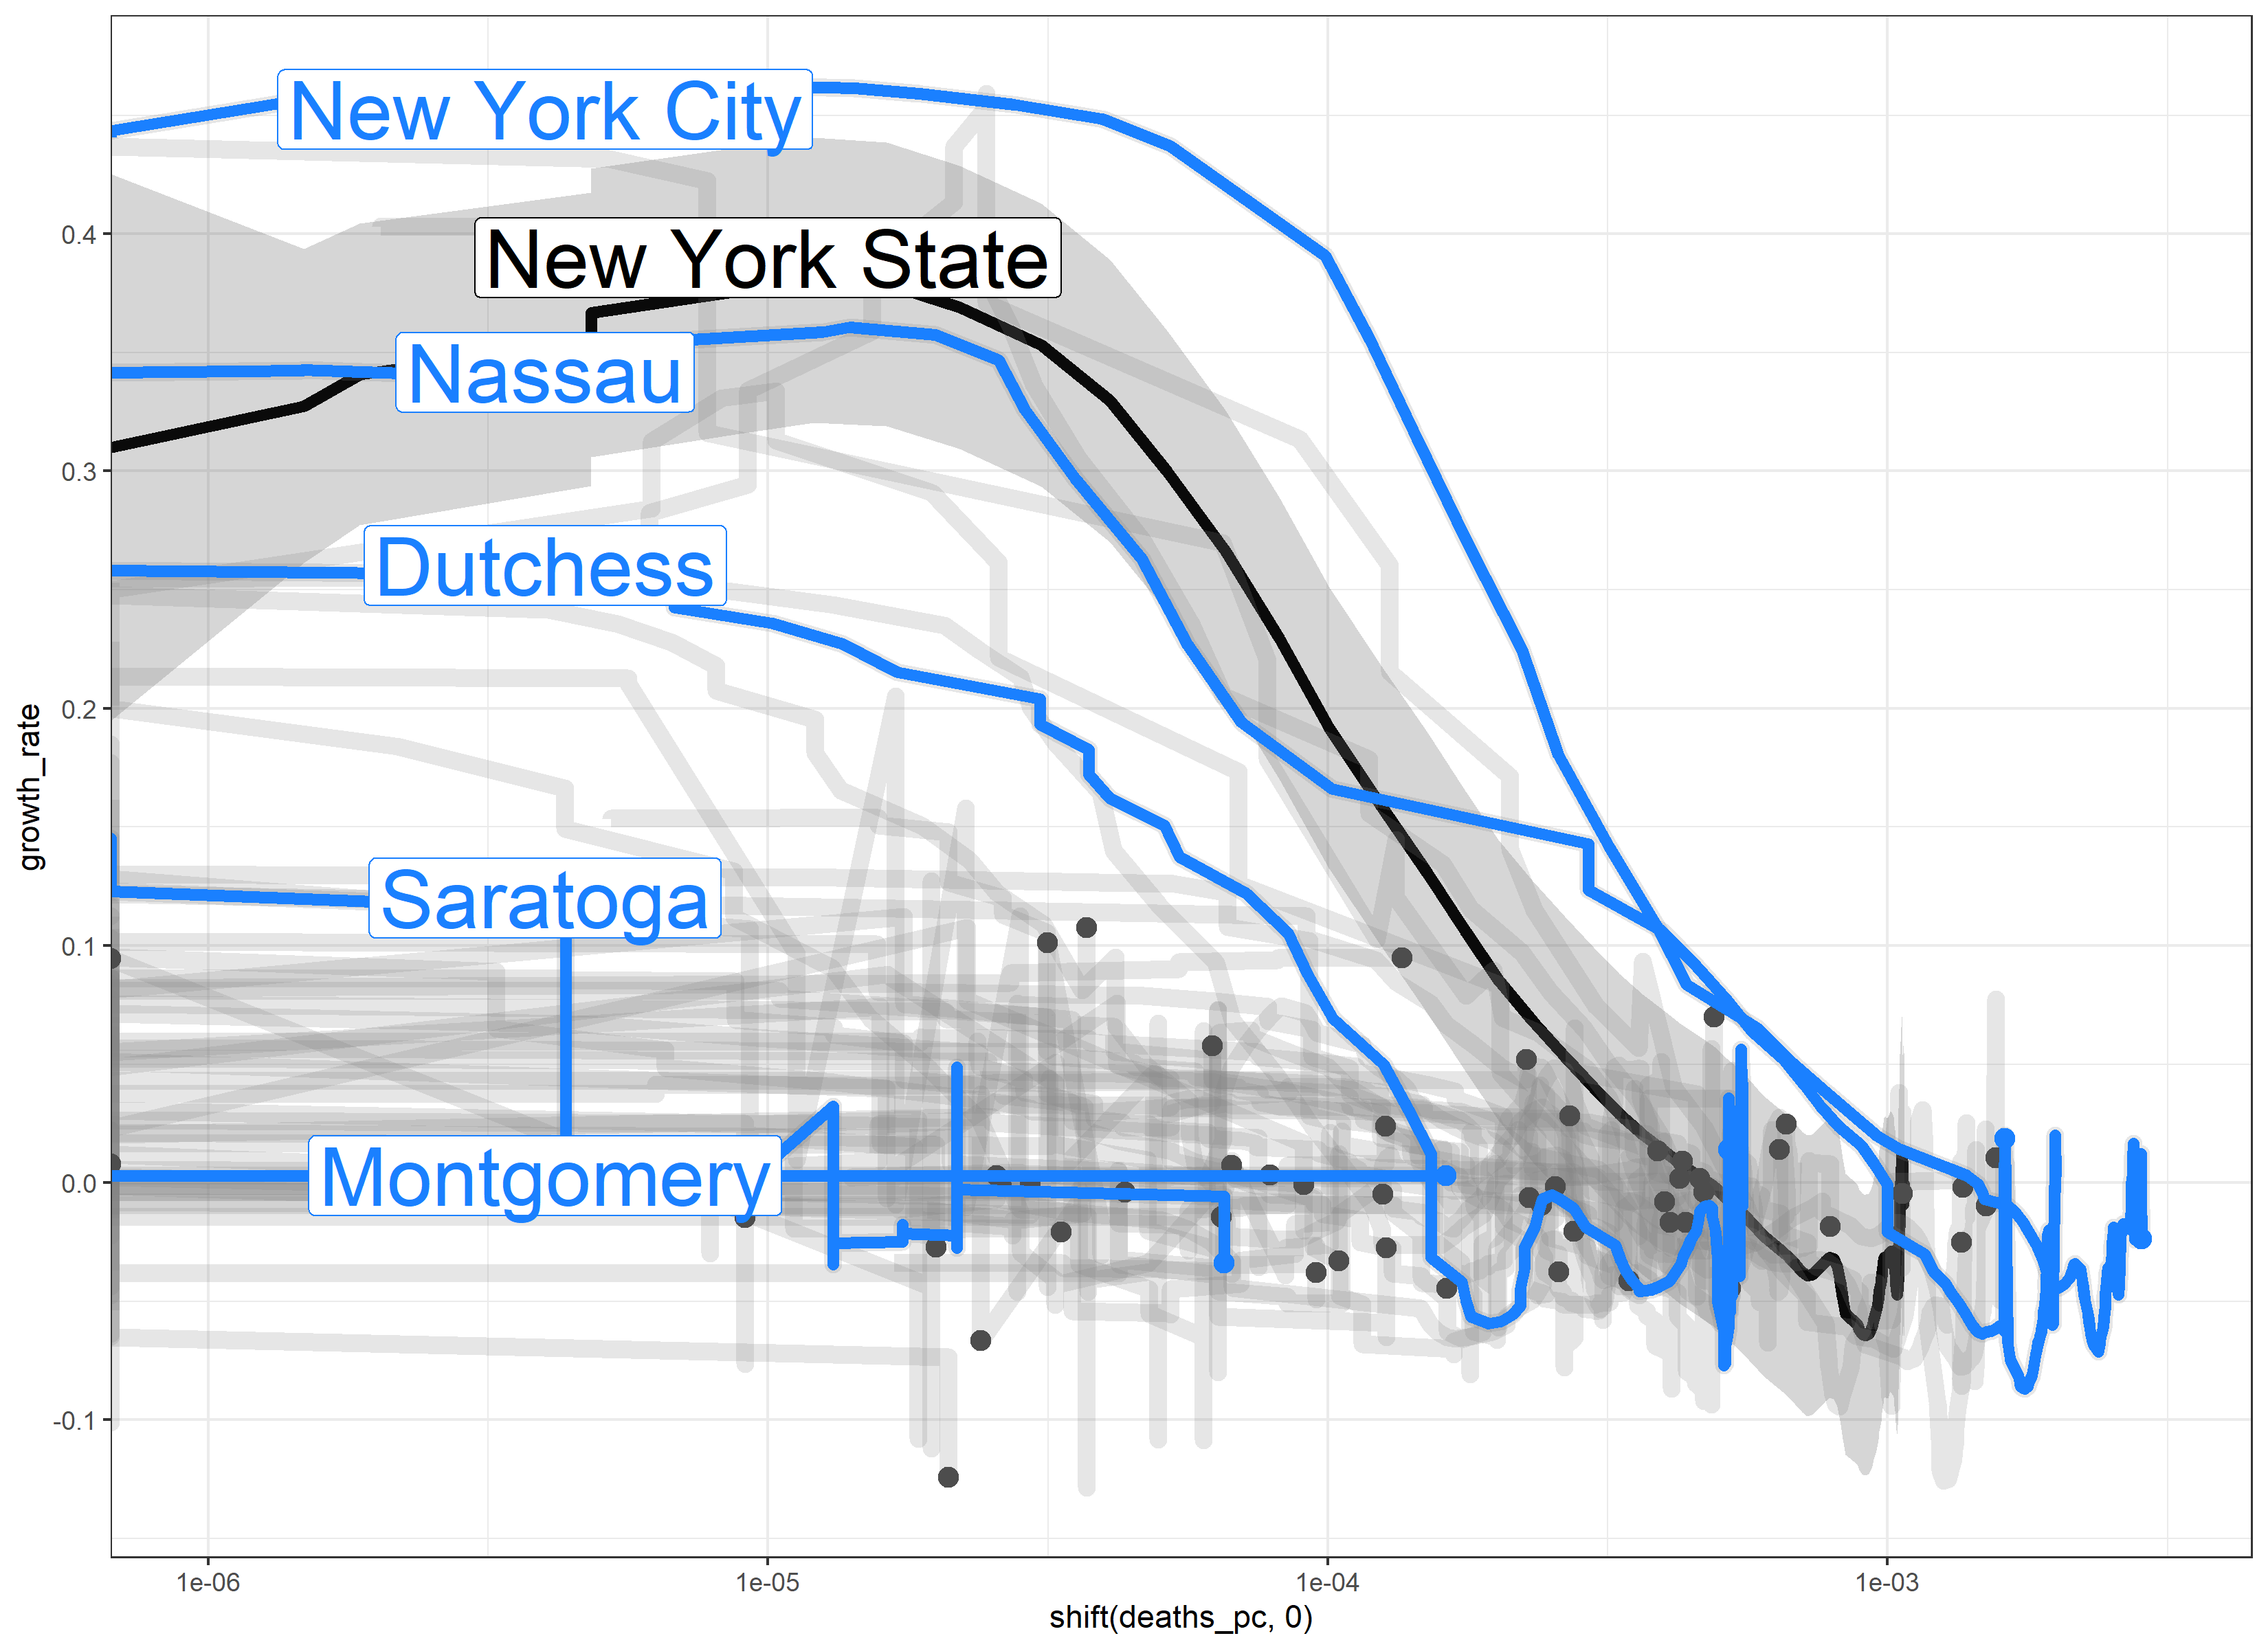
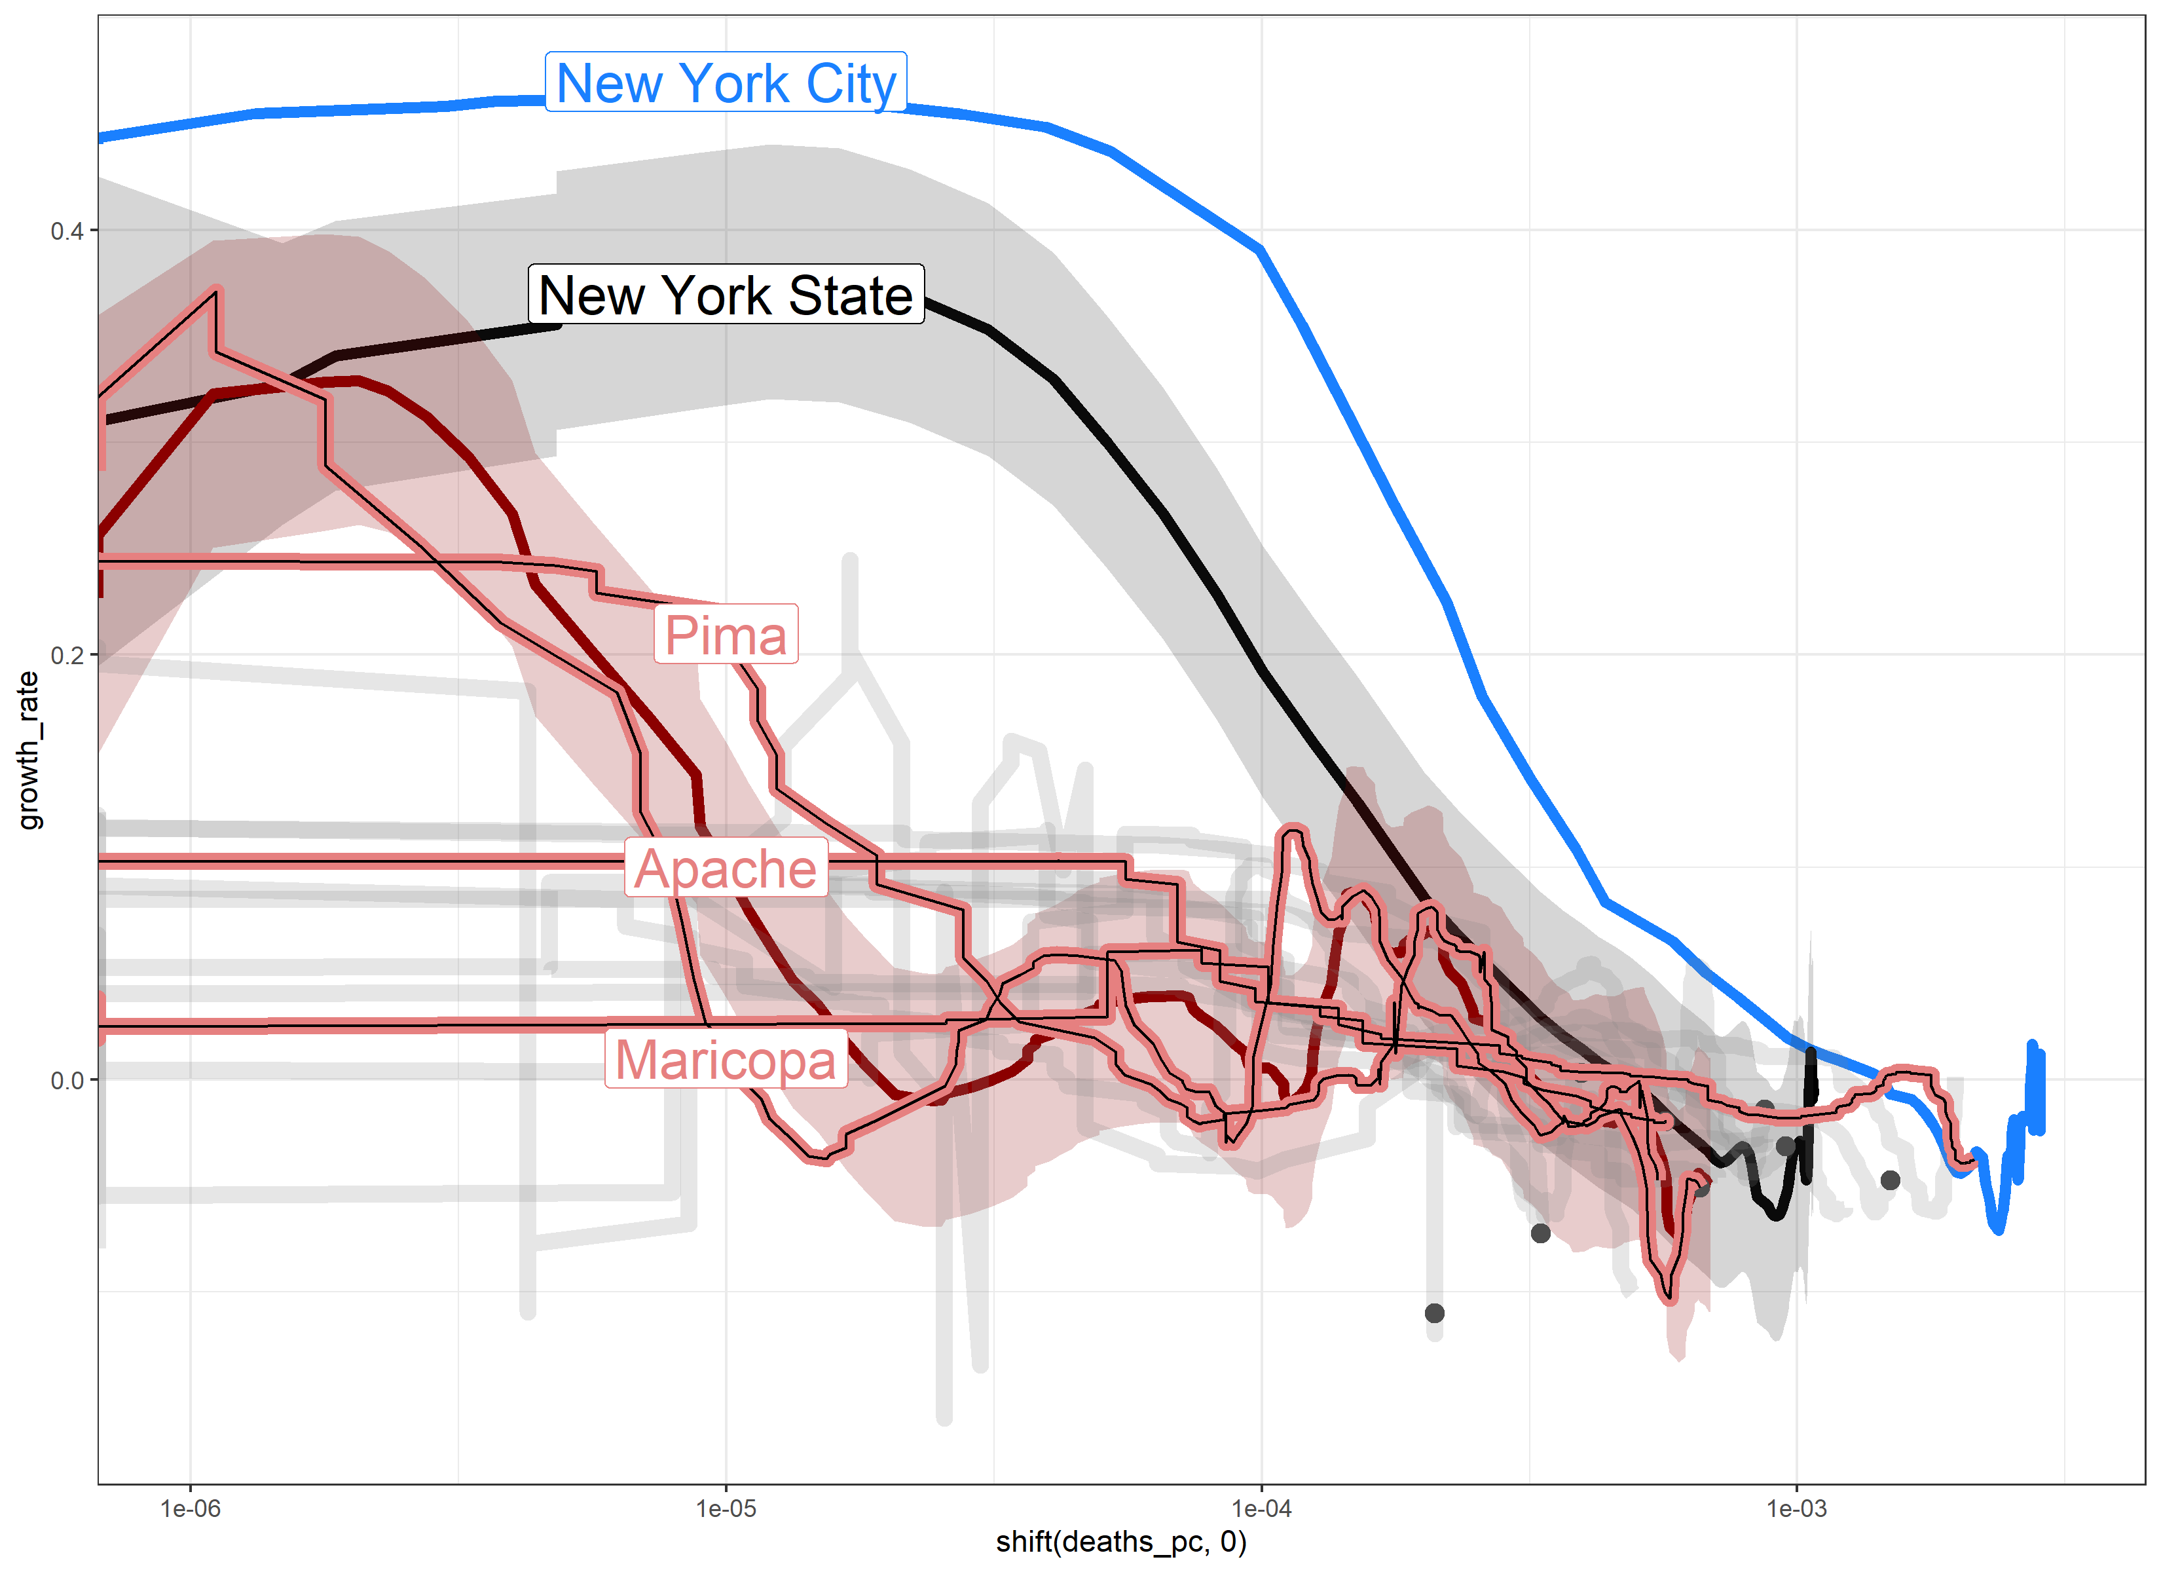
New York Counties
Arizona Counties
0.4
0.3
0.2
Growth Rate
0.1
0
-0.1
10⁻⁶
10⁻⁵
10⁻⁴
10⁻³
10⁻⁶
10⁻⁵
10⁻⁴
10⁻³
Deaths Per-Capita

