Slide 1
STANDBY
PROMPT BOOK
PRODUCT OVERVIEW & ROADMAP
Standby.
The stage manager’s prompt book, reimagined for the rehearsal room.
One calm, local-first home for the company, the calendar, the cues, and the reports. Built for stage managers everywhere, from Off-Off-Broadway (OOB) black boxes to Actors’ Equity Association (AEA) houses.
reptarbro.github.io/Stagemgmt
2026

Slide 2
Purpose & What’s Inside
01
1
2
3
One place for everything
Offline and private
Paperwork you hand out
Calls know who is cast
Conflicts flag against calls
Cue-to-cue appears at tech
Switch shows in one tap
Data lives on the device
Loads instantly, anywhere
One-file backup and restore
Nothing leaves the device
Rehearsal reports as PDFs
Printable sign-in & cast lists
Calendar export to phones
Email a report in one tap
9
0
100%
$0
Modules
Logins
On-device
To start
Standby · Product Overview & Roadmap

Slide 3
Why Standby, Not Five Other Tools
02
Capability | Standby | Spreadsheets & docs | Generic PM apps | SaaS platforms
Everything in one place | ✓ | ✗ | ~ | ~
Works fully offline | ✓ | ~ | ✗ | ✗
No account or login | ✓ | ~ | ✗ | ✗
No subscription fee | ✓ | ✓ | ~ | ✗
Built for theater work | ✓ | ✗ | ✗ | ~
One link, any device | ✓ | ~ | ✓ | ✓
Data stays on your device | ✓ | ✓ | ✗ | ✗
Standby · Product Overview & Roadmap

Slide 4
The Real-World Win
03
The wifi is down during tech
An actor is running late at 6:25
Because the whole prompt book lives on the iPad, the cues, contact sheet, and schedule are all still right there.
Mark them Late once in Attendance. It already flows onto the sign-in sheet and into tonight’s report.
✓ Nothing skips a beat
✓ Logged once, everywhere
A designer needs contacts tonight
You sub in on a running show
Print the cast list or export a CSV in a single tap, with no login and no shared-drive hunting.
The outgoing stage manager sends one backup file. Import it, and the whole prompt book is yours.
✓ Sent in one tap
✓ Up to speed in seconds
Standby · Product Overview & Roadmap

Slide 5
Built for the Field: OOB & AEA
04
For OOB companies
For AEA productions
Free and installs nothing, for companies with no budget and no IT
Runs on the SM’s own iPad, with no account to provision
Export and import covers the handoff when the SM changes
A sample production teaches the whole tool in one tap
Distribution-ready reports and callboard sign-in sheets
Attendance: present, late, absent, excused, no-show
Break and timing notes captured in every report
Emergency contact and conflict tracking that respects availability
Standby · Product Overview & Roadmap

Slide 6
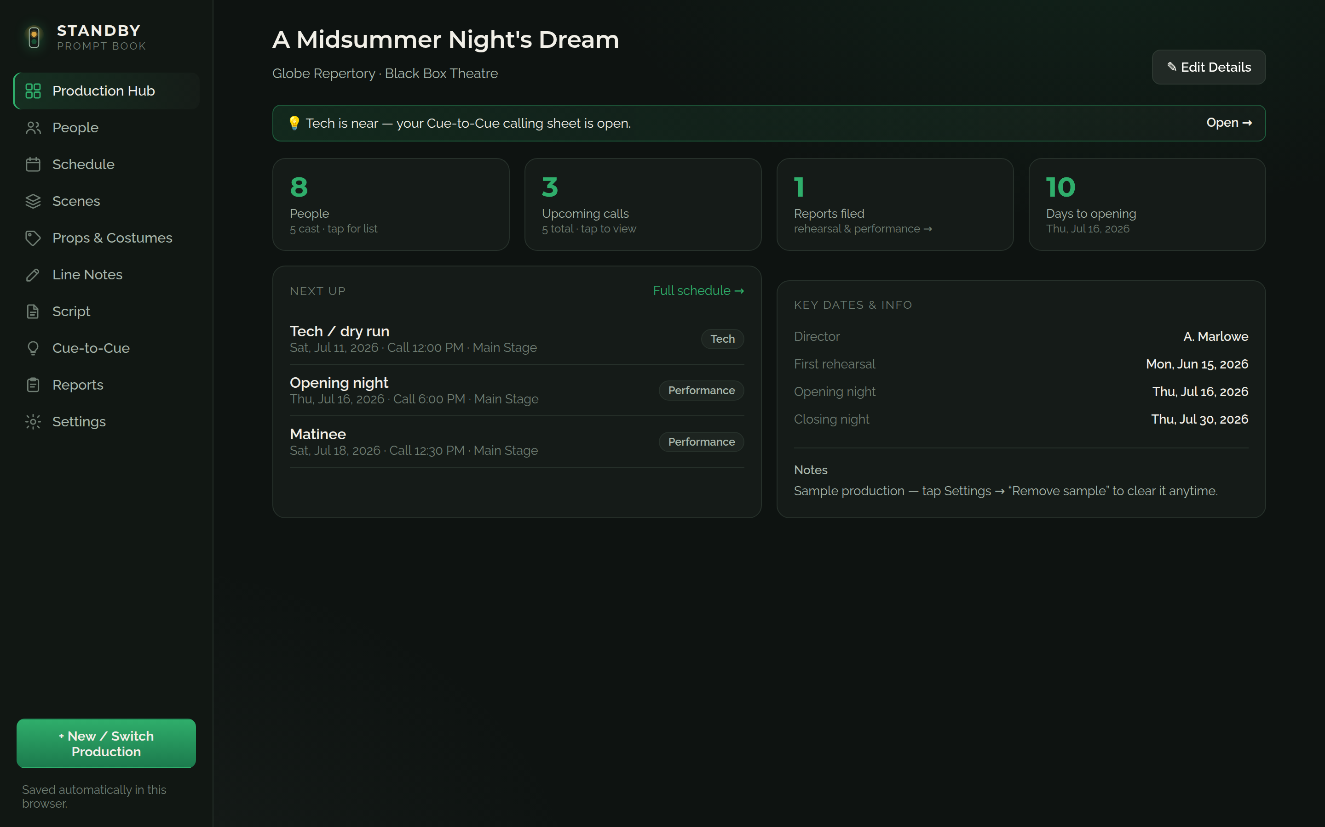
THE INTERFACE · 1 OF 5
Production Hub
The Production Hub is the show’s home screen. Tappable tiles surface the headline numbers (cast size, upcoming calls, reports filed, and days to opening), while "Next Up" lists the coming calls and "Key Dates" pins the milestones. When tech approaches, a banner links straight to the calling script.
Standby · Product Overview & Roadmap

Slide 7
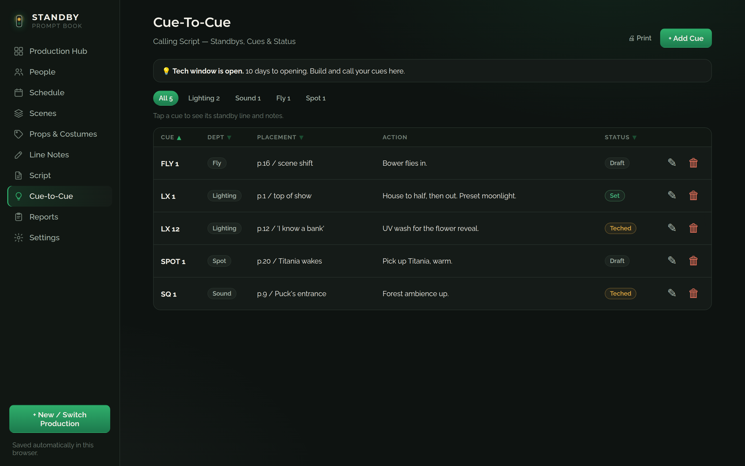
THE INTERFACE · 2 OF 5
Cue-to-Cue Calling Script
The Cue-to-Cue view holds every standby, cue, placement, action, and status in one sortable table. Department filters let the caller isolate a single track, and each cue moves from Draft to Teched to Set as the sequence is built. It appears automatically as tech week nears.
Standby · Product Overview & Roadmap

Slide 8
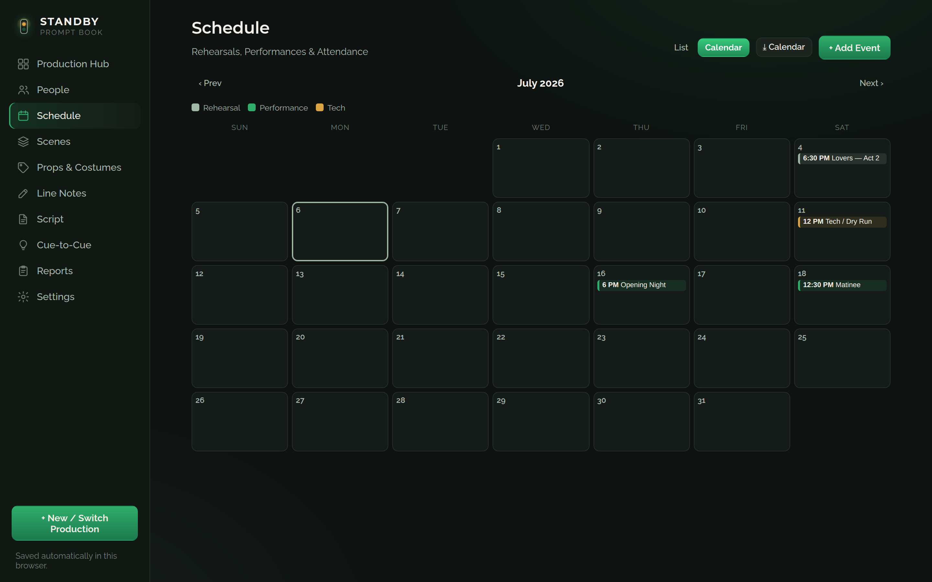
THE INTERFACE · 3 OF 5
Schedule & Calendar
The Schedule shows the whole production month at a glance, color-coded by event type with a legend. Rehearsals, tech, and performances each read instantly, and tapping any date opens that call. The same events export to the company’s phones as a calendar file.
Standby · Product Overview & Roadmap

Slide 9
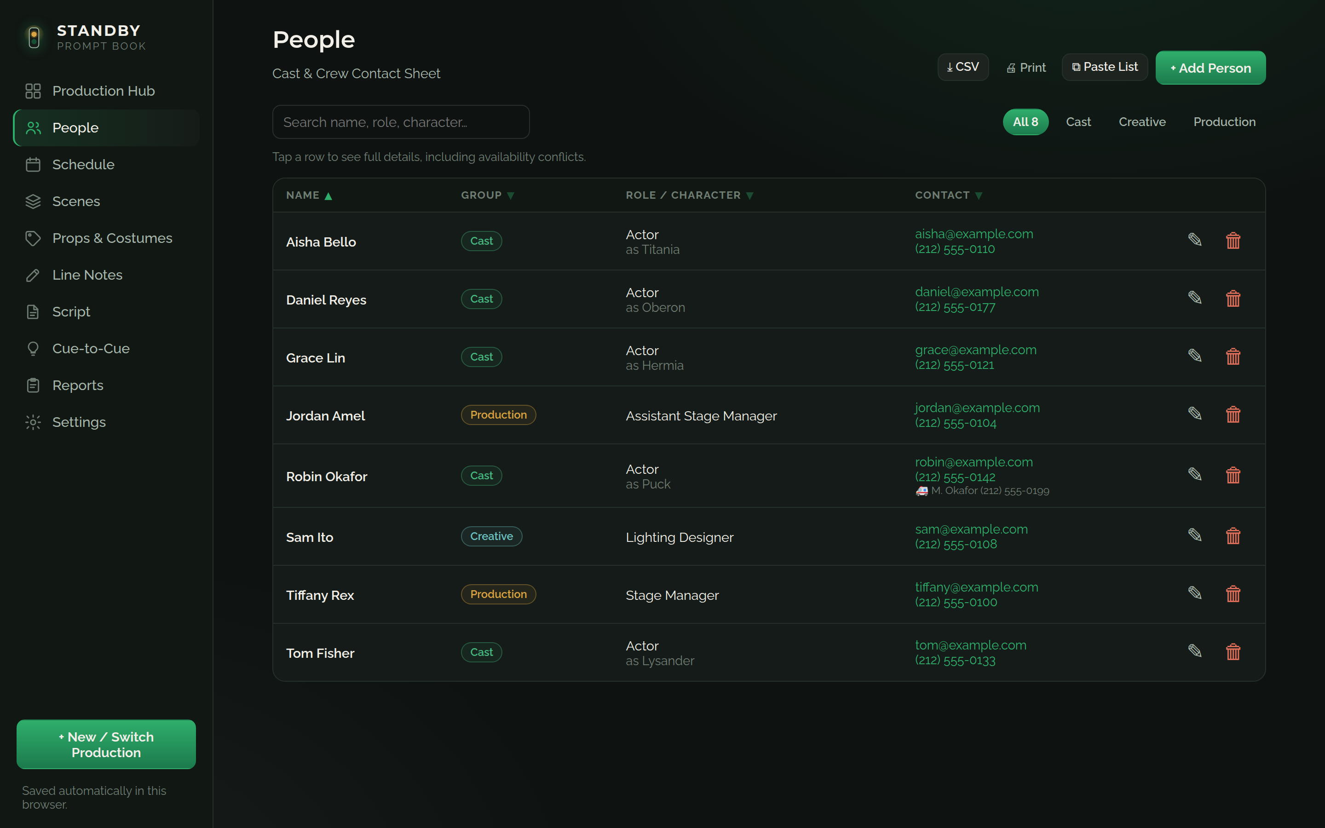
THE INTERFACE · 4 OF 5
People & Contact Sheet
People is the cast and crew contact sheet. Each row carries the person’s group, role or character, contact details, and emergency contact, and the list sorts and filters instantly. It prints as a clean cast list and exports as a CSV.
Standby · Product Overview & Roadmap

Slide 10
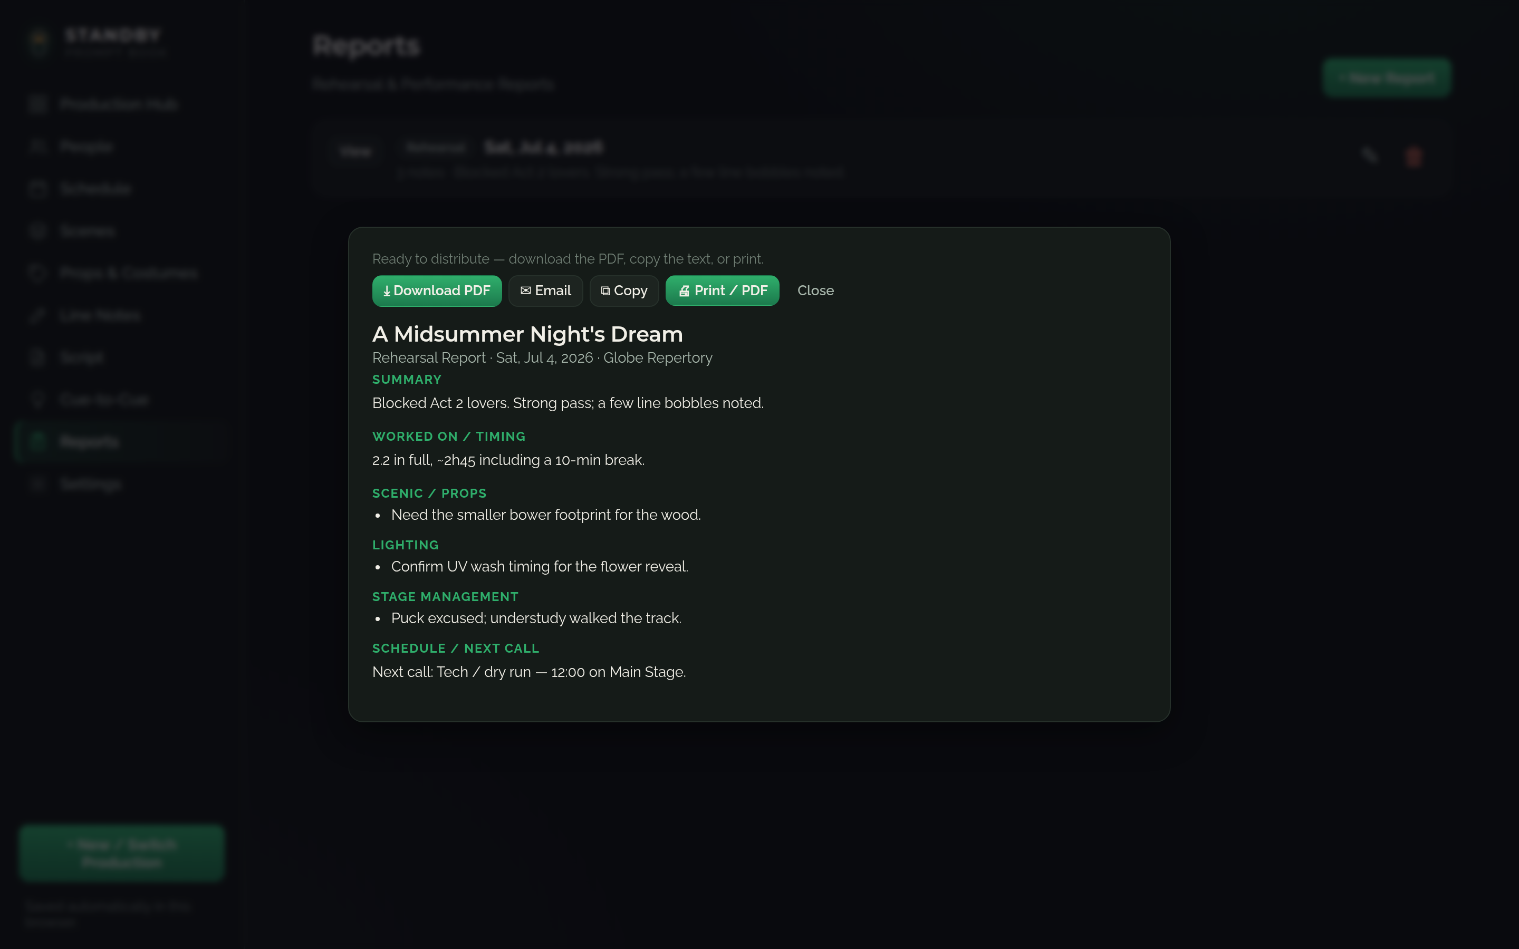
THE INTERFACE · 5 OF 5
Rehearsal Reports
Reports are written in a structured form and open in a distribution-ready view. From here the stage manager downloads a clean PDF, opens an email with the subject pre-filled, copies the text, or prints. Everything is ready to send to the company after the call.
Standby · Product Overview & Roadmap

Slide 11
Roadmap, Toward a Full-Fledged App
05
Now SHIPPED, v3.5
Complete single-user prompt book
All nine modules, offline, responsive, print & PDF. Live and in use.
Q3 2026 PHASE 2a
Sync and shareable views
Accounts with cross-device sync and a shareable read-only link.
Q4 2026 PHASE 2b
Collect and remind
Availability forms, reminders, and email the script to cast.
Q1 2027 PHASE 3a
Teams, companies, and roles
Collaboration, company accounts and roles, subscription tier.
Q2 2027 PHASE 3b
Deep integrations and a native app
Script-page linking, native app, calendar sync, e-signature sign-in.
Standby · Product Overview & Roadmap

