Slide 1
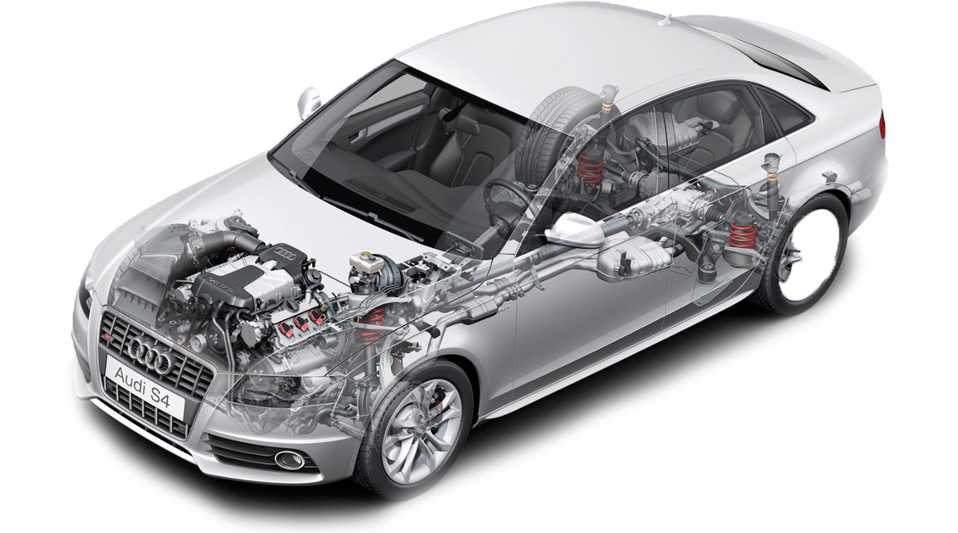
SEATS
VEHICLE STRUCTURE
WINDSCREEN
STEERING & HORNS
WIPERS & WASHERS
EXHAUST SYSTEM
BONNET
EXHAUST EMMISSIONS
LIGHTS
FUEL SYSTEM
MIRRORS
POWER STEERING FLUID
TYRES & WHEEL
SUSPENSION
BREAKS

