Slide 1
AI TRANSFORMING HOSPITAL OPERATIONS · SRS 2026
AI coordinates care.
The constraint moves.
ONE OPERATING MODEL
6
AI levers
Arrivals
Context carries forward
The opportunity is not another point solution. It is one coordinated operating model—from arrival to recovery.
Diagnosis
Routes first time
OR core
Readiness synchronizes
Recovery
Capacity becomes explicit
THE DECISION
Where does coordination release capacity—and reveal the next investment?
01
Notes:
Open with the tension: the robot and surgeon can be ready while four ordinary handoffs still threaten the case. Pause after the question.
Central thesis: the hospital is already full of intelligence; it is short on coordination.

Slide 2
HOSPITAL OPERATING TWIN · LIVE DEMO
Now, watch the
constraint move.
Follow one hospital from arrival to recovery—and see the next capacity decision become visible.
LAUNCH LIVE DEMO →
01
02
03
ARRIVAL
→
OPERATING ROOM
→
RECOVERY
02
Notes:
Close on the decision, not the technology. One flow. One owner. One scorecard. The point is coordinated, human-governed execution—not autonomous clinical care.

Slide 3
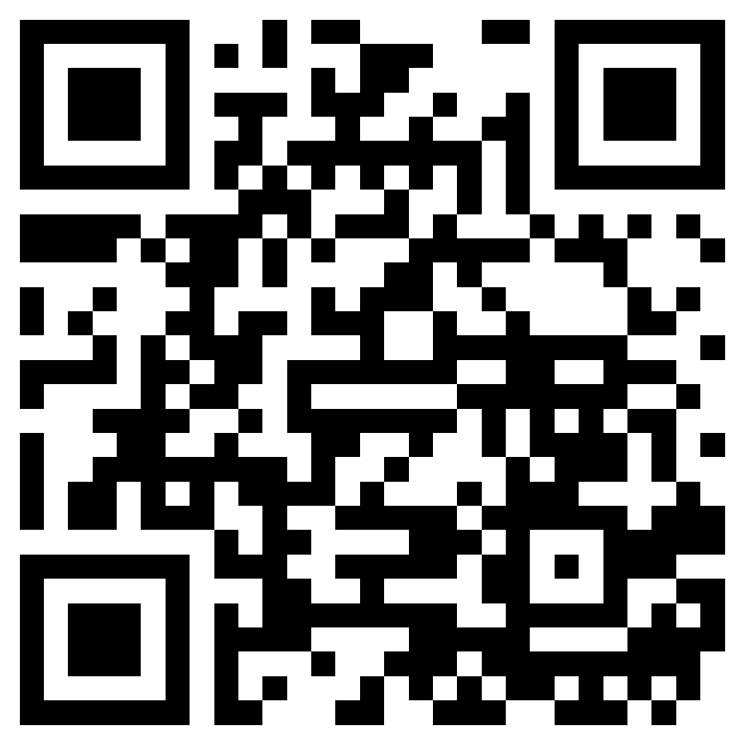
AI TRANSFORMING HOSPITAL OPERATIONS · SRS 2026
Take the operating twin
with you.
Explore the source, story, and next version of the 3D hospital operating simulator.
SCAN TO EXPLORE →
01
02
03
GITHUB
→
OPEN SOURCE
→
KEEP EXPLORING
03
Notes:
Close on the decision, not the technology. One flow. One owner. One scorecard. The point is coordinated, human-governed execution—not autonomous clinical care.

