Slide 1
AI TRANSFORMING HOSPITAL OPERATIONS · SRS 2026
The robot is ready.
The hospital isn’t.
ONE ROBOTIC CASE · 48 HOURS OUT
47:36
hours to incision
Authorization
Evidence requested
Robotic surgery made the procedure precise.
AI must make the episode around it coherent.
OR + robot
Block secured
Scrub coverage
2-hour gap
Bed capacity
1 staffed bed
THE QUESTION
Can the institution move with the same precision as the machine?
01
Notes:
Open with the tension: the robot and surgeon can be ready while four ordinary handoffs still threaten the case. Pause after the question.
Central thesis: the hospital is already full of intelligence; it is short on coordination.

Slide 2
THE ECONOMIC MANDATE
Hospital economics no longer permit coordination waste.
2024
2024
AHA 2025
$1.635T
+8.9%
56%
U.S. hospital spending
one-year growth
of hospital costs are labor
Every unused minute, delayed bed-day, and failed handoff now compounds across the most expensive system in the economy.
Sources: CMS National Health Expenditure data (2024); AHA 2025 Costs of Caring report.
02
Notes:
Make this a board-level problem, not a technology trend. Costs, demand, and acuity are rising together; coordination waste is no longer operational trivia.

Slide 3
THE COORDINATION GAP
No system owns the whole clock.
Every function sees its task. The risk accumulates between them.
01
02
03
04
05
AUTHORIZATION
PRE-OP
STAFF +
INSTRUMENTS
BED
INCISION
payer evidence
labs + clearance
credentials + trays
acuity + capacity
ready case
The bottleneck is not intelligence inside a system.
It is accountability across systems.
03
Notes:
Trace the case from authorization to incision. Each function can perform locally and the case can still fail globally because no workflow owns the end-to-end clock.

Slide 4
THE TECHNOLOGY SHIFT
The next value layer is execution.
A dashboard predicts failure. A governed agent helps prevent it—and verifies what happened.
01
02
03
04
RECORD
→
SEE
→
PREDICT
→
COORDINATE
What happened?
What is happening?
What will happen?
What should happen next?
SENSE
PLAN
ACT
VERIFY
04
Notes:
Do not frame this as a smarter dashboard. The distinctive value is a closed loop: sense, plan, act within permissions, and verify completion.

Slide 5
ENTERPRISE TRANSFORMATION MAP
Six levers. One operating system.
The strategic mistake is funding six portfolios. The opportunity is connecting one system.
DX
FD
RX
LC
TA
PM
Clinical
Diagnosis
Digital
Front Door
Robotics
Longitudinal
Care
Task
Automation
Precision
Medicine
SHARED CONTEXT
One longitudinal view of intent, capacity, risk, and state
GOVERNED ACTION
Permissions, thresholds, named approvals, rollback, and stop conditions
CAUSAL SCORECARD
Access · flow · workforce · economics · trust
Transformation architecture developed for the SRS 2026 executive demonstration.
05
Notes:
Make the category distinction explicit: these are six value-creation interfaces to one operating layer, not six disconnected AI portfolios.

Slide 6
THE SIX THESES
Each lever changes the unit of management.
DX
Clinical Diagnosis
FD
Digital Front Door
RX
Robotics
Episode → continuously updated routing decision
Channel → persistent relationship that resolves needs
Precision instrument → distributed capacity platform
LC
Longitudinal Care
TA
Task Automation
PM
Precision Medicine
Visits → continuously managed queue
Task → governed outcome, executed and verified
Specialist report → learning operating model
06
Notes:
Clinical Diagnosis becomes a routing decision; the Digital Front Door becomes a resolution relationship; Robotics becomes distributed capacity; Longitudinal Care becomes a managed queue; Task Automation becomes a governed outcome; Precision Medicine becomes a learning operating model.
Decision rules: build pathways, measure resolution, manage the episode, assign every signal, redesign before automating, and connect each precision insight to an action.

Slide 7
THE COMPOUNDING MECHANISM
Value compounds only when the loop closes.
01
02
03
04
SENSE
→
DECIDE
→
ACT
→
LEARN
signals + state
options + tradeoffs
people + workflow + robot
outcomes + exceptions
←
EVERY COMPLETED EPISODE SHOULD IMPROVE THE NEXT DECISION
DX
FD
RX
LC
TA
PM
07
Notes:
The value does not compound because six tools coexist. It compounds because every episode produces better context, safer actions, and measurable learning for the next one.

Slide 8
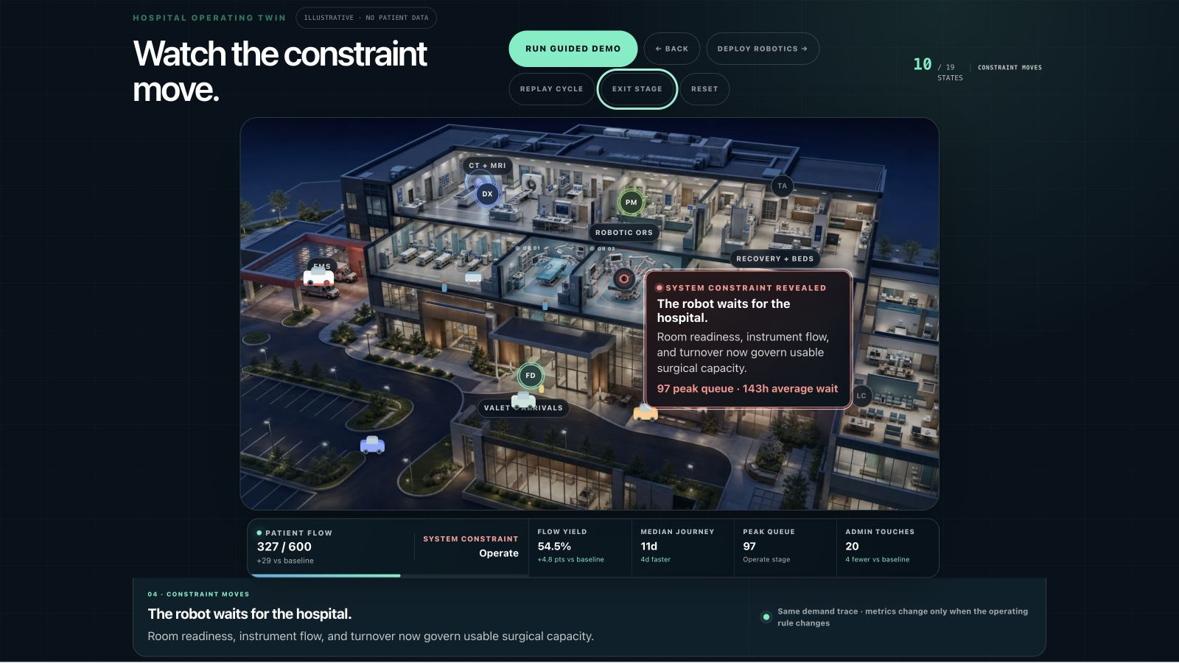
08
Notes:
Transition into the Hospital Lab. Say: same 600 synthetic episodes, same 30-day demand trace, same clinical priority—different operating rules. Reset the twin, run the guided sequence, and ask the audience to watch the constraint move. Point out once that the cars, EMS, patients, and caregivers keep moving at the same speed; improvement appears as fewer touches, shorter journeys, more completed episodes, and a different binding constraint.
Credibility moments: pain-point callouts resolve and migrate as each lever enters the operating model; Precision Medicine adds selective upstream work; Robotics releases local capacity without immediately moving enterprise throughput; the connected system ultimately exposes staffed recovery capacity as the next investment decision. All coefficients are illustrative assumptions, not observed AdventHealth performance.

Slide 9
CASE 7B · ROBOTIC PARTIAL NEPHRECTOMY
Four handoffs can still strand one robotic case.
The robot and surgeon are booked. Ordinary coordination failures still threaten the episode.
ACCESS
Authorization evidence requested
Payer API · 4 min
READINESS
Pre-op lab still pending
LIS · 21 min
CAPACITY
Credentialed scrub coverage gap
Workforce · live
FLOW
Only one staffed critical-care bed
Bed command · live
47H 36M TO INCISION
Synthetic case · no patient data
09
Notes:
Name each risk and its source. The demonstration begins with fresh signals, not a prompt asking a chatbot to invent a plan.

Slide 10
GOVERNED AGENT LOOP
Not a chat window. A governed decision system.
Goal + policy + permissions + stop conditions → one constrained plan
01
ACCESS
Executed
Assemble evidence
Retrieve criteria
ONE PLAN
02
READINESS
Preserve
the case
Executed
Secure lab slot
Hold lab slot
→
→
03
CAPACITY
OR director
Model schedule swap
with explicit tradeoffs
Approve schedule swap
04
FLOW
Access lead
Test bed contingency
Approve payer submission
Reversible work executes automatically. Consequential actions stop at named human approvals.
10
Notes:
The agents work in parallel, but authority is not parallelized away. Reversible actions can execute; the OR director and Access lead approve their respective consequential actions.

Slide 11
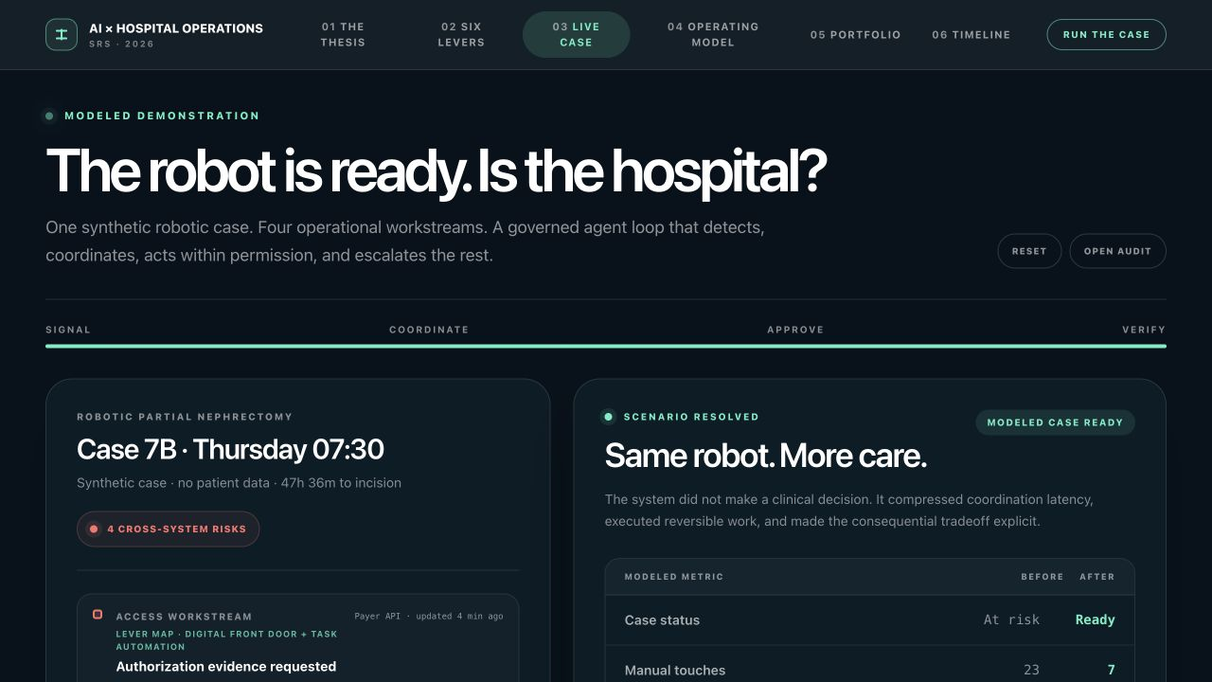
SCENARIO RESOLVED · MODELED DEMONSTRATION
Same robot. More care.
No clinical judgment was delegated. Coordination latency was compressed around existing assets and staff.
23 → 7
0 → 96
manual touches
OR minutes recovered
6.5h → 1.8h
$0 → $41K
overtime exposure
modeled margin protected
ASSUMPTIONS · one avoided cancellation · 96 OR minutes · local contribution estimate
Illustrative outputs only; not a clinical or financial forecast.
11
Notes:
Label the result as scenario-resolved and modeled. Open the audit strip briefly. The key point is not the exact dollar figure; it is the governed mechanism that turns existing capacity into care.

Slide 12
EVIDENCE, NOT INEVITABILITY
Embedded AI is already moving operational outcomes.
Early implementations show the value of intelligence inside the workflow—not beside it.
HARTFORD HEALTHCARE
PENN ORACLE
−0.63
884
days of length of stay
fewer scheduling-error hours / year
$52–67M estimated annual benefit
5% more accurate OR scheduling
OBSERVATIONAL IMPLEMENTATION
HEALTH-SYSTEM IMPLEMENTATION
These results support the mechanism. They do not yet prove a fully agentic hospital.
Sources: INFORMS Analytics (Hartford HealthCare); University of Pennsylvania Center for Health Care Transformation and Innovation (ORACLE).
12
Notes:
Be precise about evidence grade. Hartford is observational and its benefit estimate is modeled; Penn is a health-system implementation. Together they support workflow-integrated intelligence, not autonomous hospital operations.

Slide 13
THE WARNING
Visibility alone does not improve flow.
A comparative NHS command-center study found no significant, consistent improvement in patient-flow outcomes.
PATIENT-FLOW OUTCOME
→
NO CONSISTENT CHANGE
COMMAND CENTER
Information without ownership and action rights is only a better view of the bottleneck.
Source: peer-reviewed comparative study of the Bradford NHS command centre, BMJ Health & Care Informatics / PMC10566538.
13
Notes:
Use the counterevidence to earn trust. The lesson is not that command centers fail; it is that visibility without redesigned decisions, ownership, and action rights is insufficient.

Slide 14
THE CONTROL ARCHITECTURE
Autonomy is a risk budget—not a feature.
Authority should narrow as consequence rises.
CONSEQUENCE RISES →
01
02
OBSERVE
03
RECOMMEND
04
EXECUTE
05
ORCHESTRATE
CLINICAL / IRREVERSIBLE
detect + explain
options + tradeoffs
reversible work
named approval
human accountability
AUTOMATIC AUTHORITY NARROWS →
AUDIT · ROLLBACK · APPROVAL · STOP CONDITIONS · HUMAN ACCOUNTABILITY
14
Notes:
Autonomy expands by reversibility and consequence, not technical possibility. Automate low-risk administrative work, gate consequential operational actions, and keep clinical accountability visibly human.

Slide 15
THE EXECUTIVE DECISION
Prove one flow in 90 days.
Buy fewer pilots. Create one closed-loop operating proof.
DAY 00–30
DAY 31–60
DAY 61–90
FRAME
SHADOW
TRANSACT
→
→
One outcome
One owner
One baseline
Connect + replay
Test gates
Refine policy
Reversible actions
Named approvals
Causal evaluation
ONE CAUSAL SCORECARD
ACCESS
FLOW
WORKFORCE
ECONOMICS
TRUST
SCALE ONLY WHEN THE SCORECARD MOVES
15
Notes:
The action is deliberately narrow: choose one constrained surgical flow with one executive owner, explicit action rights, and a baseline. Shadow first, transact only reversible actions, and scale only when the causal scorecard moves.

Slide 16
AI TRANSFORMING HOSPITAL OPERATIONS · SRS 2026
The future hospital is
coordinated—not autonomous.
The winners will turn signals into safe action faster—
not simply accumulate more AI.
RUN THE TWIN →
01
02
03
ONE FLOW
→
ONE OWNER
→
ONE SCORECARD
16
Notes:
Close on the decision, not the technology. One flow. One owner. One scorecard. The point is coordinated, human-governed execution—not autonomous clinical care.

