Slide 1
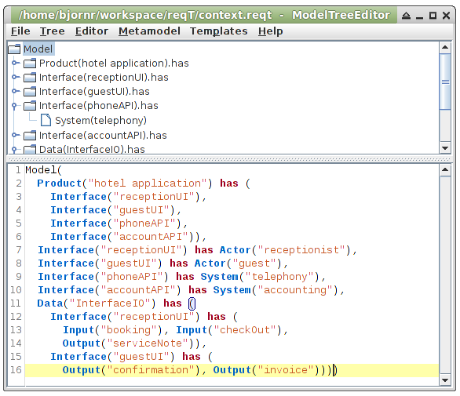
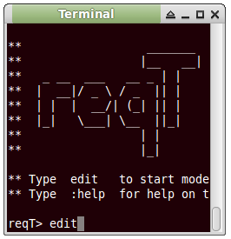
Ctrl+E
Edit selected tree node
Tree
Ctrl+R
Replace selected tree node by Model in editor
Editor
Ctrl+Enter
Enter code to console and evaluate

Slide 2
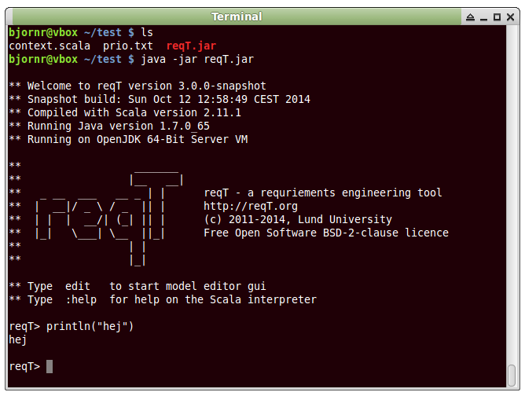

Slide 3
