Slide 1
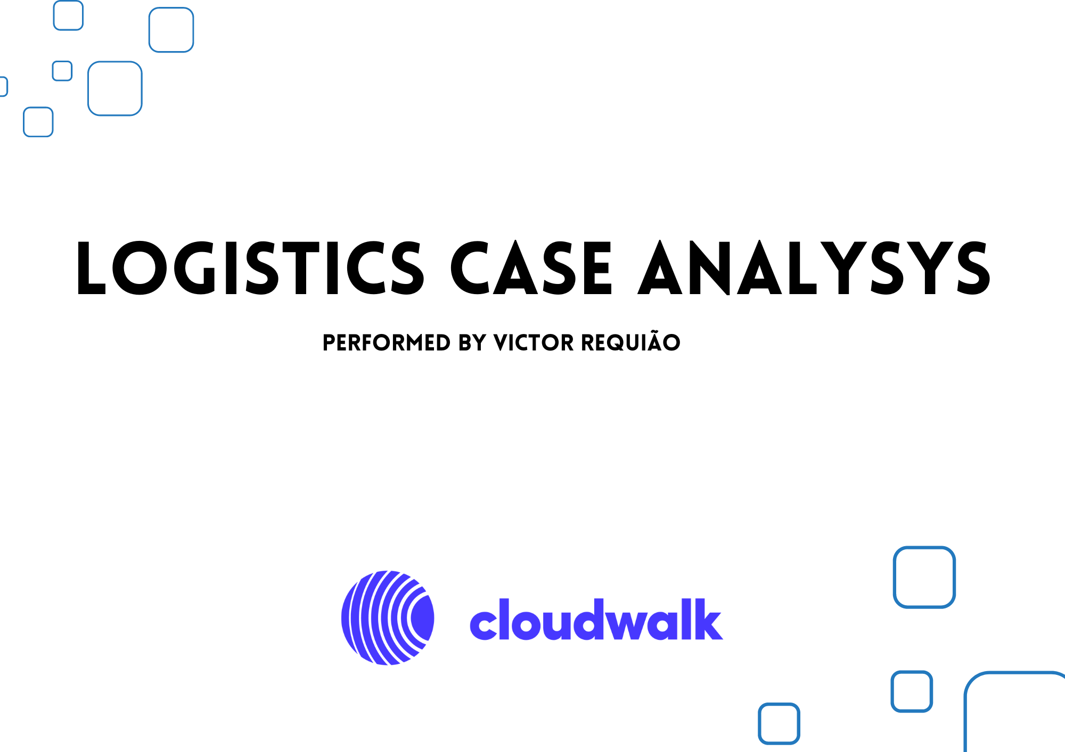

Slide 2
Introduction
This is the presentation of the analysis conducted on the dataset provided by Cloudwalk for a case study about the logistics operation.

Slide 3
Primary Analysis
Analyzing the data for insights

Slide 4
What is the data?
The dataset contains a historical shipping transactions, covering the period from September 2021 to February 2023.
Key stats:
Number of records in the dataset: 42.710
Dataset Information:
The dataset provides detailed information on transit, starting from the sales order to the delivery date
It includes data such as the expected delivery date and the shipping cost associated with each delivery
The dataset covers deliveries performed by two providers
Geographical data such as the state the deliveries were made

Slide 5
Selecting the right kpi:
Shipment time
Shipment Cost
On-time deliveries (OTD)
Transit time
Customer Feedback if avaliable

Slide 6
Calculations added to the dataset
Delivery time from sales
Delivery time from order
Transit time between each phase of delivery
On-time delivery rate (OTD)
Successful delivery rate
Rates per provider
Rates per region
Averages

Slide 7
TRENDS AND PATTERNS
IN THE DATASET

Slide 8
98,85% of the deliveries were successfuly completed.
1,04% of the deliveries were returned for various reasons.
0,11% of the deliveries were cancelled.

Slide 9
Average shipment info
In general, the shipping cost shows minimal variation, typically within a range of R$2,00.
Also in general, the shipping time shows minimal variation, typically within a range of 2 days.
However, upon closer examination, intriguing insights emerge from the data.

Slide 10
Comparison between shipping time and cost per provider per region

Slide 11
Insights
Provider #2: Cheaper, Faster, and More Precise
Provider #2 stands out as a courier that offers cost-effective, faster, and more precise delivery services for products in general.
Regional Shipping Costs and Time Variations
Shipping costs and delivery times to the North region of Brazil are significantly higher compared to other regions.
Provider #1 vs. Provider #2: Cost and Delivery Comparisons
Provider #1 only offers cheaper shipping options than Provider #2 for deliveries to the North and Northeast the delivery time difference between them for those region is almost none.
In all other regions, Provider #2 offers cheaper and faster shipping options compared to Provider #1.
Provider #1 performed over 8600 deliveries, Provider #2 made over 33600 deliveries.

Slide 12
42217 successful deliveries were made by Provider 1 and Provider 2.
Only 2014 were delayed

Slide 13
The general OTD is:
- On time 95%
- Delayed 5%
OTD per region is also excellent
North has 97.35% of On-time deliveries
Northeast has 98% of On-time deliveries
Center-East has 94% of On-time deliveries
South has the lowest percentage with 89.2% of On-time deliveries
Southeast has 95.85% of On-time deliveries

Slide 14
Insights
Overall Comparison of Providers
Provider #2 showcases a competitive edge with its lower costs, faster delivery times, and a significantly higher On-Time Delivery (OTD) rate compared to Provider #1.
OTD rate for Provider #2 is 97.18%.
OTD rate for Provider #1 is 82.85%.
Both providers maintain a high successful delivery rate, exceeding 95%.
Order Distribution by Region
The Southeast and Northeast regions have the highest number of orders, followed by the South, Central-West, and North regions.

Slide 15
Geographical distribution of deliveries
The Southeast region accounts for the highest percentage of orders 45.21%, with São Paulo (SP) having the highest number of orders at 9,824, followed by Minas Gerais (MG), Rio de Janeiro (RJ), and Espírito Santo (ES).
The Northeast region represents a significant portion of orders 22.68%, with Bahia (BA) being the highest contributor at 3,133 orders. Other notable states include Ceará (CE), Pernambuco (PE), Paraíba (PB), and Maranhão (MA).
The South region contributes 14.93% of the total orders, with Paraná (PR) having the highest number of orders at 3,101, followed by Santa Catarina (SC) and Rio Grande do Sul (RS).
The Central-West region represents 11.25% of the orders, with Goiás (GO) leading with 2,426 orders, followed by Mato Grosso (MT), the Distrito Federal (DF), and Mato Grosso do Sul (MS).
The North region accounts for 5.93% of the orders, with Pará (PA) having the highest number of orders at 1,229, followed by Rondônia (RO), Amazonas (AM), and Tocantins (TO).
It is worth noting that some states have relatively lower order volumes, such as Acre, Amapá , and Roraima, indicating potentially smaller markets or less demand in these regions.

Slide 16
Further insights
When analyzing the column "sales_order_created_at," we observed an unexpected variation in the estimated delivery time. It is surprising to find that in some cases, the time difference between the sales order and the actual delivery exceeds 400 days. This contrast becomes evident when considering that, on average, the time between an order and product delivery is only 6 days. There appears to be an error or misinformation in the dataset regarding the delivery time for certain orders, based on the sales order.
Considering, for example, the delivery with ID 41465, there was a significant time difference of 497 days between the sales order and the actual delivery. However, when taking into account the order placement and the delivery date, the actual time it took for the product to reach the customer was only 8 days. This highlights a notable discrepancy of 489 days between the sales order and the order fulfillment.
This instance is one of the many observed in the dataset
For further analysis we are only considering the difference between device order creation date and the delivery date.

Slide 17
Estimated time between order phases
The average time difference between a sale (sales_order_created_at) and a delivery order (device_order_created_at) is 3.9 days.
The average time difference between ordering delivery (device_order_created_at) and processing the delivery (processing_at) is 15 minutes and 25 seconds.
The average time difference between processing the delivery (processing_at) and transiting to local distribution (in_transit_to_local_distribution_at) is 5 hours and 7 minutes.
The average time difference between transit to local distribution (in_transit_to_local_distribution_at) and arrival at the local distributor (local_distribution_at) is 3.18 days.
The average time difference between arriving at the local distributor (local_distribution_at) and leaving for delivery (in_transit_to_deliver_at) is 1.76 days.
The average difference between the time from departure to delivery (in_transit_to_deliver_at) and delivery time (delivered_at) is 1.3 days.

Slide 18
Problem Solving.
Considering data-driven decision.

Slide 19
Based on the data already analyzed, what would you do to reduce the average delivery time to 3 days?
By considering the time from sale to delivery, there is a significant opportunity to improve our delivery timelines. By reducing the time between the sales order and the delivery order, we have the potential to shorten the final delivery deadline by up to 4 days. As highlighted on slide 17, the current average time between a sale and a delivery order is 3.9 days, indicating room for improvement in the operational efficiency. Implementing strategies to streamline this process can lead to faster order fulfillment, increased customer satisfaction, and a competitive edge in the market.
Additionally, we can reduce the longer delivery times in the North and other regions by teaming up with a new logistics partner for targeted operations.
One idea is to keep a substantial stock of products at strategic shipping points within each region, so that delivery orders can be processed locally.
This approach would significantly cut down on the time it takes for the products to reach our customers.
By adopting this localized approach, we can boost our efficiency, provide faster service, and ensure greater customer satisfaction. It's an exciting opportunity to better serve these regions and tap into their full market potential.

Slide 20
If you were to ask the engineering teams to gather more data, what should it be and why?
I need more comprehensive information about the delivery process step-by-step and an understanding of why there are so many lines with missing data.
What is the reason for the significant time difference between the "sales_order_created_at" column and the "delivery_order_created_at" column in many of the orders?
What are the specific routes or methods used by the providers for deliveries?
Additionally, it would be valuable to gather customer feedback regarding their delivery experience. What are their thoughts and opinions about the deliveries?
Another aspect worth exploring is how the payment method chosen by customers influences the time between the purchase and the delivery order.

Slide 21
What were the problems, how did you find them and what should we do to fix them?
In the dataset, I noticed that there were instances of imprecise information that significantly affected the average shipping times. For example, in the columns with ID 14883, 14838, and 14715, the "delivered_at" information was duplicated and had very inaccurate dates.
Additionally, the significant time difference between a sales order and a device order greatly impacted the overall average time rates.
The lack of detailed step-by-step information about the shipments makes it challenging to understand the reasons behind some delayed deliveries.
Furthermore, there was no available information about the reasons for cancelations and returns of certain items, preventing me from evaluating this metric accurately.
By addressing these data inconsistencies and obtaining more granular insights into the shipping process, I can better analyze and improve the delivery performance.

Slide 22
THANK YOU
Victor Reichenbach Requião
requiaovictor@gmail.com
+55 71 99919-8008

