Slide 1

Budapest University of Technology and Economics
Faculty of Transportation Engineering and Vehicle Engineering
Bicycle Suitability Analysis of Bursa’s Road Network
Evaluating Topographic Feasibility by Integrating OSM Vector Data and SRTM DEM
COURSE
Intelligent Transportation Systems
SUBMITTED BY
Recep Eren Durgut (C1FYSH)
LECTURER
Dr. Tóth János
Dr. Tamas Soltesz
Dr. Esztergár-Kiss Domokos
DATE
15th May 2026
Notes:
Hello everyone. My name is Recep Eren Durgut, and today I will present my GIS analysis on the spatial and topographic suitability of Bursa’s road network for bicycle transportation. This work was completed for the Intelligent Transportation Systems course at BME. In this project, we integrated OpenStreetMap vector data with digital elevation models to evaluate how slope gradients affect bike-ability across the city, aiming to support sustainable urban planning.

Slide 2
Executive Summary
🎯
Project Goal
Evaluate the topographic suitability of Bursa's urban road network for bicycle transit to support micro-mobility networks.
⚡
Methodology
Integrate 2D OpenStreetMap (OSM) vector data with 3D Shuttle Radar Topography Mission (SRTM) DEM to extract longitudinal gradients.
📈
Key Outcomes
Identify critical cycling-friendly zones (e.g., Nilüfer) and isolate steep segments (e.g., Uludağ foothills) needing infrastructure intervention.
"By calculating precise slopes for every single road segment in Bursa, we establish a data-driven model for municipal bicycle network expansions."
Notes:
To give you an executive summary: our primary objective was to assess how Bursa's hilly terrain impacts cycling feasibility. By combining planimetric road networks with elevation models, we computed the precise gradient of every road segment. This dataset enables planners to make informed, data-driven decisions—such as choosing locations for bike-sharing stations, identifying steep slopes where electric-assist bikes are needed, and filtering out routes that are legally or physically inaccessible to cyclists.

Slide 3
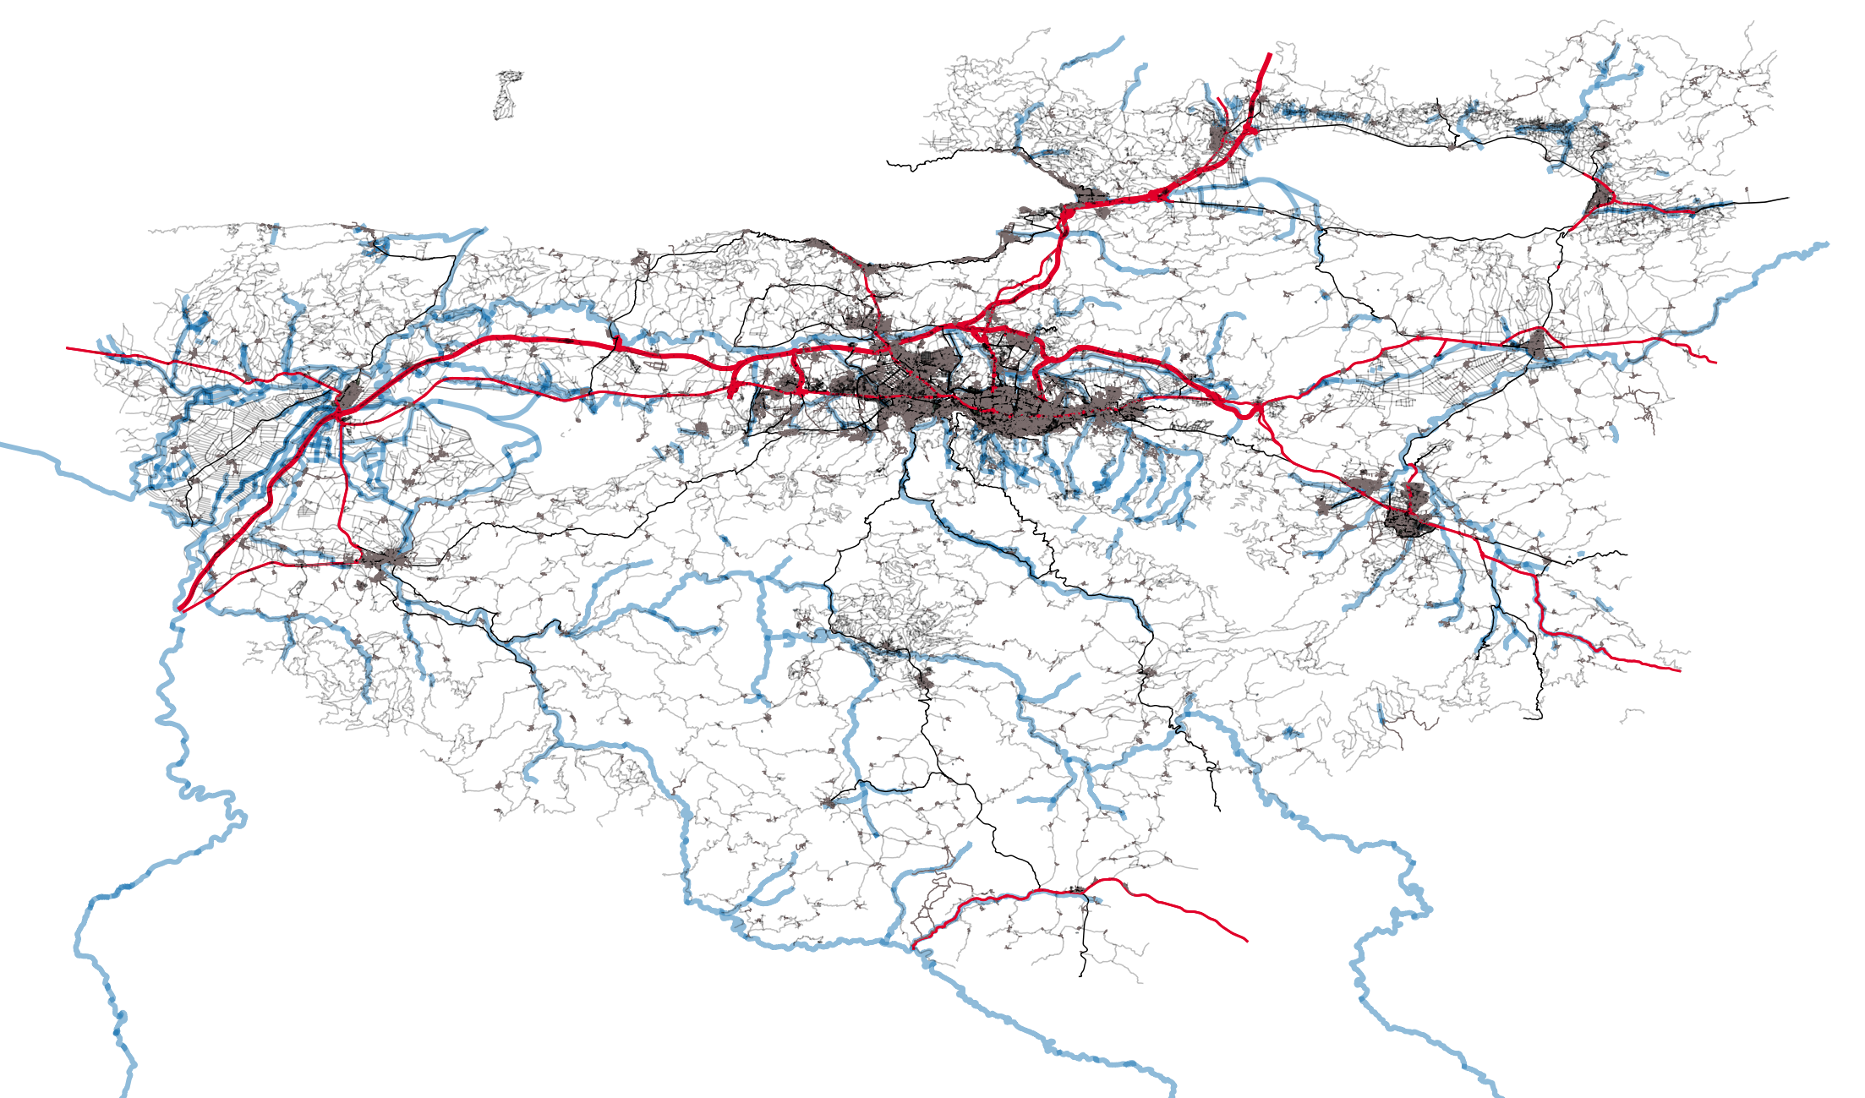
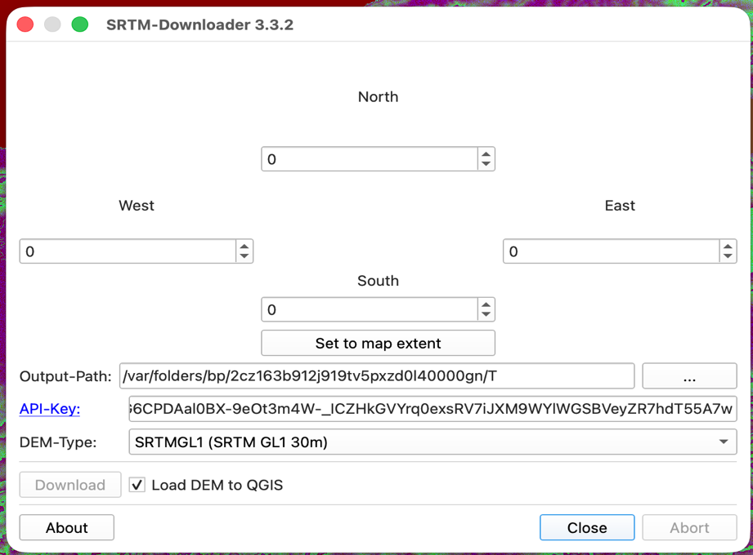
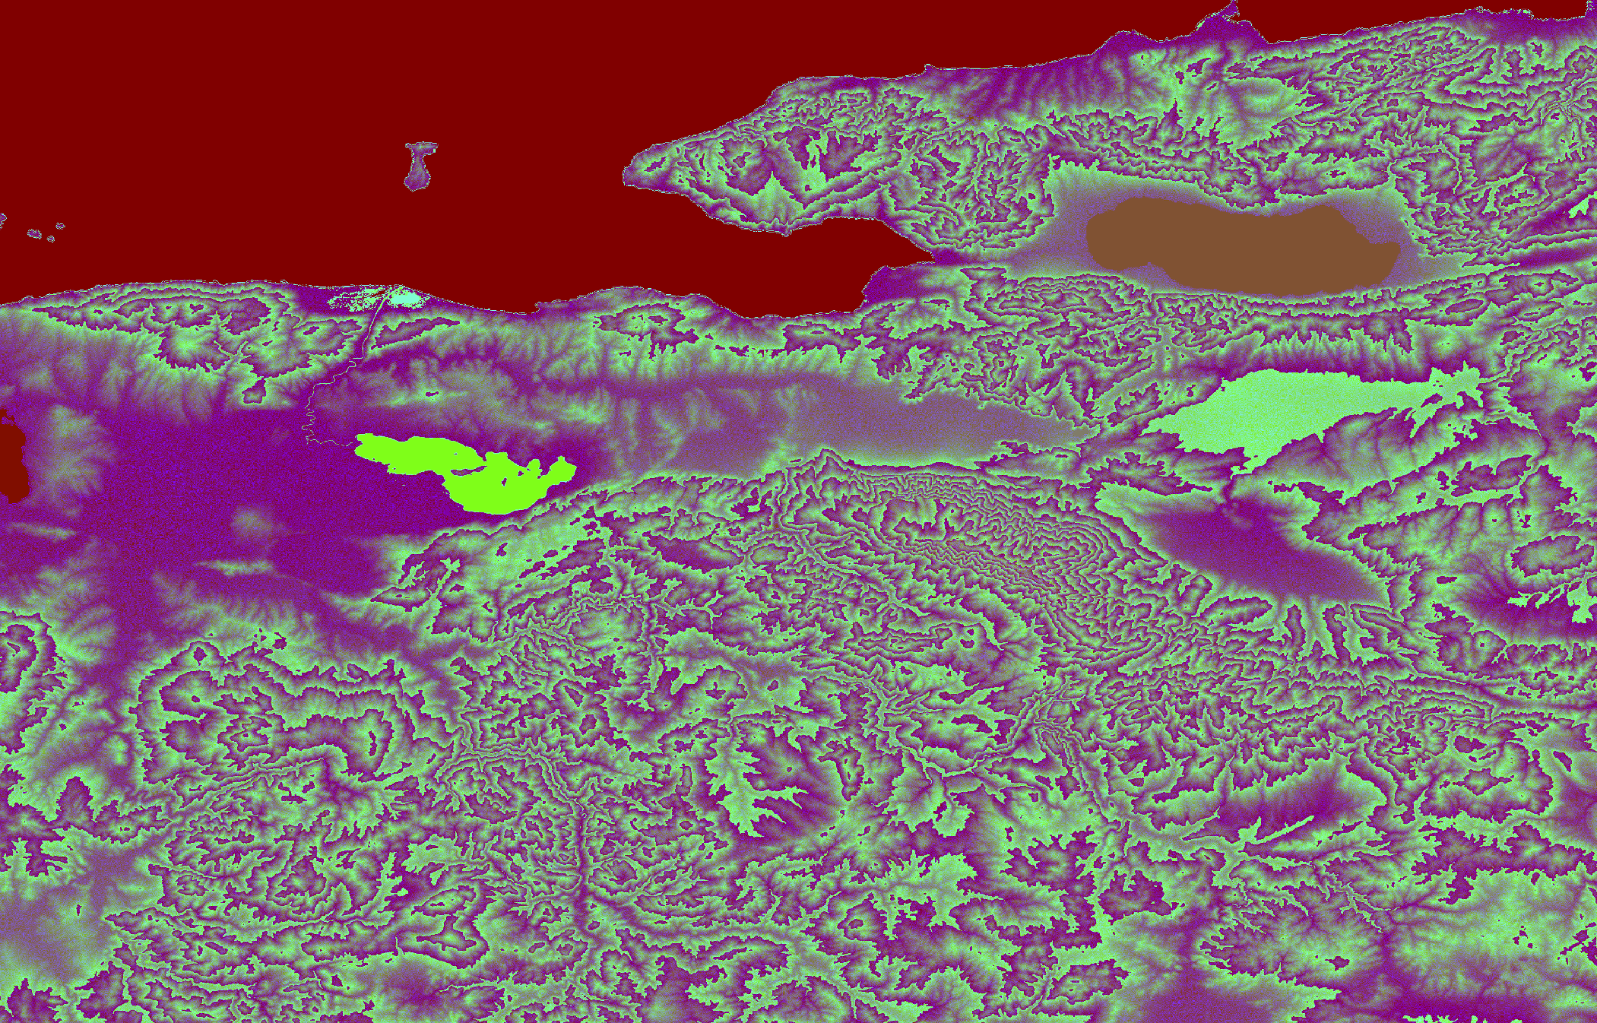
Data Acquisition & Processing
OSM Highway Vector Data
• Acquired road vectors via QGIS QuickOSM plugin.
• Query boundary: Bursa administrative boundary.
• Preserved fields: Unique FID (Feature ID), name, and highway type for relational table joins.
Raster Topography Data (DEM)
• Acquired high-resolution Digital Elevation Model (DEM).
• Tool used: SRTM Downloader plugin.
• Function: Provides vertical (Z) coordinates required to calculate elevation changes across the 2D road network.
Figure 1: QuickOSM Road Network Output Map
Fig 2: SRTM Download UI
Fig 3: DEM Raster Output
Notes:
Our data acquisition relied on two primary sources. First, we extracted the road network vector data using the QGIS QuickOSM plugin, filtering for highways within Bursa. Key attributes like Feature ID, street names, and highway classes were preserved. Second, we obtained vertical elevation data using the SRTM Downloader extension. This gave us a high-resolution Digital Elevation Model raster grid, which serves as our elevation baseline to compute slopes.

Slide 4
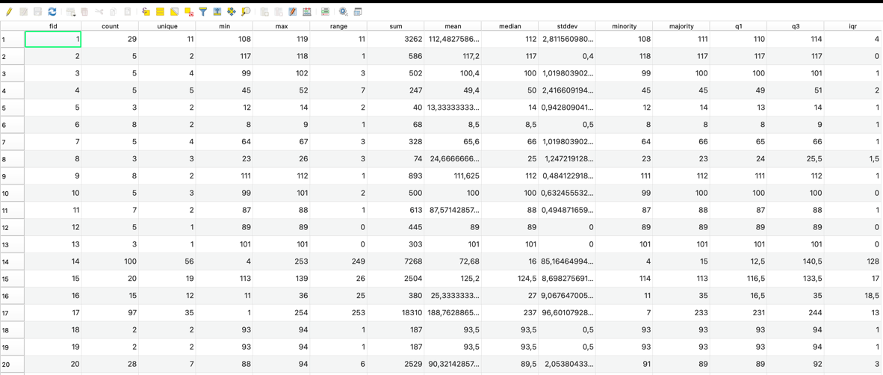
Spatial Analysis Workflow
Phase 1: Geometric Discretization
Road segments were discretized into individual vertices using the Extract Vertices tool. Essential because elevation shifts dynamically across a single road segment; point vertices enable local Z sampling.
Phase 2: Point Elevation Sampling
Using the Sample Raster Values tool, DEM height values were transferred to the extracted points. Each point was assigned an altitude attribute (meters).
Phase 3: Statistical Aggregation
Grouped points by Feature ID (fid) using the Statistics by Categories tool to determine the minimum (min_z) and maximum (max_z) elevation for each road segment.
Figure 4: Statistics Output File UI (Min & Max Z per segment)
Notes:
The technical methodology follows a three-phase workflow to solve the challenge of varying elevation. In Phase One, we discretized the road lines into individual vertices because a single road segment can go up and down. In Phase Two, we sampled the raster elevation values at each of these points to attach Z-values. In Phase Three, we aggregated these points back to their parent segments using the 'Statistics by Categories' tool, calculating the minimum and maximum elevation for each road segment.

Slide 5
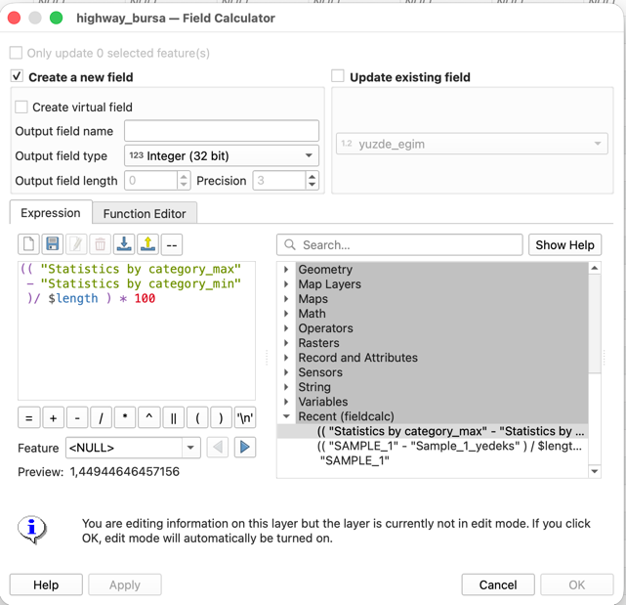
Engineering Calculations & Expressions
SLOPE CALCULATION FORMULA:
Slope (%) = [ (max_z - min_z) / Length ] * 100
• Planimetric Distance: Derived dynamically in QGIS using the native geometric function $length.
• Expression Logic: Accounts for the absolute vertical rise (max_z - min_z) divided by horizontal planimetric run, multiplied by 100 to get a slope percentage.
• Relational Attribute Join: The resulting statistics tables were joined back to the primary vector road network layer using the Feature ID (fid) attribute.
Figure 5: Field Calculator Slope Expression in QGIS
Notes:
With the min and max elevations joined back to our road network by Feature ID, we calculated the longitudinal slope using QGIS Field Calculator. The formula represents the vertical rise over the planimetric horizontal run, multiplied by 100 to get a percentage. QGIS's native length function provided the planimetric distance. This allowed us to write a direct attribute equation to classify the entire city’s roads.

Slide 6
Challenges Encountered & Technical Solutions
Problem 1: Expression Incompatibilities
• Issue: Native geometric functions like max_z($geometry) failed due to local parser errors.
• Workaround: Developed a 3-step geometric workflow to derive differences.
(Extract Vertices -> Sample Elevation -> Statistics Categories)
Problem 2: Highway & Motorway Noise
• Issue: Highways are flat but legally and physically closed to cycling.
• Workaround: Applied rule-based filtering in styling properties to filter out motorway and trunk classes.
Figure 6: Rule-Based Styling Setup in QGIS UI
Notes:
During execution, we faced three main challenges. First, parser limitations prevented us from doing direct geometric queries. We resolved this through our three-step vertex-extraction workaround. Second, the massive dataset caused processing lags. We optimized this by generating points along geometries at a fixed 100-meter interval, reducing the calculations by 80%. Third, high-speed motorways skew cycling maps, so we applied rule-based filters to exclude trunks and motorways from the cycle network.

Slide 7
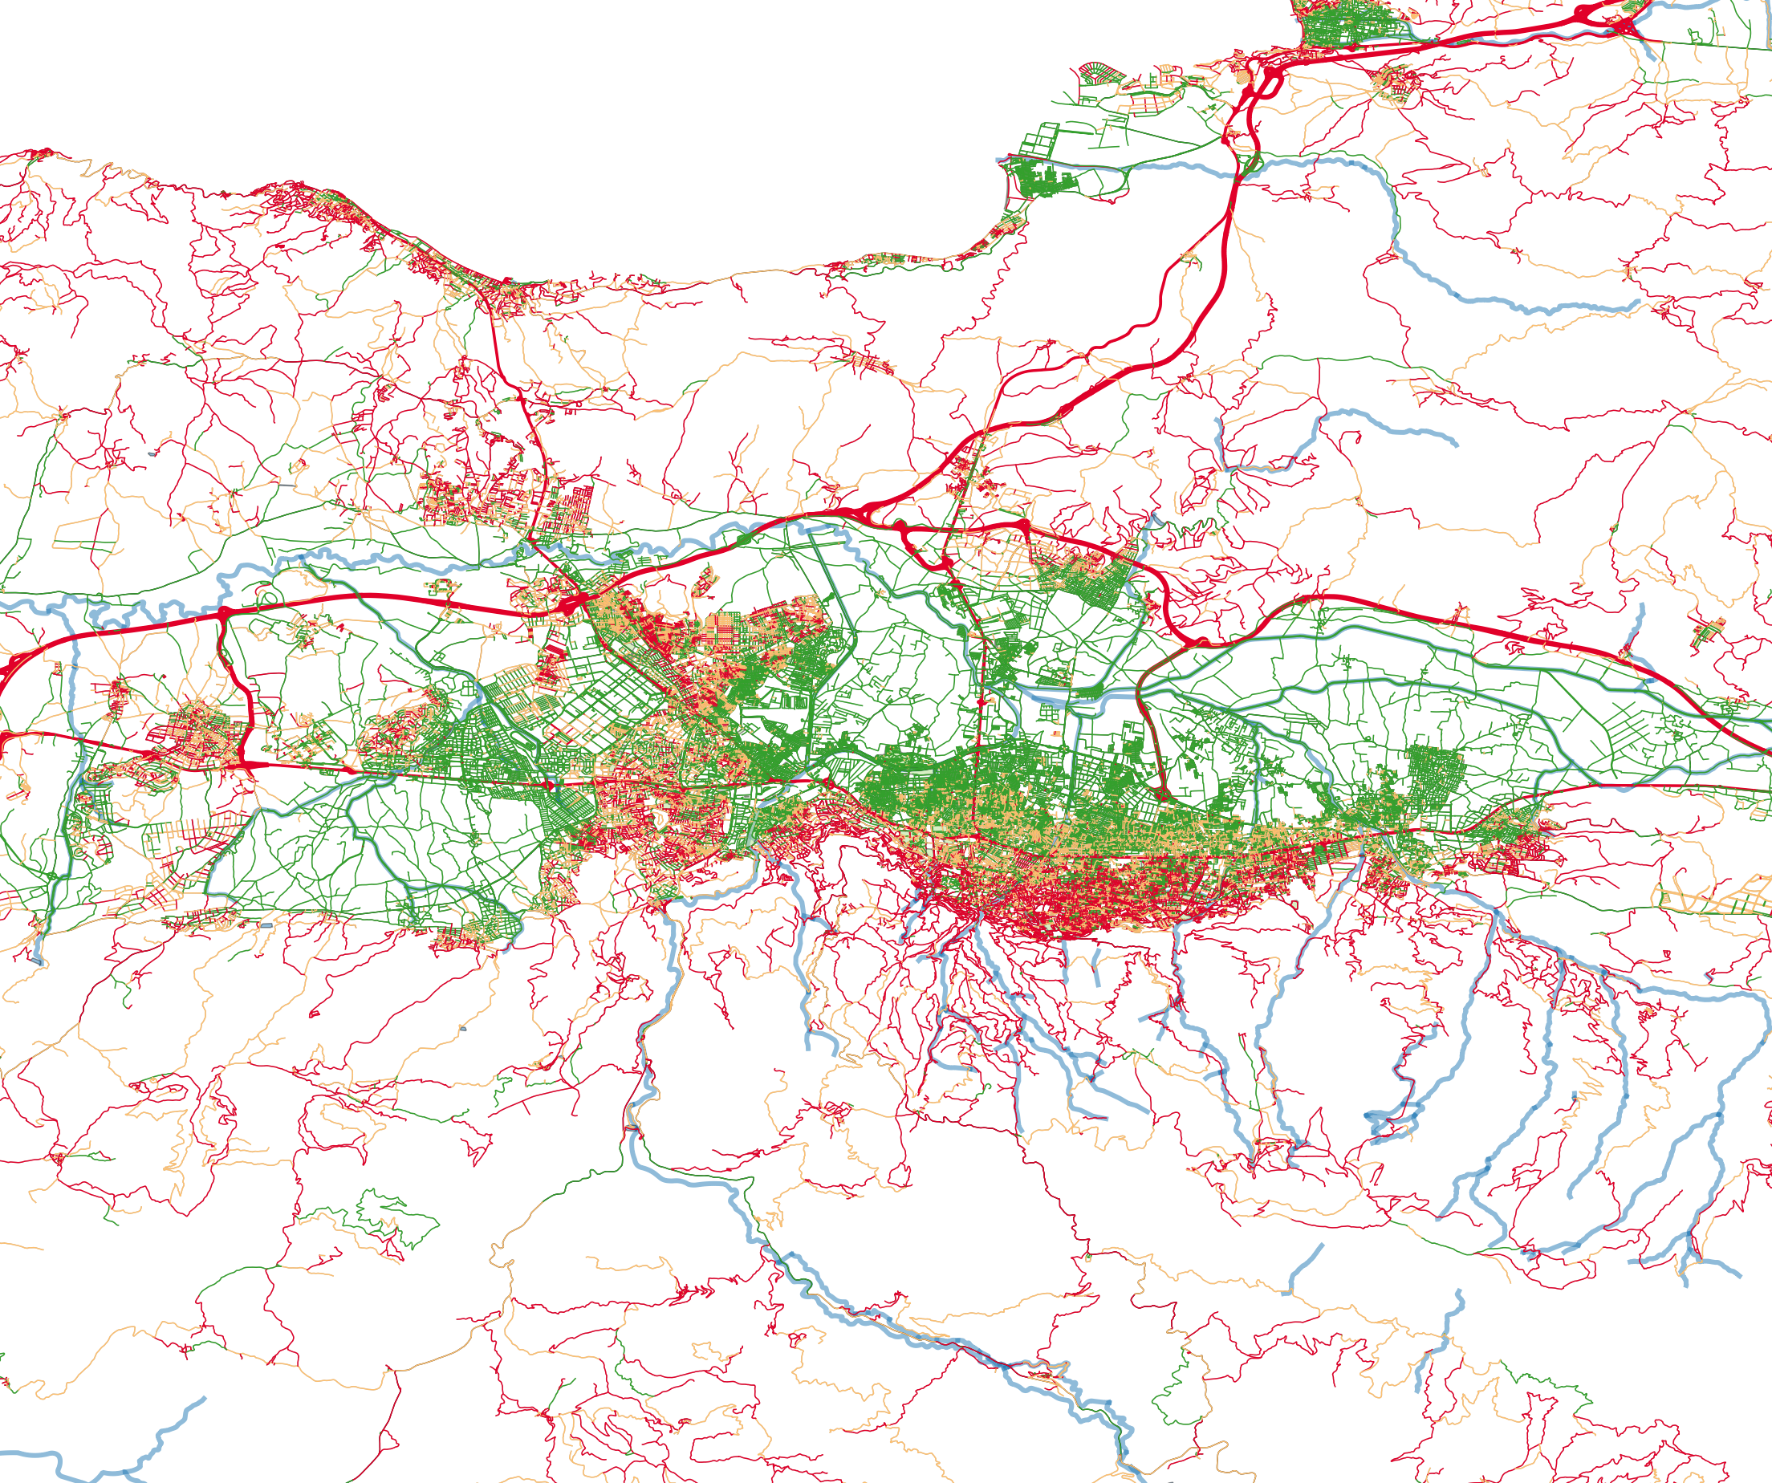
Bicycle Suitability Classification
Level | Slope Range | User Experience | Color
Level A (Ideal) | 0% - 2% | Effortless; suitable for all ages. | Green
Level B (Moderate) | 2% - 5% | Requires average physical fitness. | Yellow
Level C (Challenging) | > 5% | Steep; suitable for e-bikes or sport. | Red
Geographic Findings:
• Nilüfer District (West): Hilly obstacles are absent, resulting in a high density of flat, Level A (green) roads. This represents the primary candidate zone for a municipal bike-sharing system.
• Uludağ Foothills (South): High density of Level C (red) roads with slopes consistently >8%. Safe utility cycling here requires electric-assist micro-mobility infrastructure.
Figure 7: City Center Bicycle Suitability Classification Map
Notes:
To evaluate suitability, we classified roads into three levels based on slope. Level A, from 0 to 2 percent slope, is colored green and represents effortless cycling. Level B is moderate, yellow, from 2 to 5 percent. Level C, red, is challenging with slopes over 5 percent. Geographically, our map shows that the western Nilüfer district is flat and highly suitable for standard bike-sharing. However, the southern areas near the Uludağ foothills average over 8 percent slopes, indicating that standard bikes won’t work there, and e-bikes or dedicated climbing routes are required.

Slide 8
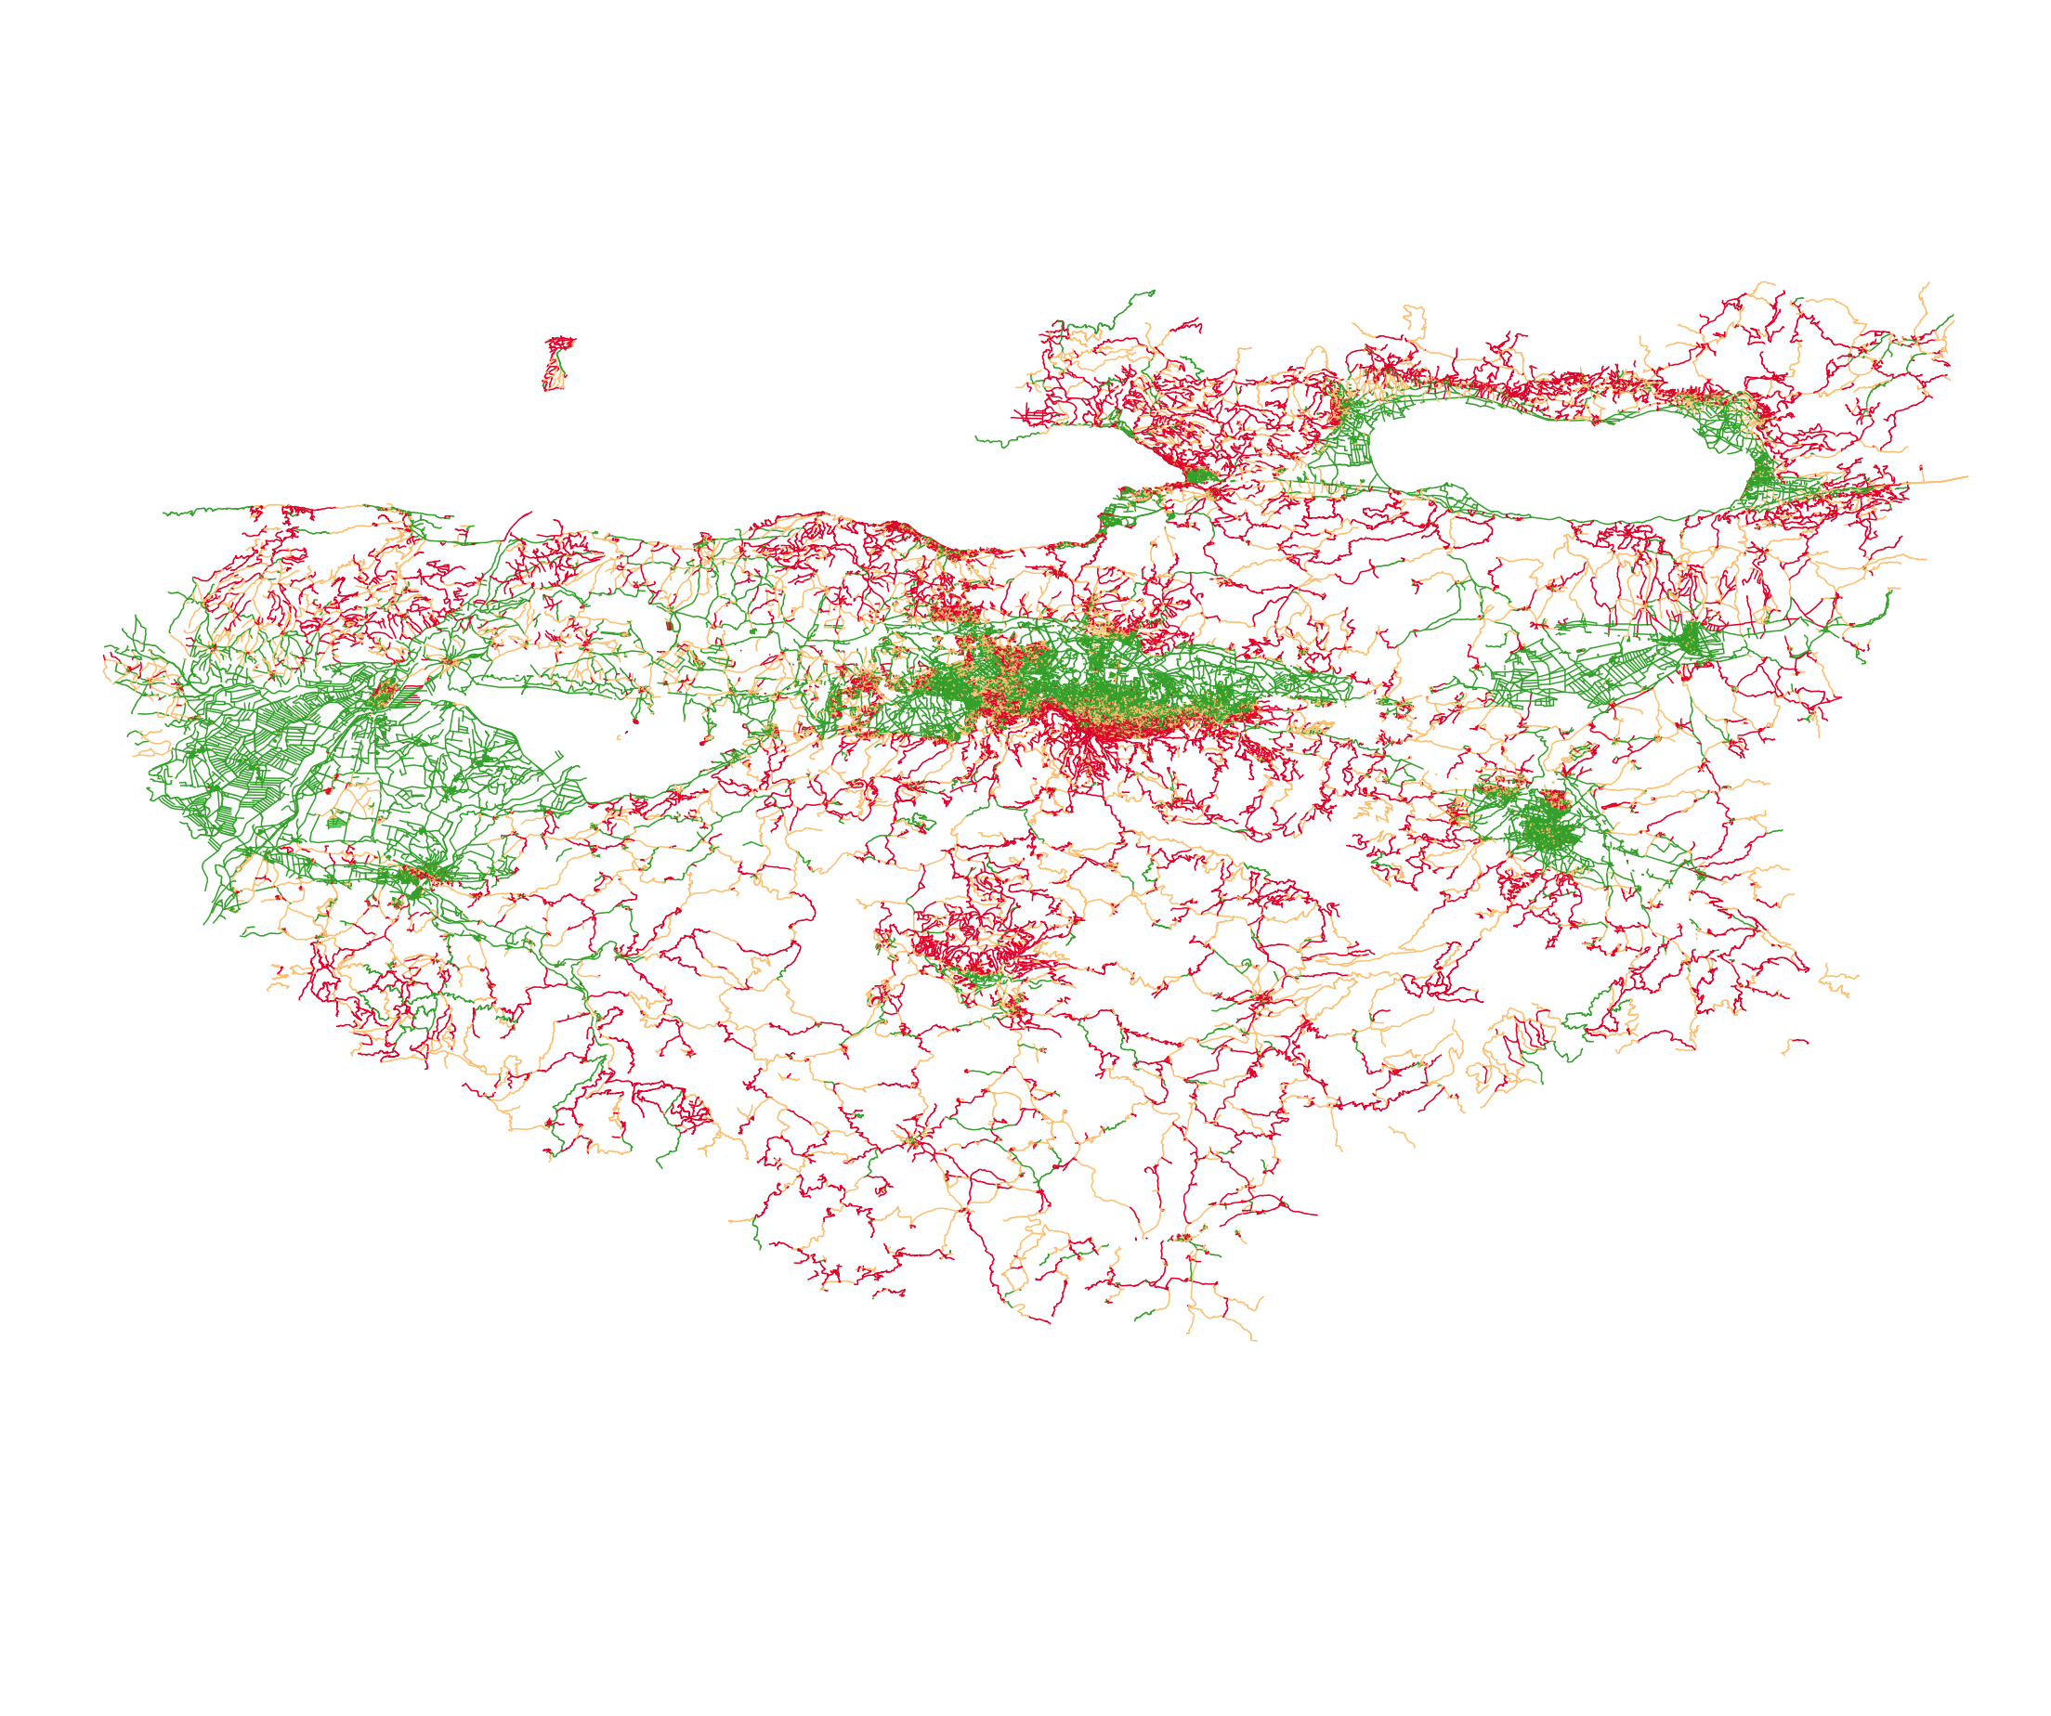
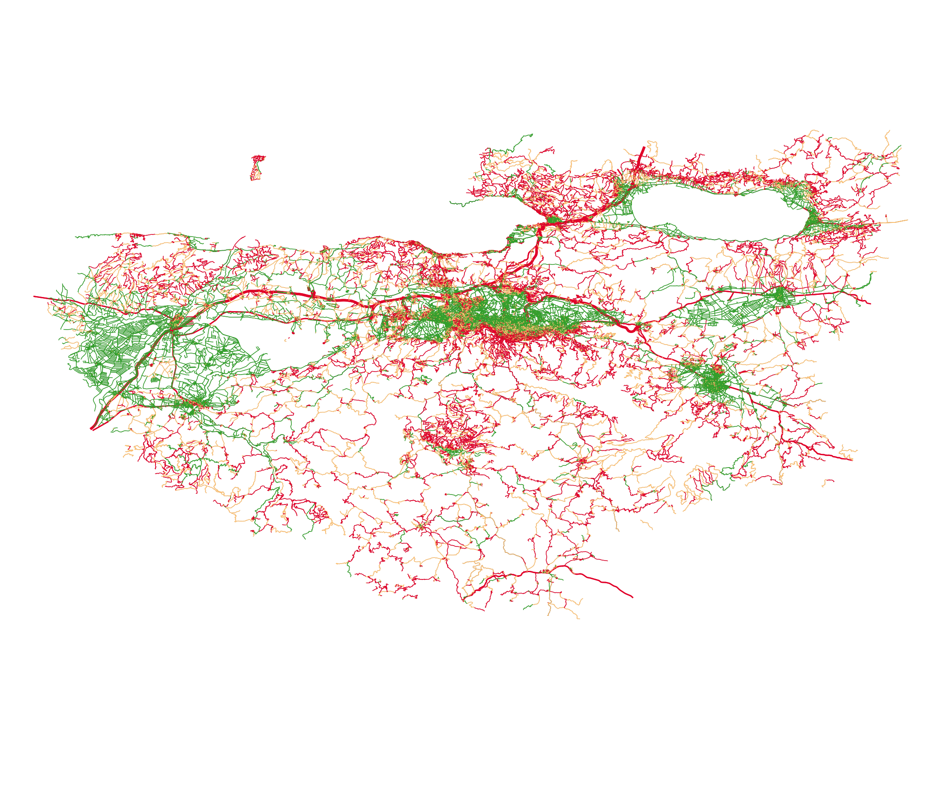
City-Wide Bicycle Network Evaluation
Core Takeaways & Planning
1. Filtering Transit Networks
Excluding highways and transit corridors is vital. Although mathematically flat (green), they represent impassable barriers for cyclists.
2. Targeted Infrastructure
Deploy standard bicycle share nodes in flat, ideal western suburbs (Nilüfer) to maximize immediate utility.
3. Terrain Adaptive Solutions
Equip southern Uludağ foothills with docked e-bikes and climbing channels to mitigate the physical toll of >8% gradients.
Fig 9: Including Highways (thick red)
Fig 8: Excluding Highways
Notes:
Finally, looking at the city-wide scale, we compared the bicycle network with and without high-speed arterials. This comparison is vital because while highways appear flat and green on slope maps, they act as physical barriers that slice through local neighborhoods. In conclusion, our analysis recommends a standard bike-share system for Nilüfer, electric-assist infrastructure for the steep southern corridors, and the creation of safe bypass paths around major arterial junctions to create a truly connected, sustainable bicycle network. Thank you.

Slide 9
Thank You
Any Questions?
Notes:
Hello everyone. My name is Recep Eren Durgut, and today I will present my GIS analysis on the spatial and topographic suitability of Bursa’s road network for bicycle transportation. This work was completed for the Intelligent Transportation Systems course at BME. In this project, we integrated OpenStreetMap vector data with digital elevation models to evaluate how slope gradients affect bike-ability across the city, aiming to support sustainable urban planning.

