Slide 1
Project 3
Team 1
Michael
Montana
Robert
Galen

Slide 2
Objective & Methods
What:
Compare stock price data from top 100 companies
Metrics:
High and lows
Comparison to 52-week data
How:
Use yFinance to get data from Yahoo Finance API; store in MySQL db on AWS; access via API
Flask app for the webpage, containerized into a Docker image
Visualizations prompt user input to compare two stocks through metrics, OHLC (open high low close) charts, and gauge charts

Slide 3
Design
Tech |  | Services
Python JavaScript MySQL HTML | Docker compose / Docker Desktop Flask BeautifulSoup | GitHub AWS (RDS, Lambda, API Gateway) MySQLWorkBench
Repository
Yahoo Finance
API
Docker Container
Scrapers (Py)
AWS
Data (JSON)
File store (CSV/JSON)
MySQL db
(RDS)
API (Flask)
HTML Website
Query (Python)
(Lambda)
JavaScript Viz
API
(API Gateway)

Slide 4
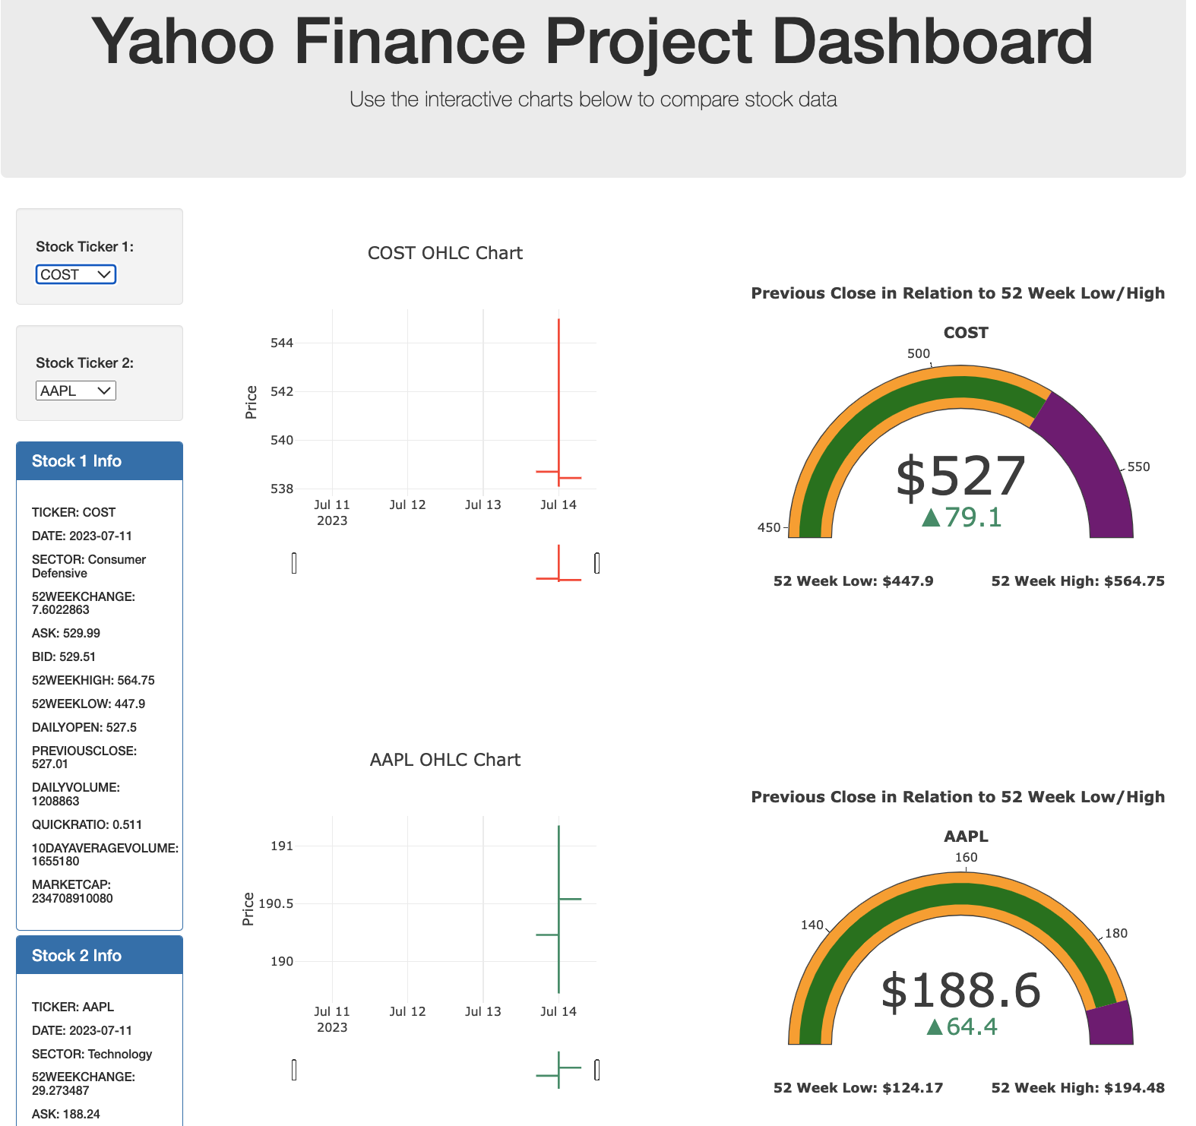
Demo Locally hosted, functional webpage Running Docker

Slide 5
Challenges
Data:
Finding existing tools to get what we wanted
Scraping 3rd party website
Tech:
Yahoo updated their Finance API & broke yFinance
Community fixed it
Services:
CORS issues with API Gateway

