Slide 1


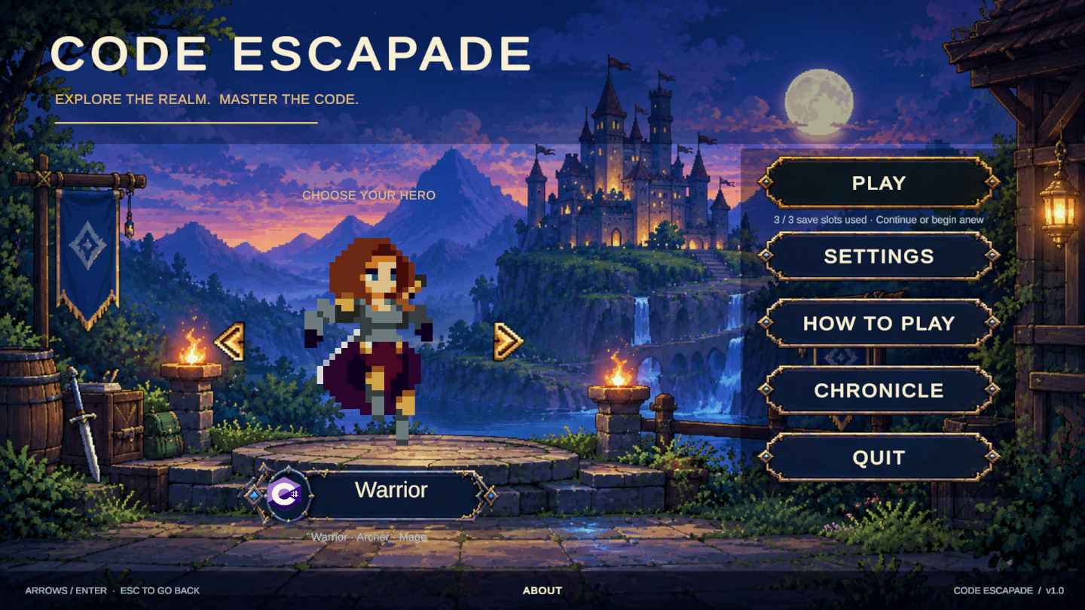
CODE ESCAPADE:
Strategic Turn-Based Game Integrating Programming Logic and Tactical Combat

Slide 2

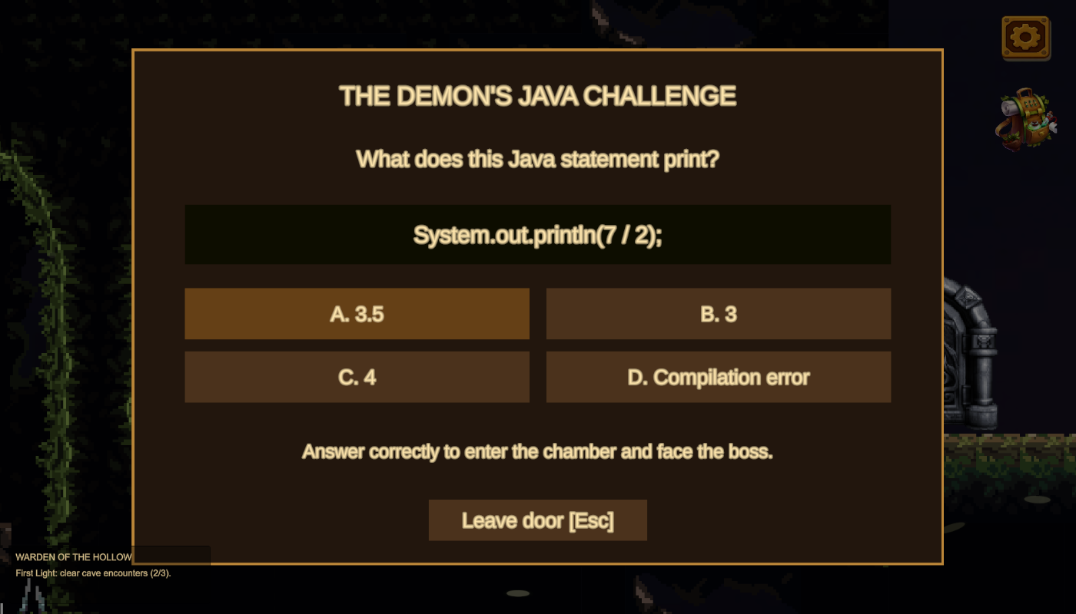
Rationale of the Project

Slide 3
Problems and Objectives

Slide 4



Problems
Static Learning
Imbalance
Engagement
Gap

Slide 5



Objectives
Gamified Logic
Instant Feedback
Adaptive Progression

Slide 6
Description of methods to be used to
develop the solution to the problem

Slide 7
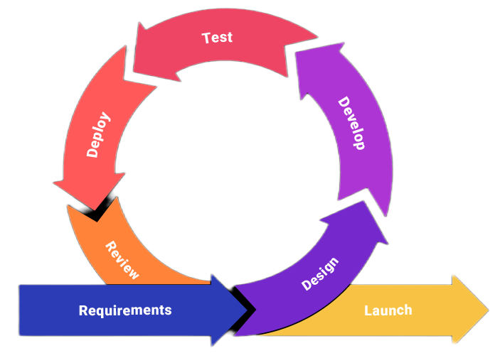
Our project uses the Agile Development Methodology.
Requirements - Identify system features
Design - Plan game structure and interface
Development - Build using Unity and C#
Testing - Fix errors and verify functionality
Deployment - Release the prototype
Review - Collect feedback for improvement

Slide 8
Calendar of Activities

Slide 9
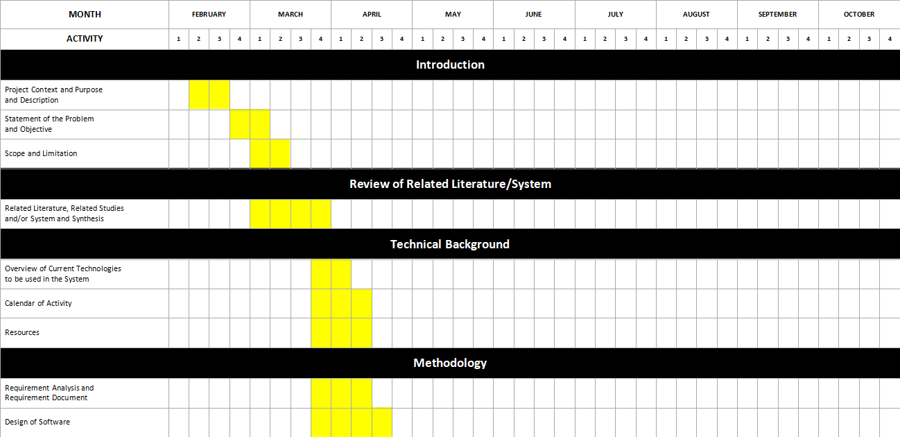
GANTT CHART

Slide 10
Week 1-2 - Finalize research title and draft Chapter 1
Week 3-4 - Gather related literature and refine project concept
Week 5-6 - Write Chapter 2 and analyze related studies
Week 7-8 - Develop Chapter 3 and prepare research methodology
Week 9 - Conduct proposal defense and gather panel feedback
Week 10 - Revise Chapters 1-3 and begin system design
Week 11- Refind Chapter 3 and finalize System design
Week 12 - Created UX/UI design in figma

Slide 11
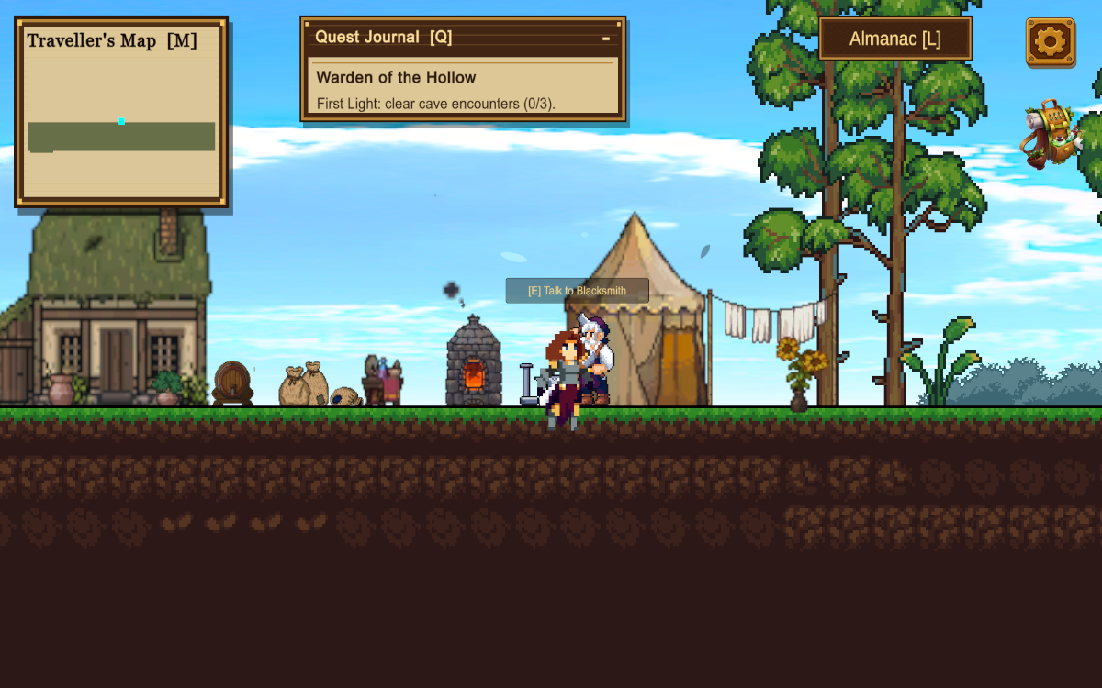
Sample Design
Main Menu:
World Exploration:

Slide 12
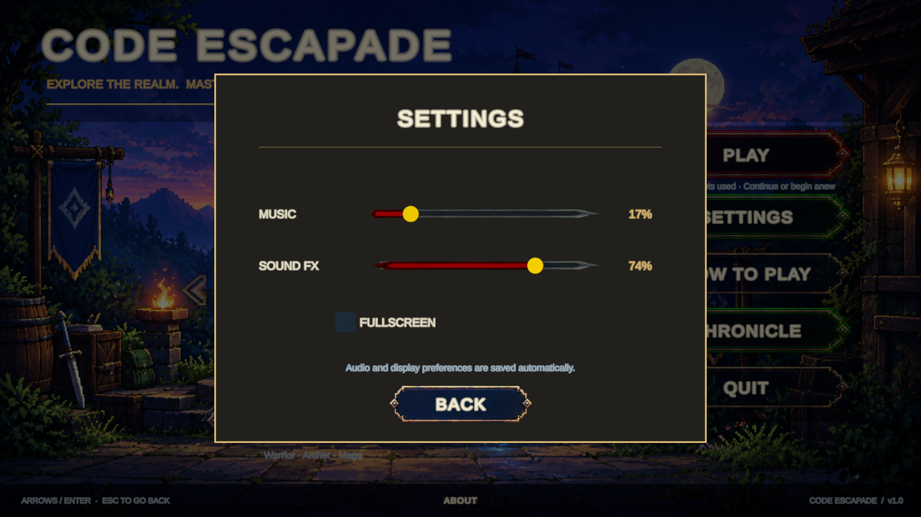
Settings Interface

Slide 13
User Interface:
Character Selection:

Slide 14
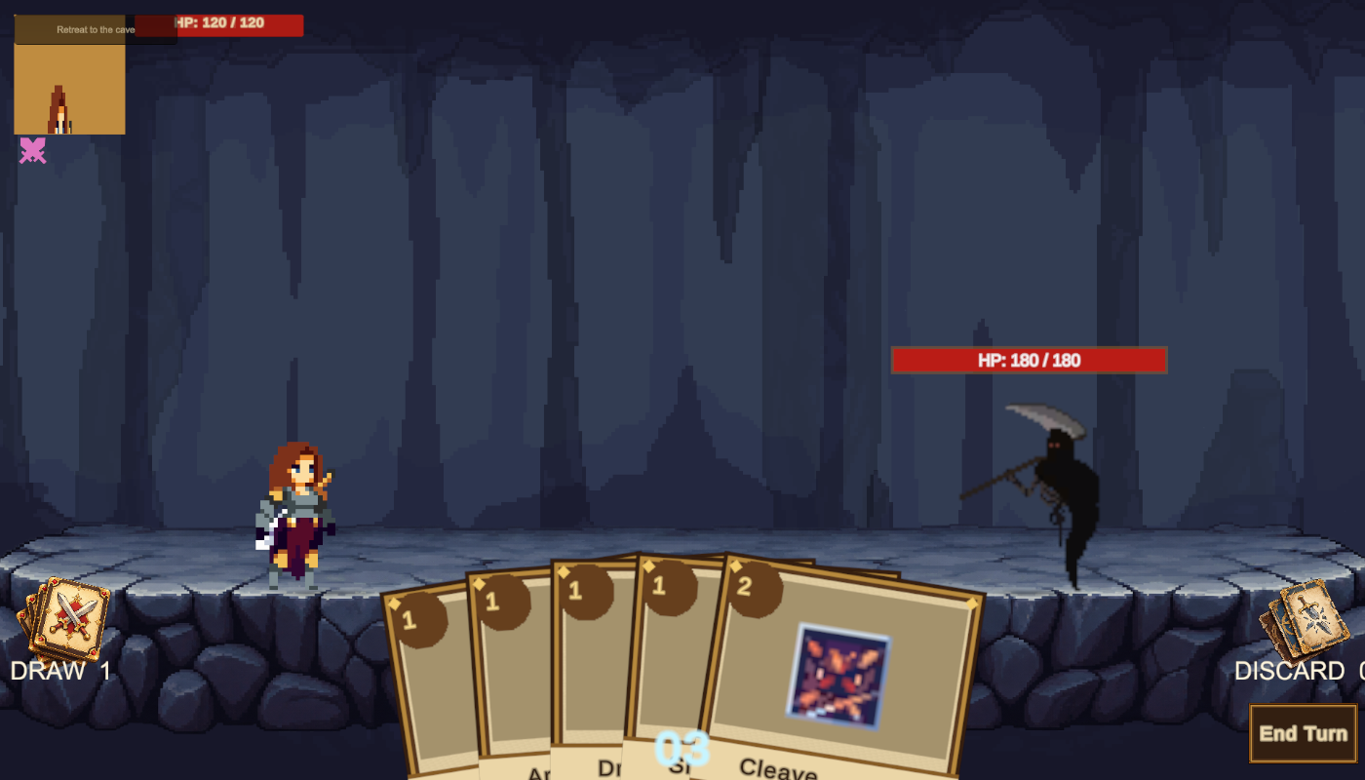
Battle Interface:
Setting Interface:

Slide 15
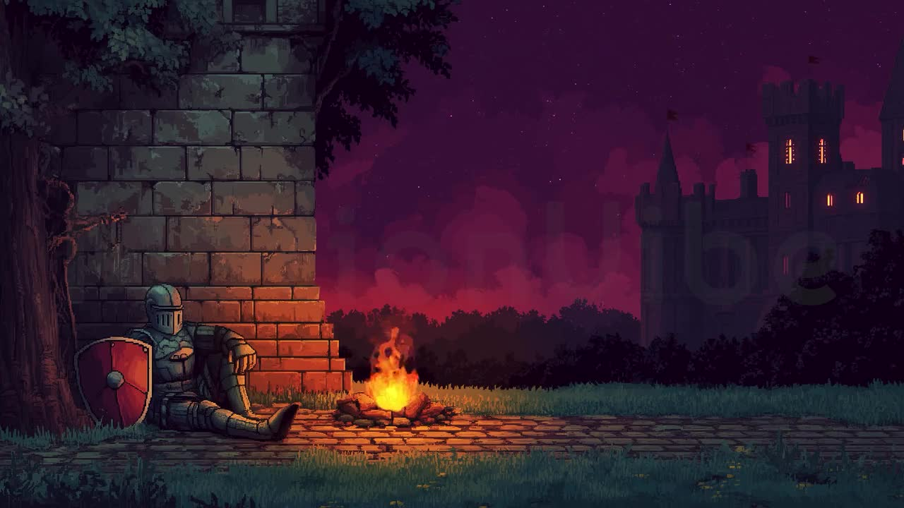


THANK
YOU

