Slide 1



social anxiety disorder
close relative of a patient

Slide 2
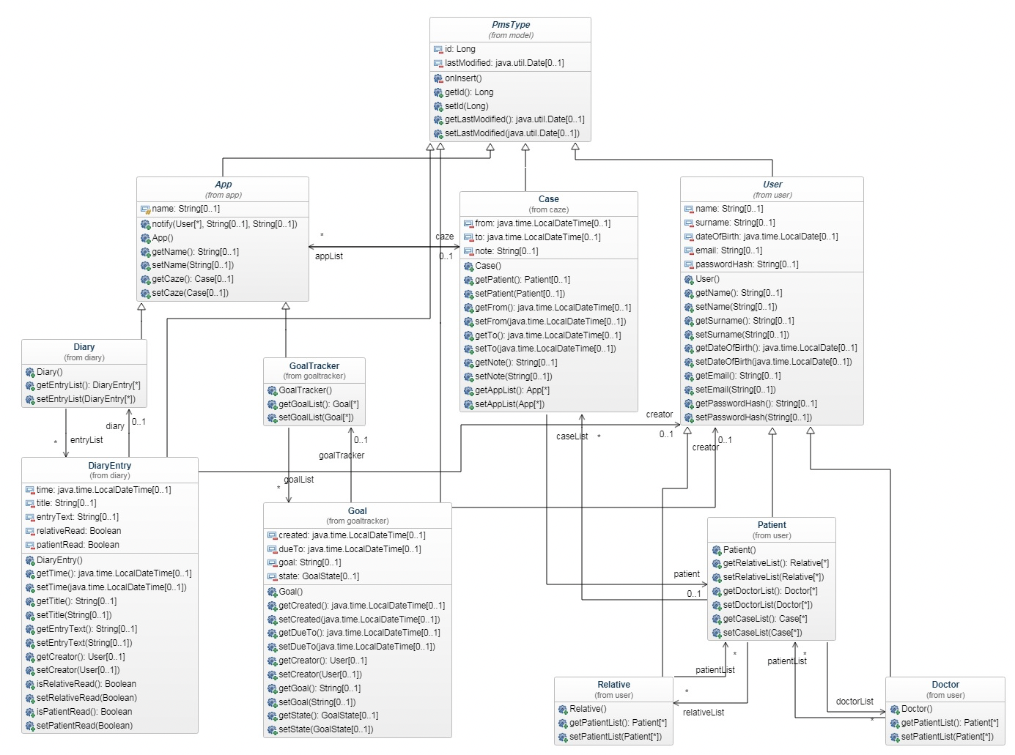
Class Diagram

Slide 3
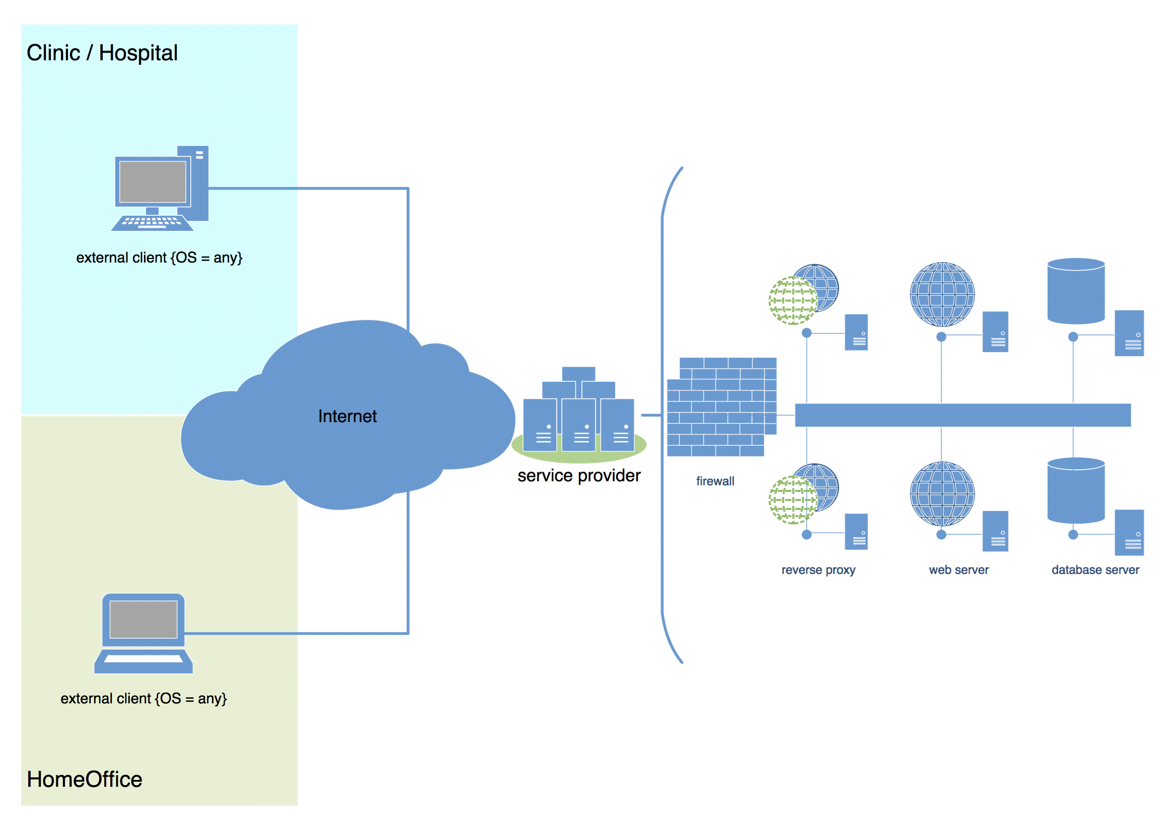
Deployment Diagram

Slide 4
Component Diagram

Slide 5
Discussion
Andreas Erb, Beat Schärz, Nik Arm, Dario Furigo, Ivo Kozina, Jannick Lüdi, Ohran Mujkic

