Slide 1





$$d_{meal}$$
Gastrointestinal
submodel
(switched system)
$$R_{a}$$
Core submodel
(Bergman model)
$$G$$
$$u_{ins}$$
Subcutaneous
Insulin
Kinetic submodel
$$I$$

Slide 2










$$d_{meal}$$
UVA/Padova
$$G$$
$$d_{meal}$$
Gastrointestinal
submodel
(switched system)
$$R_{a}$$
Core submodel
(Bergman model)
$$\hat{G}$$
estimator
$$\hat{x}$$
Subcutaneous
Insulin
Kinetic submodel
$$I$$
$$\hat{G}$$
$$u_{ins}$$
controller
$$\text{r}$$

Slide 3






$$d_{meal}$$
$$R_{a}$$
Gastrointestinal
submodel
(switched system)
Nonlinear MPC
$$G_{ref}$$
Core submodel
(Bergman model)
Nonlinear
Programing
$$u_{mpc}$$
Subject
(UVA/Padova Model)
$$G$$
Subcutaneous
Insulin
Kinetic submodel
$$x̂$$
Extended Kalman filter

Slide 4


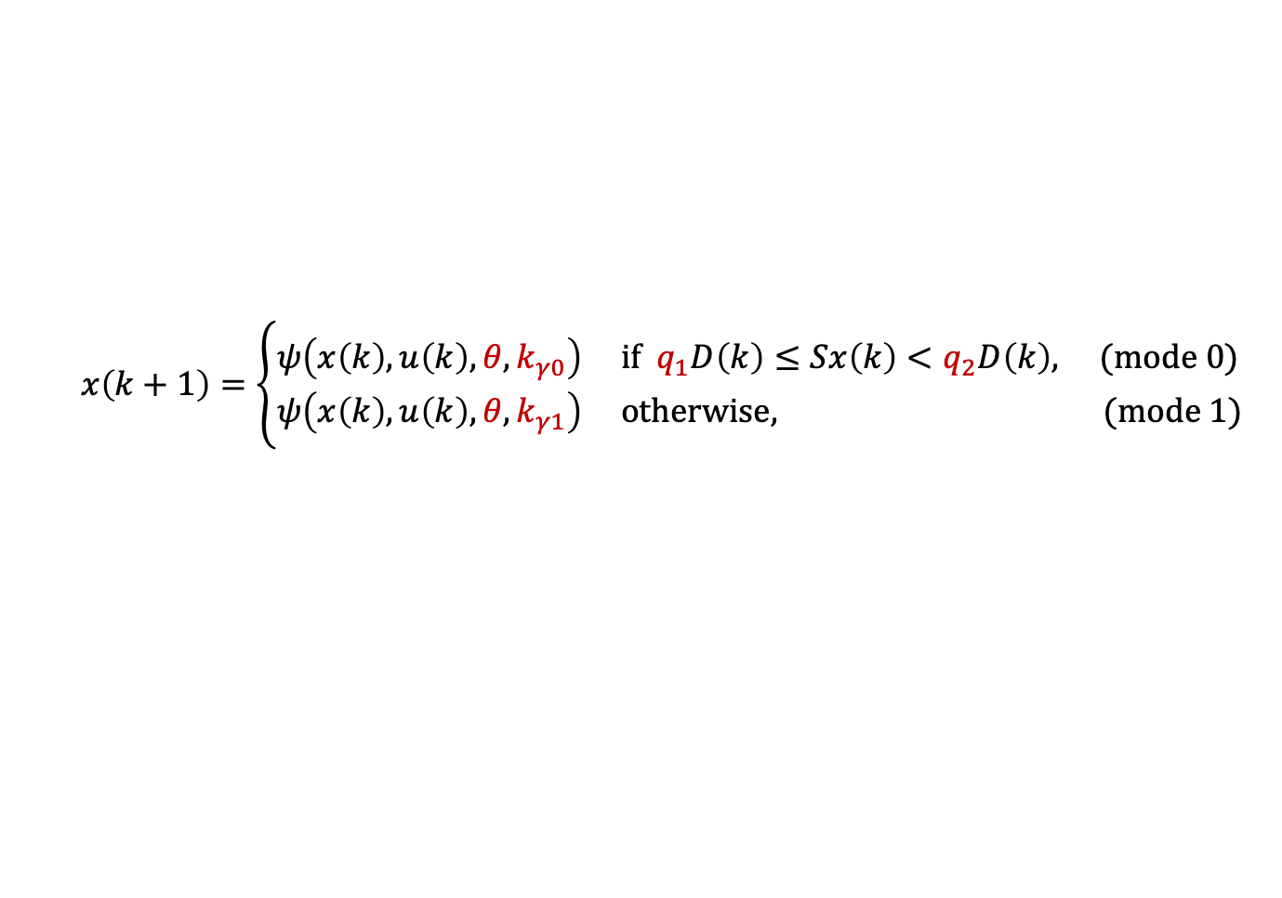
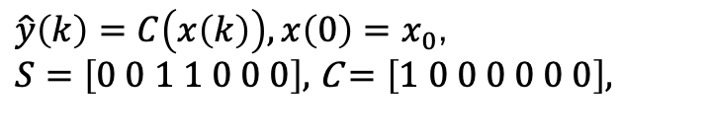
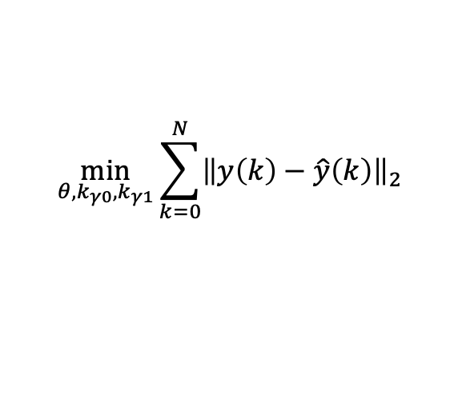
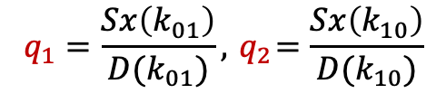
$$x\left(k+1\right)=\left\{\begin{aligned}&ψ\left(x\left(k\right),u\left(k\right),θ,k_{γ0}\right) if q_{1}D\left(k\right)≤Sx\left(k\right)<q_{2}D\left(k\right), (mode 0) \\ &ψ\left(x\left(k\right),u\left(k\right),θ,k_{γ1}\right) otherwise, (mode 1)\end{aligned}\right.$$
$$\min_{θ,k_{γ0},k_{γ1}}{\sum_{k=0}^{N}{{\left\|y\left(k\right)−\hat{y}\left(k\right)\right\|}_{2}}}$$
$$x\left(k+1\right)=\left\{\begin{aligned}&ψ\left(x\left(k\right),u\left(k\right),θ,k_{γ0}\right) if \hat{m}(k)=0 \\ &ψ\left(x\left(k\right),u\left(k\right),θ,k_{γ1}\right) if \hat{m}(k)=1\end{aligned}\right.$$
Subject (UVA/Padova Model)
Input
Glucose
Mode
Estimator
$\hat{y}\left(k\right)=C\left(x\left(k\right)\right),x\left(0\right)=x_{0}$,
$S=\left[0 0 1 1 0 0 0\right],$C $=\left[1 0 0 0 0 0 0\right],$
$$q_{1}=\frac{Sx\left(k_{01}\right)}{D(k_{01})}, { q}_{2}=\frac{Sx\left(k_{10}\right)}{D(k_{10})}$$
Mode
Parameter Estimation
$$θ^{∗}$$
SSOGMM

Slide 5
















$$U_{ii}$$
Brain and erythrocytes
$$d_{meal}$$
Gastrointestinal
tract
$$R_{a}$$
Renal
$$E$$
$$G_{p}$$
LIVER
Glucose
system
$$G_{t}$$
Muscle and
adipose tissues
$$EGP$$
$$U_{id}$$
$$G$$
$$I$$
$$u_{ins}$$
Subcutaneous
Insulin
$$R_{ai}$$
Insulin
system
Degradation
$$I$$
Alpha-cell
$$SR_{H}$$
Glucagon
system
Degradation
Subcutaneous
Glucagon
$$Ra_{H}$$
$$H$$
Notes:
Uva/padova schematic diagram

Slide 6















$$U_{ii}$$
Brain and erythrocytes
$$d_{meal}$$
Gastrointestinal
tract
$$R_{a}$$
Subcutaneous
Glucagon
Renal
$$Ra_{H}$$
$$E$$
$$G_{p}$$
Alpha-cell
$$SR_{H}$$
Glucagon
system
LIVER
Glucose
system
$$G_{t}$$
Muscle and
adipose tissues
$$H$$
$$EGP$$
$$U_{id}$$
$$G$$
$$I$$
$$u_{ins}$$
Subcutaneous
Insulin
$$R_{ai}$$
Insulin
system
Degradation

Slide 7








$$u_{ins}[k]$$
Observer
or
Extended Kalma filter
$$u_{ins}(t)$$
$$\hat{x}[k]$$
Subject
(UVA/Padova Model)
$$G(t)$$
$$d_{meal}(t)$$
$$G[k]$$
$$x(t)$$
$$R_{a}[k]$$

Slide 8
$$d_{meal}$$
$$R_{a}$$
Gastrointestinal
submodel
(switched system)
Nonlinear MPC
$$G_{ref}$$
Core submodel
(Bergman model)
Nonlinear
Programing
$$u_{mpc}$$
Subject
(UVA/Padova Model)
$$G$$
Subcutaneous
Insulin
Kinetic submodel
$$x̂$$
Extended Kalman filter

