Slide 1

A closer look at S&P 500 Index using GARCH
Reza Dadfar

Slide 2
Content
Motivation
Time series characteristics
Model Selection
Forecast

Slide 3
Motivation
Goal: Understanding and analysis of the underlying mechanism of stock market price.
Specification: The non-constant volatility of the stock returns demands for special models to predict the stock price characteristics.
Suggestion: analyse the underlying price evolution of the S&P 500 index and forecast the volatility and the return using GARCH model.

Slide 4
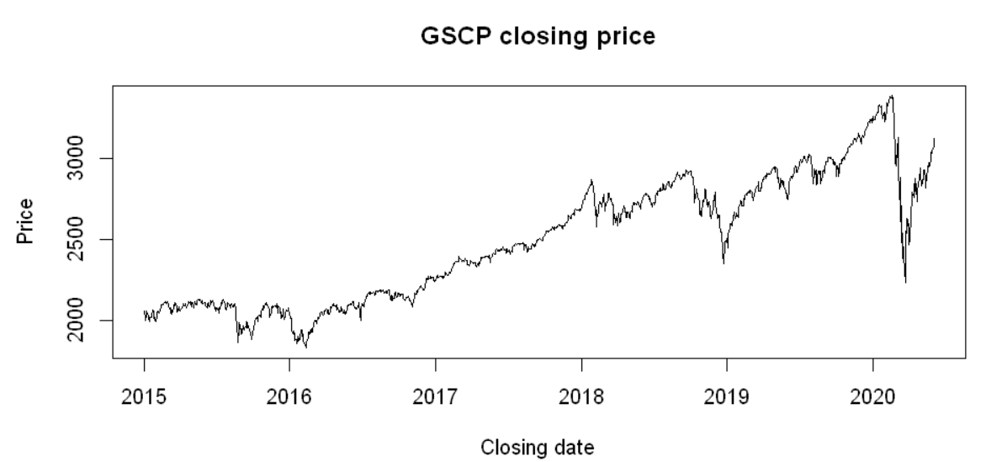
S&P 500 Price evolution, Yahoo finace
Stationary?
S&P 500 price from 2015 to 2020 (i.e. GSCP is the ticker symbol for the S&P 500)

Slide 5
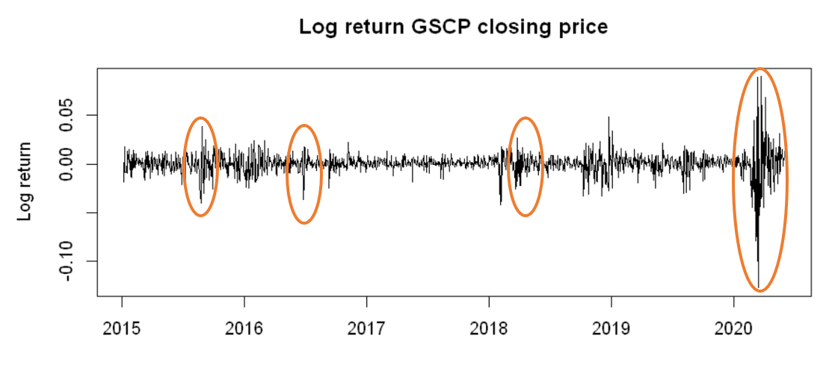
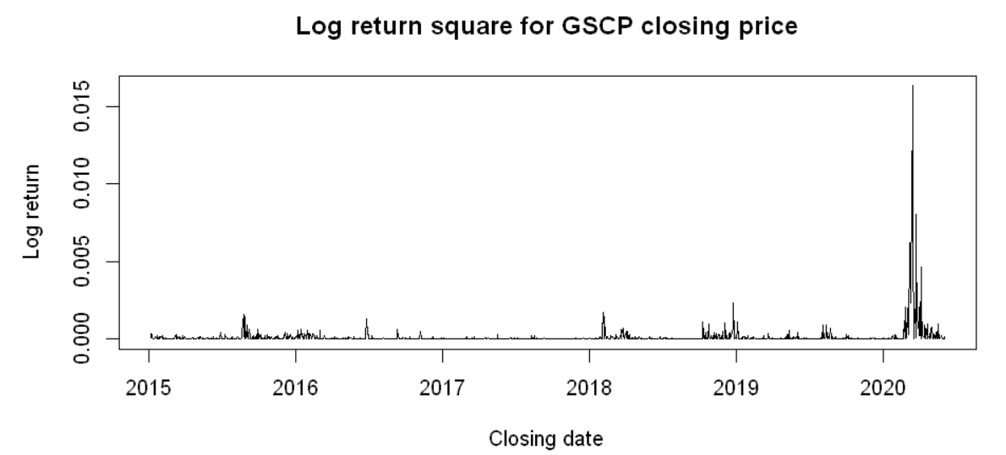

S&P 500 log-return and log-return squared
ARMA models are based on the assumption of a constant conditional variance
Models such as the autoregressive conditionally heteroscedastic or ARCH were developed to model changes in volatility, (i.e. generalization, GARCH)
Mathematical representation
$$r_{t}={μ+σ}_{t}ε_{t}$$
$$σ_{t}^{2}=ω+\sum_{j=1}^{p}{α_{j}r_{t−j}^{2}}+\sum_{j=1}^{q}{β_{j}σ_{t−j}^{2}}$$
Log return and log return square for S&P 500 from 2015 to 2020

Slide 6
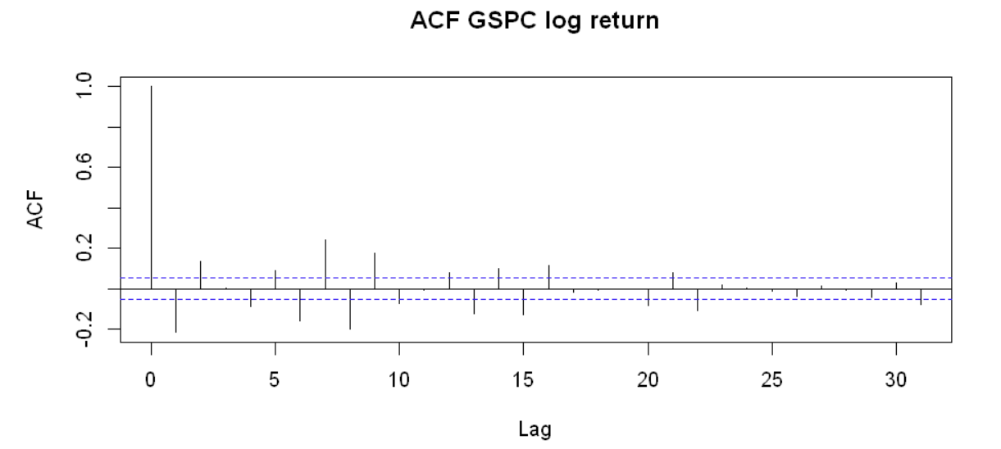
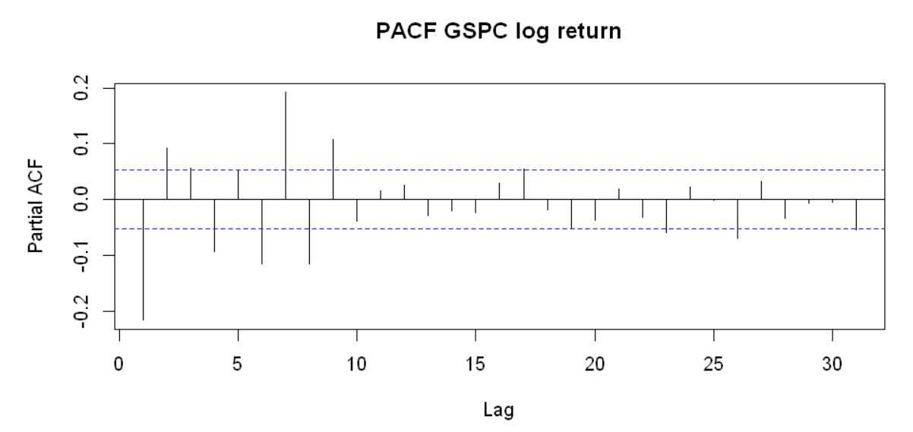
The log-return correlation functions
Auto correlation and partial auto correlation for the log-return is shown.
ARMA model or white noise?

Slide 7
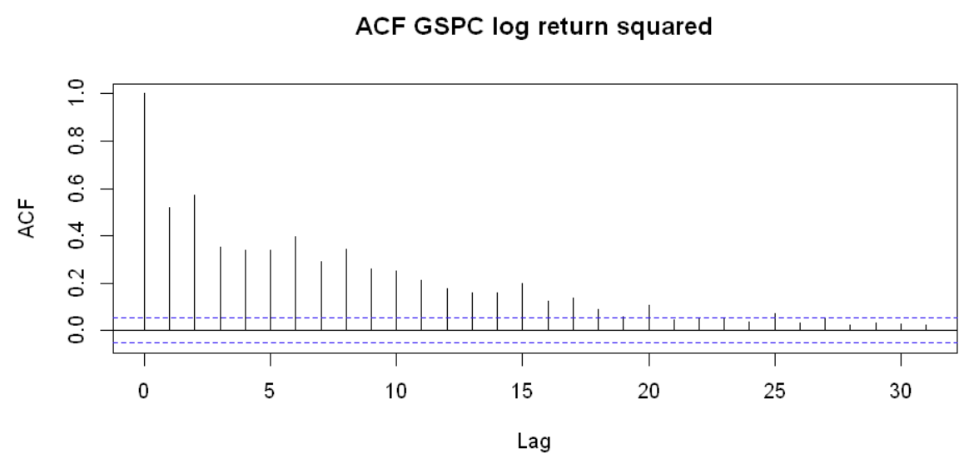
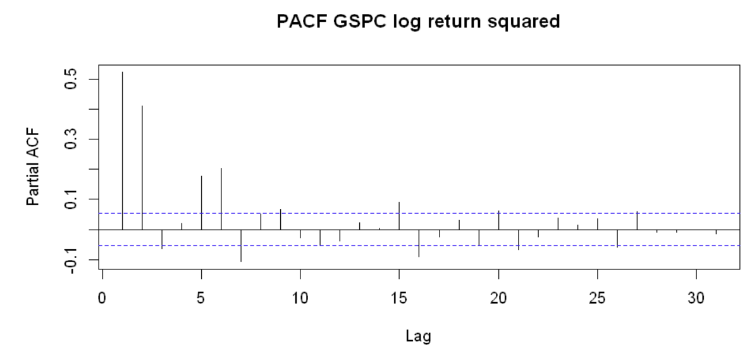
The log-return squared correlation functions
Auto correlation and partial auto correlation for the log-return is shown.
ARMA model or white noise?

Slide 8
Box-Ljung test
Box-Ljung test is a type of statistical test of whether any of a group of autocorrelations of a time series are different from zero [1].
Box-Ljung test
lag | Log-return | Log-return squared
1 | X-squared = 64.131p-value = 1.11e-15 | X-squared = 371.64 p-value < 2.2e-16
2 | X-squared = 89.191p-value < 2.2e-16 | X-squared = 817.53 p-value < 2.2e-16
3 | X-squared = 89.24 p-value < 2.2e-16 | X-squared = 986.19 p-value < 2.2e-16
6 | X-squared = 144.33 p-value < 2.2e-16 | X-squared = 1519.9 p-value < 2.2e-16
Box Ljung test on return and return squared using different lags.
$H_{0}$: The data are independently distributed (i.e. the correlations in the population from which the sample is taken are 0, so that any observed correlations in the data result from randomness of the sampling process) [1].
$H_{a}$: The data are not independently distributed; they exhibit serial correlation [1].
[1] https://en.wikipedia.org/wiki/Ljung%E2%80%93Box_test

Slide 9
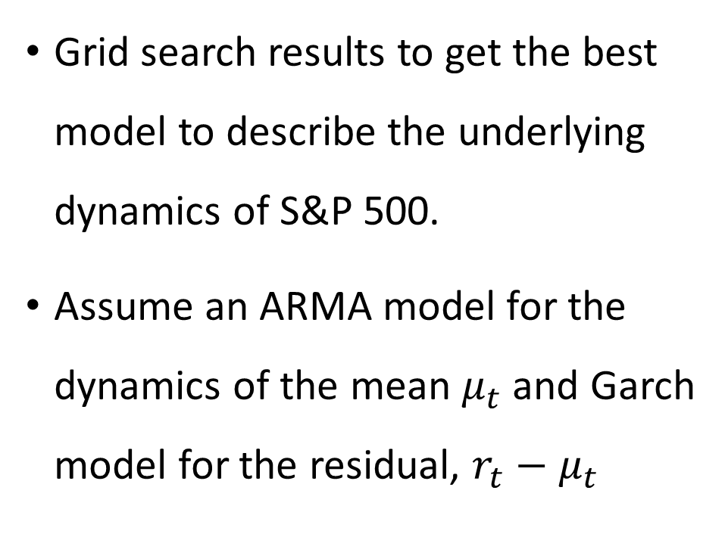
Model Selection
Grid search results to get the best model to describe the underlying dynamics of S&P 500.
Assume an ARMA model for the dynamics of the mean $μ_{t}$ and Garch model for the residual, $r_{t}−μ_{t}$
Model | Error distribution | Log-Likelihood | AIC | Coefficient
ARMA(0,0), Garch(1,0) | normal | 4458.822 | -6.538257 | significant
ARMA (0,0), Garch(1,1) | normal | 4667.197 | -6.842549 | significant
ARMA (0,0), Garch(1,1) | t-distribution | 4724.502 | -6.925167 | significant
ARMA (1,0), Garch(1,1) | t-distribution | 4729.616 | -6.931205 | significant
ARMA (1,0), Garch(2,1) | t-distribution | 4729.849 | -6.930080 | not significant
Different ARMA model for the mean and Garch model for the residual

Slide 10
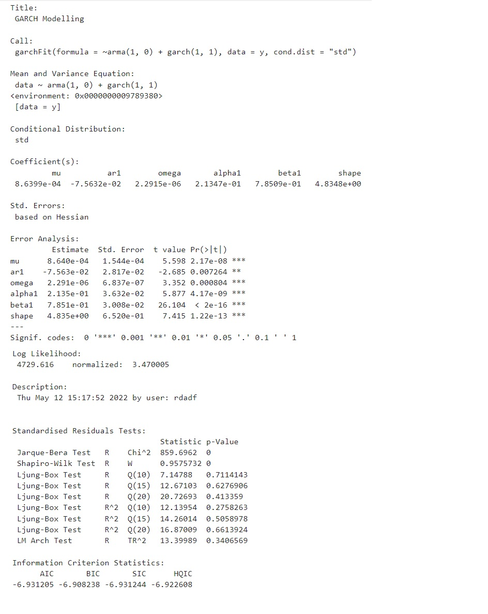
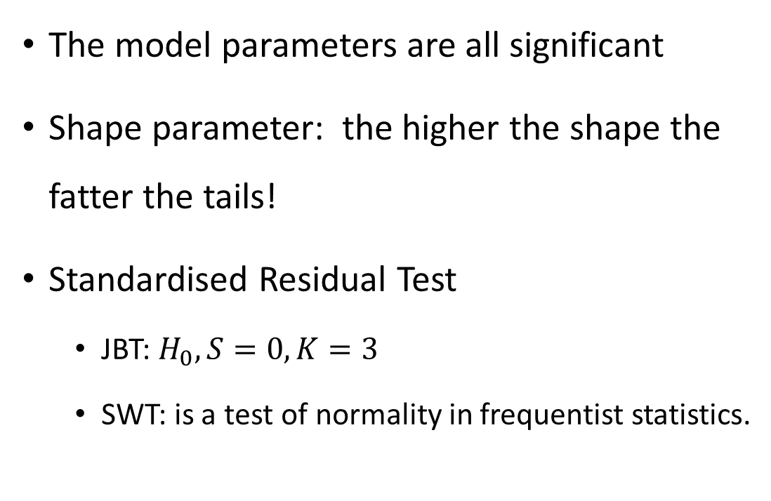
Model identification output
The model parameters are all significant
Shape parameter: the higher the shape the fatter the tails!
Standardised Residual Test
JBT: $H_{0}, S=0, K=3$
SWT: is a test of normality in frequentist statistics.
Notes:
https://stats.stackexchange.com/questions/252842/does-shape-parameter-degrees-of-freedom-for-students-t-distribution-in-rug

Slide 11
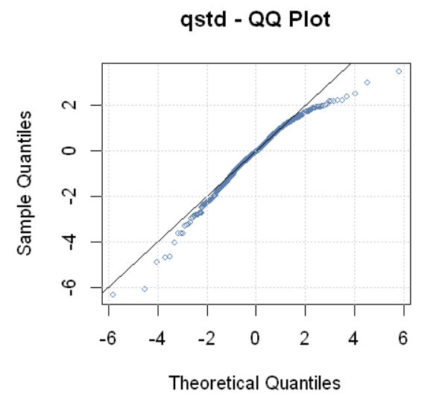
Q-Q Test of the residual
Can we considered the residual as normal?
Model can be more tuned for example other type of Garch model can be used?

Slide 12
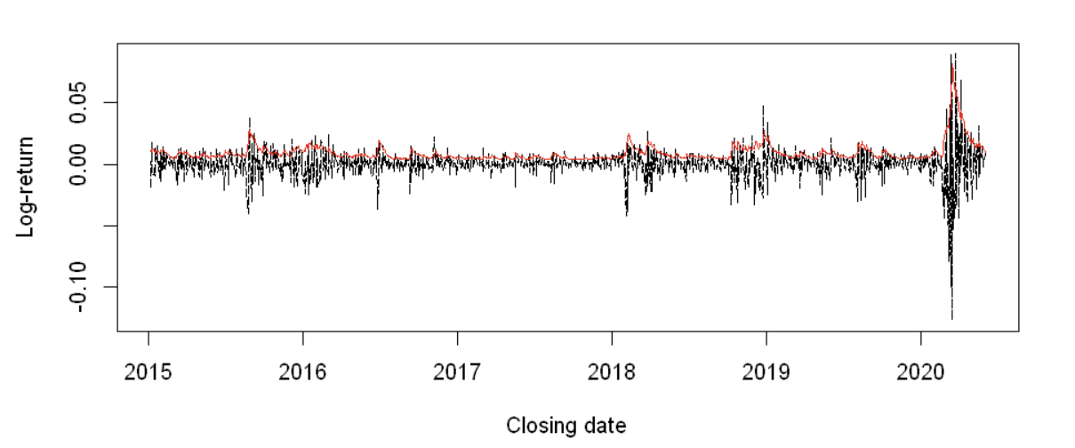
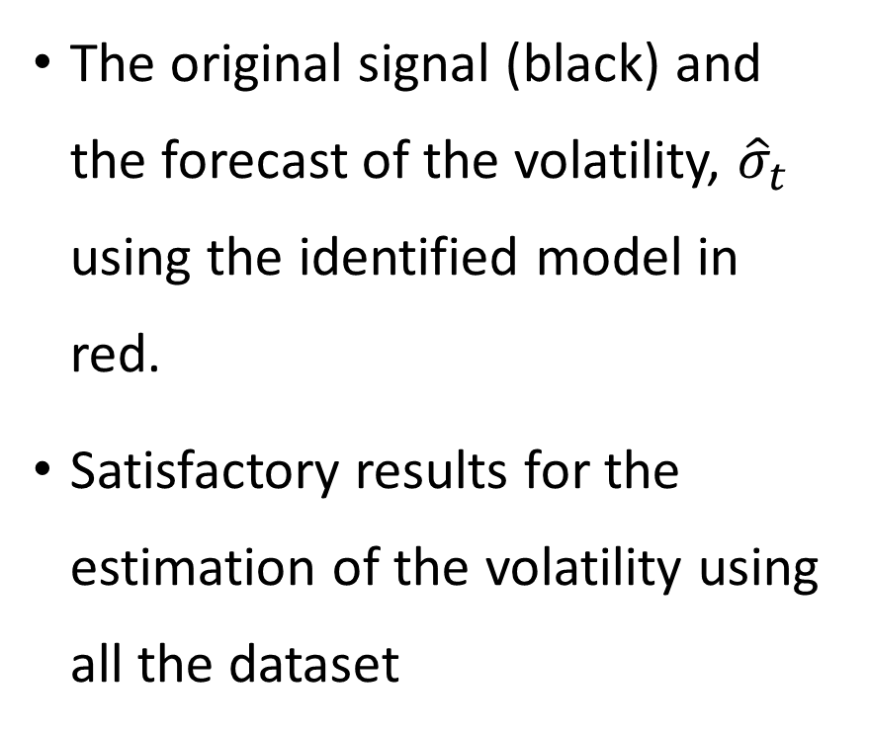
Model Forecast (Using all the data)
The original signal (black) and the forecast of the volatility, ${\hat{σ}}_{t}$ using the identified model in red.
Satisfactory results for the estimation of the volatility using all the dataset
The log return and the estimated volatility are shown in one plot

Slide 13
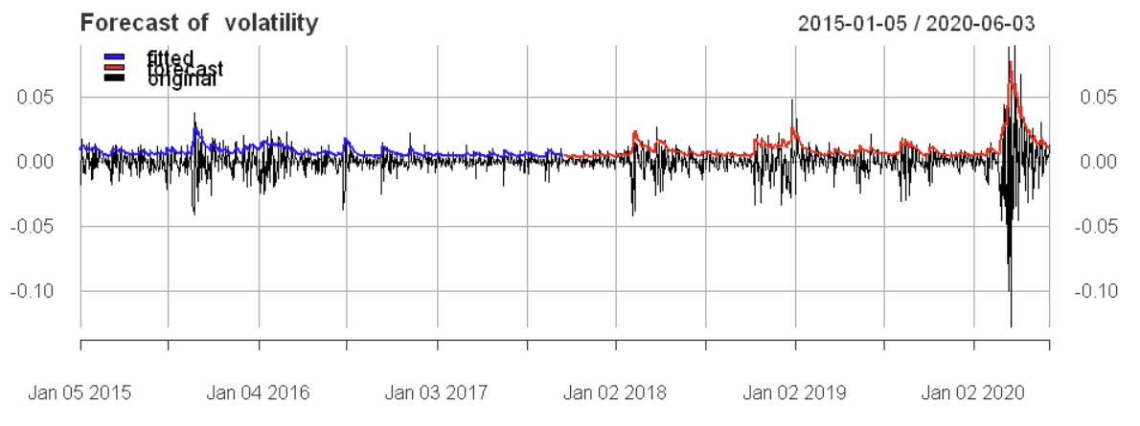
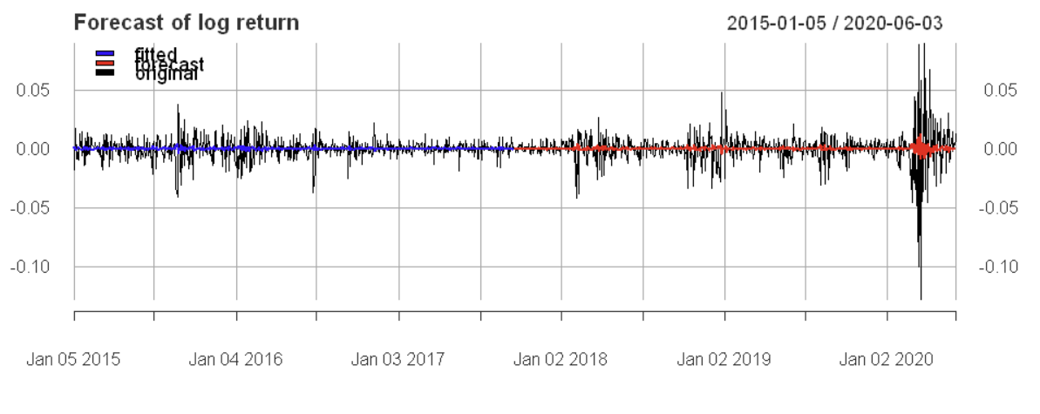
Model forecast use only half of the data
The volatility estimation using half of the data (rolling window with length 1)
The log return forecase using the final model (rolling window of length 1)

Slide 14
Conclusion
S&P 500 index log-return is model using Garch
The GARCH model is identified using R.
The volatility is predicted using Garch with Good accuracy
More effort is required to accurately predict the log-price information.

