Slide 1

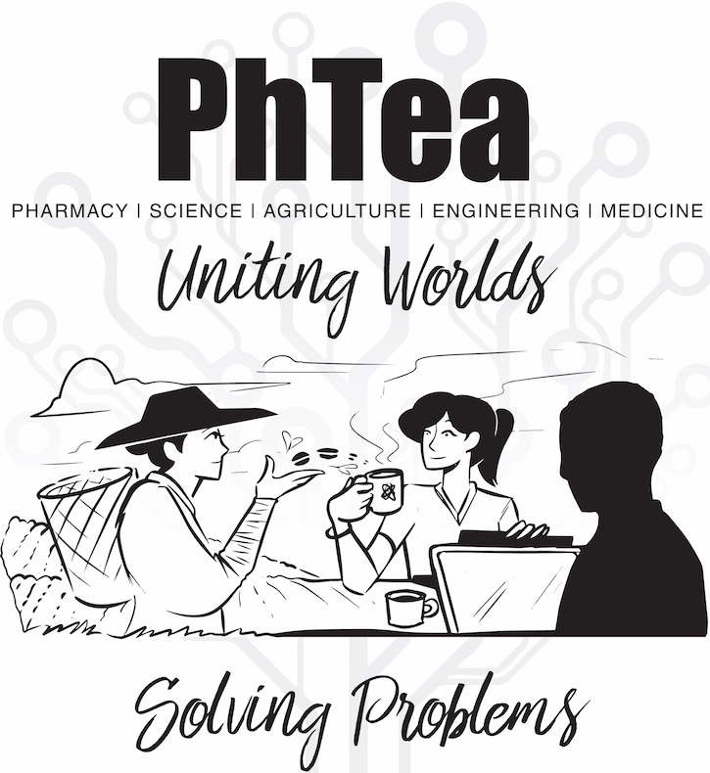
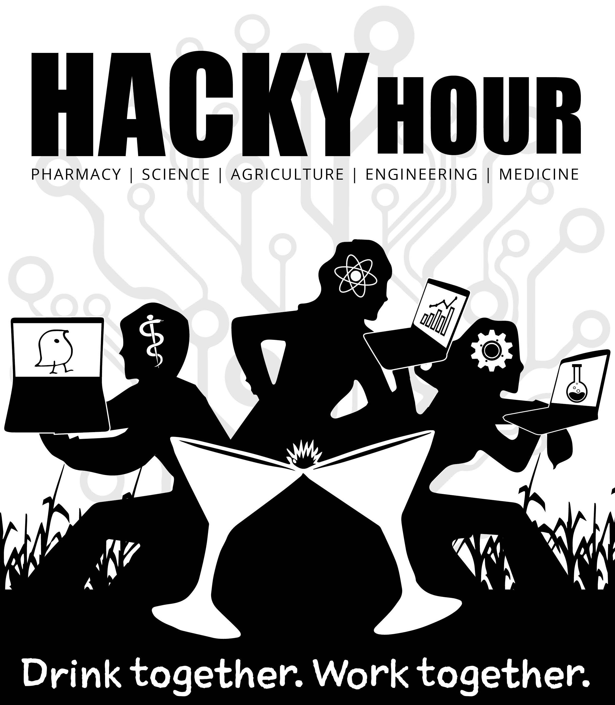
The Research Bazaar is a worldwide festival promoting the digital literacy emerging at the center of modern research
Not into the bar scene?
Not into mornings?
Weekly Tuesdays 8-10
Nucleus Café, Keating Building
Weekly Thursdays 4-7
Frog & Firkin

