Slide 1



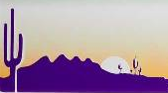

Square Logo
Notes:
Arizona up the Research Bazaar square logo. This will be an alternate form of the longer Research Bazaar AZ logo with the Arizona flag
General ideas:
Change the 3 people to be more saguaro shaped?
Or add desert landscape behind people?

Slide 2
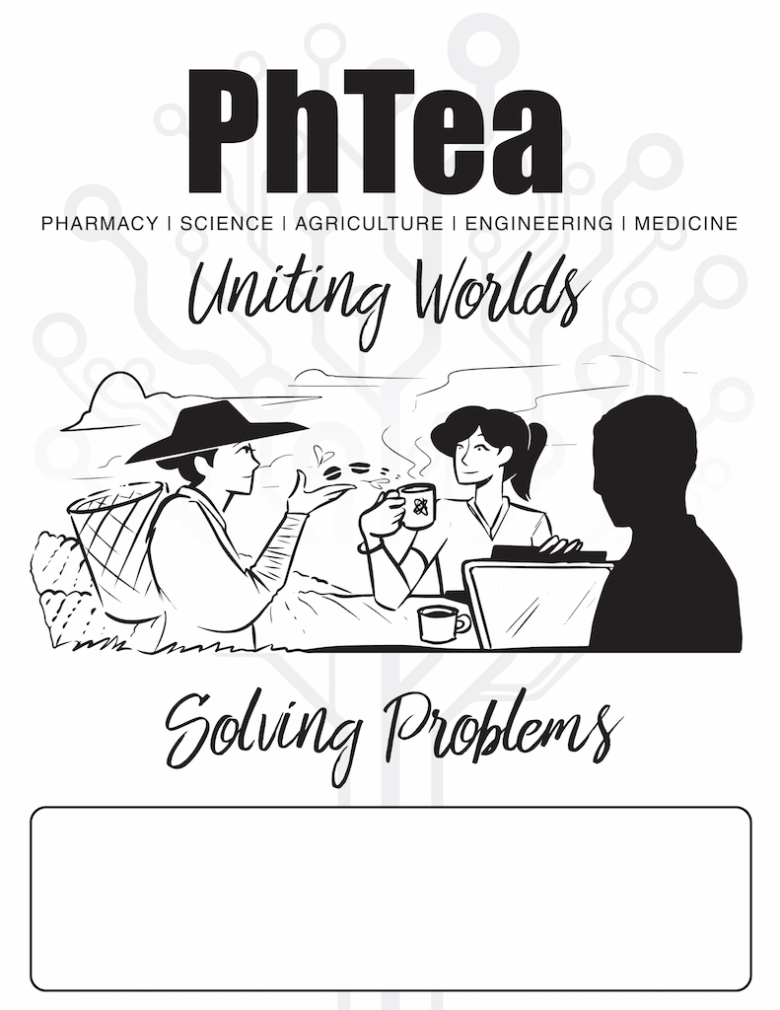
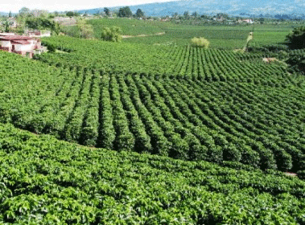





PhTea Pharmacy | Science | Agriculture | Engineering | Medicine Uniting Worlds
Solving Problems
Notes:
PhTea is the morning/non-alcoholic version of Hacky Hour. It’d be great if they shared some of the same esthetics. I really like how the Hacky Hour logo is atmospheric
Idea for the logo:
Tea field and/or coffee field on the left. Farmer with coffe/tea dropping it into a cup.
On the right, the cup being held up by a researcher around a group of other researchers working together (a lá Hacky Hour Charlie’s Angels triplet)

Slide 3




Hacky Hour
Mariah’s Final
Mock Up
Inspiration
Hacky
Hour
Notes:
Charlie’s angels silhouette but for Hacky Hour: main person working on a laptop, one side person drinking from a mug, one side a scientist. Hacky Hour in cool font across bottom to fit.
Thoughts:
Perhaps have ideas, data, experiments, code, etc coming out of it at the top.<-These may relate to the 5 BIO5 topic areas: Pharmacy, Science, Agriculture, Engineering, Medicine. Consider including a wug walking around (https://languagefix.files.wordpress.com/2008/09/wugbumper-full.jpg)
Has to fit into a small square sometimes

Slide 4
Shut Up & Write → Shut Off & Write?
Shut Off & Write
Unplug. Dig In.
Notes:
Shut Off & Write
Person pushing up against a semi-closed door with things like emails, twitter symbols, otherwise popping through the last bit of unclosed door. A group of people sitting together and working/writing on laptops. Same group as Hacky Hour but turned inwards toward each other instead of outward.

Slide 5

EVERYONE
WELCOME
Thursdays 4–7 PM @ Gentle Ben’s Brewing

