Slide 1

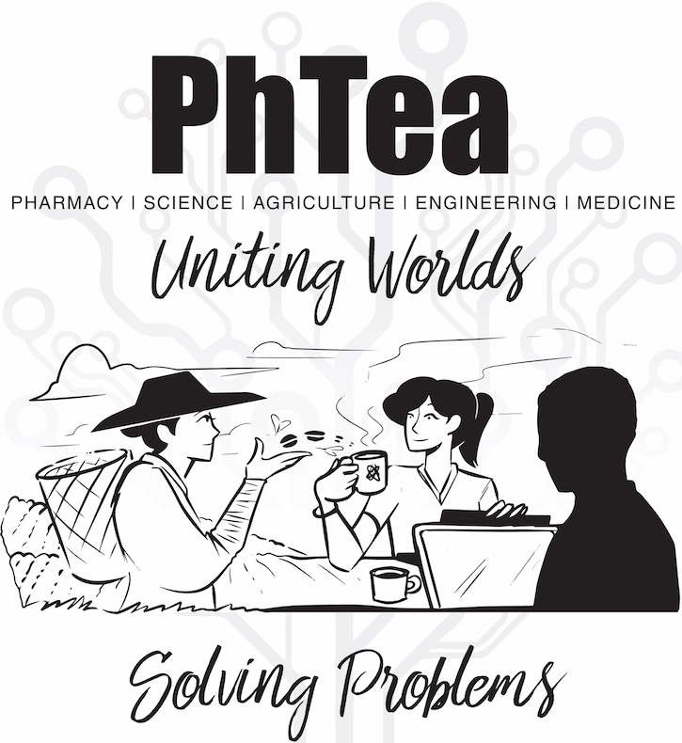
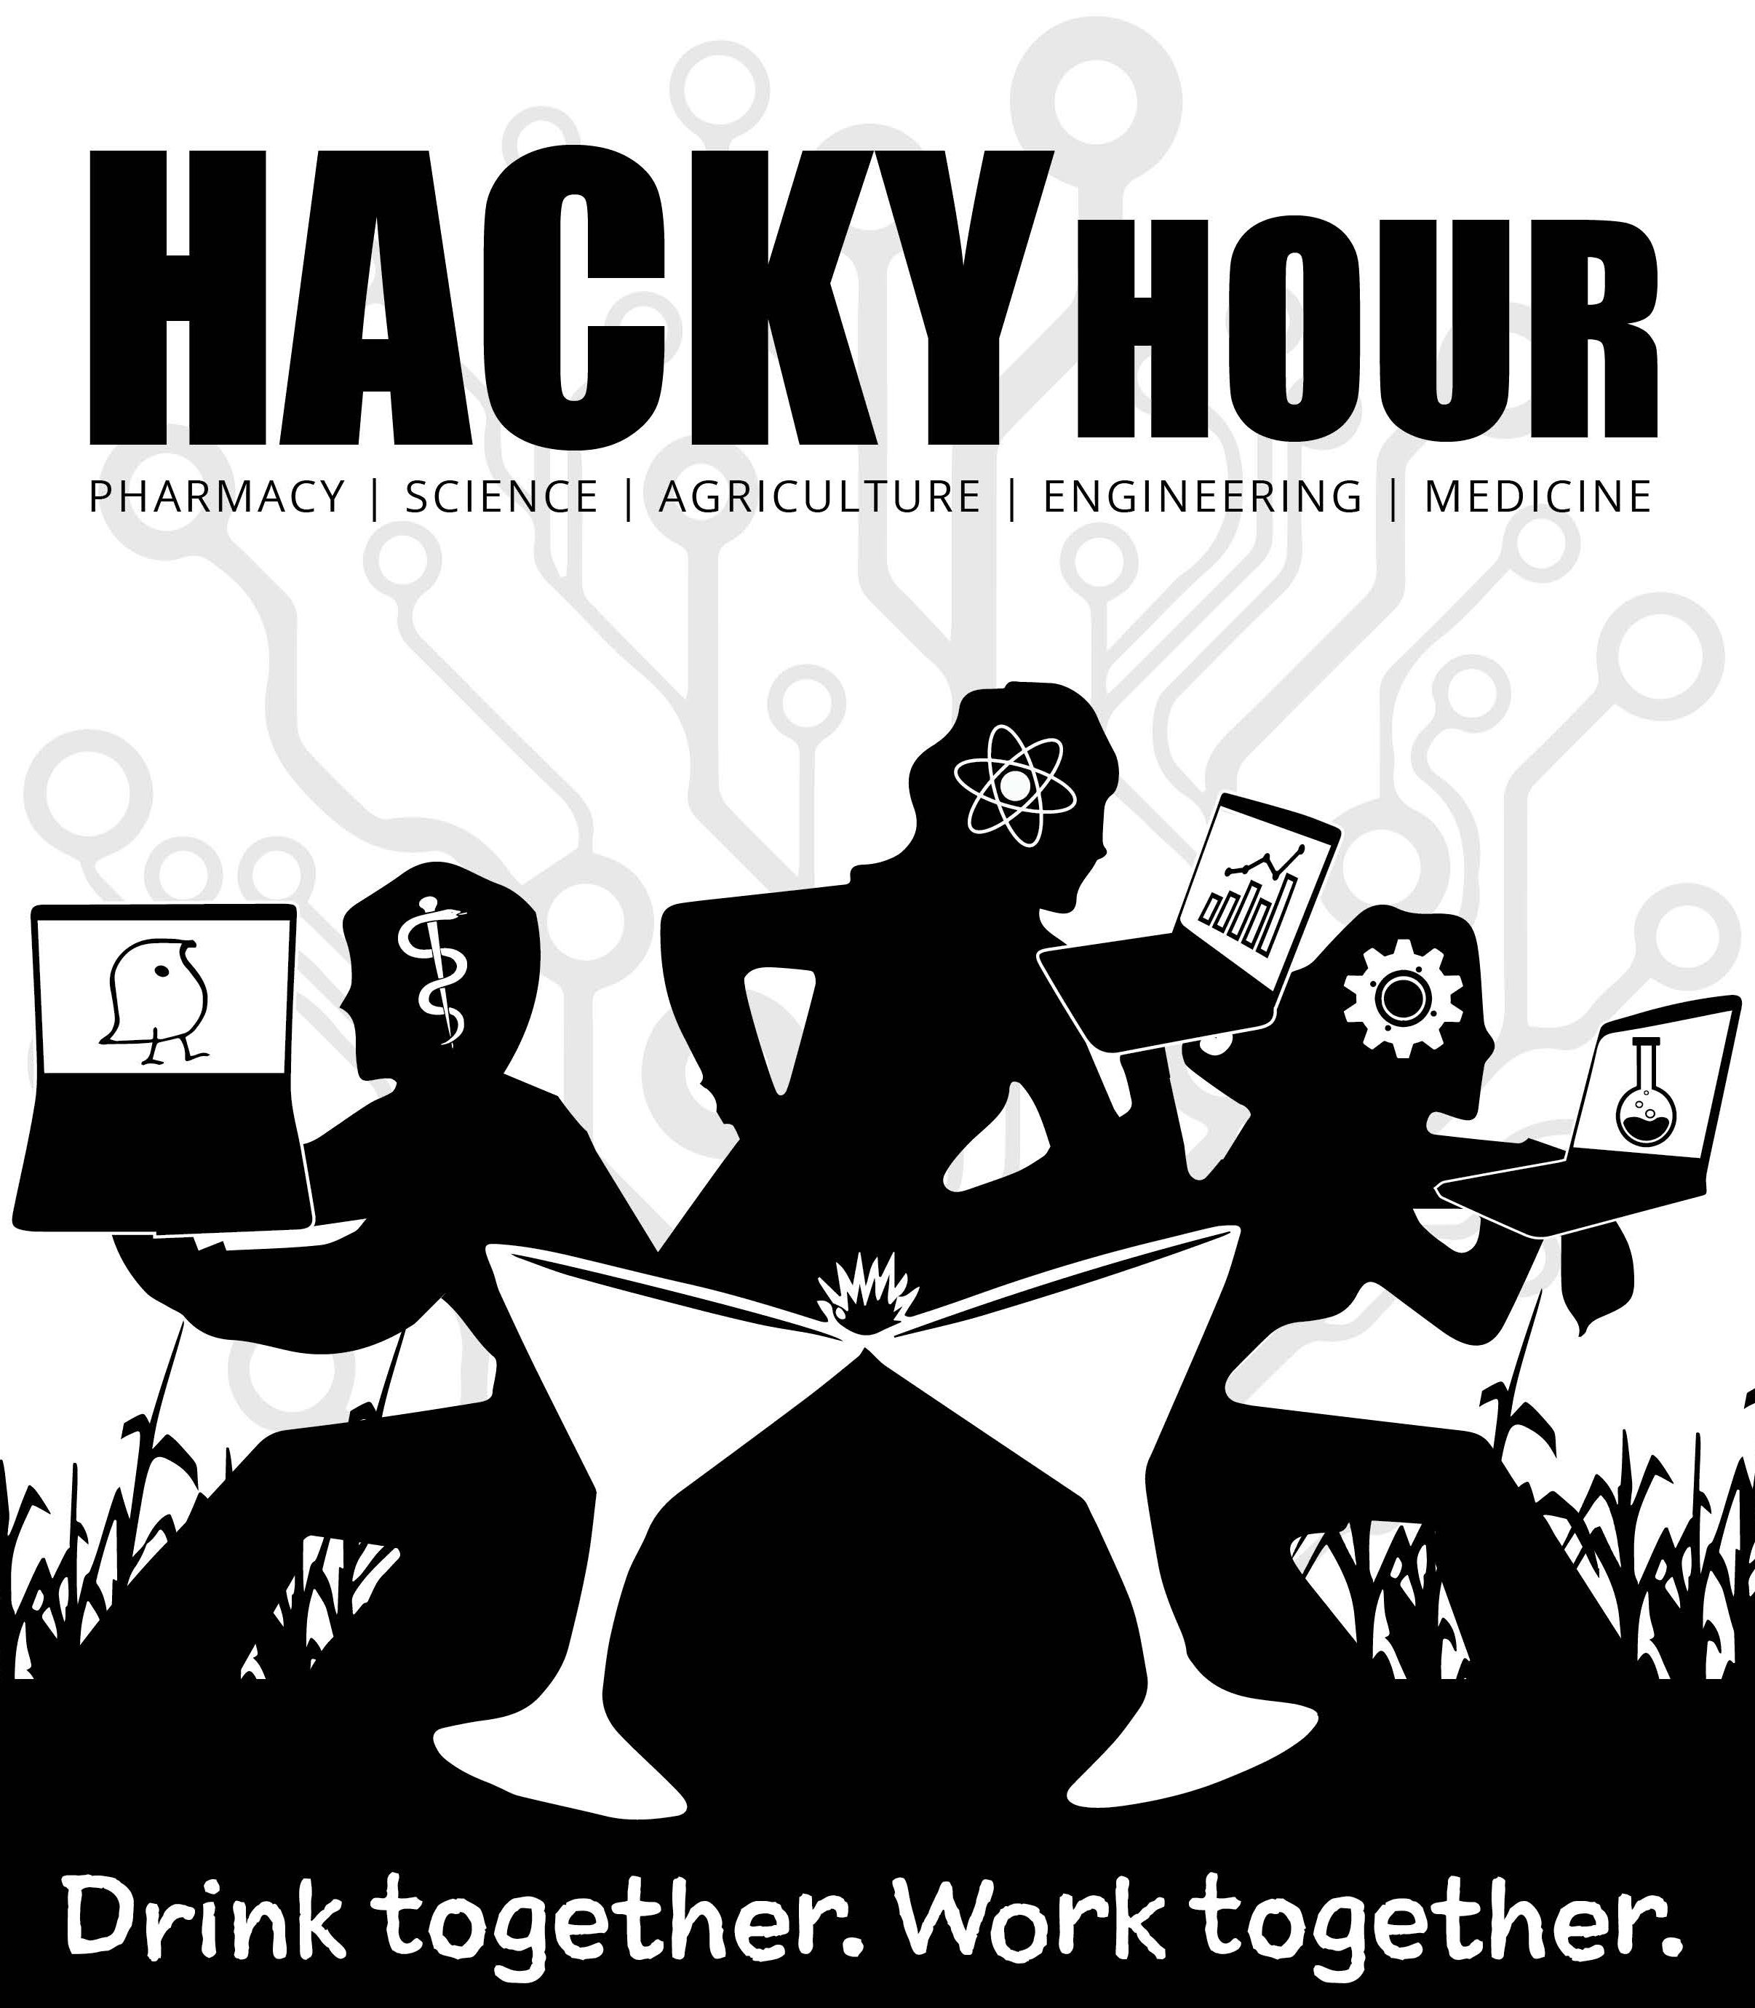
The Research Bazaar is a worldwide festival promoting the digital literacy emerging at the center of modern research
Not into the bar scene?
Not into mornings?
Weekly Tuesdays 8-10
Nucleus Café, (Keating Building)
1657 E Helen St
Weekly Thursdays 4-7
Pasco (Main Gate Square)
820 E University Blvd

Slide 2

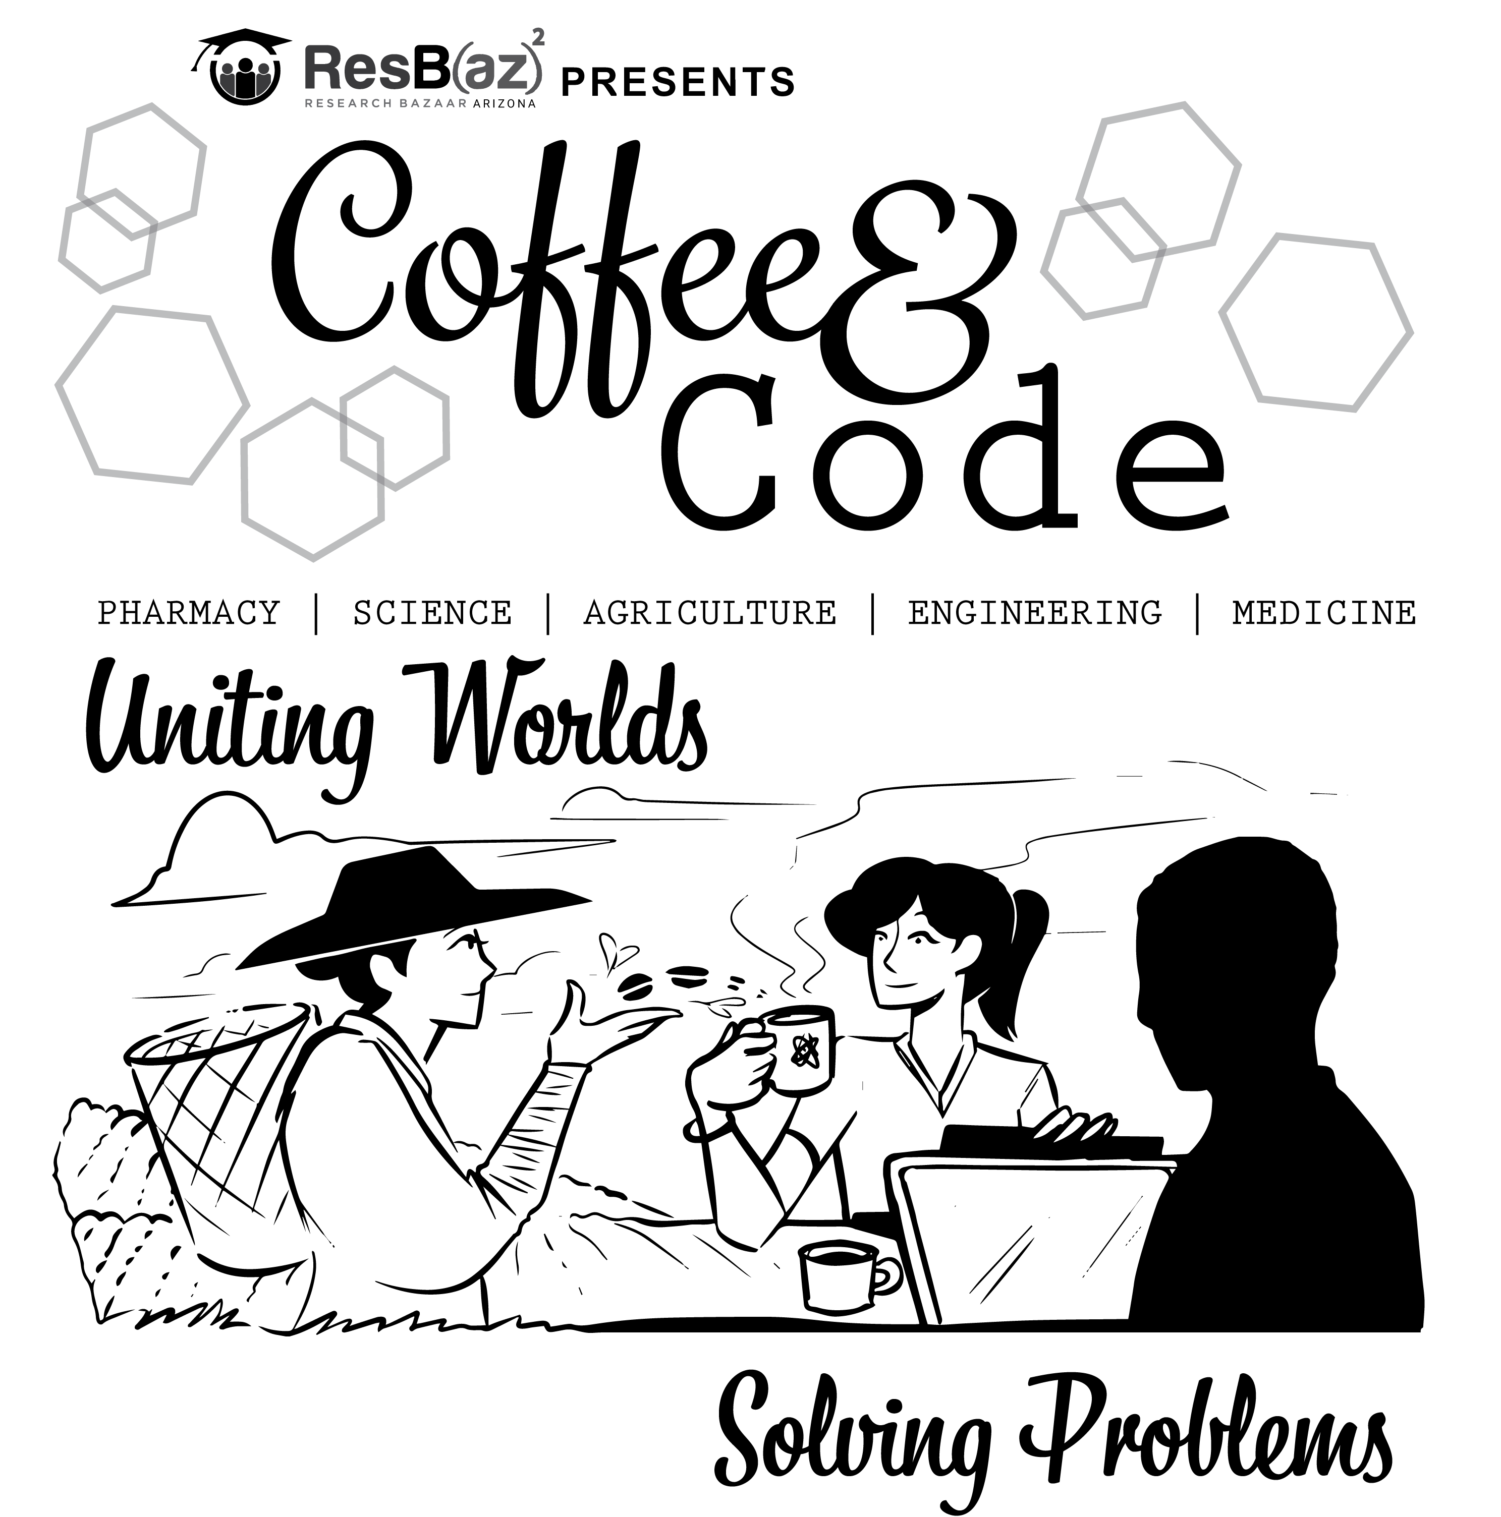
The Research Bazaar is a worldwide festival promoting the digital literacy emerging at the center of modern research. Check us out @resbazaz
Need help with science or computers? Tired of quietly suffering trying to figure it out? Come hang out with us; it’s free!* Just want to hang out? Also free!*
Not into the bar scene?
Not into mornings?
Weekly, Tuesdays 8-10
Catalyst Café, (Keating Building)
1657 E Helen St
Weekly, Thursdays 4-7
Gentle Ben’s (Main Gate Square)
865 E University Blvd
* No beverages are provided. But it’s still fun and fairly cheap one way or the other.◆
◆ Neither fun nor cheap is a guarantee. But if you are still reading this, and it’s funny: we feel more confident about the first part.

Slide 4


presents
Thursdays 4-7 PM @ Pasco Kitchen & Lounge
Going? Hit us up @resbazaz.
Coding! Science! Zymurgy! Or start the weekend!
Thursdays 4-7 PM @ Pasco Kitchen & Lounge
Going? Hit us up on @resbazaz
Coding! Science! Zymurgy! Or start the weekend!

Slide 5
presents
Weekly, Tuesdays 8-10 AM @ The Catalyst Cafe
Going? Hit us up on @resbazaz
UA BIO5 Institute (Keating building)
1657 E Helen St, Tucson, AZ 85721

