Slide 1
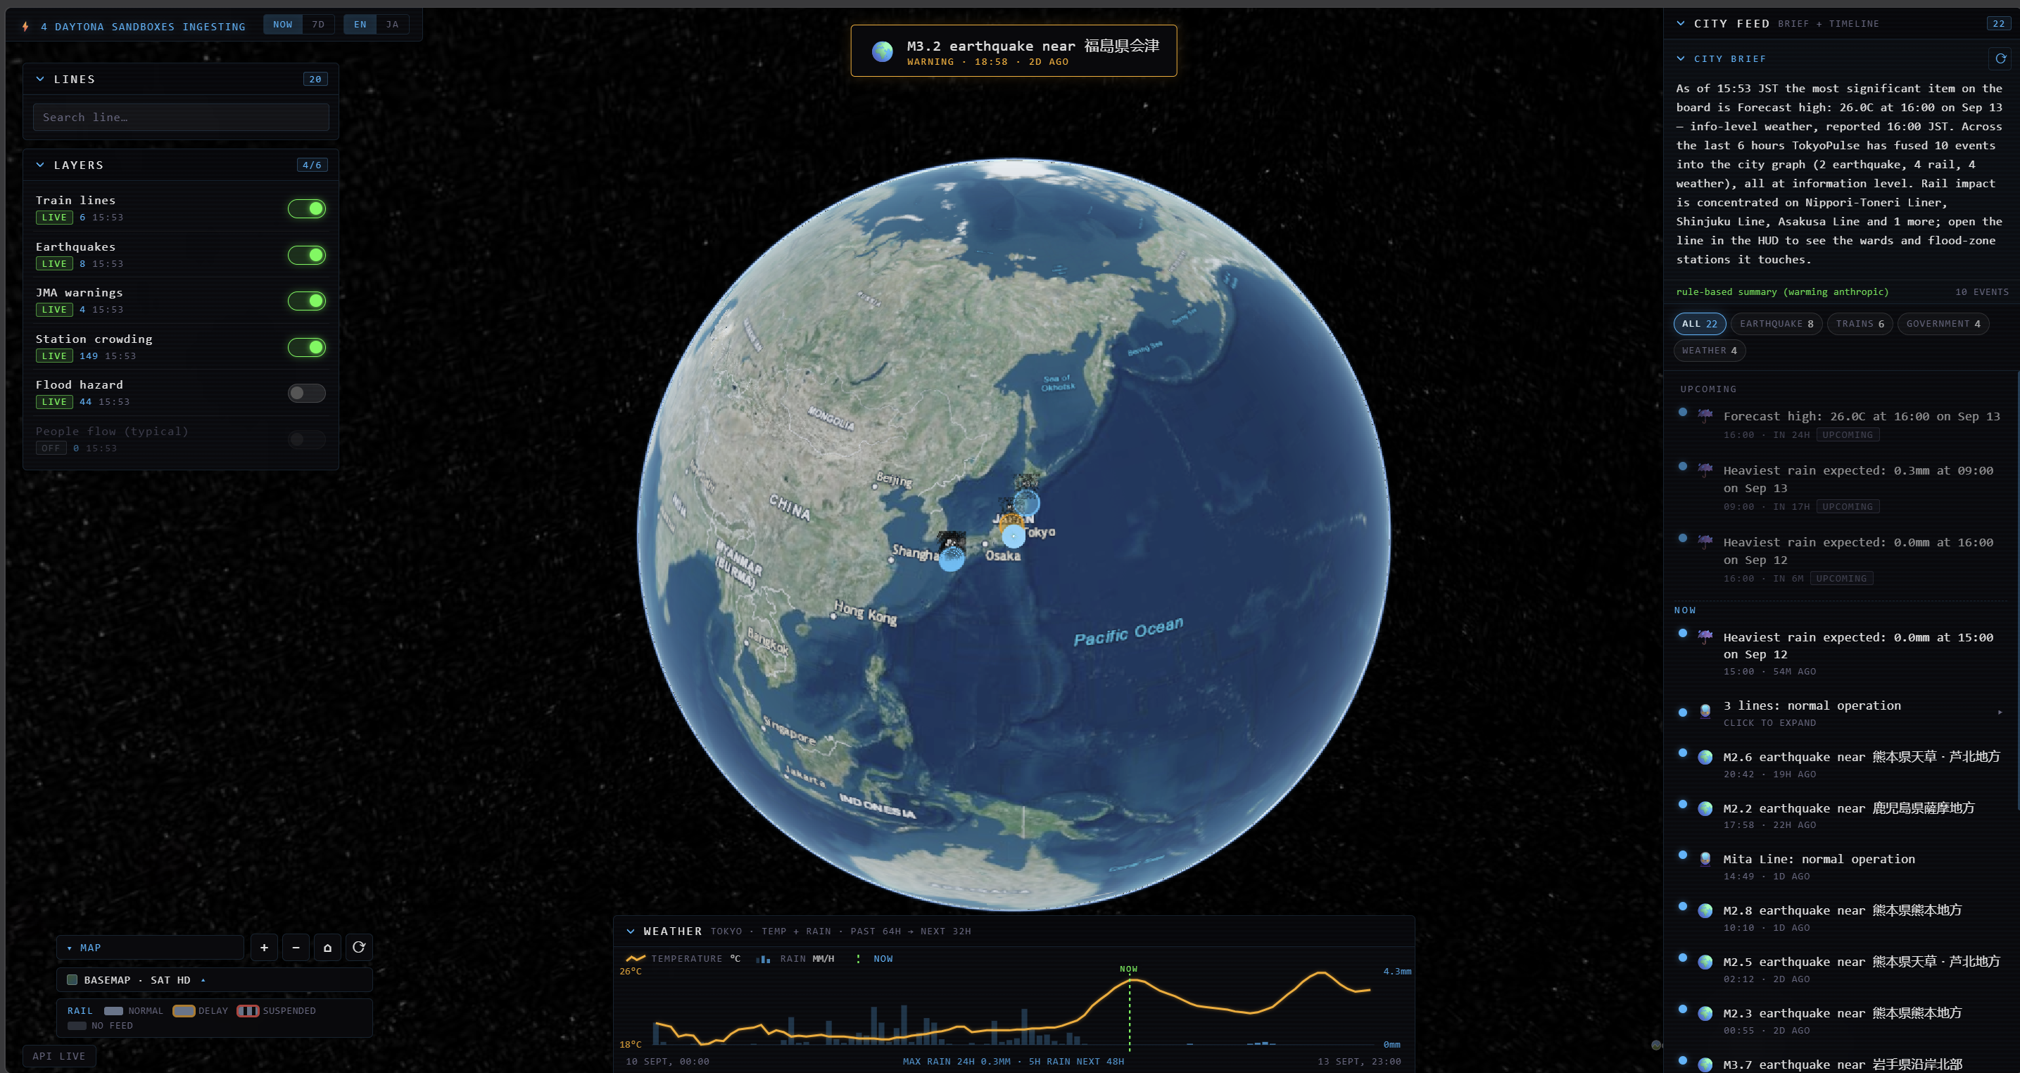
DAYTONA HACKSPRINT TOKYO · BUILT IN 2 HOURS
TokyoPulse
A live city-operations map for Tokyo. Trains, earthquakes, warnings, weather, floods and crowding — fused into one connected graph with a time dimension, rendered on a 3D globe.
NEO4J AURA · DAYTONA SANDBOXES · CESIUMJS · FASTAPI · CLAUDE
Notes:
TokyoPulse: a live Tokyo city-operations map built in a 2-hour hackathon. It fuses siloed real-time feeds into one connected graph with a time dimension: past 7 days, now, next 48 hours.

Slide 2
01 · THE PROBLEM
Tokyo's real-time city data is everywhere — and nowhere.
Train status ODPT — per-operator, per-app, one line at a time
“what's happening around me right now, what happened earlier, and what's coming?”
Earthquakes P2PQuake — its own feed, its own map
Weather warnings JMA — official bulletins, separate site
No single view answers this today.
Each feed has its own format, its own app, its own map — and none of them connect an event to the lines, stations and wards it actually affects, or place it on a timeline from the past week to the next 48 hours.
Forecast & rain Open-Meteo — historic + next 48h, separate again
Flood & crowding GSI hazard tiles, ridership stats — static silos
Notes:
Five real-time sources, all public, all siloed: different formats, different apps. Nothing connects an event to the infrastructure it affects, and nothing puts past, present and forecast on one timeline.

Slide 3
02 · ARCHITECTURE
Feeds → sandboxes → graph → API → globe
DATA
4 live keyless feeds (ODPT trains · P2PQuake · JMA · Open-Meteo) + static geo: rail GeoJSON, 149 stations, wards, GSI flood tiles
THE ONE DESIGN IDEA
Every feed normalizes into one Event shape.
The timeline, the alert banner and the LLM city brief are three renderings of the same Neo4j query — build the query once, render it three ways.
COMPUTE
Daytona fan-out — 4 sandboxes launched in parallel, one per feed; each runs that feed's pure normalize() and fails independently
GRAPH
Neo4j Aura — (Line)-[:SERVES]→(Station)-[:IN]→(Ward); live (Event)-[:AFFECTS]→(Line|Ward) with type, severity, time
API
FastAPI — /events · /lines.geojson · /impact/{line} · /brief · /forecast; every endpoint resolves live → cache → mock, never 500s
Sandboxes have no egress in this account — so the host fetches, each sandbox runs the pure normalize step. Real parallel compute on the critical path; flipping to full in-sandbox ingest needs zero code change.
UI
Vite + React + CesiumJS — 3D globe, layer toggles, timeline (7d → now → +48h), impact panel, JP/EN city brief
Notes:
Five planes. Live feeds are fetched and pushed into four parallel Daytona sandboxes, each normalizing one feed into a shared Event shape, written to Neo4j Aura. A single-file FastAPI serves five endpoints with a live-cache-mock resolver, and a Cesium globe renders it.

Slide 4
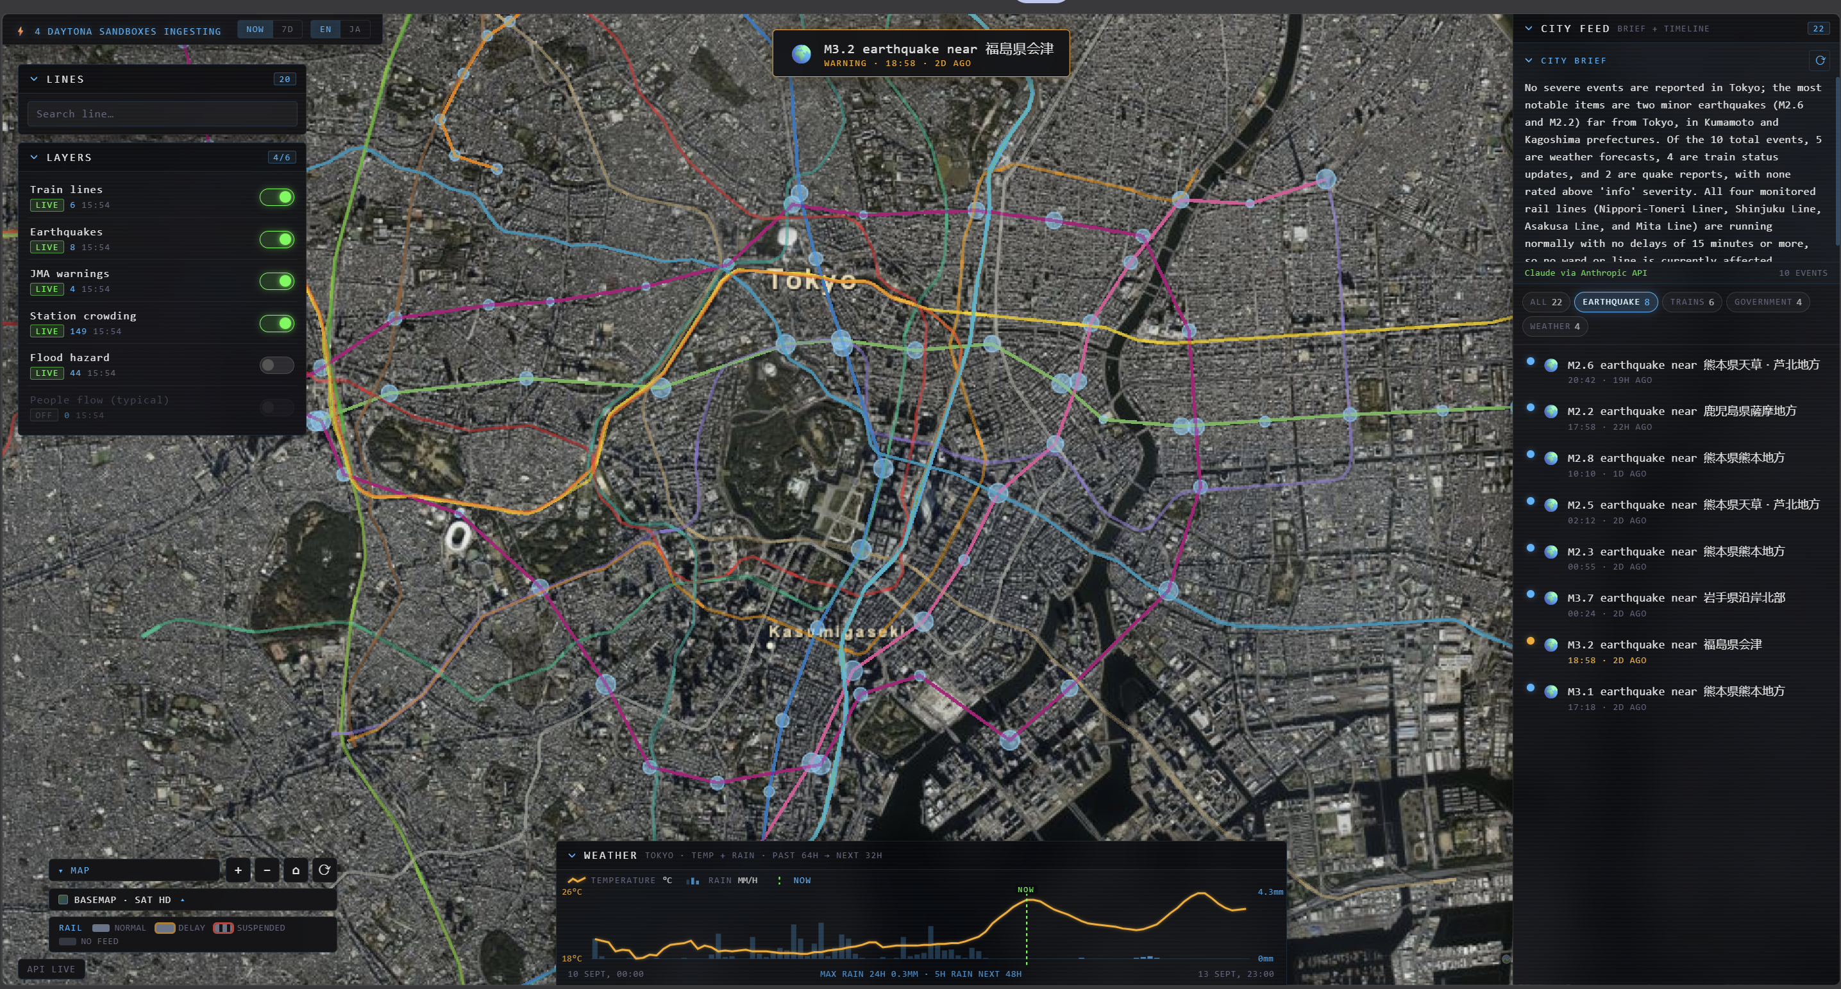
03 · THE PRODUCT
One graph, rendered as a living map
Timeline
past 7 days → now → next 48h, one scrubbable feed
Impact panel
pick a line → wards, stations, flood-zone hits — live Cypher
City brief
JP/EN summary generated fresh from the live event set
Replay, honestly
demo quake fires on cue — always tagged REPLAY, never faked
Tactical HUD over live Tokyo — 20 rail lines colored by status, 149 crowd-weighted stations, quake pulses, flood overlay, scrolling city feed.
Notes:
The UI: Cesium globe with GSI imagery, layer toggles for trains, quakes, warnings, crowding and flood hazard; a city feed with an LLM brief; a weather strip covering past 64h and next 32h. The impact panel is a real graph query, not a canned answer.

Slide 5
04 · OUTCOME
Real feeds, real graph, real compute — in 2 hours
4
1.9–3.4s
149
0
Daytona sandboxes per run,
launched in parallel
measured sandbox startup,
normalize on the critical path
stations in the graph —
20 lines, 23 wards
500s — every endpoint
degrades live → cache → mock
The graph answers what a table can't: select the Shinjuku Line and one Cypher query returns 6 wards, 21 stations, 11 of them in flood zones, and the events affecting it right now — live, against Neo4j Aura.
What's real: live train/quake/warning/weather ingest, real Cypher impact queries, fresh Claude-generated JP/EN briefs. Honestly labeled: Toei-only line status, proxy crowd heatmap, REPLAY-tagged demo events.
“Resident app today, ward dashboard tomorrow.”
Notes:
Everything on this slide is measured or live: 4 sandboxes at 1.9 to 3.4 seconds startup, 149 stations seeded, zero 500s by design. Closing line from the demo script.

