Slide 1
SHAKTI PHOTON SOLUTIONS
Website Revamp 2026
The Problem · The Strategy · The Live Product
Prepared for team review — June 2026
🔗 Live site: shakti-photon-solutions.vercel.app
⚡ Powered by IIT Madras Research Park

Slide 2
CONTEXT
The Problem — Why We Rebuilt the Website
Our old Wix website was holding back the business
❌ Zero control over SEO
❌ No lead generation system
❌ Locked into Wix platform
Wix's auto-generated HTML is bloated and not indexable. AI search tools (ChatGPT, Perplexity) couldn't find us. Keywords like 'green hydrogen India' returned zero hits.
Every inquiry required navigating to a Contact page. No pre-filled product context. High friction = lost leads. No WhatsApp integration. No enquiry tracking.
Could not add custom schema, structured data, or blog. Slug URLs were ugly. Mobile performance was poor. Monthly platform fees with no technical ownership.

Slide 3
STRATEGY
The Solution — A Purpose-Built Website
Rebuilt from scratch in HTML/CSS/JS. Free hosting. Full control.
🎯 Goal 1: Lead Generation First
• Enquiry possible within 3 clicks from landing • Product-specific enquiry modal (popup) with pre-filled context • WhatsApp button on every page — direct to scientist • 'Get a Quote' in persistent navbar
🔍 Goal 2: GEO/SEO Visibility
• Structured keywords: 'green hydrogen India', 'PEM electrolyzer India', 'CCUS India', 'fuel cell system India', 'MEA manufacturer India', 'carbon capture company India', 'net zero enabler India' • FAQPage JSON-LD schema → AI assistants cite us • 5 deep technical articles → topical authority
⚙️ Goal 3: Compound Engineering
• Full technical documentation in repo (PROJECT.md, DECISIONS.md) • Any AI model can onboard in < 2 minutes • CHANGELOG tracks every change • ROADMAP drives prioritised next steps

Slide 4
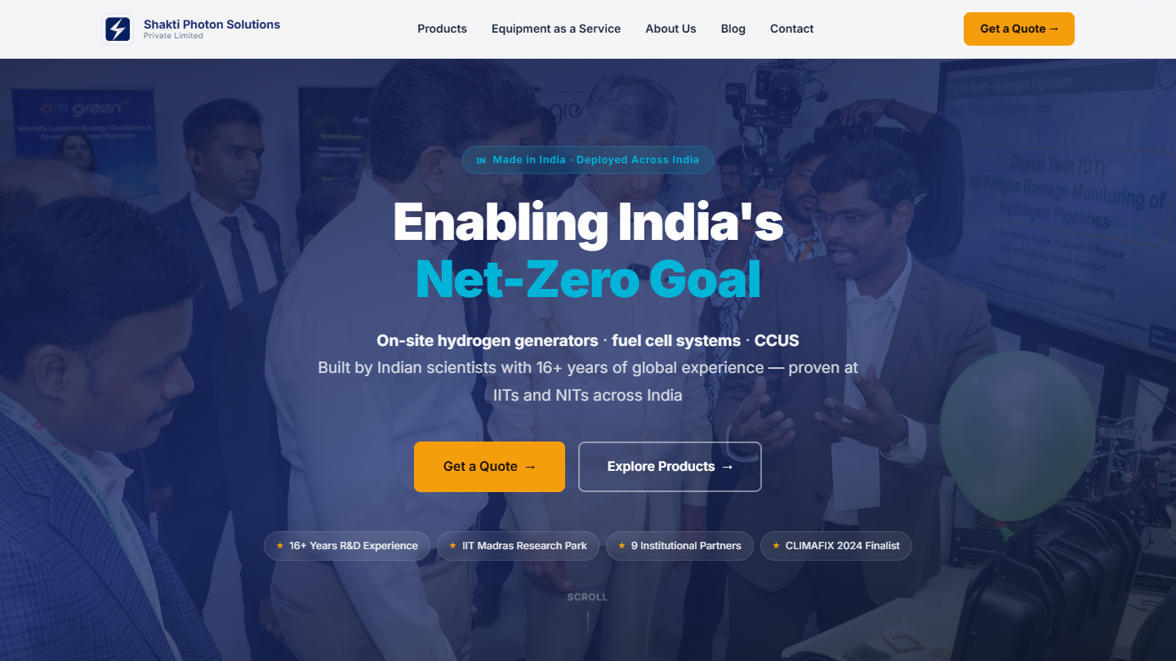
PAGE 1 OF 7
Homepage — Hero + Stats
First impression: brand story, trust signals, 3-click enquiry
🏠 Homepage / Hero
✅ Headline: 'Enabling India's Net-Zero Goal' ✅ Tagline: 'On-site hydrogen generators · fuel cell systems · CCUS' ✅ Stats: 16+ years R&D, 9+ institutions, 0.01–100kW ✅ Dual CTA: 'Explore Products' + 'Get a Quote' ✅ Scroll reveal animations
🔗 View Live →
👆 Click to open in browser · Add comment on this slide if any text needs changing

Slide 5
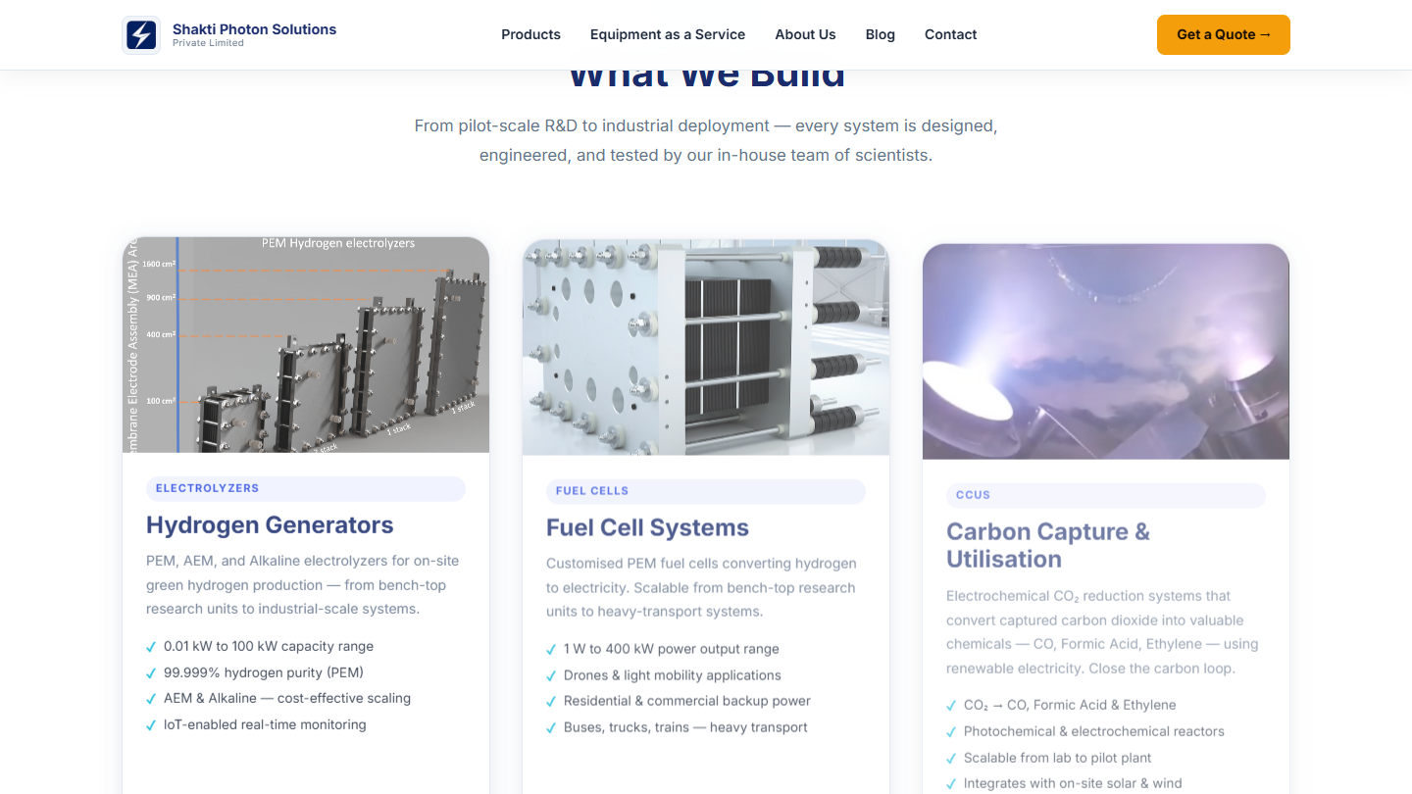
PAGE 1 OF 7
Homepage — What We Build
Product families with individual enquiry buttons
⚗️ What We Build
Products shown: • Hydrogen Generators (PEM/AEM/Alkaline) • Fuel Cell Systems • CCUS Systems • Photochemical Reactor • MEA Manufacturing Each card has: • 'Enquire →' button → popup modal • Pre-filled product name in form • Confetti on successful submission
🔗 View Live →
👆 Click to open in browser · Add comment on this slide if any text needs changing

Slide 6
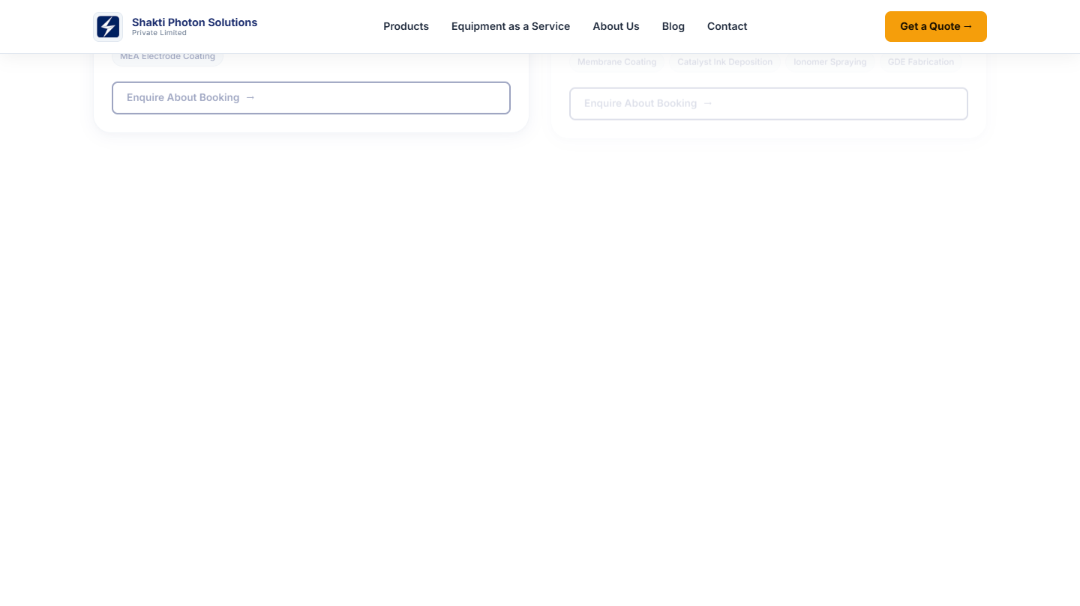
SEO / GEO
Homepage — FAQ Section (GEO Strategy)
AI assistants (ChatGPT, Perplexity, Gemini) will cite these answers
🔍 FAQ — GEO Schema
Why this matters: When someone asks ChatGPT or Google 'green hydrogen company India' — our FAQ answers are what the AI reads. Keywords targeted: • 'green hydrogen company India' • 'PEM electrolyzer India' • 'CCUS India' • 'MEA manufacturer India' • 'net zero enabler India' • 'carbon capture company India' 10 Q&As in JSON-LD schema (invisible to humans, read by AI crawlers)
🔗 View Live →
👆 Click to open in browser · Add comment on this slide if any text needs changing

Slide 7
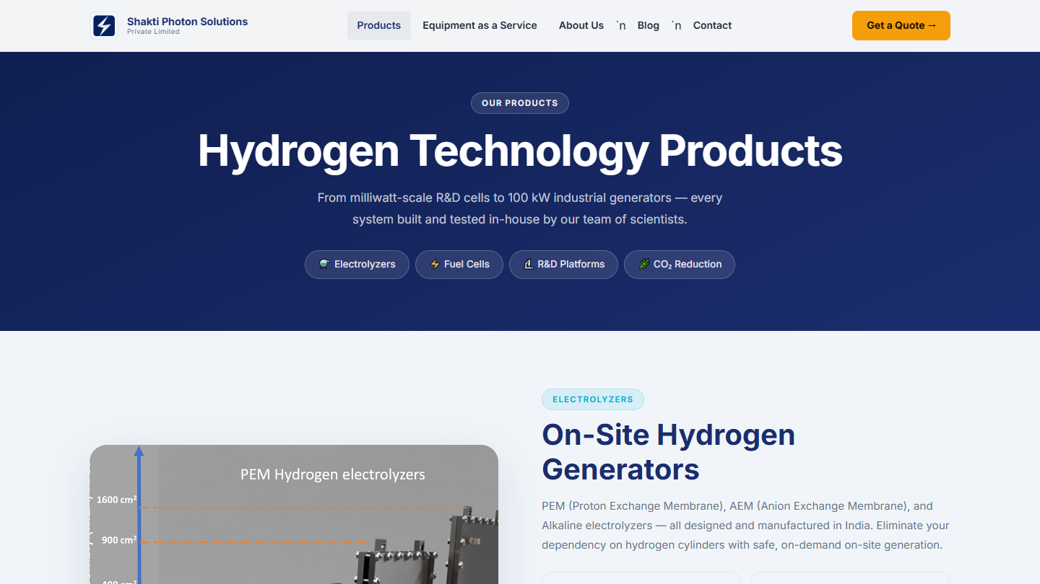
PAGE 2 OF 7
Products Page
Detailed specs, tech comparison, and individual product enquiry
🧪 Products Page
Products listed: • PEM Electrolyzer (0.01–100kW) • AEM Electrolyzer • Alkaline Electrolyzer • Fuel Cell Systems (1W–400kW) • CCUS / CO₂ Reduction Systems • Photochemical Reactor • MEA Manufacturing Each product: • Tech specs • Applications • 'Enquire' button → pre-filled modal
🔗 View Products Page →
👆 Click to open in browser · Add comment on this slide if any text needs changing

Slide 8
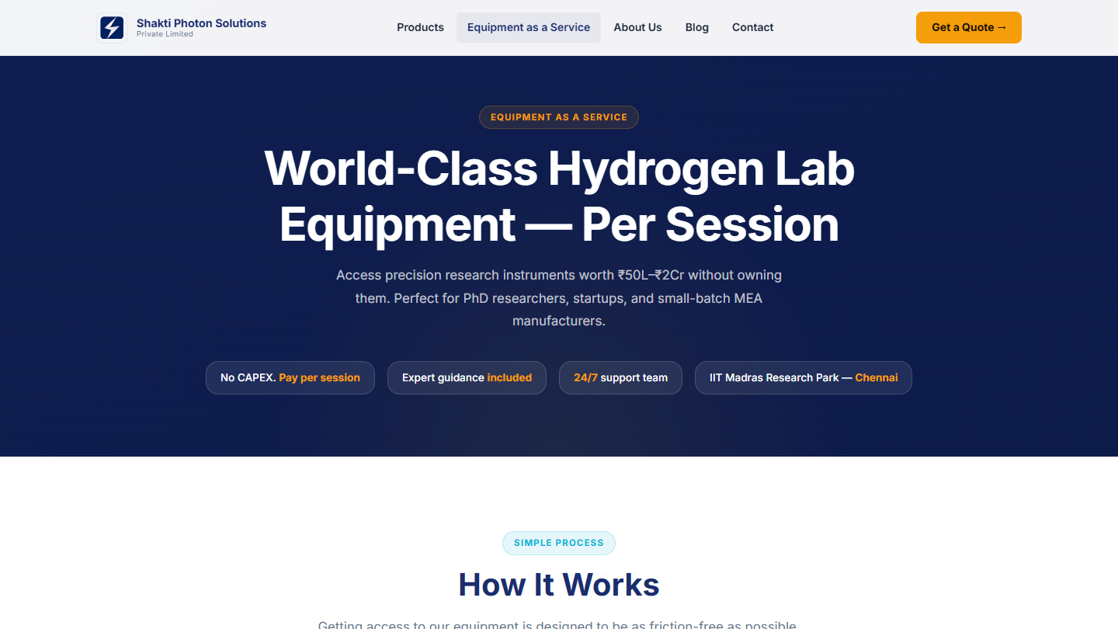
PAGE 3 OF 7
Equipment as a Service (EaaS)
Access ₹1Cr+ lab equipment by the session — no purchase needed
🔬 EaaS Page
Equipment offered: • RF Magnetron Sputtering (thin film deposition) • Ultrasonic Spray Nozzle (catalyst/MEA coating) • Hot Press (MEA bonding) • 3D Printing (prototyping) Target users: • PhD researchers at IITs/NITs • Hydrogen startups • Industry R&D teams Enquiry button on each card → pre-filled with equipment name
🔗 View EaaS Page →
👆 Click to open in browser · Add comment on this slide if any text needs changing

Slide 9
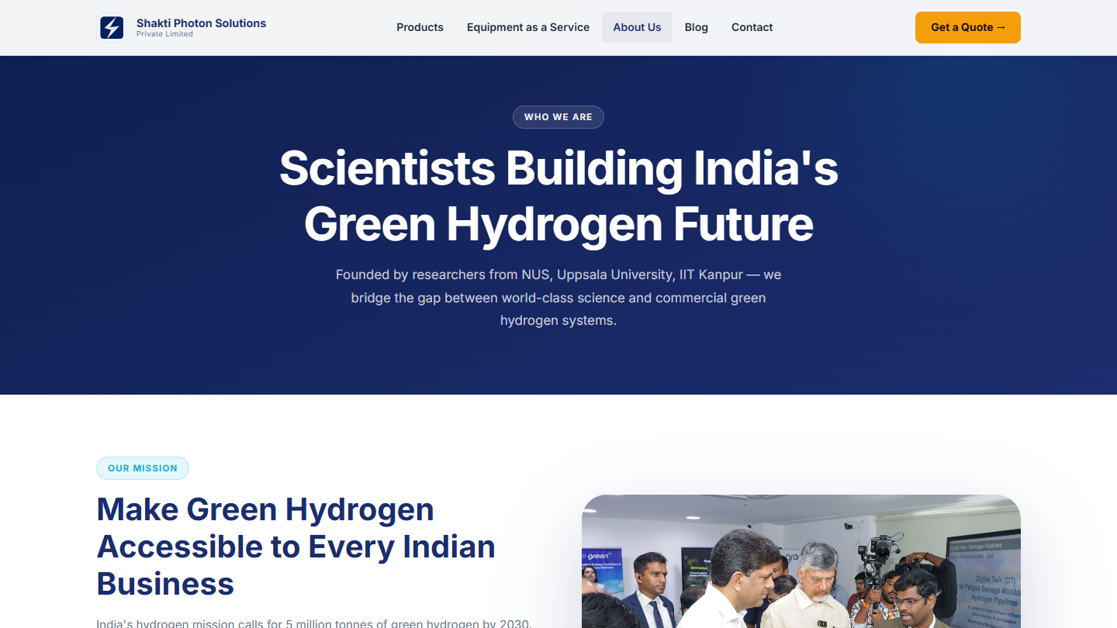
PAGE 4 OF 7
About Us Page
Founder stories, credentials, and institutional partnerships
👥 About Us Page
Sections: • Founder profiles with photos • Academic credentials (NUS Singapore, Uppsala, IIT Kanpur — 16+ years R&D) • 60+ publications • Company story & mission • Offices: – Chennai (IIT Madras R-Park) – Guntur (SRM AP University) Builds trust with enterprise buyers & government clients
🔗 View About Page →
👆 Click to open in browser · Add comment on this slide if any text needs changing

Slide 10
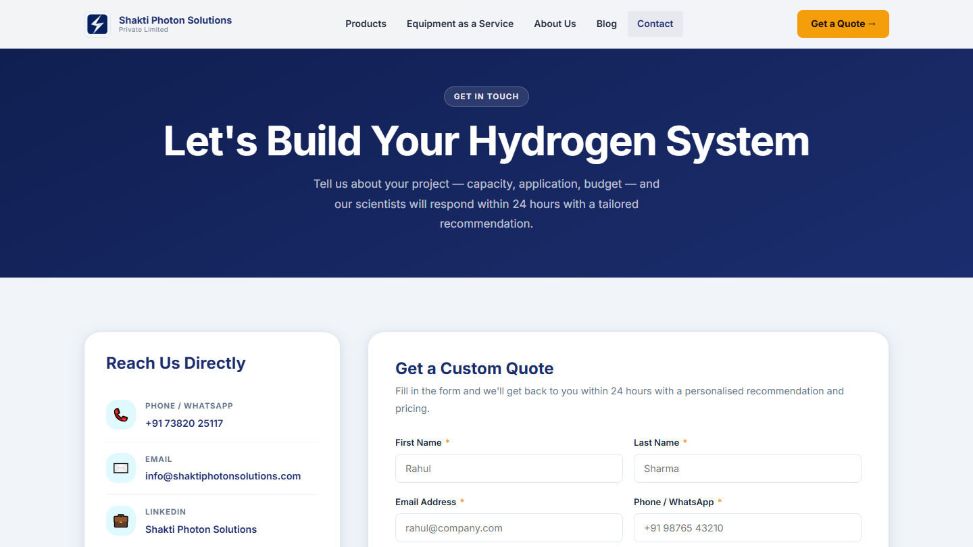
PAGE 5 OF 7
Contact Page
Three paths to contact — form, WhatsApp, and phone. Within 3 clicks from anywhere.
📞 Contact Page
Contact channels: • Web form → Formspree (auto email notification) • WhatsApp: +91 73820 25117 • Email: info@shakti... Enquiry modal (from product pages) also submits to same Formspree endpoint with the product name pre-filled. Office addresses: • Chennai — IIT Madras R-Park • Guntur — SRM AP University
🔗 View Contact Page →
👆 Click to open in browser · Add comment on this slide if any text needs changing

Slide 11
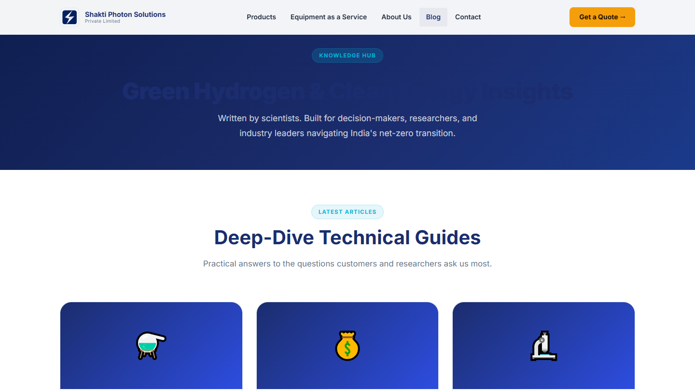
PAGE 6 OF 7
Blog — Knowledge Hub
5 deep-dive articles targeting the keywords customers actually search
📝 Blog / Knowledge Hub
5 articles published: 1. PEM vs AEM vs Alkaline Electrolyzer (India) 2. Hydrogen Generator Cost in India 2026 3. EaaS for Hydrogen Research 4. CCUS in India — CO₂ to Chemicals 5. Fuel Cell Systems India Each: 800–1200 words, Article JSON-LD, enquiry CTA
🔗 View Blog →
👆 Click to open in browser · Add comment on this slide if any text needs changing

Slide 12
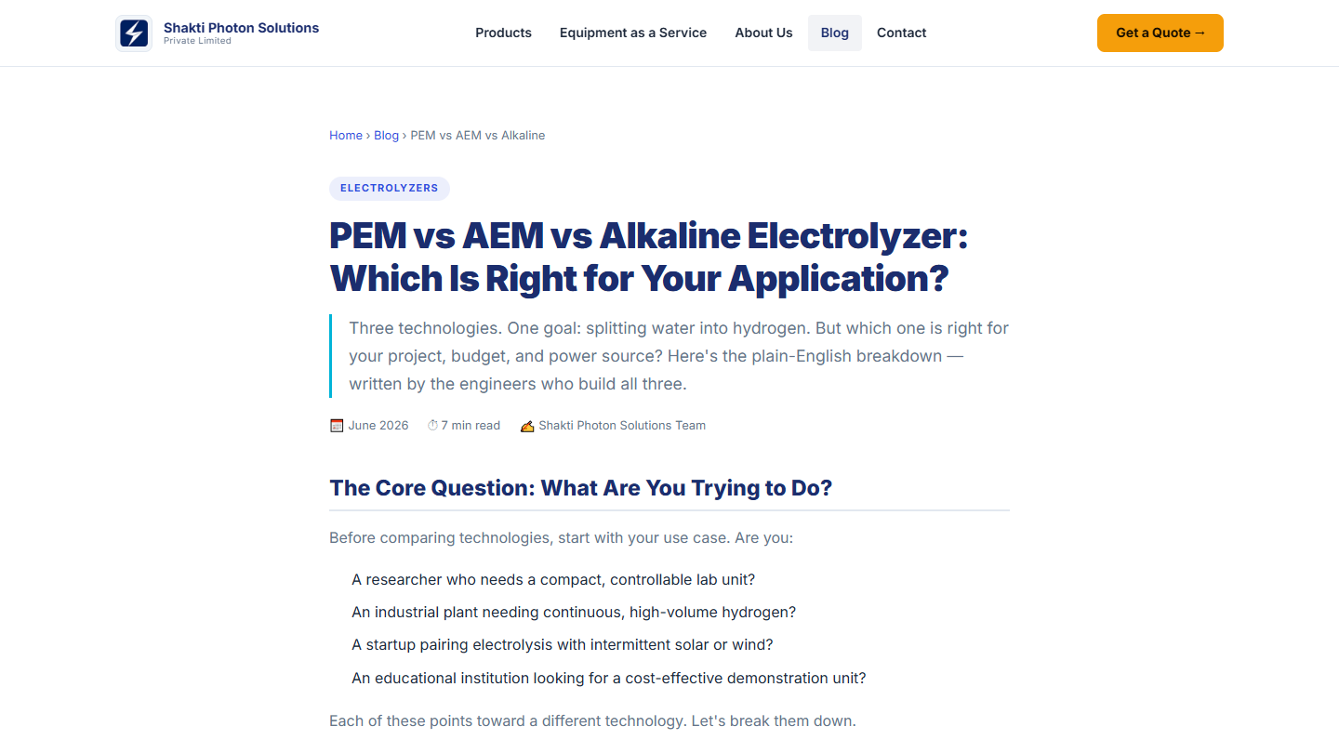
PAGE 7 OF 7
Sample Article — PEM vs AEM vs Alkaline
Technical depth that earns trust and Google/AI visibility
📄 Article Structure
Every article has: • Breadcrumb navigation • Article JSON-LD schema (author, date, headline) • Keyword-rich H1/H2/H3 • Comparison tables • Callout boxes (tips, info) • In-article enquiry CTA with WhatsApp button • Related articles sidebar Articles are written factually — team should review for technical accuracy.
🔗 View Article →
Add slide comment for technical corrections needed

Slide 13
TECHNICAL STRATEGY
SEO / GEO Architecture — How We Get Found
Three-layer strategy: meta → schema → content
Layer 1 Meta & Keywords
Layer 2 Structured Data (JSON-LD)
Layer 3 Content / Articles
• <meta keywords> with 19 target terms • <meta description> mentions CCUS, MEA, net zero, carbon capture • Open Graph for LinkedIn sharing • Twitter Card for social previews
• Organization schema (who we are) • FAQPage schema (10 Q&As) • Article schema on each blog post • Visible microdata (itemscope) → AI assistants read these directly
• 5 technical articles (800–1200 words) • Each targets a commercial keyword • Internal linking between articles • Sitemap updated (11 URLs) → Topical authority over 3–6 months

Slide 14
INFRASTRUCTURE
Technical Stack & Infrastructure
Fast, free, and fully owned — no platform dependency
Frontend
Bundler / Dev
HTML5 · CSS3 (vanilla) · JavaScript (ES modules)
Vite 5 — instant hot-reload in development
No framework lock-in. Any developer can edit.
Build output: optimised HTML/CSS/JS for production.
Hosting
Forms
Vercel — free tier, global CDN, auto-deploy from Git
Formspree — receives enquiry form submissions by email
URL: shakti-photon-solutions.vercel.app
No backend server needed. Upgrade to Supabase ready.
Version Control
Domain (pending)
Git + GitHub — full history, every change tracked
shaktiphotonsolutions.com — DNS to be pointed to Vercel
AI documentation: PROJECT.md, DECISIONS.md, CHANGELOG.md
After team review and approval of the new site.

Slide 15
NEXT STEPS
What We Need From You
📋 Review the articles
🔗 Review the website live
Check technical accuracy of the 5 blog articles. Add slide comments for corrections needed. Specially: price ranges in 'Hydrogen Generator Cost India' article.
Click each page link on slides 4–12. Test the enquiry modal on any product. Test WhatsApp button — does it pre-fill correctly?
🌐 DNS Migration (when ready)
✍️ New FAQ suggestions
When team is satisfied, point shaktiphotonsolutions.com DNS to Vercel. We will walk you through the NameCheap steps. Estimated: < 1 hour to go live on custom domain.
What questions do customers ask on WhatsApp or at demos? Send them to the engineer — we add new FAQ cards to the website and the AI schema within 24 hours.
🔗 Live site: shakti-photon-solutions.vercel.app

