Slide 1

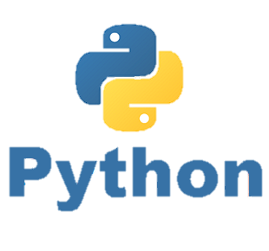


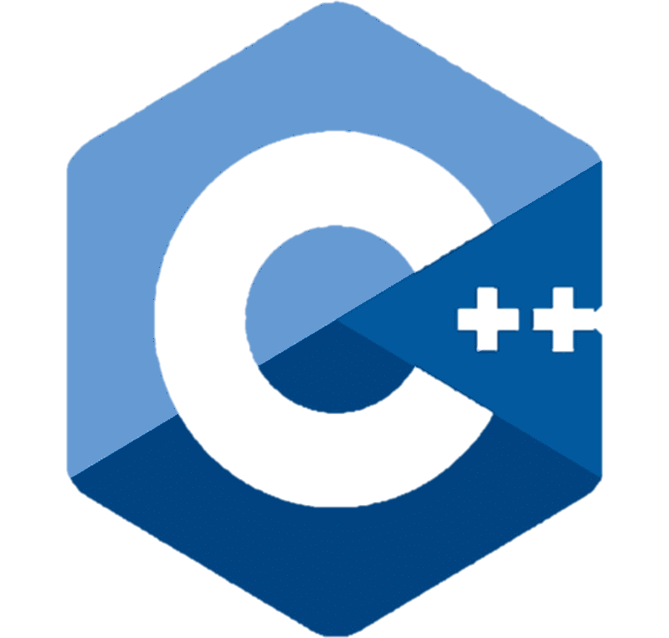
Object Oriented Programming (OOP)
Lecture 1 - Introduction

Slide 2
Course Outline & Details
Outlined by Alfa Prima (AP) Denpasar, see excel file.
Course | : | OOP Programming
Time | : | Thursday 17.00 pm – 18.45 pm
Room |  | Lab 2
Instructor/ Lecturer | : | P E D Putra, M. Si. M. Eng. https://www.linkedin.com/in/p-e-d-putra-7802a5104/ https://research-pedputra.github.io/main/index.html
Assessment | : | Attendance, Full
 |  | Assignment, 30 %
 |  | Mid-Sem (UTS), 40 %
 |  | Final-Sem (UAS), 40 %
 |  | Additional rules, skip-class means -5 from final score*
Lecture |  | 70 % Practice + 30 % Theory

Slide 3
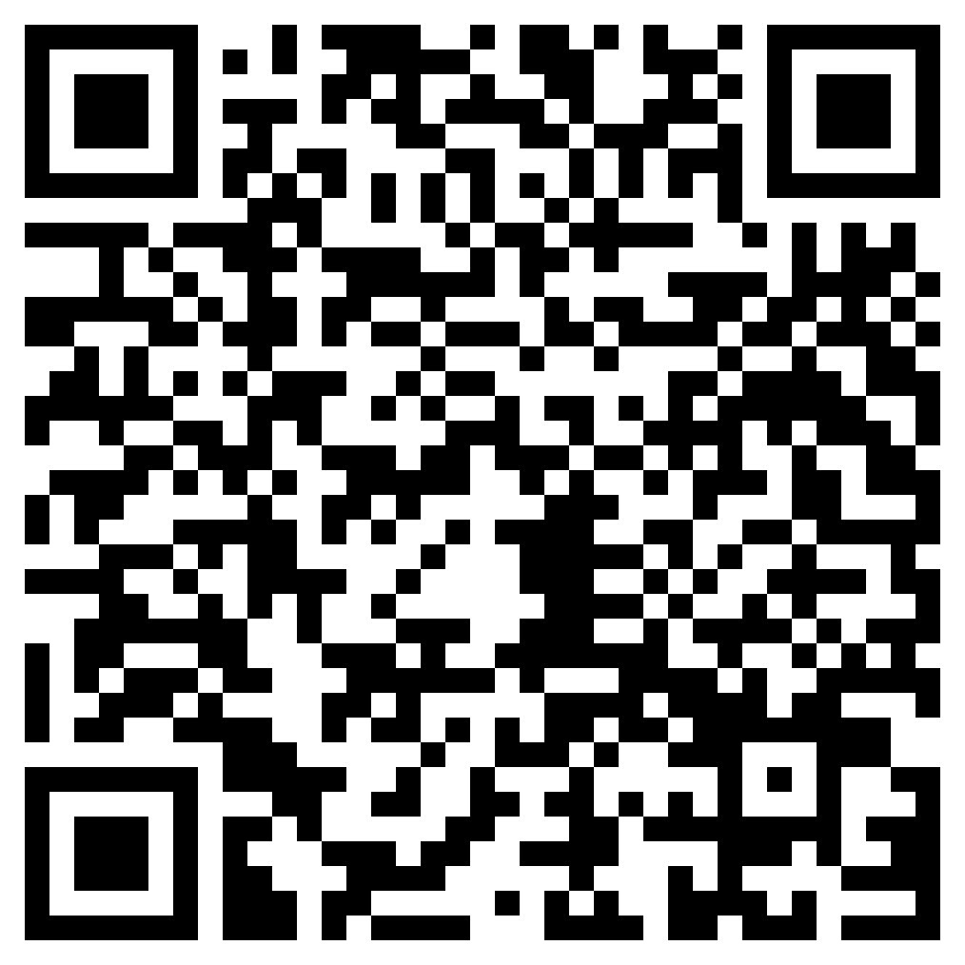
Resources
Phillips, Dusty. Python 3 Object-oriented Programming: Building Robust and Maintainable Software with Object-oriented Design Patterns in Python. Packt Publishing Ltd, 2015.
Craig, Iain D. Object-Oriented Programming Languages: Interpretation. Springer. 2007
Matthes, Eric. Python Crash Course, 3rd Edition. No Starch Press, 2023
Feel free to download, scan me

Slide 4
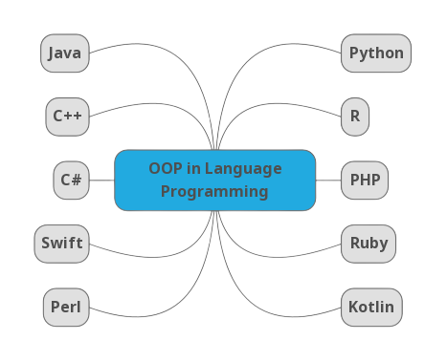
A glance of OOP

Slide 5




Python as a Programming Language
Spyder
Jupyter notebook
Jupyter lab
Google colabs (Jupyter in google)

Slide 6
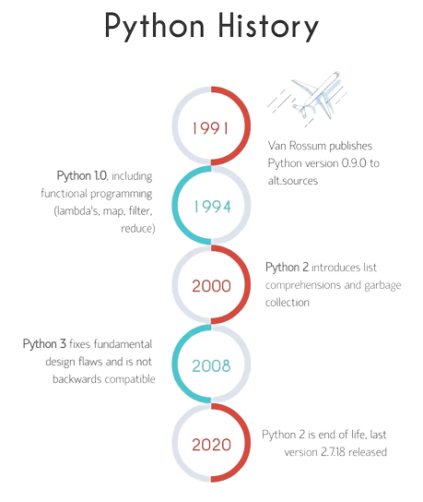
Python as a Programming Language
We are here,
most updated

Slide 7
Python as a Programming Language
Software Interfaces
Spyder
Jupyter notebook
Jupyter lab
Google colabs (Jupyter in google)
Installing Python, see jupyter notebook file.

Slide 8
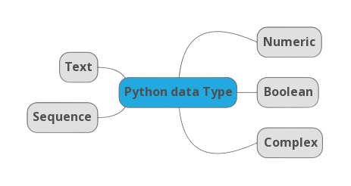
Python Data Structures
Numeric Types:
int: Represents integers, such as 5, -3, and 0.
float: Represents floating-point numbers, including decimal values like 3.14.
Text Type:
str: Represents strings of characters, such as "Hello, World!".
Boolean Type:
bool: Represents boolean values, which can be either True or False.
Sequence Types:
list: Represents ordered and mutable (changeable) sequences of elements.
tuple: Represents ordered and immutable (unchangeable) sequences.
range: Represents a sequence of numbers.
Complex Types:
real + imaginary: Normally starts with cobination of "int" and "str", where the "str" part represent the imaginary while the "int" represent the real number.. etc.

Slide 9
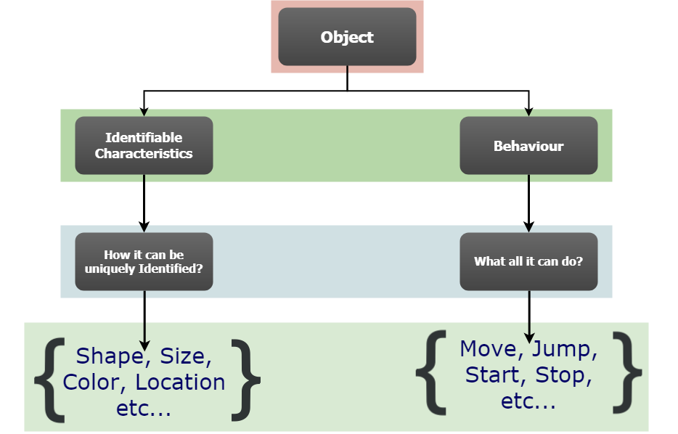
Introduction Object Oriented
Object is a collection of data (identifiable, measurable) and associated behaviors
Object-oriented means functionally directed towards modeling objects.

Slide 10
Object, Class, Attribute, and Methods
Python supports many kinds of data
[1,2,3,4,.. ]………… 3.14…………. “Hello World”
Each of it is an object, and every object has:
Type
Data representation
A set of procedure for interaction with the object
An object is an instance of a type
1234 is an instance of an int (integer)
“Hello" is an instance of a string
Example:
L = [1,2,3,4,5]
Data type = List
How to manipulate?
L[i]
L[i:j]
+, -, x (*), : (/)

Slide 11
Object, Class, Attribute, and Methods
Class:
A Class can be defined as a user-defined prototype for an object that defines a set of attributes that characterize any object of class. The attributes are data members and methods, accessed via dot method.
Make a distinction between creating a class and using an instance of the class
creating the class involves
defining the class name
defining class attributes
using the class involves
creating new instances of objects
doing operations on the instances
for example, L=[1,2] and len(L)
class volume():
# Attributes here
…………………………………

Slide 12
Object, Class, Attribute, and Methods
Attributes:
Data and procedures that “belong” to the class
Data attributes
Think of data as other objects that make up the class •
for example, a coordinate is made up of two numbers
Methods (procedural attributes)
Like a function that works only with this class
Think of methods as functions that only work with this class
How to interact with the object

Slide 13
Defining a class
What data initializes Coordinate object
class Coordinate(object):
def __init__(self, x, y):
self.x = x
self.y = y
Special methods to create an instance __ is double underscore
Parameter to refer to an instance of the class
Two data attribute for every coordinates object
Note on “self”
“Self” in Python is like the pointer “this” in C++. In Python, functions in class access data via “self”
“Self” in Python works as a variable of function but it won’t invoke data.

Slide 14
Define a Method for The Coordinate Class
Use it to refers to any instances
class Coordinate(object):
def __init__(self, x, y):
self.x = x
self.y = y
def distance(self, other):
x_diff = (self.x-other.x)**2
y_diff = (self.y-other.y)**2
return (x_diff + y_diff )**0.5
Another parameter to the method
Methods behave just like functions (take params, do operations, return)

Slide 15
How to use a Method?
def distance(self, other):
# code here
This is the method def
Using the class:
Conventional way
c = Coordinate(3,4)
zero = Coordinate(0,0)
print(c.distance(zero))
Equivalent to
c = Coordinate(3,4)
zero = Coordinate(0,0) print(Coordinate.distance(c, zero))
Object to call method on
Parameters not including self
(self implied to be c)
Name of class
Parameters including an object to call the method on, representing self
Name of method
Name of method

Slide 16
Print representation of an object
>>> print(c)
This simply print the object data
>>> print(f”The coordinate is {c}”)
Format the string to be printed
Format the string to be printed
Place holder of c.
It indicates that the value of the variable c should be inserted into the string at that location.

Slide 17

Special Operators
+, -, ==, , len(), print, and many others
Check here for details
https://docs.python.org/3/reference/datamodel.html#basic-customization
define them with double underscores before/after
__add__(self, other) self + other
__sub__(self, other) self - other
__eq__(self, other) self == other
__lt__(self, other) self < other
__len__(self) len(self)
__str__(self) print self

Slide 18
Encapsulation – Protection and/or Private
class Person:
def __init__ (self):
self.A = 'Jokowi dodo'
self.__B = 'Ganjar Pranowo'
def PrintName (self):
print(self.A)
print(self.__B)
P = Person()
If we do
print(P.A)
>> Jokowidodo
If we do
print(P.__B)
>> AttributeError: 'Person' object has no attribute '__B'
We should do
print(P.PrintName)
>> Jokowi dodo
Ganjar Pranowo

Slide 19
Exercise
class Item:
pay_rate = 0.8
def __init__(self, name, price, quantity):
self.name = name
self.price = price
self.quantity = quantity
def total_price(self):
return self.price * self.quantity
def discount(self):
self.price = self.price * Item.pay_rate
item1 = Item("Iphone", 100, 5)
item1.discount()
item2 = Item("Samsung", 200, 5)
print(f'Total price of {item1.name} is {item1.price}' )

Slide 20
Exercise
Fix the incomplete line code below!
class Triangle:
def __init__(self, a, b, c):
# write code here
pass
# write code here
t1 = Triangle(3, 4, 5)
# write code here

Slide 21
Exercise
Fix the incomplete line code below!
class Triangle:
def __init__(self, a, b, c):
# write code here
pass
# write code here
t1 = Triangle(3, 4, 5)
# write code here
class Triangle:
def __init__(self, a, b, c):
self.a = a
self.b = b
self.c = c
def get_perimeter(self):
perimeter = self.a + self.b + self.c
return perimeter
t1 = Triangle(3, 4, 5)
perimeter = t1.get_perimeter()
print("The perimeter of the t1 triangle is", perimeter)

Slide 22
Exercise
Complete the code below so that it can print 10 names instead of one name!
Employee = "Eka"
def eat():
print("{} is eating pizza".format(Employee))
>>> Eka is eating pizza

Slide 23
Exercise
Complete the code below so that it can print 10 names instead of one name!
class Employee:
def __init__(self, name):
self.name = name
def eat(self):
print("{} is eating pizza".format(self.name))
Employees_name = ["Putu", "Kadek", "Koming", "Ketut"]
employees = [Employee(name) for name in Employees_name]
for employee in employees:
employee.eat()
Employee = "Eka"
def eat():
print("{} is eating pizza".format(Employee))
>>> Eka is eating pizza

Slide 24
Conclusion
Object Oriented Programming (OOP) in Python is a programming paradigm that revolves around the concept of objects. It is a way of structuring and organizing code that emphasizes the creation of reusable and modular components.
Object, Class, Attribute, and Methods are essential component in constructing a line codes programming.
Through OOP, the protection can be well implemented. This will be limiting the access to the data with a clear line code management.

