Slide 1




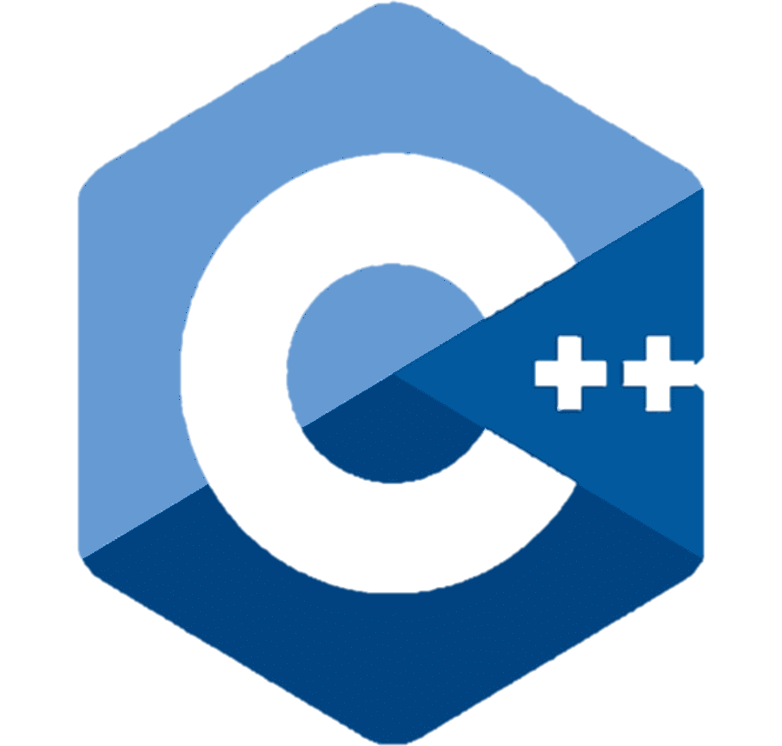
Object Oriented Programming (OOP)
P E D Putra, M.Si.
Lecture 1 - Introduction

Slide 2
Course Outline & Details
Outlined by Alfa Prima (AP) Denpasar, see excel file.
Course | : | OOP Programming
Time | : | Thursday 17.00 pm – 18.45 pm
Room |  | Lab 2
Instructor/ Lecturer | : | P E D Putra, M. Si. M. Eng. https://www.linkedin.com/in/p-e-d-putra-7802a5104/ https://research-pedputra.github.io/main/index.html
Assessment | : | Attendance, Full
 |  | Assignment, 30 %
 |  | Mid-Sem (UTS), 40 %
 |  | Final-Sem (UAS), 40 %
 |  | Additional rules, skip-class means -5 from final score*
Lecture |  | 70 % Practice + 30 % Theory

Slide 3

Resources
Phillips, Dusty. Python 3 Object-oriented Programming: Building Robust and Maintainable Software with Object-oriented Design Patterns in Python. Packt Publishing Ltd, 2015.
Craig, Iain D. Object-Oriented Programming Languages: Interpretation. Springer. 2007
Matthes, Eric. Python Crash Course, 3rd Edition. No Starch Press, 2023
Feel free to download, scan me

Slide 4
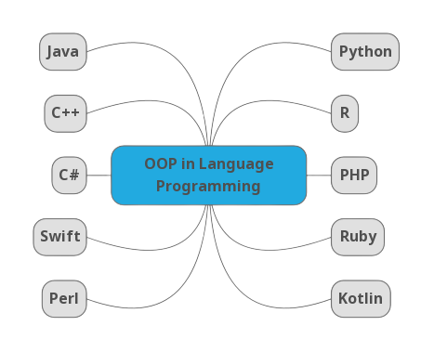
A glance of OOP

Slide 5




Python as a Programming Language
Spyder
Jupyter notebook
Jupyter lab
Google colabs (Jupyter in google)

Slide 6
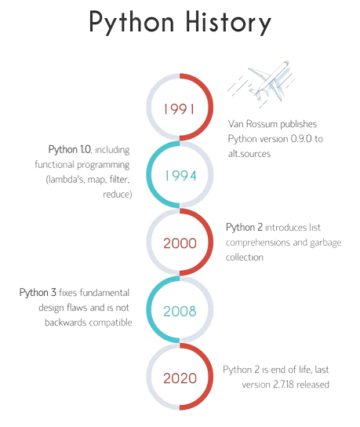
Python as a Programming Language
We are here,
most updated

Slide 7
Python as a Programming Language
Software Interfaces
Spyder
Jupyter notebook
Jupyter lab
Google colabs (Jupyter in google)
Installing Python, see jupyter notebook file.

Slide 8
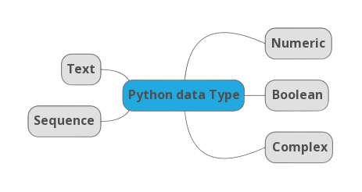
Python Data Structures
Numeric Types:
int: Represents integers, such as 5, -3, and 0.
float: Represents floating-point numbers, including decimal values like 3.14.
Text Type:
str: Represents strings of characters, such as "Hello, World!".
Boolean Type:
bool: Represents boolean values, which can be either True or False.
Sequence Types:
list: Represents ordered and mutable (changeable) sequences of elements.
tuple: Represents ordered and immutable (unchangeable) sequences.
range: Represents a sequence of numbers.
Complex Types:
real + imaginary: Normally starts with cobination of "int" and "str", where the "str" part represent the imaginary while the "int" represent the real number.. etc.

Slide 9

Time to rock
Move to Jupyter-notebook

