Slide 1

List Comprehensions
P E D Putra, M.Si.
Lecture 2 – Fundamental concept, Looping

Slide 2
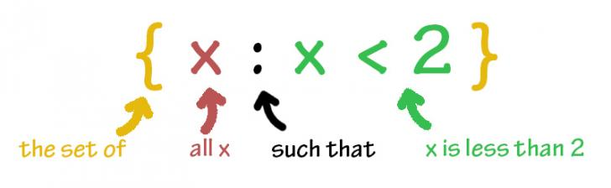
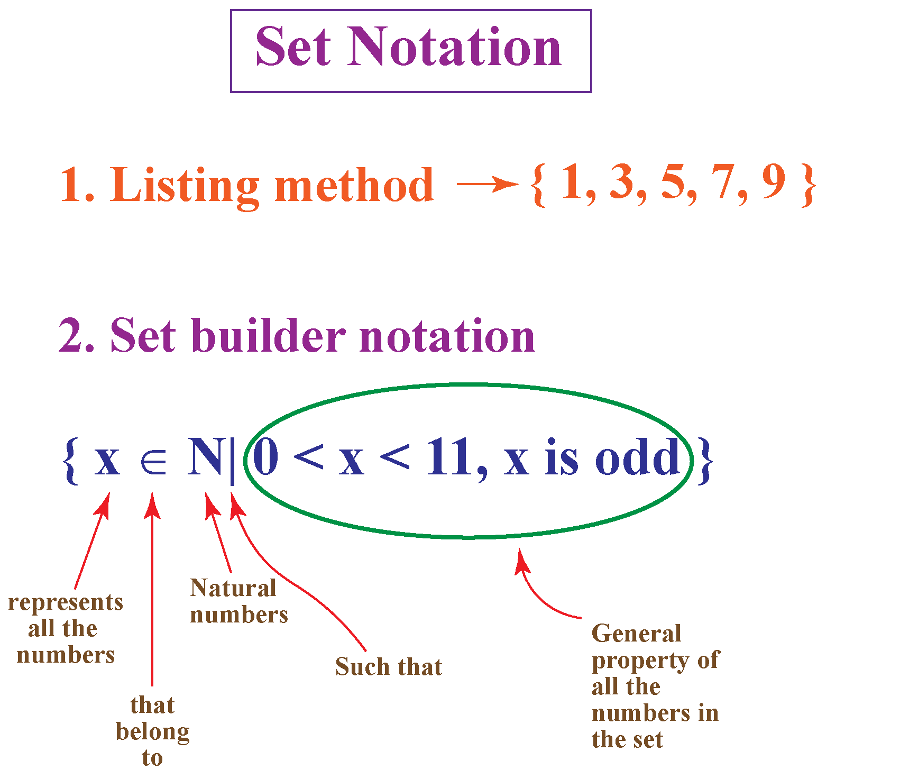
List Comprehensions
A list comprehension is a programming language construct for creating a list based on existing lists.
WHY DO WE NEED COMPREHENSIONS?
Inspired by math’ s set comprehension notation for defining sets in terms of other sets.

Slide 3
List Comprehensions
Recall the concept of List data
>>>> Numbers = [1,2,3,4,5,6,7]
>>>> print(type(Numbers))
Output:
< class ‘list’ >
>>>> Numbers = [1,2,3,4,5,6,7]
>>>> Numbers.append(11)
>>>> print(Numbers)
Output:
[1,2,3,4,5,6,7,8,9,10,11]
Then what if we need to create a square numbers from an existing list?
Looping
Repeating an element based on the requested expression.

Slide 4
List Comprehensions
Syntax
expression for item in list
Where expression is some calculation or operation acting upon the variable item.
For each member of the list, the list comprehension
1. sets item equal to that member,
2. calculates a new value using expression
It then collects these new values into a list which is the return value of the list comprehension.

Slide 5

List Comprehensions
A square numbers from a list data
>>>> Numbers = [1,2,3,4,5,6,7]
>>>> for i in Numbers:
print(i**2)
Output:
1,4,9,16,25,36,49
Start
Actions
Syntax
Conditions
TRUE
expression for item in list
FALSE
Fig. 1. Concept of looping
>>>> Numbers = [1,2,3,4,5,6,7]
>>>> New = [i**2 for i in range Numbers]
print(New)
Output:
1,4,9,16,25,36,49

Slide 6
List Comprehensions
Syntax
expression for item in list
If list contains elements of different types, then expression must operate correctly on the types of all of list members.
If the elements of list are other containers, then item can consist of a container of items matching the type and “shape” of the list members.
>>>> li = [(‘ a ’ , 1), (‘b’, 2), (‘ c ’, 7)]
>>>> new_data = [ n * 3 for (x, n) in li]
>>>> print(New_data)
Output:
[3, 6, 21]

Slide 7
List Comprehensions
Creating a list of odd number
In
we can do
>>>> data = [ (i+(1+i)) for i in range(6) ]
>>>> print(data)
Output:
[1,3,5,7,9,11]
Concept!
Numbers = Number + (1+Number)
Indexing numbers start from 0,1,2,3,4,5,6,…………….
Numbers = 0 + (1+0)
Numbers = 1 + (1+1)
Numbers = 2 + (1+2)
Numbers = 3 + (1+3)
Numbers = 4 + (1+4)
Numbers = 5 + (1+5)
Numbers = 6 + (1+6)
What if we use
data = [2*i+1 for i in range(6)]
[1,3,5,7,9,11,13]
THE SAME

Slide 8
List Comprehensions
Slicing and editing a list via Looping
In
we can do
>>>> my_list = [“Kevin", “Jack", “Roxanne", “Vannie", “Jenny“, “Curtis”]
>>>> Newlist = [ ]
>>>> for item in my_list:
Newlist.append(item + “Jonas”)
>>>> print(Newlist)
Concept!
Data =[list,list,list,list]
Newlist = [ ]
for i in Data:
Newlist.append(i + “xxx”)
Compare to
my_list.append(Jonas)
Data list
Print
expressions
TRUE

Slide 9
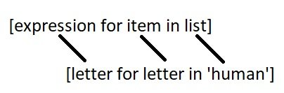
List Comprehensions
Iterating through a string Using List Comprehension
In
we can do
>>>> h_letters = [ letter for letter in 'human’ ]
>>>> print( h_letters)
Output:
[‘h’, ‘u’, ‘m’, ‘a’, ‘n’]
Concept!
Introducing the Lambda function
>>>> letters = list(map(lambda x: x, 'human’))
>>>> print(letters)
Output:
[‘h’, ‘u’, ‘m’, ‘a’, ‘n’]
In Python, a lambda function is a special type of function without the function name.

Slide 10
List Comprehensions
Iterating Using Nested List Comprehensions
Since list comprehensions take a list as input and produce a list as output, they are easily nested
>>> li = [3, 2, 4, 1]
>>> [elem*2 for elem in
[item+1 for item in li] ]
Output:
[8, 6, 10, 4]
The inner comprehension produces: [4, 3, 5, 2]
So, the outer one produces: [8, 6, 10, 4]

Slide 11
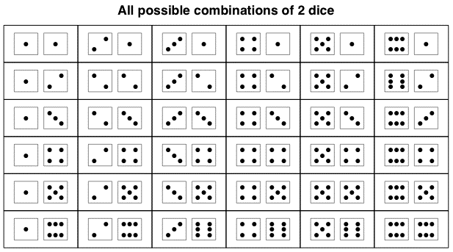
List Comprehensions
Dice rolls via loop
Consider we have a dice with 6 sides. Then the possible dice values we got is the combination between those numbers all together.
In python we can do
>>>> rolls = [ ]
>>>> for r1 in range(1,7):
for r2 in range(1,7):
rolls.append( (r1,r2) )
Output :
[(1, 1), (1, 2), (1, 3), (1, 4), (1, 5), (1, 6), (2, 1), (2, 2), (2, 3), (2, 4), (2, 5), (2, 6), (3, 1), (3, 2), (3, 3), (3, 4), (3, 5), (3, 6), (4, 1), (4, 2), (4, 3), (4, 4), (4, 5), (4, 6), (5, 1), (5, 2), (5, 3), (5, 4), (5, 5), (5, 6), (6, 1), (6, 2), (6, 3), (6, 4), (6, 5), (6, 6)]

Slide 12

Time to rock
Move to Jupyter-notebook

