Slide 1
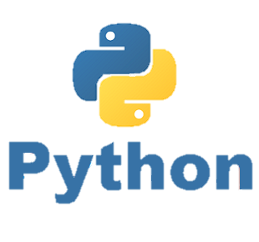
Functions
P E D Putra, M.Si.
Lecture 4 – The use of functions in python

Slide 2
Functions
Function: Equivalent to a static method in Java.
Syntax:
def name():
statement
statement
...
statement
Must be declared above the 'main' code
Statements, expression, actions inside the function must be indented
hello2.py
1 2 3 4 5 6 7 | # Prints a helpful message. def hello(): print("Hello, world!") # main (calls hello twice) hello() hello()

Slide 3
Functions
Function: Equivalent to a static method in Java.
Syntax:
def name():
statement
statement
...
statement
Python uses indentation to indicate blocks, instead of {}
Makes the code simpler and more readable
In Java, indenting is optional. In Python, you must indent.
hello3.py
1 2 3 4 5 6 7 8 | # Prints a helpful message. def hello(): print("Hello, world!") print("How are you?") # main (calls hello twice) hello() hello()
*** Note, uppercase and lowercase characters are distinct

Slide 4
Functions
Function: Equivalent to a static method in Java.
Syntax:
def name():
statement
statement
...
statement
Programming Challenge:
User Controlled Hollow Rectangle
**************
* *
* *
* *
* *
**************

Slide 5
Functions
Local Variables
Functions are like “mini programs”
We can create variables inside functions just as we would in the main program
>>> def bugs():
numbugs = int(input(‘How many bugs? ‘))
print (numbugs)
>>> bugs()
Output:
Variables that are defined inside of a function are considered “local” to that function.
Objects outside the “scope” of the function will not be able to access that variable

Slide 6
Functions
Passing an argument to a functions
It’s useful to not only call a function but also send it one or more pieces of data as an argument
This process is identical to what you’ve been doing with the built-in functions we have studied so far
x = random.randint(1,5) # send 2 integers
y = len(‘Obama’) # send 1 string
>>> def square(num):
print (num**2) # num assumes the value of the
# argument that is passed to
# the function (5)
>>> square(5)
Output:
25

Slide 7
Functions
Passing a multiple argument to a functions
The functions execute the block code “by positions”
>>> def average(num1, num2, num3):
sum = num1+num2+num3
avg = sum / 3 print (avg)
>>> average(100,90,92)
Output:
94
Multiple arguments represented by multiple variables; num1, num2, num3
We call “average(xxx,xxx,xxx)” to run the functions.
xxx with any numbers

Slide 8
Functions
Global Variables
When a variable is created outside all of your functions it is considered a “global variable”
It is located outside of the functions
>>> name = 'Obama’
>>> def showname():
print ("Function:", name)
print ("Main program:", name)
>>> showname()

Slide 9

Time to rock
Move to Jupyter-notebook

