Slide 1
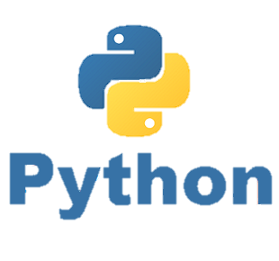
When to use OOPs
P E D Putra, M.Si.
Lecture 7 – Using OOPs in Python

Slide 2
Identifying Object, Attribute, Method, and Class
Look at the following class that determines a coordinate x and y
What data initializes Coordinate object
class Coordinate(object):
def __init__(self, x, y):
self.x = x
self.y = y
def distance(self, other):
x_diff = (self.x-other.x)**2
y_diff = (self.y-other.y)**2
return (x_diff + y_diff )**0.5
Parameter to refer to an instance of the class
Special methods to create an instance __ is double underscore
Another parameter to the method
Two data attribute for every coordinates object
Use it to refers to any instances

Slide 3
How to work with Class
c = Coordinate(3,4)
zero = Coordinate(0,0)
print(c.distance(zero))
Simply call the associated class by
Object to call method on
Parameters not including self
(self implied to be c)
Name of method
zero = Coordinate(0,0)
We start the measurement from reference (0,0)
Place holder of c.
It indicates that the value of the variable c should be inserted into the string at that location.
>>> print(f”The coordinate is {c}”)
Format the string to be printed
Format the string to be printed

Slide 4
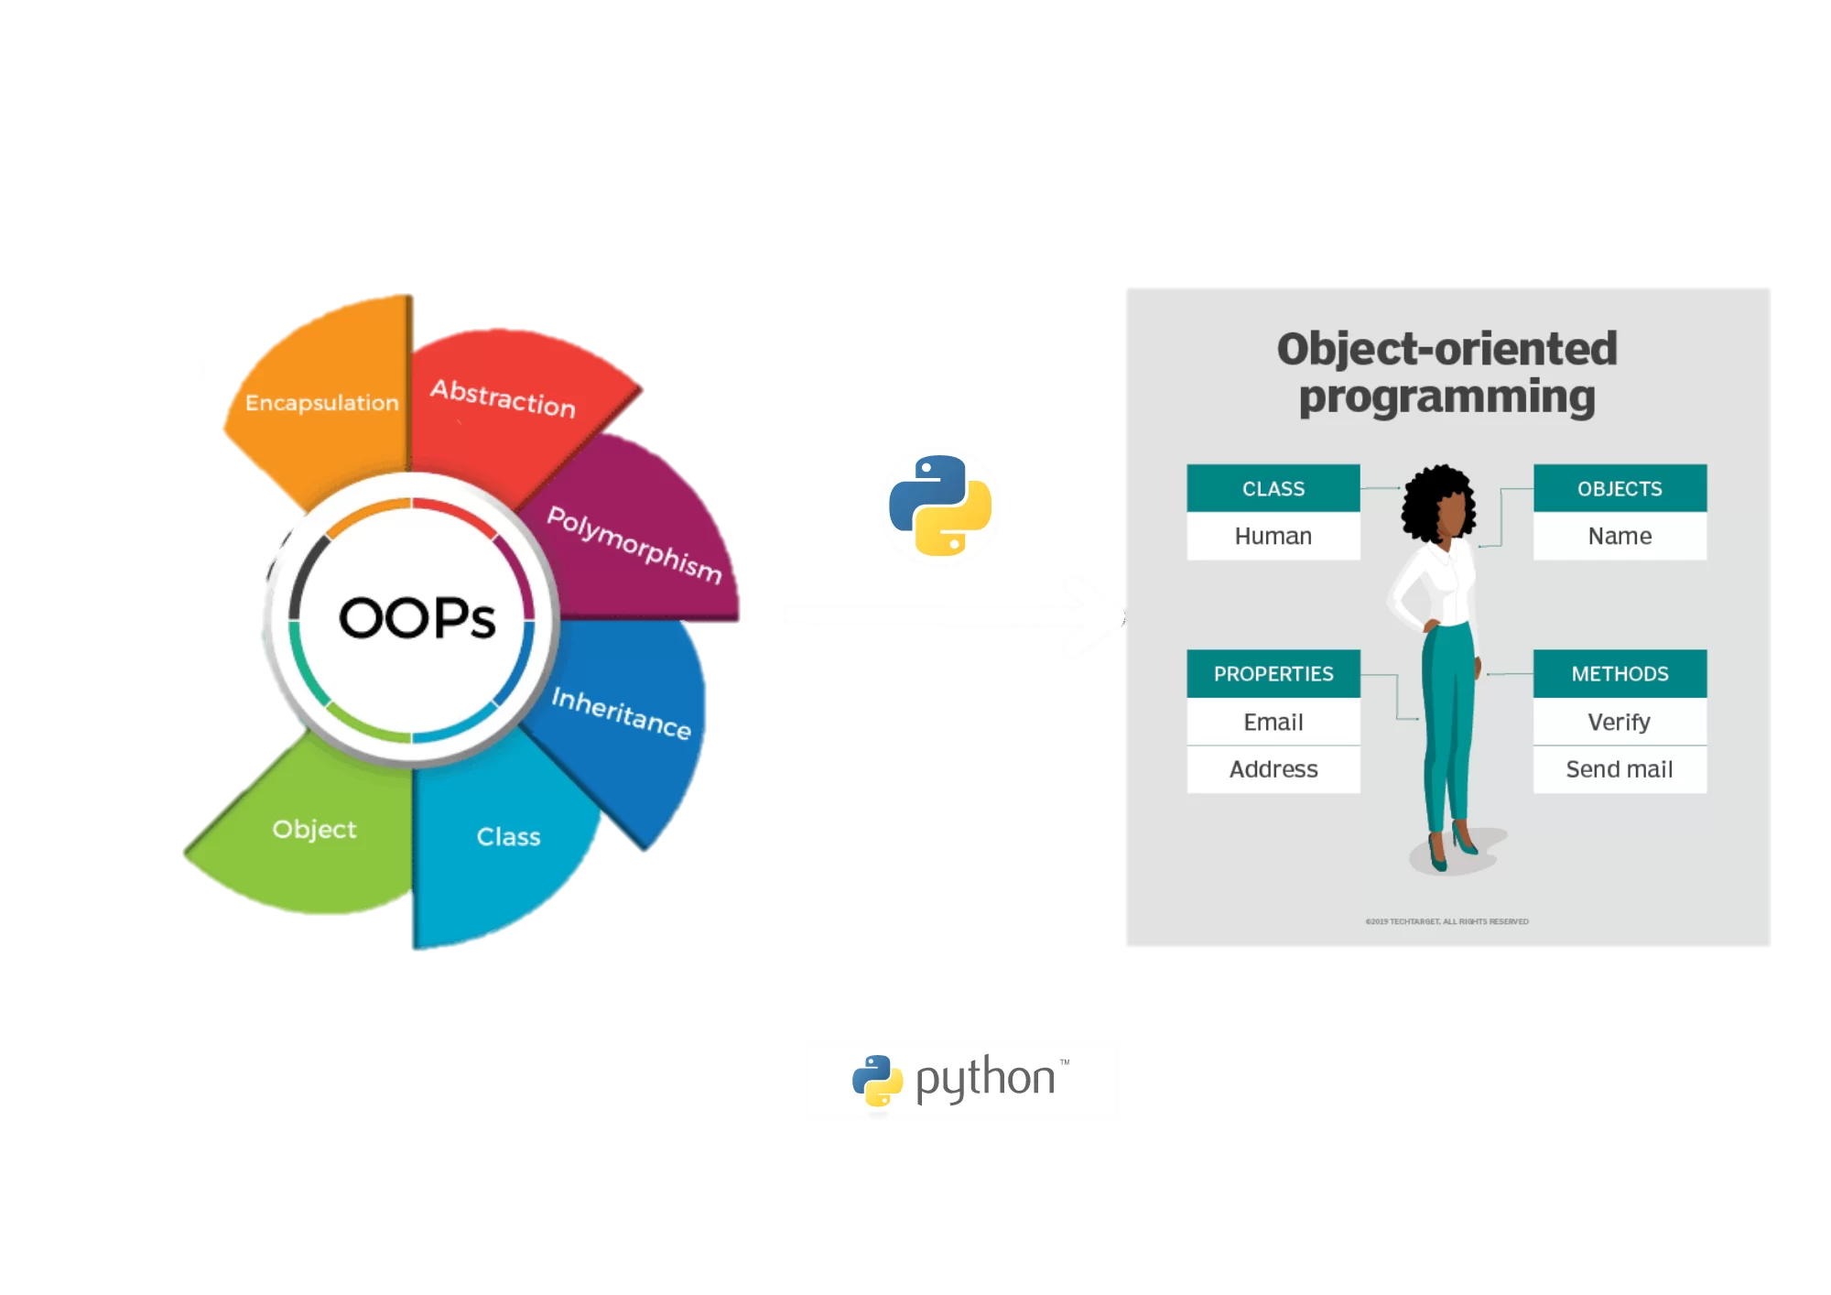
To build an OOPs
Object-Oriented Programming (OOP) is a programming paradigm or methodology that organizes and structures code using objects. An object is a self-contained unit that combines data (attributes or properties) and functions (methods) that operate on that data. OOP is based on several fundamental concepts:

Slide 5
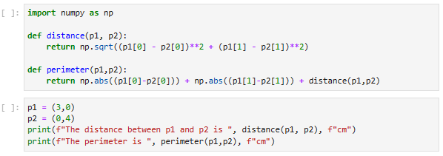
When to use OOP: Treating object as Object
Consider we have two coordinate p₁ and p₂. To measure the distance and its perimeter, we simply define the functions as follows:
Problems!!! We need to repeat the calling functions again and again …………..

Slide 6
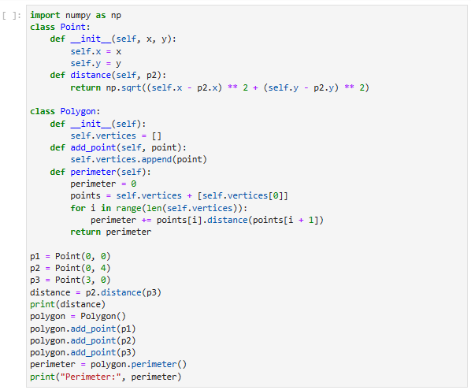
When to use OOP: Treating object as Object
In OOPs we can re-organized and simplify the code

Slide 7
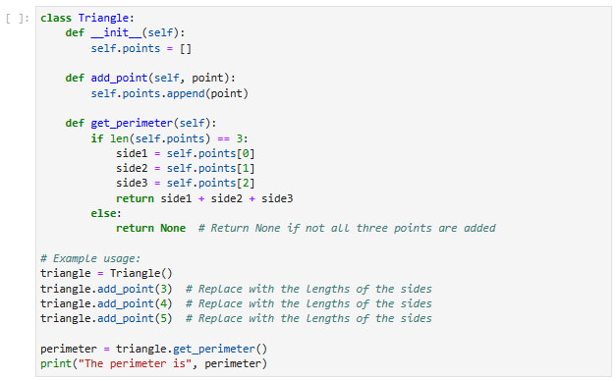
When to use OOP: Treating object as Object
OOPs made the task easier to be done
The first method
The second method

Slide 8
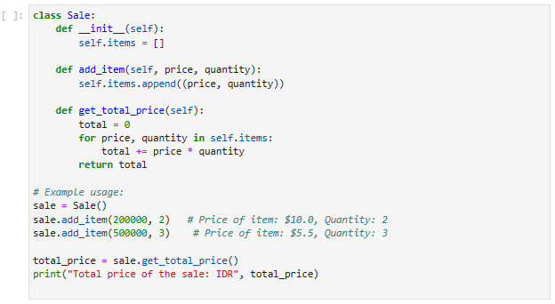
When to use OOP: Treating object as Object
OOPs diminished a repeated procedure
The first method
The second method
How to work with the class

Slide 9
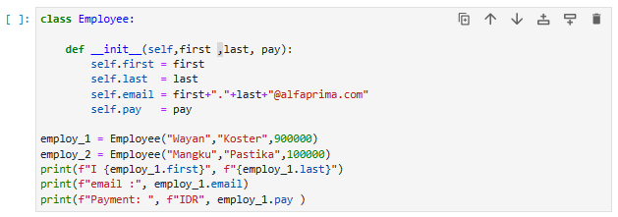
Explain all the lined code in this OOP
The class, Employee
Constructor
Calling and using the class
Action

Slide 10

When to use OOP: The Needs
We need to use OOP whenever dealing with:
Modeling Real-world Entities
Code Reusability
Graphical User Interfaces (GUIs)
Dealing wit Complex System
When Dealing with Database Application
Managing Software Library and Frameworks
Go to jupyter-notebook for details

Slide 11
Home-Work (HW) - 05
Create a simple program using OOP. It can not be the same with others. Those submitting the same program will consider for Zero score, both.

