Slide 1
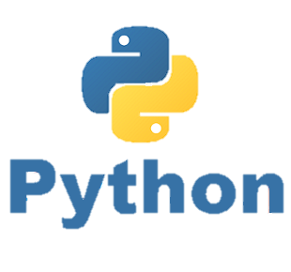
Built-in Packages Library in Python
P E D Putra, M.Si.
Lecture 6 – Built-in Packages Library in Python: NumPy, Matplotlib

Slide 2
NumPy
It is Numerical Python
Efficient multidimensional array processing and operations
- Linear algebra (matrix operations)
- Mathematical functions
An array is a type of data structure
Array (objects) must be of the same type
1 2 3 4 | import numpy as np data = np.array([1,2,3,4])
How to use
1 2 3 4 5 6 7 8 9 10 11 | import numpy as np a = np.arange(4) # array([0, 1, 2, 3]) b = np.array([2, 3, 2, 4]) c = [2, 3, 4, 5] a * b # array([ 0, 3, 4, 12]) b - a # array([2, 2, 0, 1]) a *c # array([ 0, 3, 8, 15])

Slide 3
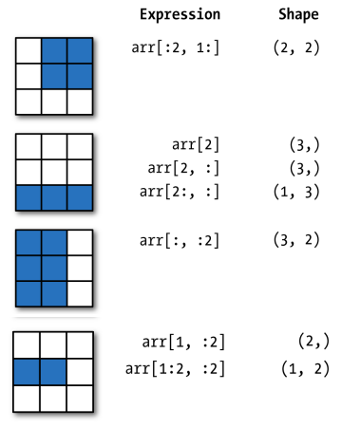
NumPy
NumPy : Slicing

Slide 4
NumPy
ndarray
ndarray is used for storage of homogeneous data
- i.e., all elements the same type
Every array must have a shape and a dtype
Supports convenient slicing, indexing and efficient vectorized computation
1 2 3 4 5 6 7 8 9 10 | import numpy as np data1 = [6, 7.5, 8, 0, 1] arr1 = np.array(data1) print(arr1) print(arr1.dtype) print(arr1.shape) print(arr1.ndim)

Slide 5
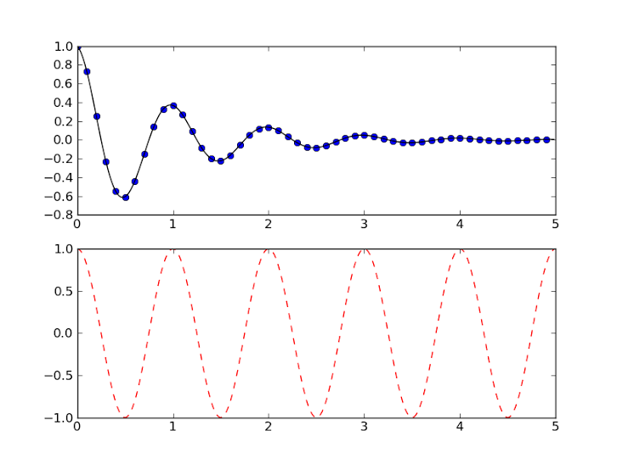
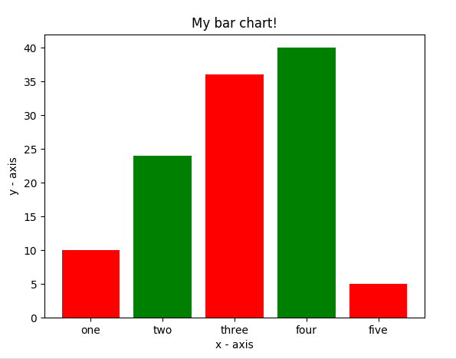
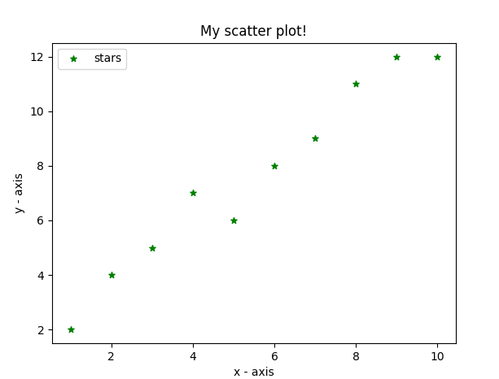
Matplotlib
Matplotlib is one of the most powerful tools for data visualization in Python.
Matplotlib is an incredibly powerful (and beautiful!) 2-D plotting library.
Matplotlib module is already included on the newest python distribution, in case of not, install it via terminal using
>>> pip install matplotlib
We can generate plots, histograms, power spectra, bar charts, errorcharts, scatterplots, etc., with just a few lines of code.

Slide 6
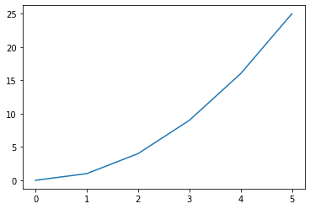
Matplotlib
1 2 3 4 5 6 7 8 9 10 11 12 13 14 | import matplotlib.pyplot as plt #create data for plotting x_values = [0, 1, 2, 3, 4, 5 ] y_values = [0, 1, 4, 9, 16, 25] #the default graph style for plot is a line plt.plot(x_values, y_values) #display the graph plt.show()
How to use
text() : adds text in an arbitrary location
xlabel() : adds text to the x-axis
ylabel() : adds text to the y-axis
title() : adds title to the plot
clear() : removes all plots from the axes.
savefig() : saves your figure to a file
legend() : shows a legend on the plot
All methods are available on pyplot and on the axes instance generally.

Slide 7
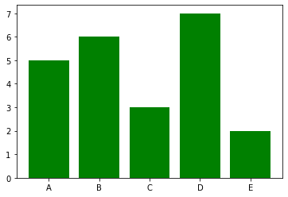
Matplotlib
1 2 3 4 5 6 7 8 9 10 | import matplotlib.pyplot as plt #Create data for plotting values = [5, 6, 3, 7, 2] names = ["A", "B", "C", "D", "E"] plt.bar(names, values, color="green") plt.show()
How to use

Slide 8

Time to rock
Move to Jupyter-notebook

