Slide 1
Return on Investment and Compute Infrastructure when value of result is not quantified
Ben Payne
20160506

Slide 2
Rapid Prototyping platforms
Your desktop - Microsoft Excel, etc
AWS
Google Compute Engine
Jupyter notebooks

Slide 3
Triage process design
New analytic
Rapid prototyping
Triage analysis
Tailored Iaas
Homogeneous
Commodity IaaS
streaming
How to evaluate merit?

Slide 4
Two approaches
Single analytic, compare RoI for multiple platforms over lifespan (ie 5 years)
Many analytics, compare RoI for a single investment period (ie fiscal year)

Slide 5
Comparison of platforms: “pay-as-you-go” vs “commodity” vs “tailored”
AWS: assume zero capital cost and zero operations and maintenance cost. Fiscal cost is in number of hours used; I assume a rate of $100/hour. Time-to-market is the advantage; assume 1 day for acquisition and creating the analytic. Time-to-solution is assumed to be 100 minutes
self-hosted commodity platform: capital cost is $100,000 (one-time investment), and the operations and maintenance is $10,000 per year (an on-going cost). Time-to-market is 5 days; time-to-solution is 60 minutes.
tailored architecture is costly — $1,000,000 for capital, and $100,000 per year for O&M. Advantage is a tiny time-to-solution, 1 minute, but the time-to-market is 1 year. Time-to-market includes NRE and acquisition.

Slide 6
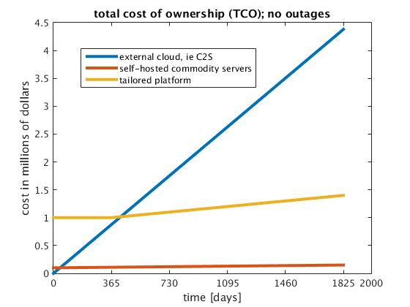
Total cost of ownership
(Assume a single analytic)
Observations:
No capital investment means initial cost is lowest
Tailored architecture costs more than commodity
Paying by the hour gets expensive
(Lower is better)

Slide 7
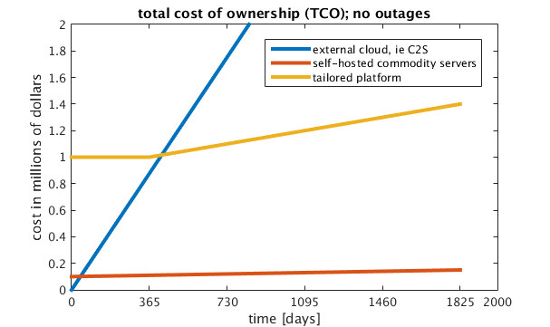
Total cost of ownership
For the current parameters, pay-by-the-hour is not as cost effective;
you do get access to compute faster

Slide 8
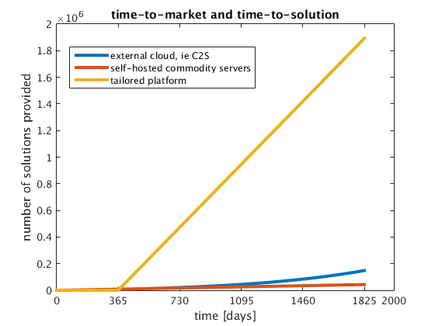
Time-to-market and time-to-solution
The tailored architecture provides more solutions over lifespan
(Higher is better)
(due to
Moore’s law)
System availability:
External cloud: 99.9%
Self-hosted cloud: 99%
Tailored architecture: 90%

Slide 9
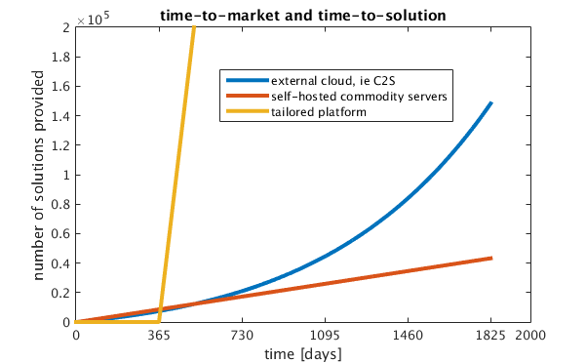
Time-to-market and time-to-solution
(due to
Moore’s law)
For the current parameters, ratio of time spent in NRE and acquisition to
time-to-solution significantly impacts throughput

Slide 10
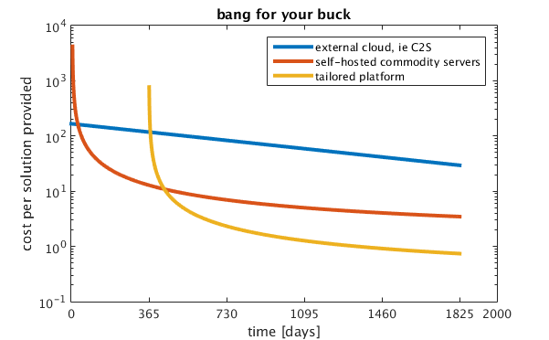
Bang-for-your-buck
(Lower is better)
Over the lifespan of the system, tailored IaaS is better ROI

Slide 11
Bang-for-your-buck
(Lower is better)
“best” depends on durability of analytic

Slide 12
Multi-tenancy on existing infrastructure: how to invest in next iteration?
Suppose existing platform environment is homogenous
Suppose you will get money to spend on compute for next fiscal period
Should that money be invested on more of the same,
or spend the money on a novel architecture?
Assumption: known tasks in the time period
Assumption: known amount of work in the period

Slide 13
Input Parameters
number of existing compute units for architecture A: 5
capital cost per compute unit for architecture A: $20
capital cost per compute unit for architecture B: $50
O&M cost per compute unit for architecture A: $5
O&M cost per compute unit for architecture B: $8
Money to invest in next fiscal period: $100
For each analytic, CPU hours for architecture A: {40, 100, 10, 5, 2}
For each analytic, CPU hours for architecture B: {30, 10, 8, 4, 1}

Slide 14
Result of analysis
current_tts =
31.4000
tts_homogeneous =
19.6250
min_tts_heterogeneous =
21.4000
Best analytic distribution, platform A =
40 0 10 5 2
best analytic distribution, platform B =
0 10 0 0 0

Slide 15
Result: maintaining homogeneous architecture yields better throughput
current_tts =
31.4000
tts_homogeneous =
19.6250
min_tts_heterogeneous =
21.4000
Best analytic distribution, platform A =
{40 0 10 5 2}
best analytic distribution, platform B =
{0 10 0 0 0}
For these parameters, change of architecture doesn’t outweigh the cost of the acquisition + O&M
Even though architecture B is always faster for every analytic, the overall mission throughput is lower for the amount of money spent. Therefore, stick with homogeneous architecture

Slide 16
Result: different initial conditions yield opposite outcome
capital cost per compute unit for architecture A: $20
capital cost per compute unit for architecture A: $30
current_tts =
31.4000
tts_homogeneous =
19.6250
min_tts_heterogeneous =
21.4000
Best analytic distribution, platform A =
{40 0 10 5 2}
best analytic distribution, platform B =
{0 10 0 0 0}
current_tts =
31.4000
tts_homogeneous =
22.4286
min_tts_heterogeneous =
21.4000
Best analytic distribution, platform A =
{40 0 10 5 2}
Best analytic distribution, platform B =
{0 10 0 0 0}

Slide 17
This methodology applies to any situation
I have a homogenous commodity IaaS and want to know whether to buy invest in a novel architecture
I have tailored IaaS and want to know whether to invest in commodity IaaS
I have both tailored and commodity IaaS and want to know what future distribution of funds maximizes throughtput
Any platform, and set of analytics
Need capital cost, O&M cost, and job runtimes per platform
Need existing infrastructure, job list, and amount of money to be invested
Output: which platform acquisition maximizes mission throughput

Slide 18
What I’m looking for
Measurements from current platforms (time-to-solution for every analytic) over some time period
Candidate platforms for acquisition
Cost of system, number of racks or nodes, both capital and O&M

Slide 19
BACKUP

Slide 20
Attack the assumptions: space-time trade-off
$$tts= \frac{\sum_{i}{{(compute unit∗time)}_{i}}}{number of compute units}$$
Compute platform B:
Configuration 1
Configuration 2
Compute platform A:
Configuration 1
Configuration 2
Configuration 3
Space-time trade-off of real applications is not linear; see Amdahl’s law
Scaling depends on how much data is exchanged; synchronous communication

Slide 21
Attack the assumptions: space-time trade-off
Each job has a scaling curve
A scheduler searches for the layout of jobs on N compute resources which minimizes time-to-solution
Scheduler output would yields the time-to-solution per platform

Slide 22
Attack the assumptions: known tasks; known amount of work
Projection is needed for the fiscal period being modeled
We have data for what was done in the previous period
Extrapolate historical data using a scaling factor

Slide 23
Getting faster doesn’t matter; the problem is constrained by meatspace
Investigating different platform architectures wrt time-to-solution
Providing users more data is not helpful
Providing users with data faster is not helpful
Replace “speed-up” with “lower cost to solution”

Slide 24
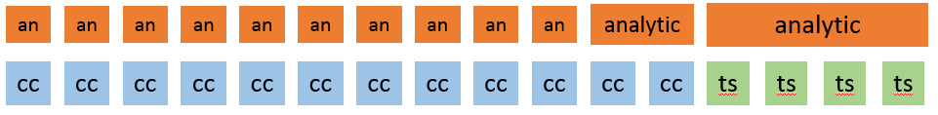
Stick with homogeneous IaaS, or augment with tailored IaaS?
Goal: balance consumers and resources (avoid both idle and inability to do mission)
Homogeneous environment:
(compute consumers)
(compute resources)
Heterogeneous environment:
These alternatives could provide equivalent mission throughput;
→ What about $?

