Slide 1
Quantitative cost/benefit analysis of Infrastructure choices for computation
Ben Payne
2016

Slide 2
Take-away: armed with quantitative cost/benefit analysis models
Summary of content:
Simple quantitative cost/benefit analysis model evaluating compute choices based on cost per solution for a single recurring analytic.
Model 1: Comparison of platforms: “pay-as-you-go” vs “commodity” vs “tailored”
Action: durability of heavy hitters should be investigated; migrate or optimize
Simplistic quantitative cost/benefit analysis model evaluating compute choices based on total cost of ownership for an existing workload.
Model 2: Multi-tenancy on existing infrastructure
Action: determine whether to diversify architecture
Desired outcome: You are armed with quantitative models for decision making

Slide 3
[Model 1] Comparison of platforms, single analytic: “pay-as-you-go” vs “commodity” vs “tailored”
AWS: assume zero capital cost and zero operations and maintenance cost. Fiscal cost is in number of hours used; I assume a rate of $100/hour. Time-to-market is the advantage; assume 1 day for acquisition and creating the analytic. Time-to-solution is assumed to be 100 minutes
self-hosted commodity platform: capital cost is $100,000 (one-time investment), and the operations and maintenance is $10,000 per year (an on-going cost). Time-to-market is 5 days; time-to-solution is 60 minutes.
tailored architecture is costly — $1,000,000 for capital, and $100,000 per year for O&M. Advantage is a tiny time-to-solution, 1 minute, but the time-to-market is 1 year. Time-to-market includes NRE and acquisition.

Slide 4
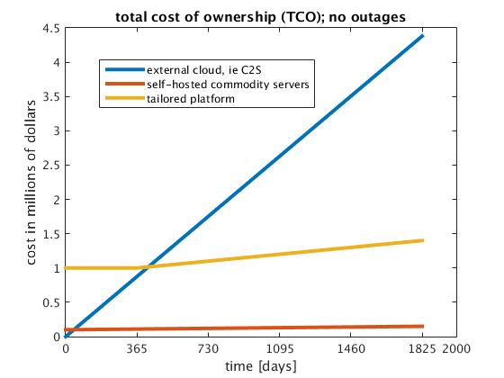
Total cost of ownership
Cloud platform, ie AWS or GCE
(Assume a single analytic)
Observations:
No capital investment means initial cost is lowest
Tailored architecture costs more than commodity
Paying by the hour gets expensive
(Lower is better)

Slide 5
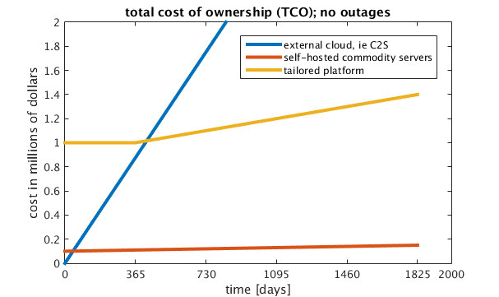
Total cost of ownership
Cloud platform, ie AWS or GCE
For the current parameters, pay-by-the-hour is not as cost effective;
you do get access to compute faster

Slide 6
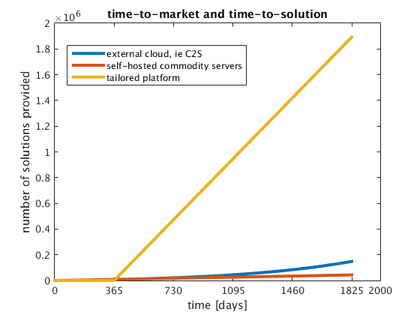
Time-to-market and time-to-solution
Cloud platform, ie AWS or GCE
The tailored architecture provides more solutions over lifespan
(Higher is better)
(due to
Moore’s law)
System availability:
External cloud: 99.9%
Self-hosted cloud: 99%
Tailored architecture: 90%

Slide 7
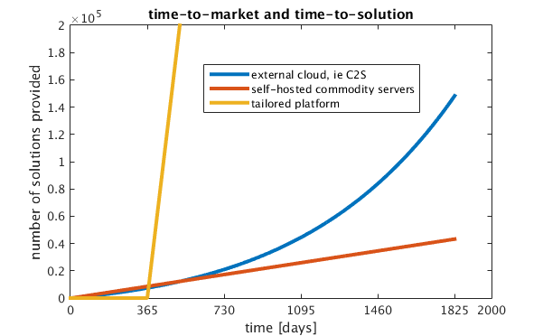
Time-to-market and time-to-solution
Cloud platform, ie AWS or GCE
(due to
Moore’s law)
For the current parameters, ratio of time spent in NRE and acquisition to
time-to-solution significantly impacts throughput

Slide 8
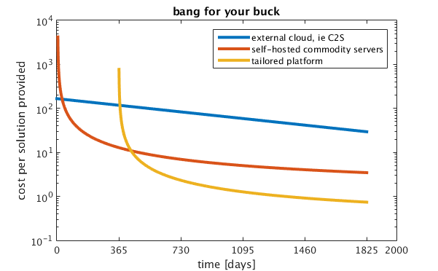
Bang-for-your-buck
Cloud platform, ie AWS or GCE
(Lower is better)
Over the lifespan of the system, tailored IaaS is better ROI

Slide 9
Bang-for-your-buck (cost per solution)
Cloud platform, ie AWS or GCE
(Lower is better)
“best” choice of compute platform depends on durability

Slide 10
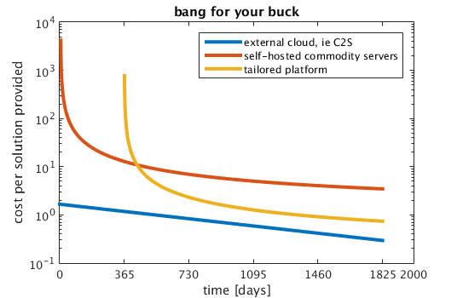
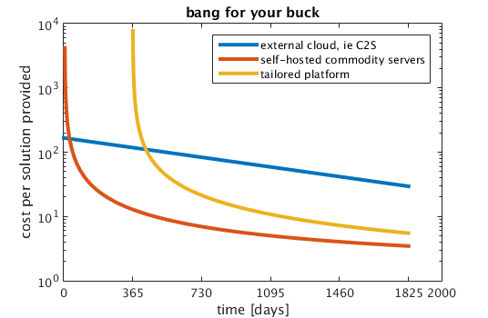
Sensitivity analysis for cost per solution
Cloud platform, ie AWS or GCE
Cloud platform, ie AWS or GCE
Lower is better
External cloud is best when cost is $1/hour rather than $100/hour
Self-hosted commodity is best when capital cost of tailored is $10M rather than $1M

Slide 11
End of “single analytic” model Start “multi-tenancy” model

Slide 12
[Model 2] Multi-tenancy on existing compute infrastructure
Suppose existing platform environment is homogenous
Suppose we will get money to spend on compute for next fiscal period
Should that money be invested on more of the same, or spend the money on a novel architecture which yields a heterogeneous compute portfolio?
Assume fixed functionality (same analytics this year and next)
Assume fixed amount of work this fiscal period and next

Slide 13

Input Parameters
Existing infrastructure
number of existing compute units for architecture A: 5
capital cost per compute unit for architecture A: $20
capital cost per compute unit for architecture B: $50
O&M cost per compute unit for architecture A: $5
O&M cost per compute unit for architecture B: $8
Money to invest in next fiscal period: $100
For each analytic, CPU hours for architecture A: {40, 100, 10, 5, 2}
For each analytic, CPU hours for architecture B: {30, 10, 8, 4, 1}
Existing workload

Slide 14

Input Parameters
Existing infrastructure
number of existing compute units for architecture A: 5
capital cost per compute unit for architecture A: $20
capital cost per compute unit for architecture B: $50
O&M cost per compute unit for architecture A: $5
O&M cost per compute unit for architecture B: $8
Money to invest in next fiscal period: $100
For each analytic, CPU hours for architecture A: {40, 100, 10, 5, 2}
For each analytic, CPU hours for architecture B: {30, 10, 8, 4, 1}
B
Existing workload
Projected workload

Slide 15
Result of analysis: current fiscal period
Existing workload
For each analytic, CPU hours for architecture A: {40, 100, 10, 5, 2}
Existing infrastructure
current_tts =
31.4000
tts_homogeneous =
19.6250
min_tts_heterogeneous =
21.4000
Best analytic distribution, platform A =
40 0 10 5 2
best analytic distribution, platform B =
0 10 0 0 0

Slide 16
Result of analysis: next fiscal period
Existing workload
For each analytic, CPU hours for architecture A: {40, 100, 10, 5, 2}
current_tts =
31.4000
tts_homogeneous =
19.6250
min_tts_heterogeneous =
21.4000
Best analytic distribution, platform A =
40 0 10 5 2
best analytic distribution, platform B =
0 10 0 0 0
Existing infrastructure
+ spend $100 on capital
and O&M for additional “A”

Slide 17
Result of analysis: next fiscal period
current_tts =
31.4000
tts_homogeneous =
19.6250
min_tts_heterogeneous =
21.4000
Best analytic distribution, platform A =
40 0 10 5 2
best analytic distribution, platform B =
0 10 0 0 0
Existing infrastructure
+ spend $100 on capital
and O&M for additional “B”
B

Slide 18
Result of analysis: next fiscal period
For each analytic, CPU hours for architecture A: {40, 100, 10, 5, 2}
For each analytic, CPU hours for architecture B: {30, 10, 8, 4, 1}
current_tts =
31.4000
tts_homogeneous =
19.6250
min_tts_heterogeneous =
21.4000
Best analytic distribution, platform A =
40 0 10 5 2
best analytic distribution, platform B =
0 10 0 0 0
Existing infrastructure
+ spend $100 on capital
and O&M for additional “B”
B

Slide 19
Result: maintaining homogeneous architecture yields better throughput
current_tts =
31.4000
tts_homogeneous =
19.6250
min_tts_heterogeneous =
21.4000
Best analytic distribution, platform A =
{40 0 10 5 2}
best analytic distribution, platform B =
{0 10 0 0 0}
For these parameters, change of architecture doesn’t outweigh the cost of the acquisition + O&M
Even though architecture B is always faster for every analytic, the overall mission throughput is lower for the amount of money spent. Therefore, stick with homogeneous architecture

Slide 20

Result: different initial conditions yield opposite outcome
capital cost per compute unit for architecture A: $20
capital cost per compute unit for architecture A: $30
current_tts =
31.4000
tts_homogeneous =
19.6250
min_tts_heterogeneous =
21.4000
Best analytic distribution, platform A =
{40 0 10 5 2}
best analytic distribution, platform B =
{0 10 0 0 0}
current_tts =
31.4000
tts_homogeneous =
22.4286
min_tts_heterogeneous =
21.4000
Best analytic distribution, platform A =
{40 0 10 5 2}
Best analytic distribution, platform B =
{0 10 0 0 0}
$100
+
+
$100
B

Slide 21
Methodology applies to variety of situations
I have a homogenous commodity IaaS and want to know whether to buy invest in a novel architecture
I have tailored IaaS and want to know whether to invest in commodity IaaS
I have both tailored and commodity IaaS and want to know what future distribution of funds maximizes throughput
Any platform, any set of analytics
Need capital cost, O&M cost, and job runtimes per platform
Need existing infrastructure, job list, and amount of money to be invested
Output: which platform acquisition maximizes mission throughput

Slide 22
End of models discussion Start of observations

Slide 23
Analysis of production compute environment
Are there “heavy hitters/resource hogs,” or does each analytic use the same amount of the compute platform?
Are the “heavy hitters” durable? Over what time scale?

Slide 24
If distribution of utilization per job is not uniform → exploit this
Durable, large scale analytics should get more attention
Optimize
Move to tailored infrastructure
Quantize the cost/benefit of moving from commodity IaaS to something else
Many analytics, compare RoI for a single investment period (ie fiscal year)
Single analytic, compare RoI for multiple platforms over lifespan (ie 5 years)

Slide 25
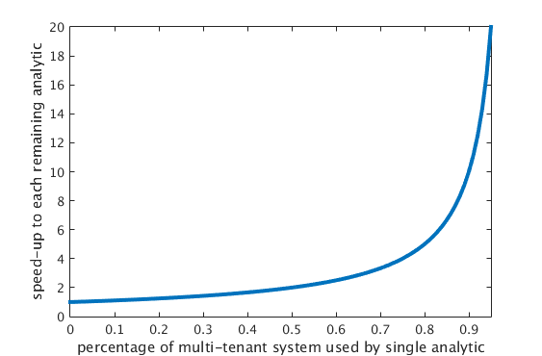
Impact to remaining analytics when heavy hitter is migrated off platform
Suppose a compute platform has hundreds of unique analytics run per day
Suppose 1 of the analytics consumes 40% of the compute resources
If that one analytic is moved off the platform, each of the remaining analytics can speed up by (1/(1-0.4)) = 1.67

Slide 26
Evaluate cost/benefit of architecture choices
collect measurements from current platforms (time-to-solution for every analytic) over some time period
then project impact on time-to-solution of augmenting existing architecture with tailored solution
don’t need to re-write every analytic; assume improvement the heaviest analytic by some speedup factor >>1
Need to know cost per rack of compute, both capital and O&M

Slide 27
Backup content
Criticisms of numerical models
Criticisms of single analytic model
Criticisms of multi-tenant model

Slide 28
Criticisms of numerical models
Some analytics aren’t feasible due to scale of data
[For example, a data set so large it doesn’t fit in RAM of an HPC]
In that case, the data could be partially loaded, then iterated. The time-to-solution would be large but quantifiable
Jobs vary due to input data, configuration parameters
Correct. Either assume ensemble averaging over large number of jobs, or account for the distribution of runtimes.

Slide 29
More assumptions that could be added
Assume software application evolves
Assume rate of software application evolution is proportional to the size of the workforce
Assume system administrator positions can be exchanged for software developer positions
→ Given some number of positions and some budget, how to maximize throughput?

Slide 30
Unquantized aspects not captured in numerical models
Unanticipated use cases for platforms
Novel analytics

Slide 31
Notes on Model 1: single analytic

Slide 32
Potential Modifications to single analytic
Rather than assume time=0 is the starting point for all systems, a more realistic portfolio has different start times for different platforms.
Rather that forcing to a single platform, what’s the benefit of augmenting platform A with surge capacity on plaform B?
A single platform typically runs a multiple analytics.
A lifespan of 5 years neglects the typical hardware refresh at year 2 or 3.

Slide 33
Attack the assumptions: space-time trade-off
$$tts= \frac{\sum_{i}{{(compute unit∗time)}_{i}}}{number of compute units}$$
Compute platform B:
Configuration 1
Configuration 2
Compute platform A:
Configuration 1
Configuration 2
Configuration 3
Space-time trade-off of real applications is not linear; see Amdahl’s law
Scaling depends on how much data is exchanged; synchronous communication

Slide 34
Attack the assumptions: space-time trade-off
Each job has a scaling curve
A scheduler searches for the layout of jobs on N compute resources which minimizes time-to-solution
Scheduler output would yields the time-to-solution per platform

Slide 35
Consequence of choosing sub-optimally
In the 0 to 1 month window, optimal choice is pay-by-the-hour: $74k for 444 solutions
If you go with commodity or tailored IaaS, then you are paying money ($100k and $1,000k, respectively) and not getting many results (618 and 0, respectively)
In the 1 month to 1 year window, optimal choice is commodity IaaS: $111.9k for 10,290 solution
If you go with pay-by-the-hour, then you are paying more money ($1,051k) and getting less mission throughput (9520 solutions)
If you go with tailored IaaS, then you are paying money ($1,020k) and not getting results (94,610 solutions)
In the 1 year to End-of-Life window, optimal choice is tailored IaaS: $1,400k for 1,892,000 solutions
If you go with pay-by-the-hour or commodity IaaS, then you are paying more money and getting less mission throughput

Slide 36
Consequence of choosing sub-optimally
Days | Platform | Money spent | Solution count
31 | Pay-by-the-hour | $74,400 | 444
 | Commodity IaaS | $100,700 | 618
 | Tailored IaaS | $1,000,000 | 0
438 | Pay-by-the-hour | $1,051,000 | 9520
 | Commodity IaaS | $111,900 | 10,290
 | Tailored IaaS | $1,020,000 | 94,610
1825 (5 years) | Pay-by-the-hour | $4,380,000 | 148,300
 | Commodity IaaS | $149,900 | 43,200
 | Tailored IaaS | $1,400,000 | 1,892,000
Best bang-for-your-buck
→ Commodity IaaS yields similar solution count for 10x less cost
than C2S
→ Tailored IaaS yields 12x more solutions and costs 3x less
than C2S

Slide 37
Notes on model 2: multi-tenancy

Slide 38
Potential Modifications to multi-tenancy
Include a switching cost
Include a switching time – might not be able to use platform B on day 1.
Rather than “existing A + new A” or “existing A plus new B”, enable exploration of “existing A + some more new A + some new B”

Slide 39
Criticisms of the multi-tenant model
For the multi-tenant, single fiscal period model, comparing analytics written by novices to optimized analytics written by experts is not fair
The point is to find which analytics should be optimized or moved to a tailored architecture
For the multi-tenant, single fiscal period model, the workload doesn’t account for unknown analytics
I don’t include unquantized aspects in this numerical model
For the multi-tenant, single fiscal period model, the workload doesn’t reflect possible changes in distribution of analytics
Correct. If you can provide a projection of the change, that can be used as an input.

Slide 40
Attack the assumptions: known tasks; known amount of work
Projection is needed for the fiscal period being modeled
We have data for what was done in the previous period
Extrapolate historical data using a scaling factor

