Slide 1

RESEARCH MASTERCLASS FOR CLINICIANS · MODULE 1
Foundations Recap Game
Twos, Threes and Fours — Before We Open Topic 3
A quick recap of the frameworks from Topics 1 and 2 — person, place, time; case definitions; the role of epidemiology — each held inside a shape, one part per point. Guess before you reveal.
www.newlandsclinic.org.zw

Slide 2
HOW TO PLAY
Shapes Hold the Ideas
Every idea below already appeared in Topic 1 or 2 — this just re-shapes it.
Triangles hold ideas with three parts. Squares on point hold ideas with four. The connector holds an idea with two.
1
Read the principle inside the shape.
2
Call out what belongs on each numbered point — before you turn the page.
3
Reveal: check your answers against the labelled points and the regional example.
Skipped on purpose: Farr, Semmelweis and Snow (Topic 1) — a great trio of examples, but not a conceptual framework.
Research Masterclass for Clinicians · Foundations Recap Game · www.newlandsclinic.org.zw

Slide 3
RECAP GAME · TRIANGLE 1 OF 3
PROMPT
Guess the Three Parts
?
1
PPP
Describes any health event
2
3
?
?
Research Masterclass for Clinicians · Foundations Recap Game · www.newlandsclinic.org.zw

Slide 4
RECAP GAME · TRIANGLE 1 OF 3
REVEALED
Person, Place, Time
PERSON
who — age, sex, HIV status, ART regimen…
✓
PPP
Describes any health event
✓
✓
PLACE
where — country, district, clinic, urban/rural
TIME
when — calendar period, season, trend
REGIONAL EXAMPLE Hypertension in HIV-positive adults ≥50 · Harare, Zimbabwe · Feb 2004 – Mar 2020 (Shamu et al., 2021).
Research Masterclass for Clinicians · Foundations Recap Game · www.newlandsclinic.org.zw

Slide 5
RECAP GAME · TRIANGLE 2 OF 3
PROMPT
Guess the Three Parts
?
1
3 Elements:
What a case definition needs
2
3
?
?
Research Masterclass for Clinicians · Foundations Recap Game · www.newlandsclinic.org.zw

Slide 6
RECAP GAME · TRIANGLE 2 OF 3
REVEALED
A Good Case Definition
METHOD OF ID.
how a case is detected — symptoms, lab test, self-report
✓
3 Elements:
What a case definition needs
✓
✓
BOUNDARIES
severity thresholds, time windows, exclusions
UNIT OF ANALYSIS
person, episode, household, suburb, event
REGIONAL EXAMPLE Newlands hypertension case: BP >140/90 on two separate days (method + boundary), counted per person (unit).
Research Masterclass for Clinicians · Foundations Recap Game · www.newlandsclinic.org.zw

Slide 7
RECAP GAME · TRIANGLE 3 OF 3
PROMPT
Guess the Three Parts
?
1
What you need to calculate any rate
2
3
?
?
Research Masterclass for Clinicians · Foundations Recap Game · www.newlandsclinic.org.zw

Slide 8
RECAP GAME · TRIANGLE 3 OF 3
REVEALED
Before You Can Count Anything
DEFINED POPULATION
the exact denominator
✓
What you need to calculate any rate
✓
✓
CASE DEFINITION
the exact numerator rule
COUNT OVER TIME
a stated period or moment
REGIONAL EXAMPLE TENART cohort: an exact enrolment list, an ART-start rule, deaths counted across 27,527 person-years (Shamu et al., 2017).
Research Masterclass for Clinicians · Foundations Recap Game · www.newlandsclinic.org.zw

Slide 9
RECAP GAME · SQUARE 1 OF 3
PROMPT
Guess the Four Parts
?
1
?
Four questions inside one definition
?
4
2
3
?
Hint: “The study of the occurrence and distribution of health-related states or events in specified populations, including the study of determinants influencing such states, and the application of this study to control the health problems.”
Research Masterclass for Clinicians · Foundations Recap Game · www.newlandsclinic.org.zw

Slide 10
RECAP GAME · SQUARE 1 OF 3
REVEALED
What Is Epidemiology?
FREQUENCY
how often?
✓
DETERMINANTS
why?
Four questions inside one definition
DISTRIBUTION
in whom, where, when?
✓
✓
✓
APPLICATION
so what?
REGIONAL EXAMPLE Porta, Greenland & Last, A Dictionary of Epidemiology, 5th ed., 2008 — the definition opening Topic 1.
Research Masterclass for Clinicians · Foundations Recap Game · www.newlandsclinic.org.zw

Slide 11
RECAP GAME · SQUARE 2 OF 3
PROMPT
Guess the Four Parts
?
1
?
Four functions, usually in sequence
?
4
2
3
?
Hint: The Role of Epidemiology
Research Masterclass for Clinicians · Foundations Recap Game · www.newlandsclinic.org.zw

Slide 12
RECAP GAME · SQUARE 2 OF 3
REVEALED
The Role of Epidemiology
DESCRIBE
what's happening
✓
APPLY
act on the finding
Four functions, usually in sequence
INTERPRET
why it's happening
✓
✓
✓
EVALUATE
is the response working
REGIONAL EXAMPLE Dolutegravir roll-out, Newlands Clinic: weight gain described → tested → screening protocols applied → cohort follow-up evaluates them.
Research Masterclass for Clinicians · Foundations Recap Game · www.newlandsclinic.org.zw

Slide 13
RECAP GAME · SQUARE 3 OF 3
PROMPT
Guess the Four Parts
?
1
?
Four ways cases & populations go wrong
?
4
2
3
?
Research Masterclass for Clinicians · Foundations Recap Game · www.newlandsclinic.org.zw

Slide 14
RECAP GAME · SQUARE 3 OF 3
REVEALED
Common Pitfalls
NUM./DENOM. MISMATCH
wrong denominator for the numerator
✓
DEFINITION DRIFT
the case rule shifts mid-study
Four ways cases & populations go wrong
CONFLATING UNITS
people vs. episodes, uncounted
✓
✓
✓
IMPLICIT POPULATION
a rate with no stated denominator
REGIONAL EXAMPLE Quoting a rate without ever stating the denominator population leaves the reader unable to judge whether it's meaningful.
Research Masterclass for Clinicians · Foundations Recap Game · www.newlandsclinic.org.zw

Slide 15
RECAP GAME · THE PAIR
PROMPT
Guess the Two Parts
Numerator, meet denominator
1
2
?
?
Hint: Two Things to Define Before You Count in Epidemiology
Research Masterclass for Clinicians · Foundations Recap Game · www.newlandsclinic.org.zw

Slide 16
RECAP GAME · THE PAIR
REVEALED
Two Things to Define Before You Count
Numerator, meet denominator
✓
✓
CASE DEFINITION
→ determines the numerator
POPULATION
→ determines the denominator
REGIONAL EXAMPLE IeDEA–Newlands cohort: all patients ≥16 starting ART, 2004–2015 — not “all Zimbabweans.” The denominator is enrolment criteria, not a map.
Research Masterclass for Clinicians · Foundations Recap Game · www.newlandsclinic.org.zw

Slide 17
SECTION · WRAP-UP
The Foundations, All at Once
Person, Place, Time who, where, when — describes any health event
A Good Case Definition method of identification, boundaries, unit of analysis
Before You Can Count Anything population, case definition, count over time
What Is Epidemiology? frequency, distribution, determinants, application
The Role of Epidemiology describe, interpret, apply, evaluate
Common Pitfalls mismatch, drift, conflated units, implicit population
Two Things to Define Before You Count case definition → numerator · population → denominator
Next — Topic 3: these building blocks turn into actual numbers — prevalence, incidence risk, incidence rate, and odds.

Slide 18
RESEARCH MASTERCLASS FOR CLINICIANS · MODULE 1
Measures of Disease Occurrence
Prevalence, Incidence Risk, Incidence Rate & Odds
Built around peer-reviewed evidence from Zimbabwe, Zambia and Southern Africa — HIV, metabolic syndrome, cholera and non-communicable diseases.
www.newlandsclinic.org.zw

Slide 19
MODULE 1 · TOPIC 3 · FOUNDATIONS IN EPIDEMIOLOGY
Measures of Disease Occurrence
Every clinical research question depends on quantifying how much disease exists and how fast new cases arise. This session builds that quantitative toolkit.
By the end of this session, you will be able to:
WHY IT MATTERS
Without a well-chosen denominator, any count of cases is meaningless as a guide to planning, resource allocation or evaluating interventions.
1
Distinguish a ratio, proportion and true epidemiological rate.
Calculate point prevalence, period prevalence, incidence risk and incidence rate.
These concepts underpin every measure of effect you will calculate in Topic 4 (Rate Ratios, Risk Ratios, Odds Ratios).
2
3
Build a person-time denominator and compute an incidence rate.
4
Define odds and explain when it is the appropriate metric.
5
Select the right measure of occurrence for a given clinical scenario.
Research Masterclass for Clinicians
www.newlandsclinic.org.zw

Slide 20
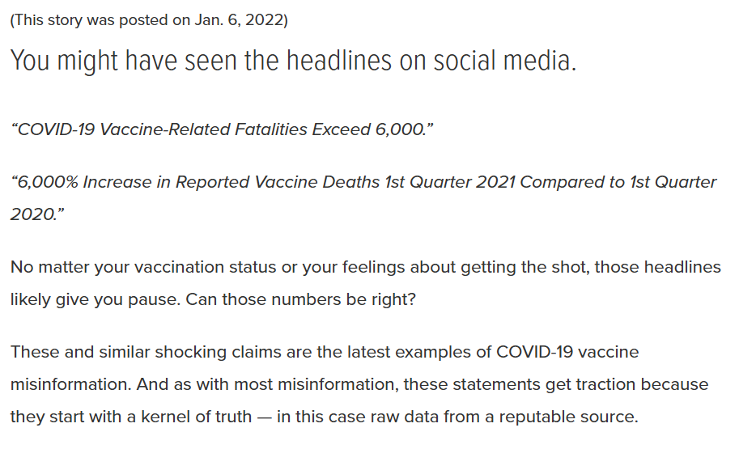
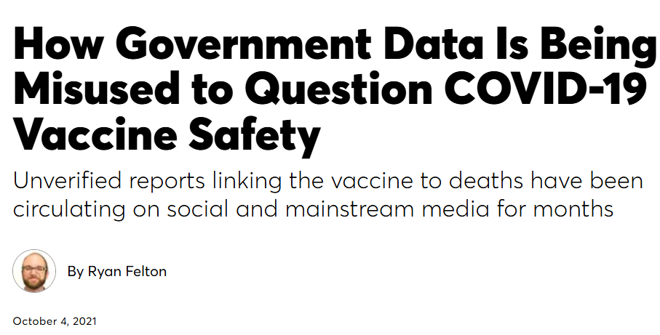
MODULE 1 · TOPIC 3 · FOUNDATIONS IN EPIDEMIOLOGY
Measures of Disease Occurrence
https://www.muhealth.org/our-stories/scary-reports-deaths-following-covid-19-vaccination-arent-what-they-seem
https://www.consumerreports.org/misinformation/government-data-misused-to-question-covid-19-vaccine-safety-a1167679946/
Research Masterclass for Clinicians
www.newlandsclinic.org.zw

Slide 21
SECTION 1 · FOUNDATIONS
Why Quantify? Raw Counts Are Not Enough
506 deaths. Is that a lot or a little? Without a denominator, you cannot know. Measures of occurrence anchor a count to the population and time over which it was observed.
THREE ESSENTIAL ELEMENTS
Case definition
Standardised criteria separating cases from non-cases (e.g. IDF criteria for MetS). Change the threshold → change the numerator.
Point prevalence of metabolic syndrome among 901 treatment-naïve adults attending primary care clinics in Zambia & Zimbabwe at enrolment (Chihota BV et al., J Int AIDS Soc, 2022).
Overall: 19%
Zimbabwe sites: 22%.
Population boundary
The denominator: the precisely bounded group from which cases come (not just “everyone”).
Time reference
A stated moment or period. Prevalence on a single day vs prevalence over an outbreak season are fundamentally different numbers.
All-cause mortality rate: 18.4 per 1,000 person-years in the Newlands Clinic HIV cohort: 506 deaths across 27,527 person-years (Chimbetete C et al., PLoS One, 2020).
Research Masterclass for Clinicians
www.newlandsclinic.org.zw

Slide 22
SECTION 1 · FOUNDATIONS
Ratios, Proportions & Rates: Getting the Terms Right
“Rate” is often used loosely in clinical conversation for any frequency measure. Epidemiology uses the term precisely.
Term | Structure | Time in denominator? | Bounded?
Ratio | X / Y (X not part of Y) | No | Unbounded
Proportion | X / (X + Y) = X / total | No (usually) | 0 – 1
True rate | Events / person-time | Yes — always | Unbounded
KEY IMPLICATION
Prevalence and cumulative incidence (incidence risk) are proportions, bounded 0–1. Incidence rate is a true rate, unbounded, because it uses person-time. Calling 19% a “prevalence rate” is common but mathematically imprecise.
EXAMPLE RATIO
EXAMPLE PROPORTION
EXAMPLE TRUE RATE
Male : female = 378:523 at Chihota et al. sites
≈ 72:100 or 3:4
MetS prevalence = 172/901 = 19.1%
Mortality = 506/27,527 PY = 18.4 per 1,000 PY
Research Masterclass for Clinicians
www.newlandsclinic.org.zw

Slide 23
SECTION 2 · PREVALENCE
Prevalence: Counting Existing Cases
Point Prevalence
WHEN TO USE PREVALENCE
The proportion of a defined population with a condition at a single exact moment.
Estimating health-service needs (how many patients need drug X today?)
Point prev. = Existing cases at T ÷ Total pop. at T
National burden profiling (ZIMPHIA HIV prevalence surveys)
Outbreak situation reports (cholera period prevalence / attack rate)
Period Prevalence
Identifying priorities for screening programme design
The proportion with the condition at any point during a defined window. Numerator = baseline cases + new cases in window.
Period prev. = (Start cases + New cases) ÷ Start pop.
Key: Prevalence is a proportion (bounded 0–1), not a true rate. It is a cross-sectional snapshot — a photograph of the pool, not a measurement of the tap flowing in.
Research Masterclass for Clinicians
www.newlandsclinic.org.zw

Slide 24
SECTION 2 · PREVALENCE — REGIONAL EVIDENCE
Point Prevalence: Metabolic Syndrome in Southern Africa
Chihota BV et al. J Int AIDS Soc. 2022;25(12):e26047 — IeDEA Southern Africa
STUDY DESIGN & POPULATION
KEY STRATIFIED FINDINGS
901 treatment-naïve adults (≥30 years) consecutively enrolled at primary care clinics in Zambia (481) and Zimbabwe (420) between August 2019 and March 2022. MetS defined by IDF criteria: central obesity + any 2 of raised BP, impaired fasting glucose, low HDL-C, raised triglycerides.
Zimbabwe sites
22% (95% CI 18–26%)
Zambia sites
16% (95% CI 13–20%)
POINT PREVALENCE CALCULATION
Prevalence in women
172 / 901 = 0.191 = 19.1% (95% CI 17–22%)
27% vs. 9% in men
Central obesity (women)
70% vs. 15% in men
HIV status and MetS
aOR 1.05 (0.74–1.51) — NS
HIV status was NOT independently associated with MetS — lifestyle factors, income and age were the stronger predictors.
Research Masterclass for Clinicians
www.newlandsclinic.org.zw

Slide 25
SECTION 2 — CHECK YOUR UNDERSTANDING
Prevalence vs Incidence: Which Is Which?
On 15 January 2024, a clinician reviews 480 patient records at a Harare clinic. She finds 108 patients currently have uncontrolled hypertension. During the following 6 months, 24 new hypertension diagnoses are made.
What is 108/480 = 22.5%?
✓
THE ANSWER
108/480 = 22.5% is a point prevalence: existing cases at a single exact moment (15 January 2024), divided by the population at that same moment.
!
COMMON MISTAKE TO AVOID
Don’t fold the 24 new diagnoses into this figure — they occurred after 15 Jan and belong to a period prevalence or incidence measure for that following window, not to this single-day snapshot.
Research Masterclass for Clinicians
www.newlandsclinic.org.zw

Slide 26
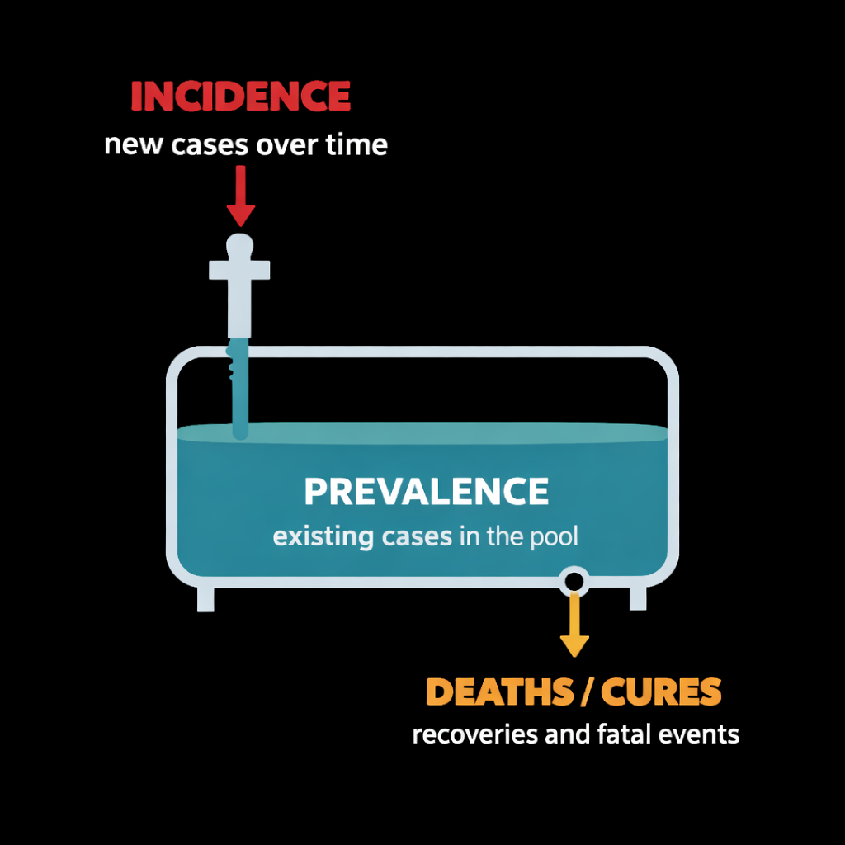
SECTION 2 · PREVALENCE
Period Prevalence, Attack Rates & the Bathtub Principle
ZIMBABWE CHOLERA OUTBREAK 2023–2024
THE BATHTUB PRINCIPLE: P ≈ I × D
34,549 suspected cases over ~17 months · Population 15.18 million (2022 census) · All 10 provinces · 62 districts affected
ART-era Zimbabwe paradox: HIV incidence has fallen, yet prevalence stays high (~13%) — ART extends duration dramatically, so the drain is plugged even as new infections decline.
17-month attack rate = 34,549/15,178,979= 0.23% = 228 per 100,000
Attack rate = cumulative incidence across an outbreak window. A single-day point prevalence would capture only a handful of active cases on that day — missing the full outbreak burden.
Research Masterclass for Clinicians
www.newlandsclinic.org.zw

Slide 27
SECTION 3 · INCIDENCE
Incidence Risk (Cumulative Incidence)
Incidence risk measures the probability that a disease-free person will develop the disease over a defined time window.
Formula & Key Requirements
CHITUNGWIZA CENTRAL HOSPITAL COHORT — Cheza A et al., PLoS One 2021
Inc. risk = New cases in period T ÷ Population at risk and disease-free at start of T
203 adult PLHIV enrolled on ART in January 2010 — followed for 10 years with minimal loss to follow-up. Incidence of NCDs (new events) calculated among those free of each condition at baseline.
Denominator must contain only people free of disease at baseline and biologically capable of developing it.
Fixed 10-year window · Near-complete follow-up → Incidence risk is appropriate
Assumes a closed cohort with uniform, complete follow-up — losses to follow-up are not accounted for by the simple proportion.
Bounded 0–1 (0–100%); interpreted as a probability for an individual entering the cohort.
Research Masterclass for Clinicians
www.newlandsclinic.org.zw

Slide 28
SECTION 3 · INCIDENCE
Person-Time: The Denominator for Open Cohorts
When cohort members are observed for variable lengths of time — due to staggered enrolment, losses or competing exits — a simple count denominator is inadequate. We replace it with person-time at risk.
Patient | Follow-up history | Person-years contributed
A | Remained disease-free for all 5 years | 5.0 PY
B | Developed the outcome at exactly year 2 → stops contributing | 2.0 PY
C | Lost to follow-up at year 3.5 → censored | 3.5 PY
Total | 1 event (Patient B) | 10.5 person-years
Incidence Rate
1 event / 10.5 PY = 0.095 per PY = 9.5 per 100 person-years
Each participant contributes time only while (a) actively observed and (b) free of the outcome. Unlike incidence risk, the rate is unbounded — it can exceed 1.0/PY for recurrent events.
Research Masterclass for Clinicians
www.newlandsclinic.org.zw

Slide 29

SECTION 3 · INCIDENCE RATE — REGIONAL EVIDENCE
Incidence Rate: Mortality at Newlands Clinic, Harare
Chimbetete C et al. PLoS One. 2020;15(8):e0237904 — Newlands Clinic, Harare
Parameter | Value
Patients followed | 4,868
Person-years accumulated | 27,527
Deaths during follow-up | 506
All-cause mortality rate | 18.4 per 1,000 PY
LEADING CAUSES OF DEATH
Tuberculosis
14.1%
Non-communicable diseases
11.9%
506 / 27,527 = 0.01837 per PY= 18.4 per 1,000 person-years
Malignancies
Simple count denominator (506/4,868 = 10.4%) would incorrectly treat a patient observed for 1 month the same as one followed 13 years.
10.7%
Meningitis
9.1%
Unknown
15.0%
Near-threefold increase in the NCD/malignancy share of deaths across 2004–2017 — only detectable using person-time allowing comparison across calendar eras.
Research Masterclass for Clinicians
www.newlandsclinic.org.zw

Slide 30
SECTION 3 — CHECK YOUR UNDERSTANDING
Dynamic Rate Calculation
A study tracks open-cohort patients for hypertension. The investigators compile a total of 2,000 person-years of observation time. Over this period, 14 new confirmed hypertension cases are diagnosed.
What is the incidence rate per 1,000 person-years?
✓
THE ANSWER
Rate = 14 / 2,000 PY = 0.007 per PY. Scaled to per 1,000 person-years: 0.007 × 1,000 = 7.0 per 1,000 PY.
!
COMMON MISTAKE TO AVOID
The usual slip is forgetting to rescale — 0.007 per PY and 7.0 per 1,000 PY are the same rate on different bases. Person-time denominators don’t need a baseline headcount; the total time observed is enough.
Research Masterclass for Clinicians
www.newlandsclinic.org.zw

Slide 31
SECTION 4 · ODDS
Odds: When Cases and Non-Cases Are Compared Directly
Probability vs Odds
CENTRAL OBESITY BY SEX — CHIHOTA ET AL., 2022
Probability = Cases / Total Odds = Cases / Non-cases
Odds Ratio (F vs M) = 2.31/0.18 ≈ 13.0
 | Cases | Non-cases | Probability | Odds
Women | 365 | 158 | 70% | 2.31
Men | 57 | 321 | 15% | 0.18
Odds = Probability / (1 − Probability). When prevalence <10%, odds ≈ probability. When prevalence is high, the two diverge substantially.
Why odds? Logistic regression models log-odds. Odds are therefore the natural output of case-control studies and any binary regression analysis. The Odds Ratio is the standard effect measure in case-control designs.
A 70% probability becomes odds of 2.31 — not 0.70. The rare-disease approximation (OR≈RR) does NOT apply here.
Research Masterclass for Clinicians
www.newlandsclinic.org.zw

Slide 32
SECTION 5 · PUTTING IT TOGETHER
Choosing the Right Measure of Occurrence
Measure | Denominator | Bounded? | Best suited to | Regional example
Point prevalence | Total pop. at one moment | 0–1 | Cross-sectional burden | Chihota MetS screen: 19%
Period prevalence | Pop. at start of window | 0–1 | Outbreak surveillance | Zimbabwe cholera attack rate: 0.23%
Incidence risk | At-risk count at baseline | 0–1 | Closed cohorts, fixed follow-up | Cheza NCD incidence, Chitungwiza
Incidence rate | Person-time at risk | Unbounded | Open/dynamic cohorts | Chimbetete mortality: 18.4/1,000 PY
Odds | Number of non-cases | Unbounded | Case-control; logistic regression | Chihota central obesity OR≈13.0
Am I counting existing cases at one moment?→Point prevalence
Am I counting cases across a window (incl. outbreak)?→Period prevalence / attack rate
New transitions, closed cohort, complete follow-up?→Incidence risk
New transitions, open cohort or variable follow-up?→Incidence rate (person-time)
Cases & controls sampled separately?→Odds (and odds ratio)
Research Masterclass for Clinicians
www.newlandsclinic.org.zw

Slide 33
SECTION 5 · READING CRITICALLY
Common Pitfalls in Reporting Measures of Occurrence
CALLING A PROPORTION A “RATE”
Prevalence and cumulative incidence are proportions, not true rates. “Prevalence rate” is a common but imprecise term. Always check whether time is in the denominator.
IGNORING LOSSES TO FOLLOW-UP
Using baseline count as denominator when 20% of participants are lost underestimates incidence risk. Person-time denominators (incidence rate) correctly account for censoring and variable observation periods.
CONFLATING ODDS AND PROBABILITY
Software outputs odds ratios from logistic regression, often misreported as relative risks. When prevalence >10%, OR > RR significantly — central obesity at 70% prevalence illustrates this starkly.
WRONG SCALE FOR RATES
18.4 per 1,000 PY, 0.0184 per PY and 184 per 10,000 PY are identical mathematically. Choose a base that makes the number interpretable to your audience without unnecessary decimal places.
Research Masterclass for Clinicians
www.newlandsclinic.org.zw

Slide 34
SECTION 6 · RECAP
Key Takeaways
✓
Proportions are bounded 0–1; true rates have person-time in the denominator and are unbounded — the terms are not interchangeable.
✓
Point prevalence photographs a pool of existing cases at one instant. Period prevalence (attack rate) captures all cases over a window.
✓
The bathtub: P ≈ I × D. ART extended HIV survival duration and kept Zimbabwean HIV prevalence high even as incidence declined.
✓
Incidence risk suits closed cohorts with complete, uniform follow-up. Person-time (incidence rate) is required for dynamic, open cohorts.
✓
Odds = cases / non-cases; bounded only below (0). The rare-disease approximation fails at high prevalence — OR is not then a close approximation of RR.
✓
The right measure is chosen by asking: existing or new? Fixed or variable follow-up? Cases and controls pre-sampled separately?
www.newlandsclinic.org.zw

Slide 35
REFERENCES
Peer-Reviewed Sources Used in This Session
Chihota BV, Mandiriri A, Shamu T, et al. for IeDEA Southern Africa. Metabolic syndrome among treatment-naïve people living with and without HIV in Zambia and Zimbabwe. J Int AIDS Soc. 2022;25(12):e26047.
Sabapathy K, Mwita FC, Dauya E, et al. Prevalence of hypertension and high-normal blood pressure among young adults in Zimbabwe. Lancet Child Adolesc Health. 2024;8(2):101–111.
Chimbetete C, Shamu T, Roelens M, Bote S, Mudzviti T, Keiser O. Mortality trends and causes of death among HIV positive patients at Newlands Clinic in Harare, Zimbabwe. PLoS One. 2020;15(8):e0237904.
Marumure J, Nyila MA. Cholera outbreaks in Zimbabwe: an in-depth analysis of drivers, constraints and reimagining the use of medicinal plants. J Trop Med. 2024;2024:1981991.
Shamu T, Egger M, Mudzviti T, Chimbetete C, Manasa J, Anderegg N, et al. Body weight and blood pressure changes on dolutegravir-, efavirenz- or atazanavir-based ART in Zimbabwe. J Int AIDS Soc. 2024;27(2):e26216.
WHO Regional Office for Africa. Zimbabwe declares cholera outbreak over. 9 August 2024. afro.who.int
Zimbabwe National Statistics Agency. 2022 Population and Housing Census Preliminary Report. Harare: ZIMSTAT; 2022.
Cheza A, Tlou B, Zhou DT. Incidence of NCDs in HIV patients on ART: Chitungwiza Central Hospital retrospective cohort 2010–2019. PLoS One. 2021;16(5):e0252180.
Porta M, Greenland S, Last JM (eds). A Dictionary of Epidemiology. 5th ed. Oxford University Press; 2008.
Research Masterclass for Clinicians
www.newlandsclinic.org.zw

