Slide 1
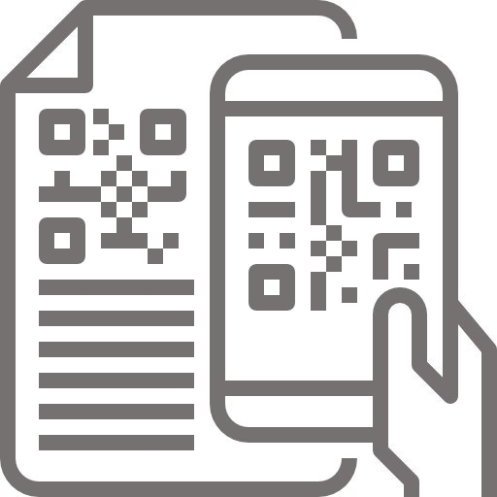



Architecture Diagram
Development Toolkit
(Doctor Portal)
Development Toolkit
(Patient App)
Apple Stores | Google Play
App download
Publish App/s
VSCode
GitHub
Client Side
Doctor Portal
Chemist scanner
Patient Mobile APP / KIOSK
Android Studio / XCode
GitHub
AWS
Server Side
Static Site
Load Balancer
API Load Balancer
Deploy Server Code
Deployment / Release Toolkit
Jenkins
Fastlane and HockeyApp
Nginx
Node.js
Web Application Server
API Application Server
3rd Party Integrations
Firebase
WhatsApp business API
Redis Server
In-Memory Cache
Adobe Analytics
(Client Side)
Crashlytics
(Client Side)
SMS Server
DB Server
[MongoDB]
Mail Server

