Slide 1
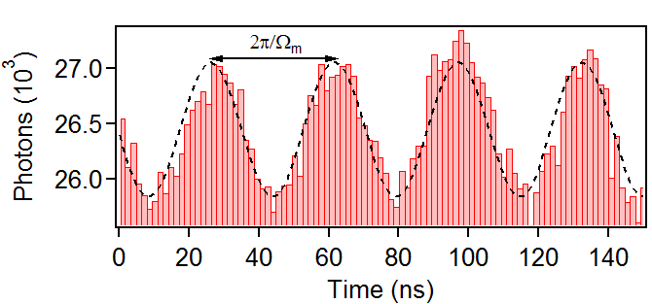
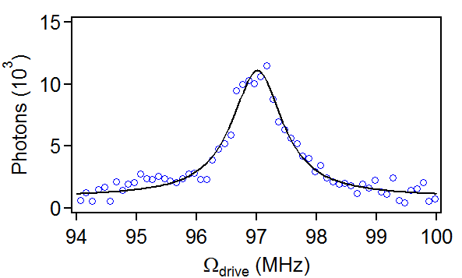
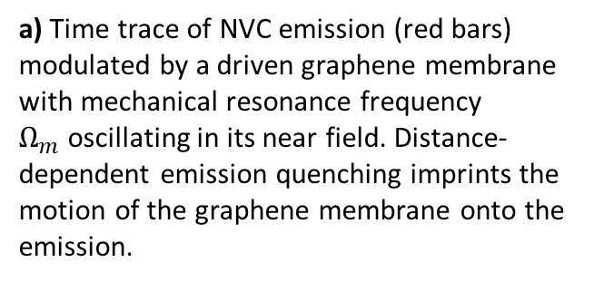
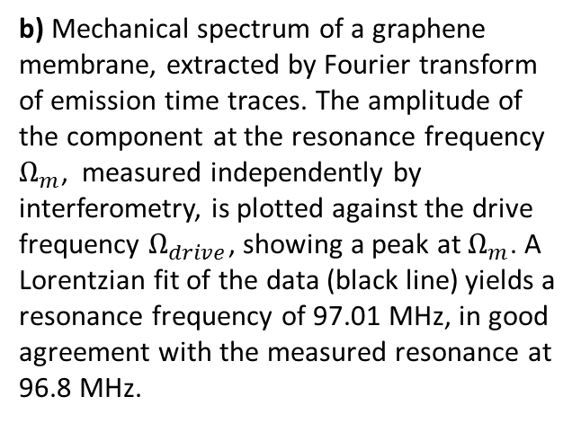
Fig. 2: Readout of graphene nano-motion via NVC emission.
a) Time trace of NVC emission (red bars) modulated by a driven graphene membrane with mechanical resonance frequency $Ω_{m}$oscillating in its near field. Distance-dependent emission quenching imprints the motion of the graphene membrane onto the emission.
b) Mechanical spectrum of a graphene membrane, extracted by Fourier transform of emission time traces. The amplitude of the component at the resonance frequency $Ω_{m}$, measured independently by interferometry, is plotted against the drive frequency $Ω_{drive}$, showing a peak at $Ω_{m}$. A Lorentzian fit of the data (black line) yields a resonance frequency of 97.01 MHz, in good agreement with the measured resonance at 96.8 MHz.

