Slide 1
main questions to answer
I : how do we see OptoMechanical Coupling ?
II : what is mechanism of this OMC ?
III : What can we do with this OMC ?

Slide 2
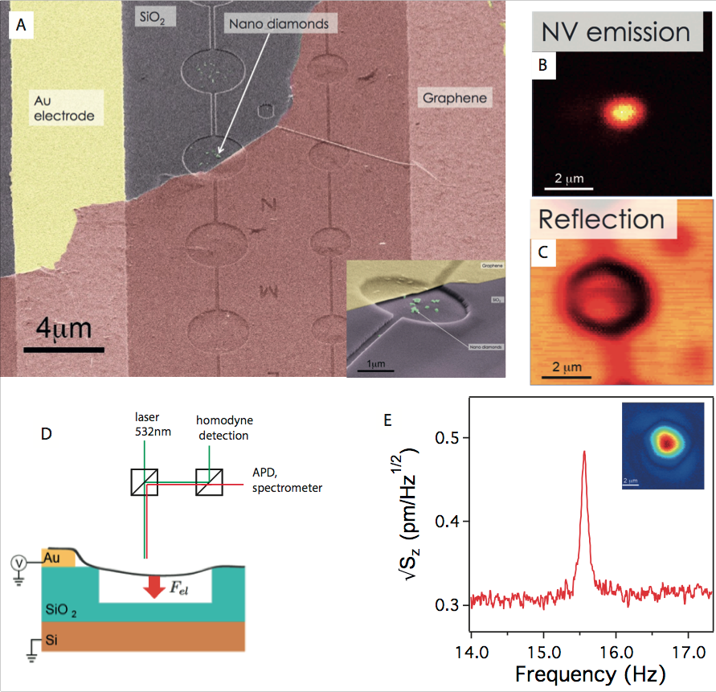
fig1 : Hybrid Graphene Nanoresonator

Slide 3
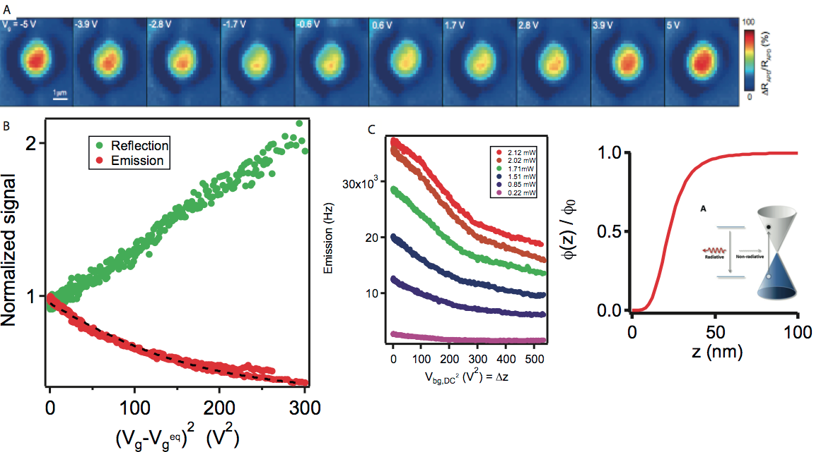
fig2 : Emitter coupled to mechanical motion

Slide 4
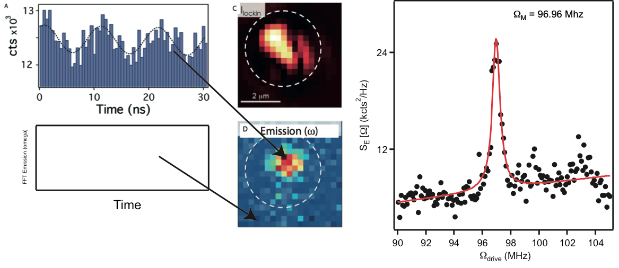
fig3 : Optomechanical control of a quantum emitter

