Slide 1
Project using web dev TOURNEY
By :
Resham Singh
Akashdeep Singh
Built using HTML, CSS, Bootstrap, Nodejs, Expressjs, Angularjs, NPM, NodeMailer, IDE, JavaScript, Jquery, MySQL, AIVEN, Cloudinary.

Slide 2
INDEX
INTRODUCTION
TECHNOLOGIES USED
KEY MODULES
USER INTERFACE
FUTURE SCOPE
CONCLUSION

Slide 3
Introduction
Objective -
The primary objective of this project is to design and develop an interactive web application that simplifies the process of discovering and managing tournaments. The platform enables users to efficiently search for tournaments based on location and sport, while offering tools for seamless event registration and management.

Slide 4
Key modules
User Management Module
Organization Dashboard Module
Player Dashboard Module
Tournament Search Module
Event Registration and Management Module
Security Authentication Module
Database Management Module

Slide 5
TECHNOLOGIES USED
HTML
CSS
JAVASCRIPT
Jquery
Nodejs
Aiven
Cloudinary

Slide 6
USER interface
Home Page
Organizer Dashboard
Organizer Profile
Publish Tournaments
Player Dashboard
Player Profile
Search Tournaments

Slide 7
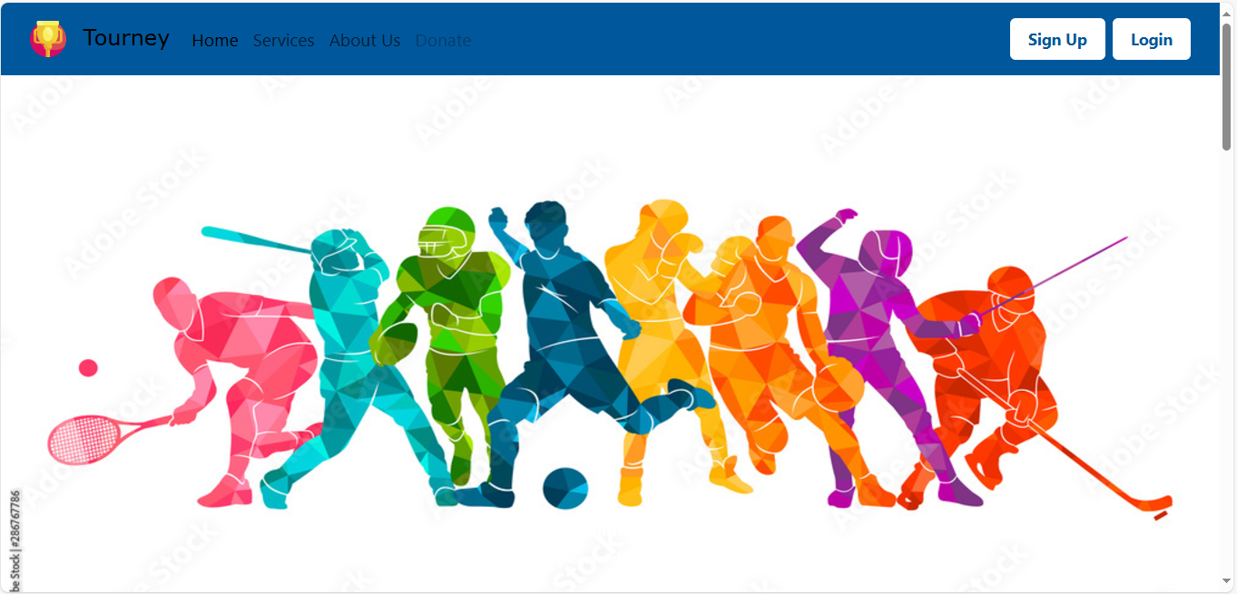
Home page

Slide 8
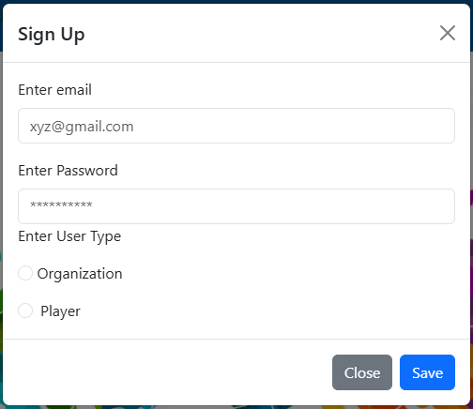
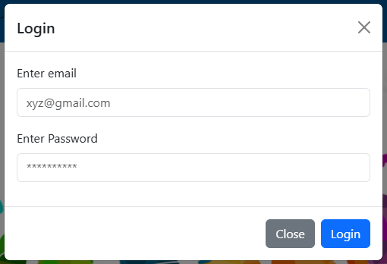
SIGNUP AND LOGIN page

Slide 9
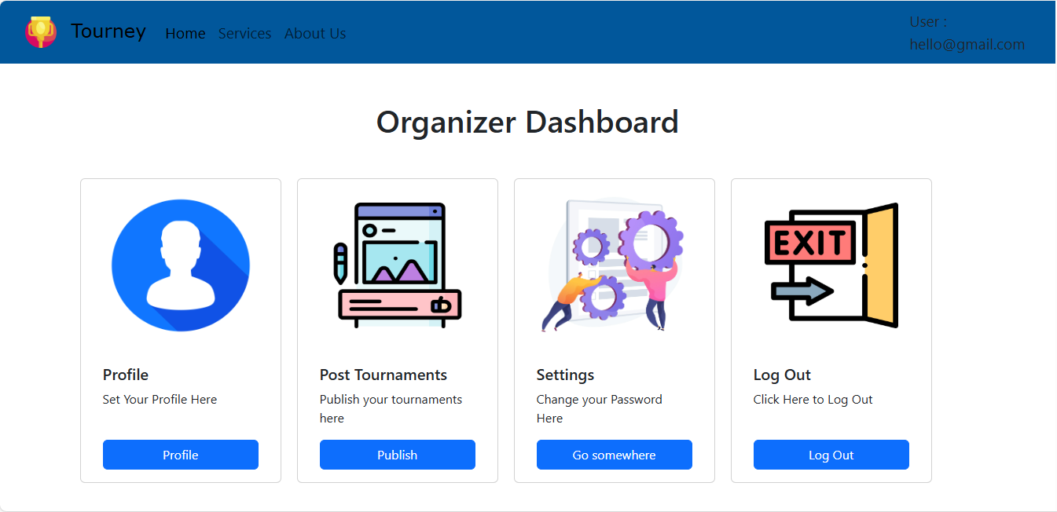
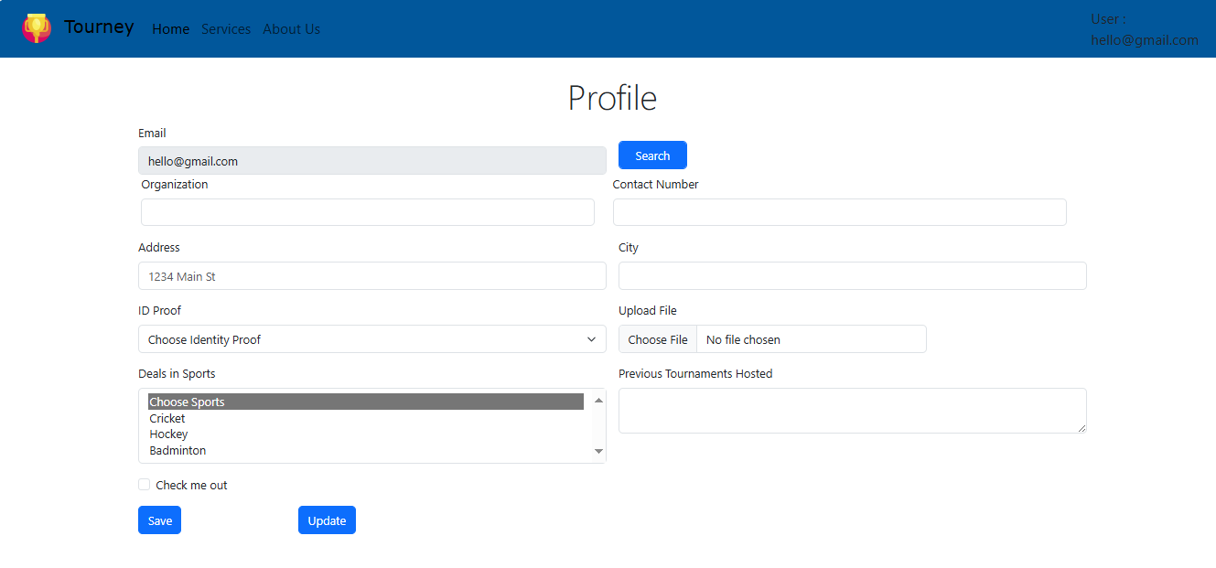
Organizer Dashboard and Organizer Profile

Slide 10
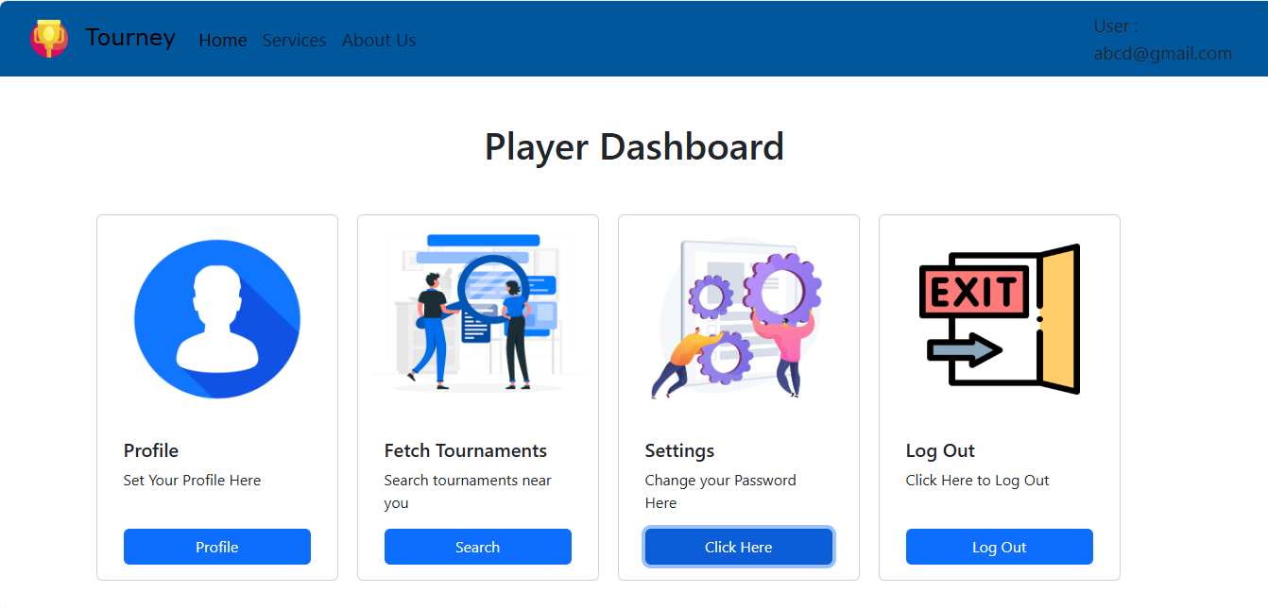
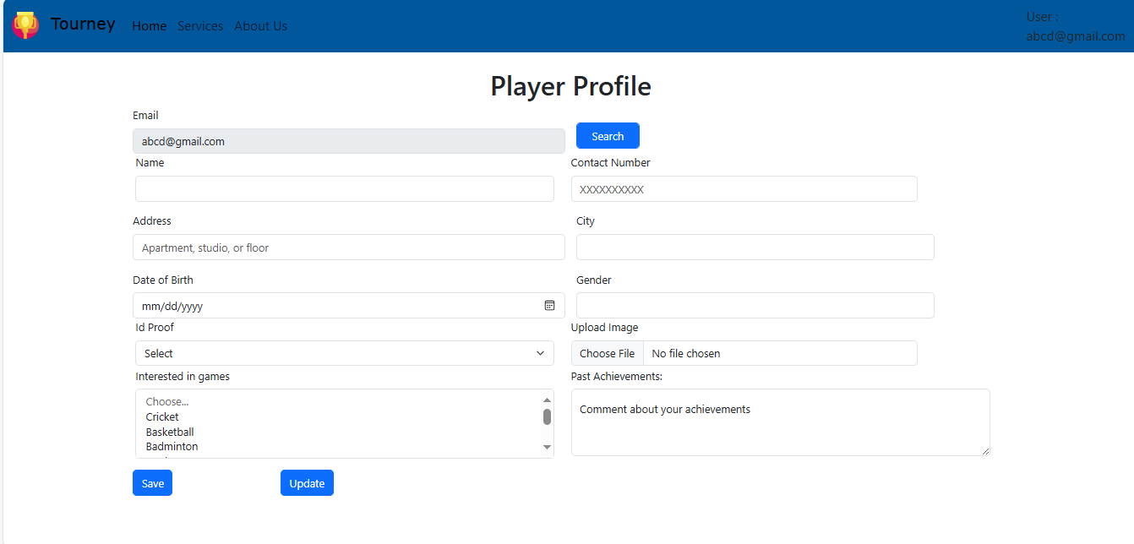
Player Dashboard and Player Profile

Slide 11
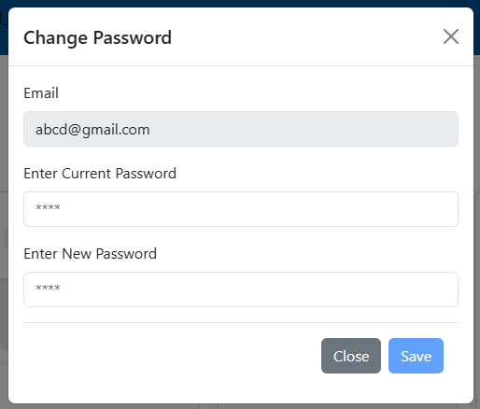
Settings page

Slide 12

Nav bar
footer

Slide 13
Future scope
1. Mobile Application Development Introduce mobile apps for iOS and Android, offering users on-the-go access to tournaments, player dashboards, and event management tools. A mobile interface will make the platform more accessible and user-friendly.
2. Social Media Integration Allow users to connect their profiles with platforms like Facebook, Instagram, and LinkedIn for sharing achievements, promoting tournaments, and gaining visibility.
3. Partnerships and Collaborations Build partnerships with game developers, sponsors, and esports organizations to provide exclusive benefits, such as in-game rewards, larger prize pools, and event promotions.
4.Virtual and Hybrid Events Support Enable features for hosting virtual or hybrid tournaments, including live streaming, virtual arenas, and online commentary. This will broaden accessibility and appeal to a global audience.

Slide 14
conclusion
The Tourney project has successfully developed a user-friendly and efficient web platform aimed at connecting players with tournaments and empowering organizers to publish their events seamlessly. By leveraging modern web technologies such as [HTML, CSS, JavaScript, and NODEJS, AngularJS, MySQL], the platform provides an intuitive experience for discovering tournaments, registering participants.

