Slide 1
Machine Learning Project -
Stock Price Prediction
Aim: Stock Price Prediction
We use multiple regression algorithms like Decision Tree Regression, SVM LS, Linear Regression, KNN Regression, ARIMA ,Prophet ,LSTM to compare the accuracy each of them can give.
We also performed sentiment analysis on economic news to influence the predicted price of the stocks.
Reshan Faraz (Phd19006)
Arpit Saxena(MT20058)
Waquar Shamsi (MT20073)

Slide 2
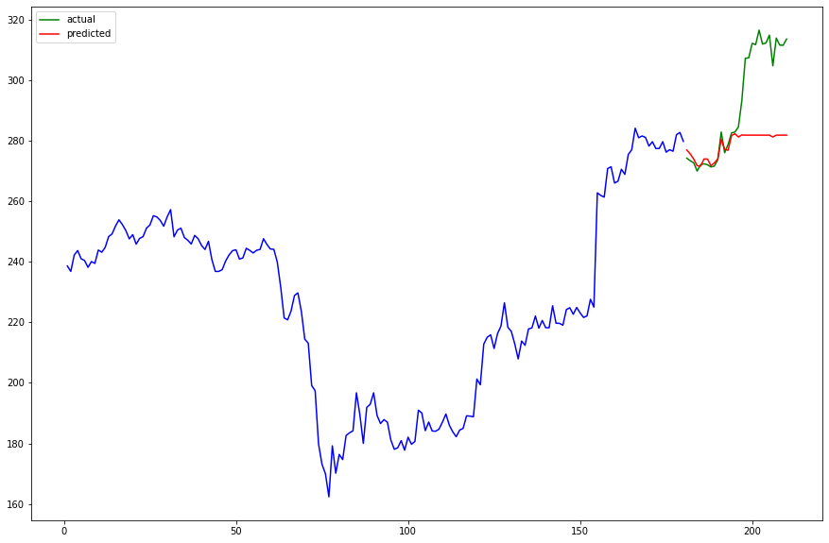
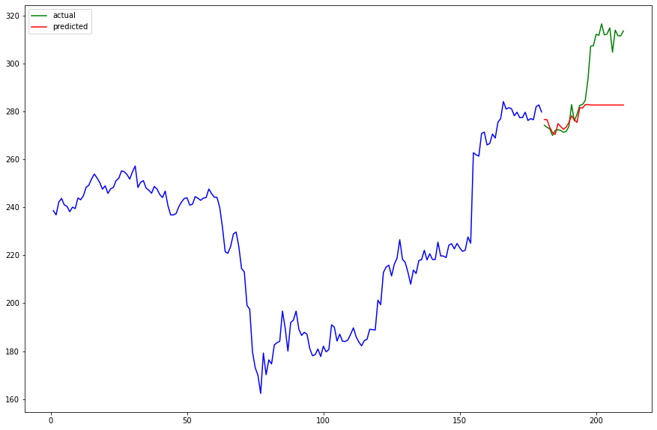
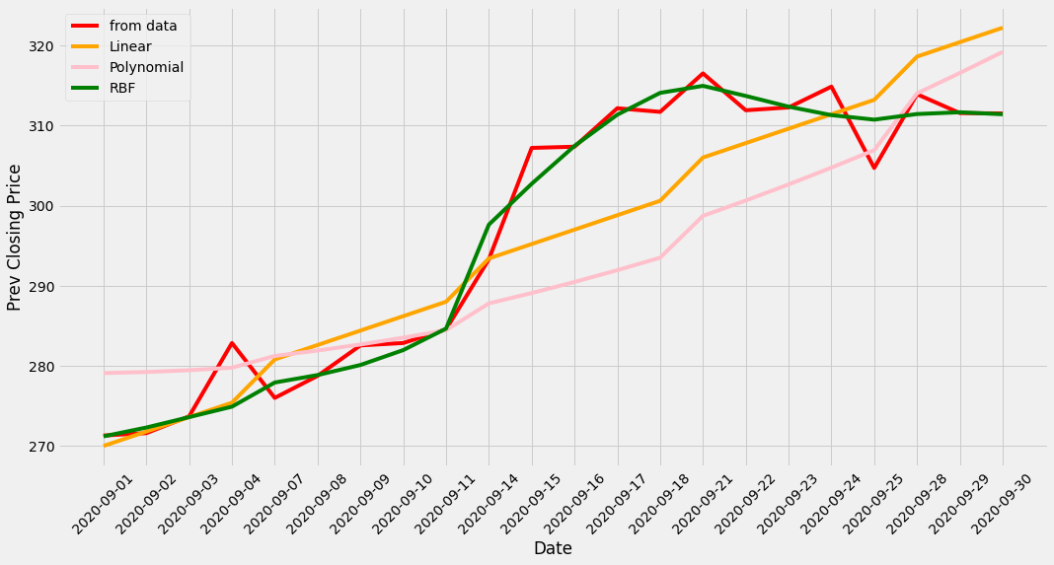
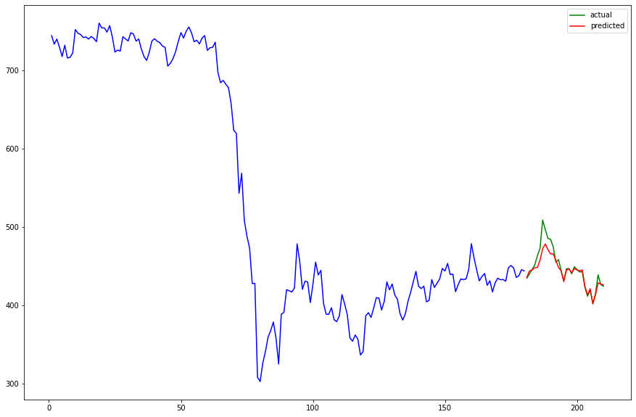

BASELINE MODELS
KNN; Stock: Wipro (MSE: 392.37)
Random Forest Stock; Wipro MSE: 370.295
Stock: Wipro
MSE: 370.29
Stock Price Prediction for Wipro
Support Vector Regressor
KNN; Stock: AxisBank (MSE: 100.68)
Random Forest; Stock: AxisBank MSE: 58.96

Slide 3
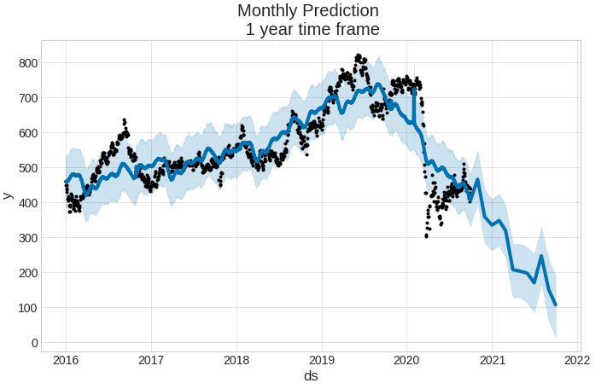
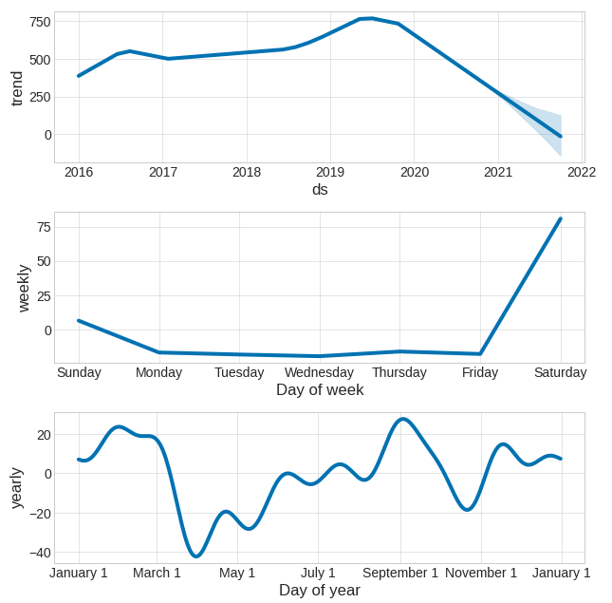
Results Achieved for Prophet
Stock Price Prediction for Axis Bank
MSE ( 35.19616710299317)

Slide 4
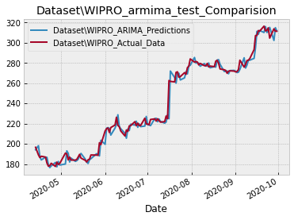
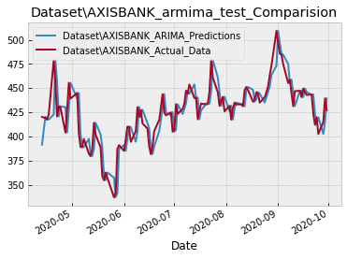
Results Achieved for ARIMA model
MSE: 34.887186486702966
MSE: 242.14351669335326

Slide 5
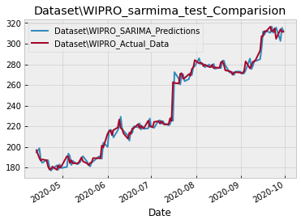
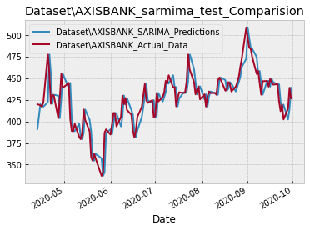
Results Achieved for SARIMA model
MSE: 34.33071791122736
MSE: 242.1835416666665

Slide 6
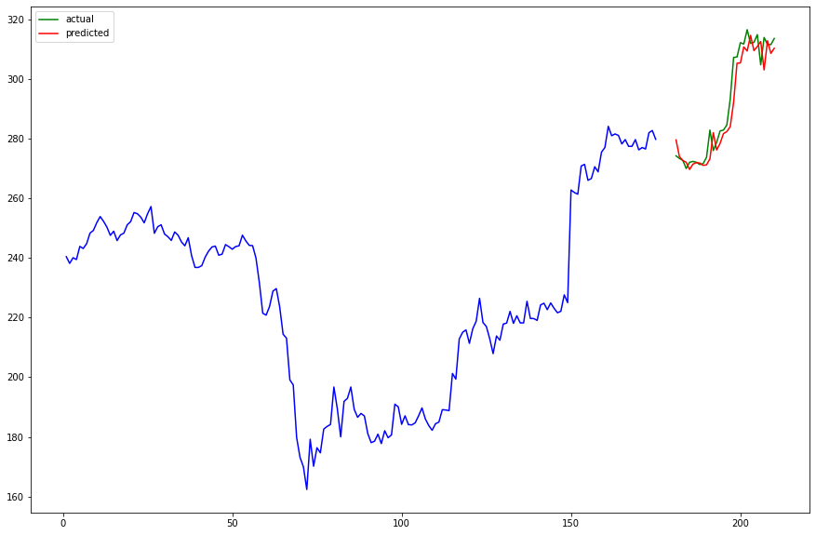

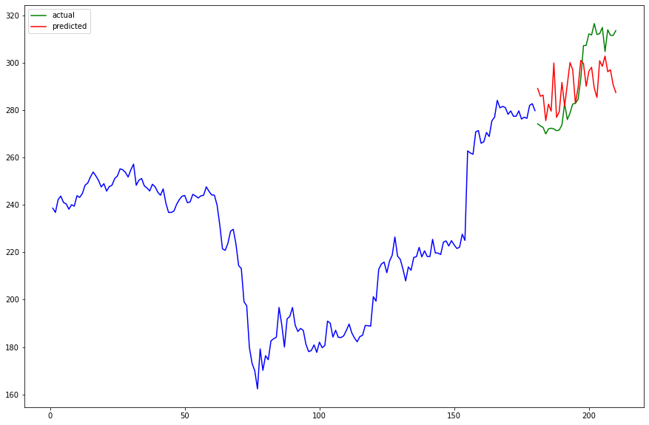

LSTM and SENTIMENT ANALYSIS
LSTM on Wipro - MSE: 37.24
LSTM on Wipro with Sentiment Analysis - MSE: 24.82 IMPROVEMENT OF : 50.02%
RandomForest with Sentiment Analysis on Wipro - MSE: 240.55 IMPROVEMENT OF : 53.93%
KNN with Sentiment Analysis on Wipro - MSE: 251.09 IMPROVEMENT OF : 56.26%

Slide 7
CONCLUSIONS
LSTM is far superior than RandomForest, KNN, SVM for stock price prediction.
Using sentiment analysis on economic news along with historical prices of stock gives much better performance.
ARIMA and Prophet Algorithm works almost as good as LSTM if not better for stock prediction.

Slide 8
Thankyou.... Any Questions ? ? ?
Contribution
Reshan Faraz
Arpit Saxena
Waquar Shamsi
SVR (support vector Regression )
Linear
Polynomial
RBF
Prophet Model
Preparation of Report and Presentation
Dataset Selection
Linear Regression Model
ARIMA Model
SARIMA Model
Preparation of Report and Presentation
k-Nearest Neighbors Regression and Random Forest Regression
Scraping Economic News to create news dataset Sentiment Analysis on LSTM, KNN and Random Forest
LSTM
Preparation of Report and Presentation

