Slide 1
Network Security
Assignment 1
Reshan Faraz (PhD19006)
Koustuv Kanungo (PhD18007)
Submitted to Dr. B.N Jain

Slide 2
Problem Statement
Implement monoalphabetic substitution cipher by substituting 2 symbols at a time. Then implement a brute force algorithm to find the key.

Slide 3
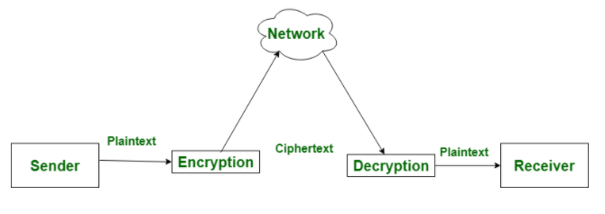
Encryption and Decryption
Encryption is the process of translating plain text data (plaintext) into something that appears to be random and meaningless (ciphertext).
Decryption is the process of converting ciphertext back to plaintext.

Slide 4
Monoalphabetic Substitution Cipher :
It is a caesar cipher, but using “permutations” based substitution
– encrypt ci ← lookup_encrypt(pi)
– decrypt pj ← lookup_decrypt(cj)
Key K == specific permutation of plaintext symbols, pi m! Different keys, where m = no. of symbols.
We are substituting multiple symbols( here 2) at a time.

Slide 5
Encrypting PlainText :
Key is generated from the number of symbols given, as the key is just a permutation of the tuples.
The encryption is done by taking 2 characters at a time and writing their corresponding cipher into the encrypted file.

Slide 6
Decrypting Cipher Text :
This follows the opposite process to the encryption.
Here, the key is switched with the tuple index, and then the tuples in the encrypted file are substituted by using the switched key to get the decrypted text.

Slide 7
Verifying the Decryption :
Simple diff with the plaintext file does the job.

Slide 8
Launching Brute Force to find the Key :
By using next_permutation() function in the C++ Standard Library, we can get multiple permutations of an array.
Through this, we can run the decryption algorithm with each permutation, and check the property of the plaintext being in non-increasing order to verify that the plaintext is indeed valid.

Slide 9
Thank you ! Any Questions ???

