Slide 1
Network Security
Assignment 4
Reshan Faraz (PhD19006)
Submitted to Dr. B.N Jain

Slide 2
Problem Statement (Project 0 Time‐stamping a document)
Upload the document to the server (or perhaps some version of it) and expect to receive the same but with the current date and time stamped onto the document. And establish document existed at the date/time stamped, and that the document has not been modified .
1 - How and where do you get the correct GMT date and time? And how often? Answer : I got the GMT date and time from local server machine using python library datetime and it easy to get datetime.datetime.now(datetime.timezone.utc).strftime("%Y-%m-%d %H:%M:%S")

Slide 3
Continue . . .
2 -Is the source reliable and the GMT date and time obtained in a secure manner? Answer : Yes the source is reliable and GMT date and time obtained in a secure manner.
3- How do you ensure privacy, in that the server does not see/keep the original document? Answer : After adding the time stamp to the document server delete the temporary file it used for signing the document , hence the privacy will be maintained . Server did not keep any copy of the document.
4- How do you share the document with others in a secure manner with the date/time preserved,and its integrity un‐disturbed? Answer : I hashed the document and attached the hashed to the end and encrypt the document with my private key and send it ,in that way receiver will verify whether the integrity of the document is maintained or not by decrypting and hashing the document and matching those hashed with the attached hashed.
5-Also ensure that the user (both the owner and anyone verifying the date/time) uses the correct “public‐key” of the “GMT date/time stamping server”. Answer : Both the parties have prior knowledge about the key pairs . For implementing this I used openssl to generate 2048 RSA key pairs.

Slide 4
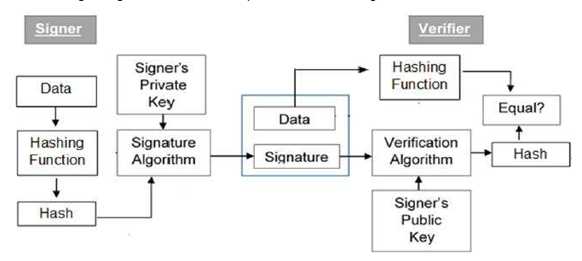
System Description and Implementation:
I program two files client.py and server.py . The client.py will contain the implementation of the user who wants to time stamp the document . while the server.py contains the implementation of the server who time stamps the document and performs digital signature on the document. For connecting client and server I used socket programming. Following are the libraries used in python socket, os, item ,datetime ,haslib.

Slide 5
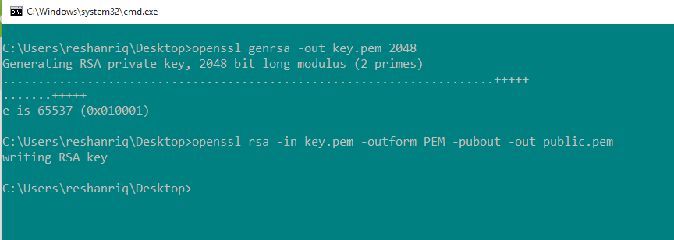
Key Generation

Slide 6
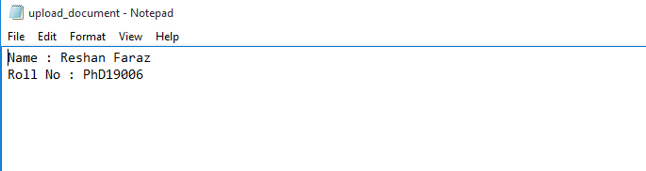
File Uploading
Client will send the document which he/she wants a timestamp. I used a simple .txt file upload_document.txt which is sent to the server. Following is the file :

Slide 7
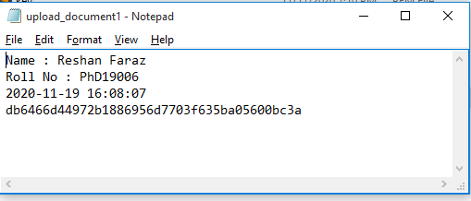
Server attached timestamp and digital sign the document and send back to client
After that client decrypt the document and verify . Following is the document received by the client :

Slide 8
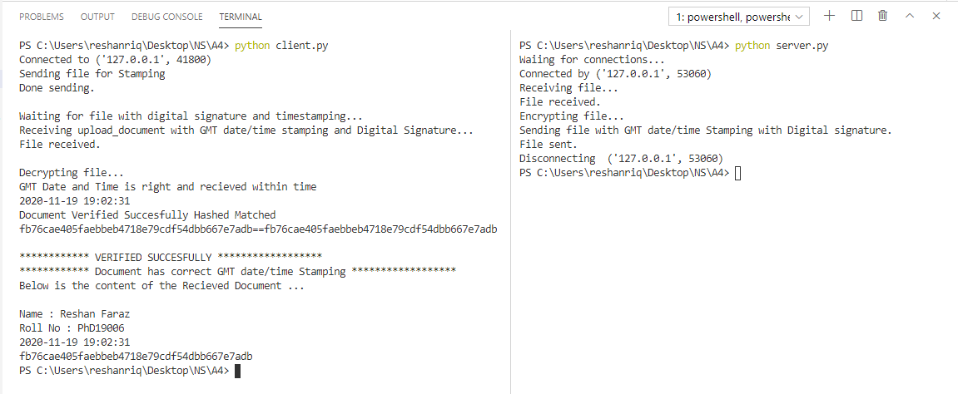
Output of the server.py and client.py

Slide 9
Thank You !!! Any Questions ?

