Slide 1
Network Security
Assignment 2
Reshan Faraz (PhD19006)
Koustuv Kanungo (PhD18007)
Submitted to Dr. B.N Jain

Slide 2
Objective
Develop a program to encrypt and decrypt a 64‐bit plaintext using DES.
-Verify the output of 1st encryption round to output of the 15th decryption round.
-Verify the cipher text with the plain text.

Slide 3
Design of system
Application is Developed in python, Basic UI is also provided for better visualization . The user will input the Message/Plain Text and key in hexadecimal and then click on Encrypt button then on the next window the Cipher text will be seen along with Plain text which was obtained by decrypting the cipher text. For the second part of the solution I also show the output of the 1st round of Encryption to the output of the 15th round of the Decryption, which is equal.

Slide 4
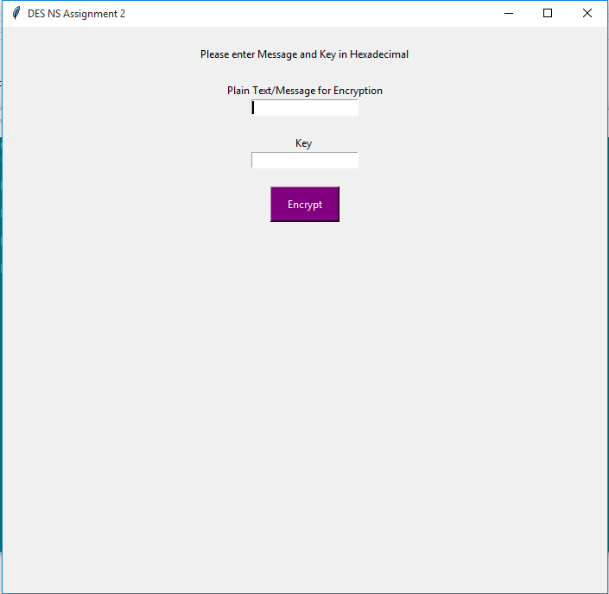
Application Start Page

Slide 5
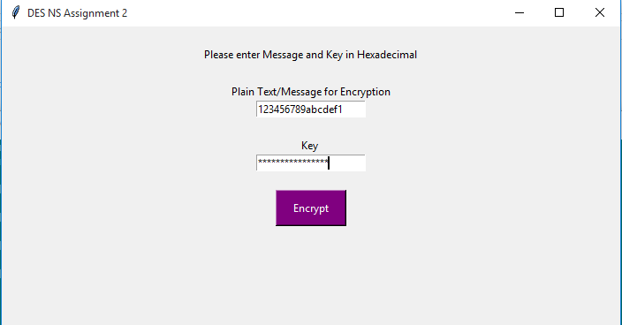
Taking Input

Slide 6
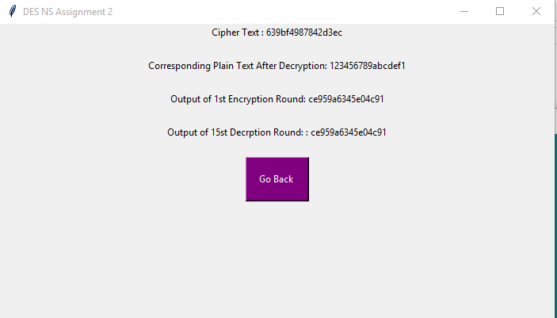
Verification

Slide 7
Thank you ! Any Questions ???

