Slide 1
OOPD
Project
HR Recruiting System
Reshan Faraz (PhD19006)
Md Shadman Ahmad (MT20188)
Submitted to Dr. Naveen Prakash

Slide 2
Project Description
Project Description: This project is aimed at developing a central Recruitment Process System for the HR Group of a company. The company keeps record of employees who have left, retired, or are removed from service. Besides replacing such employees, the HR department may also be asked to recruit against completely new positions. The salary structure, designation structure are decided by the HR department and recruitment steps are initiated. These include storing applicant data, conducting interviews, and issuing appointment letters to selected candidates.
The Objective is to implement Object Oriented Design for the project. For this we have created six different classes for instantiating different objects. The concept of OOPD like inheritance and complex Objects are used. The SOLID principles like SRP, OCP are kept in consideration for the project.

Slide 3
Classes Used
Person: This class instantiates Person Objects which has the general attributes of a person :
Name
DOB
Gender
Method:
Show_selected() - This method is for any person who comes to the portal to check the selected candidates
This class serves as the base class for every person like Applicants ,Admins, and Employees
Job: This class creates different jobs with attributes
Job_description
Position
Salary
And Methods:
Register() - To register the newly created job to the list of jobs available
Show_jobs_available() - To show the available jobs for the organisation. This function can be invoked by both Applicants and Admins
Show_applied_candidates() -To display the candidates which has applied for particular job. This function can be invoked only by Admin
Take_new_job_details() - To open an interface for admin to insert new job details

Slide 4
Applicant: This class instantiates an Applicant applying for a particular job .It inherits Person class and has its attributes:
Work-experience
High-school Percentage
College CPI
Applied Job id
And methods:
Register() - for registering itself on to the portals database after entering the attribute details
Employee: This class inherits from the Person class and has a complex Object ‘Job’ as an attribute which gives the employee attributes
Job_description
Position
Salary
Methods:
Register() - for registering itself to the Employee register
Resign() - for leaving the job for a giver reason and become an Ex-Employee

Slide 5
HRadmin: This class inherits from the base Person class. Hr Admins have full access to the portals and can invoke most of the attributes of other cass. It has attributes
Username
password
Methods:
shortlist() - To shortlist he applied candidates by putting certain criteria
interview() -To take interview of the shortlisted candidate and produce the final selected list
show_shortlisted_candidate() -To check shortlisted candidate before interview
show _emloyee_register() - To check the employees working in the organisation
separate_employee() - To do the resignation process of an employee and mention the reason for the separation
show_ex_employees() - To show the employees who have left the organisation with the reason for leaving

Slide 6
userGUI: This class serves as the main page for the portal and has different buttons to navigate to the different pages of the portal through buttons. The buttons serves as the methods to open other pages
It has the following attributes:
Title
Admin_login
Applicant_login
list_of_selected _candidates
Methods:
main() -This method opens a window as the mainloop and shows the attributes of user GUI
like title and buttons on the window. These buttons are for admin login, applicant login and showing selected candidates which when clicked creates a new window object for the respective pages

Slide 7
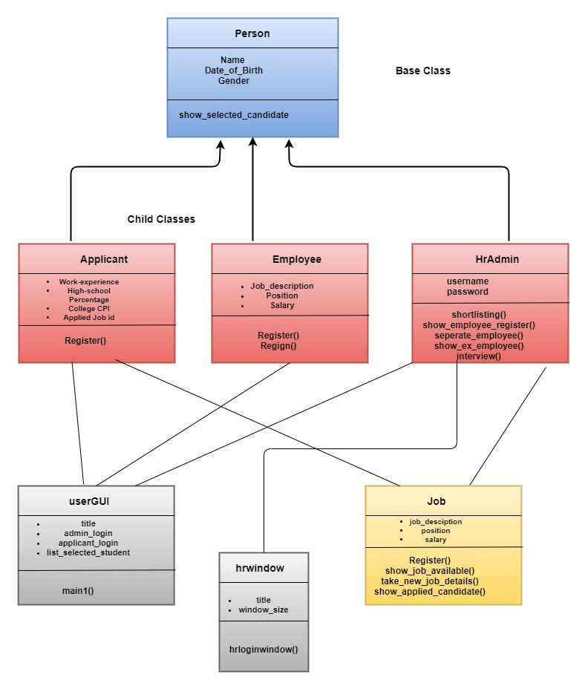
Class
Model

Slide 8
SRP (Single Responsibility Principle)
In SRP ,class a computer program should have responsibility over a single part of that program's functionality, which it should encapsulate. For this project the User Interface part will be implemented using SRP as the welcome page of the application have userGUI class which is responsible only for the UI part from which it is encapsulated like the HR admin login , showing the list of selected candidate.

Slide 9
OCP (Open - Close Principle)
OCP principle works on open for extension but closed for modification. In our application classes like the Person ,Employee will follow the OCP principle. For e.g in class Employee , we have methods to register for new employee and Resignation of employee. These two methods are not allowed for modification but we can extend the Employee class by adding more functionality like employee can give feedback while leaving the Company or Employee can give reference for new jobs opening to other people.
Inheritance is extensively used in the project . Classes like Applicant ,Employee, HrAdmin inherit from the base Person class which ensures OCP principle

Slide 10
COMPLEX OBJECT
Concept of complex Object says that we can use an object as an attribute for another object. In this project we have used this concept for Employee class.An Employee object inherits from person class and has a job as an attribute. But the job itself is a class having attributes job_description, salary and Position. So the employee can have a job and for accessing its salary we can use emp1.job.salary

Slide 11
GUI Using Object Oriented Module
In this Project we have use TkInter for implementing GUI which itself is based on Object Oriented Programming Design. The window that opens using TkInter is an object having different attributes like geometry ,size and title.
The Buttons that are placed on the the window are also object having the name of the button , colour and size as attribute and the command behind the button is a behaviour which has a function associated to it .

Slide 12
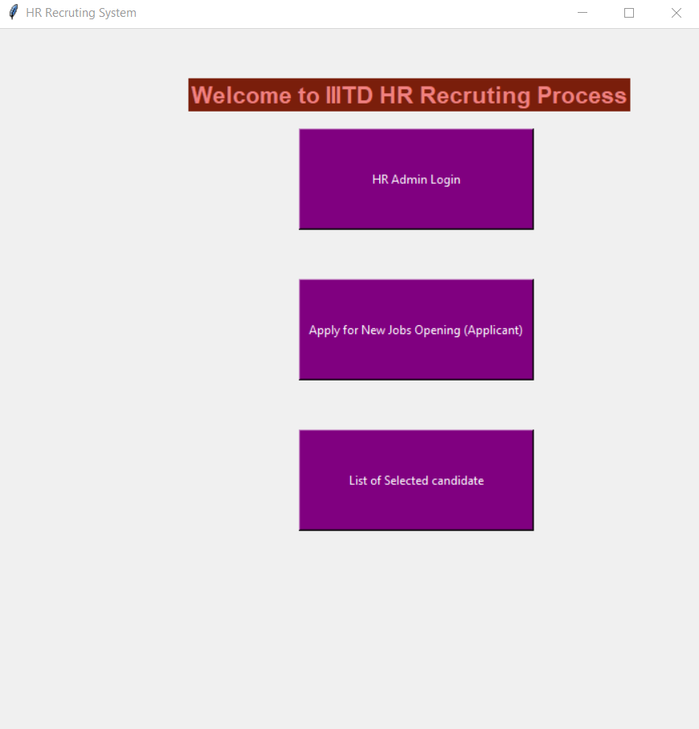
HOME PAGE OF THE HR PORTAL
Home page has these three buttons

Slide 13
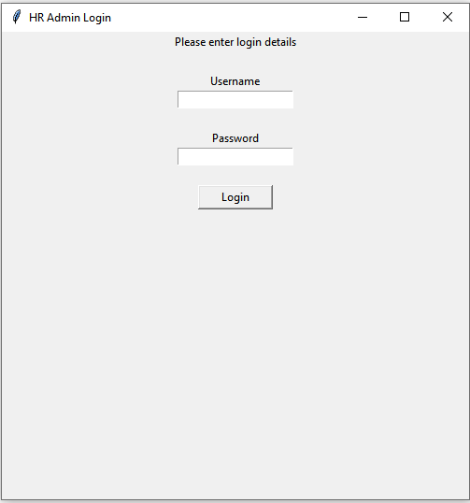
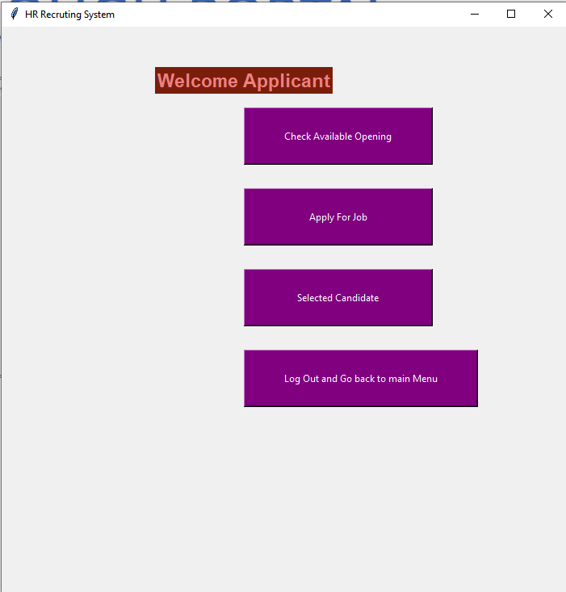
NAVIGATING THROUGH PORTAL

Slide 14
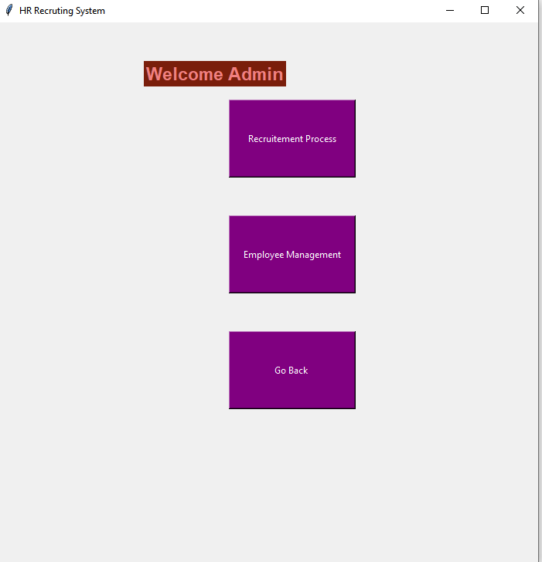
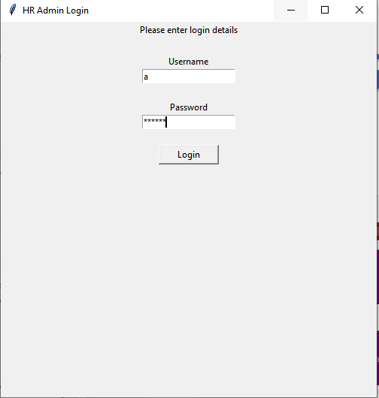
HR ADMIN LOGIN PAGE

Slide 15
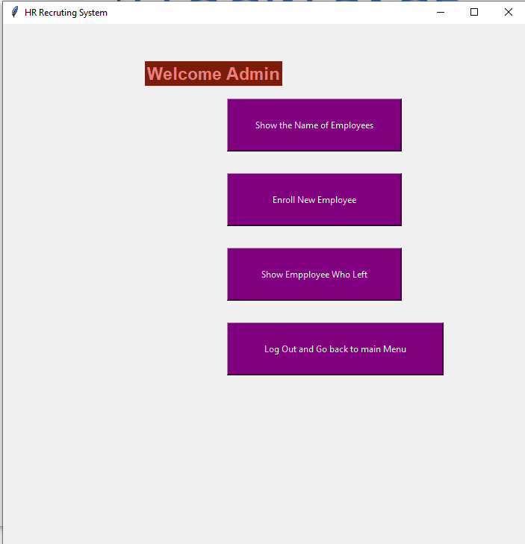
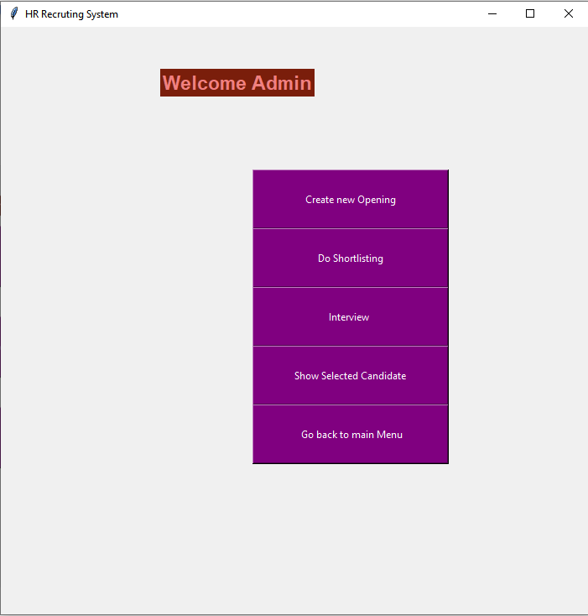
ADMIN LOGIN PAGE HAS
Recruitment process
Employee management

Slide 16
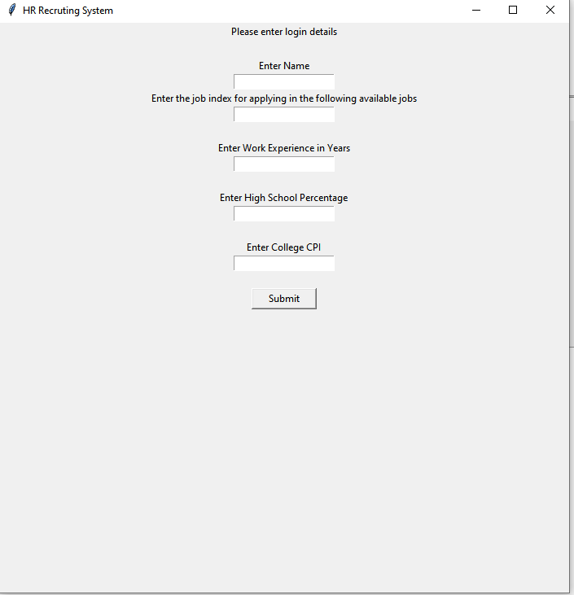
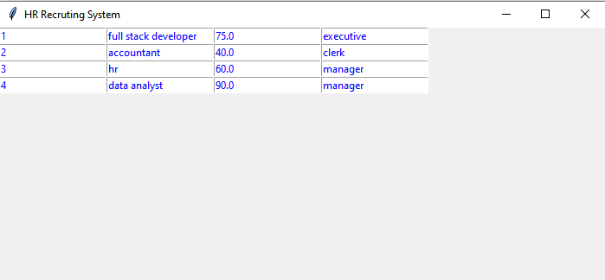
APPLICANT LOGIN PAGE

Slide 17
SAMPLE DEMONSTRATION
An applicant named Vatsal will apply for a job from the available jobs
HR admin will check the applied jobs
HR admin will do the shortlisting and interview process
Vatsal will check for the selected list from the portal

Slide 18
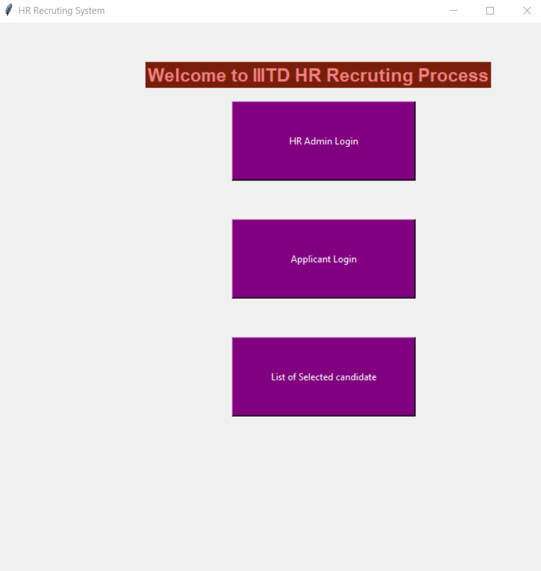
Vatsal goes to the HR portal and applies for new job

Slide 19
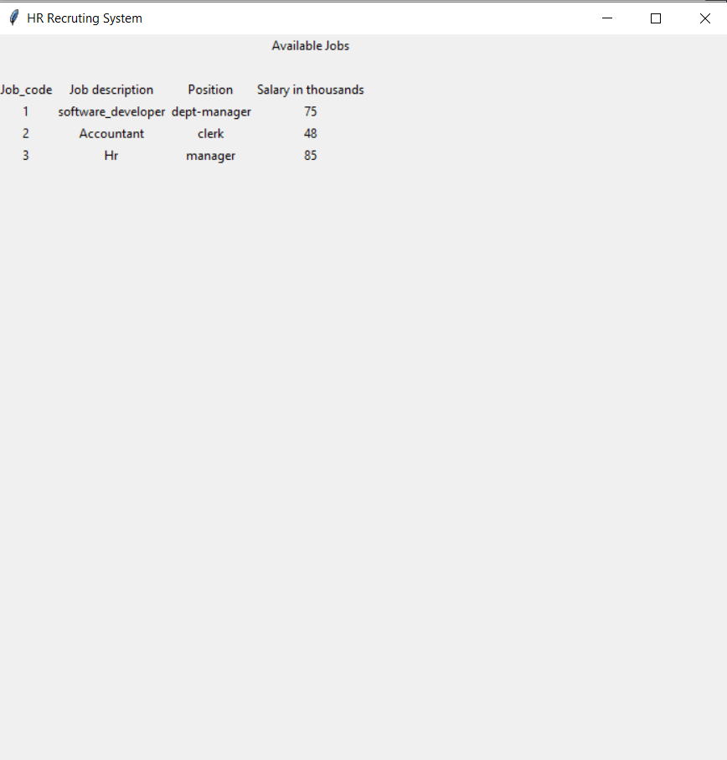
He checks the available job openings

Slide 20
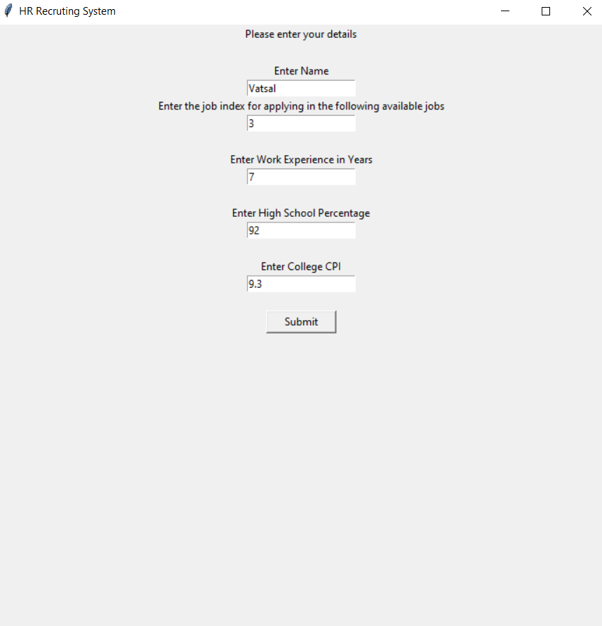
He decides to apply for manager post in HR which is job no 3

Slide 21
HR Admin will login to the portal

Slide 22
Hradmin will go to the Recruitment process

Slide 23
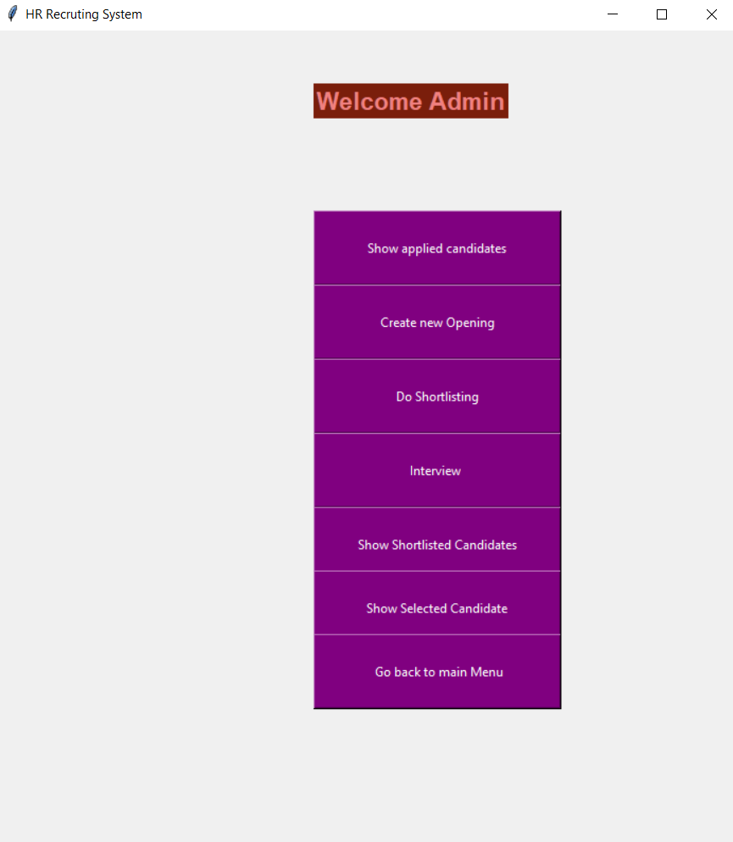
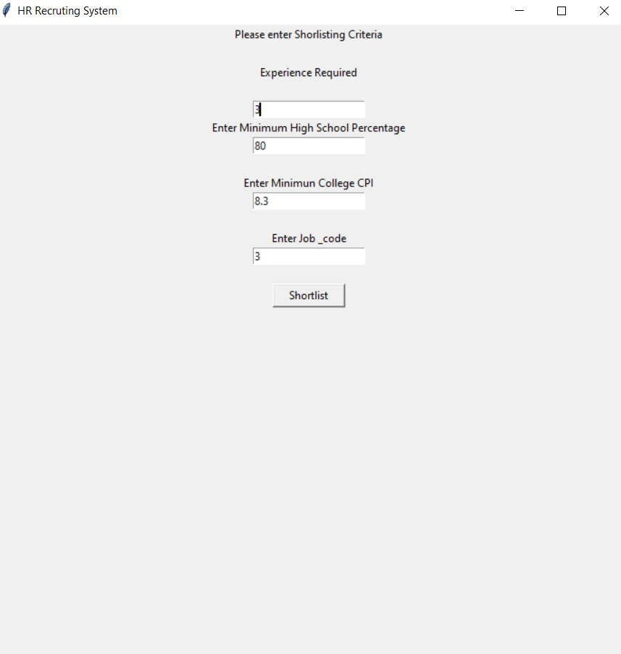
HR Admin will set the shortlisting criteria for job code 3 which Vatsal has applied for

Slide 24
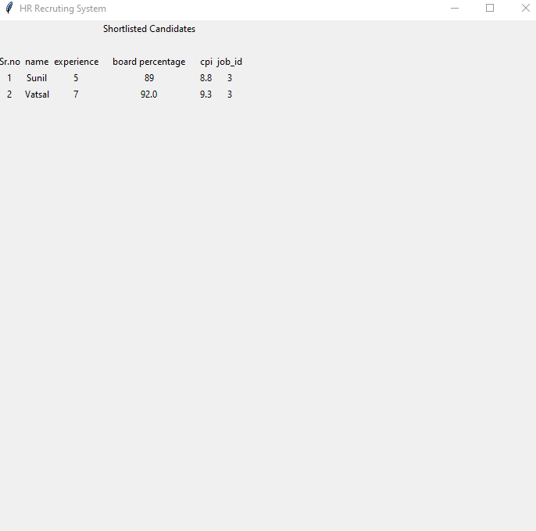
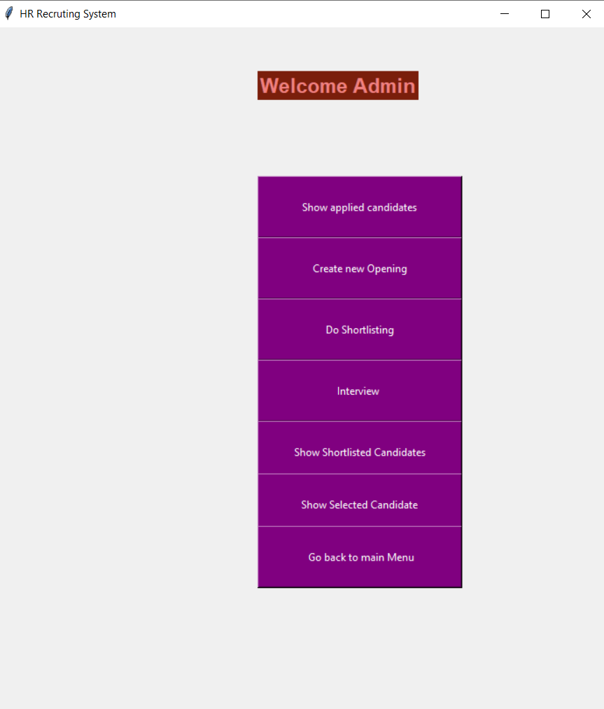
Hr Admin will check the shortlisted candidates
Vatsal and Sunil has been shortlisted

Slide 25
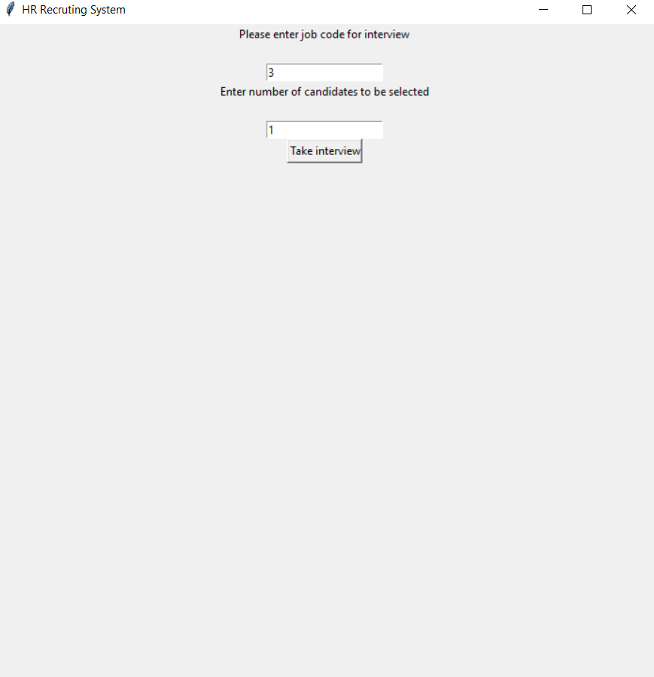
HR admin will do the Interview process for job code 3
One candidate is to be selected in interview

Slide 26
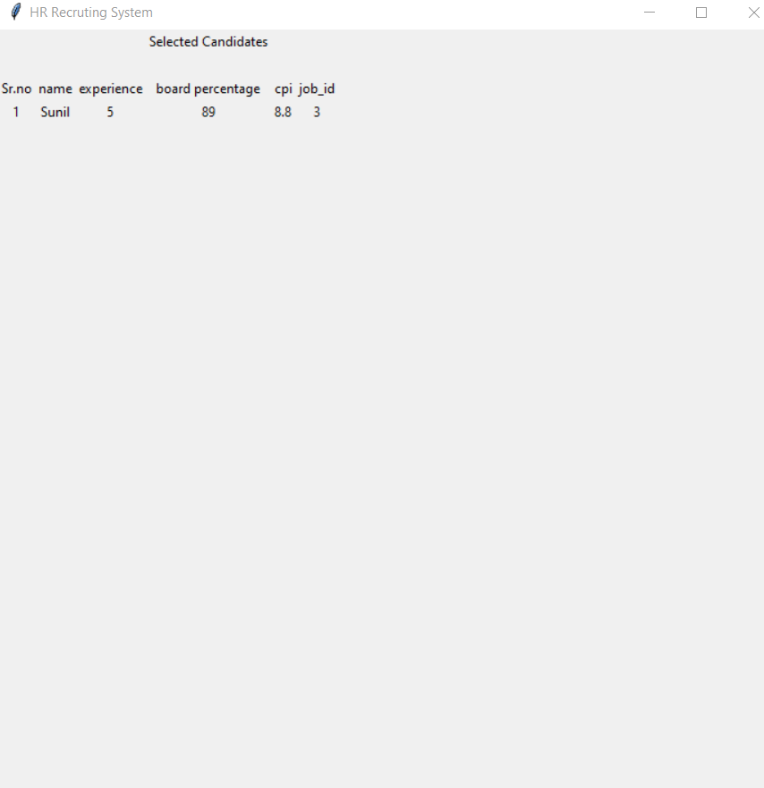
Vatsal visits the website to check the result
Ops! Vatsal has not been selected, Sunil has been selected

Slide 27
Contributions of the Members
Reshan Faraz (PhD19006)
🡪Implementing the classes.
🡪Implementation of GUI using tkinter
🡪Debugging the code
Md Shadman Ahmad(MT20188)
🡪Back end development
🡪Implementing the classes.
🡪Debugging the code

Slide 28
Thanks
Any Questions ? ? ?

