Slide 1
CODE
FLOW
AND SAMPLE
RUN

Slide 2
DESCRIPTION OF DATABASE USED
SQ lite database has been used
The data base has three tables
applied_candidates
Jobs_available
employee_register

Slide 3
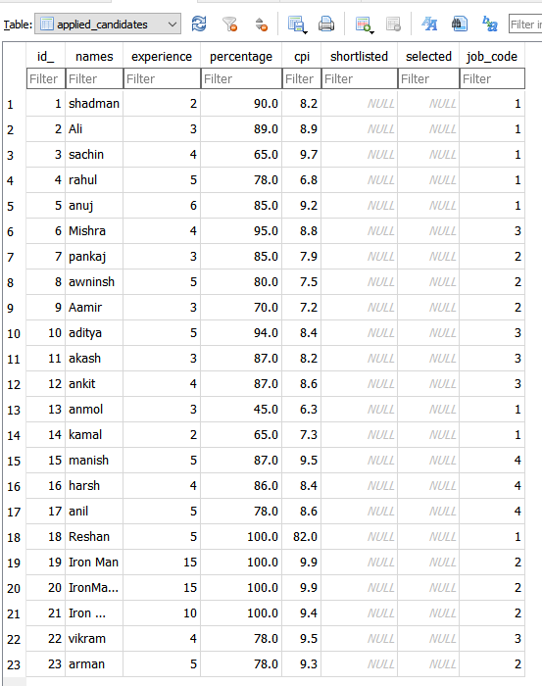
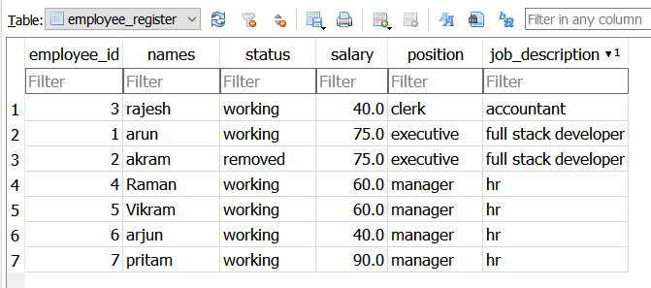
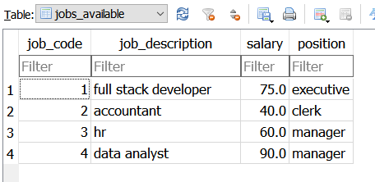
TABLES OF THE DATABASE

Slide 4
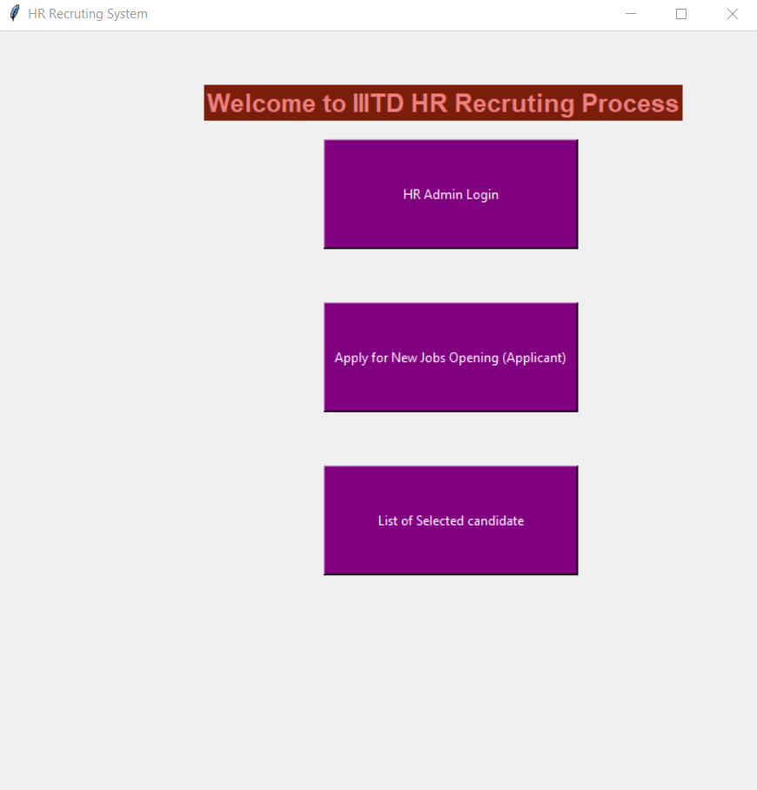
HOME PAGE OF THE HR PORTAL
Home page has these three buttons

Slide 5
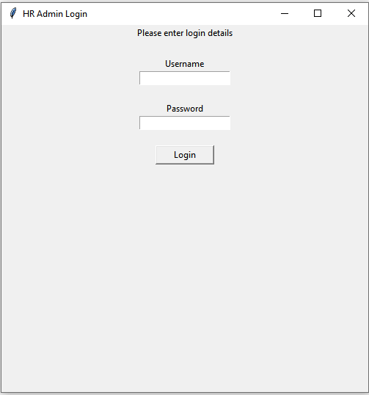
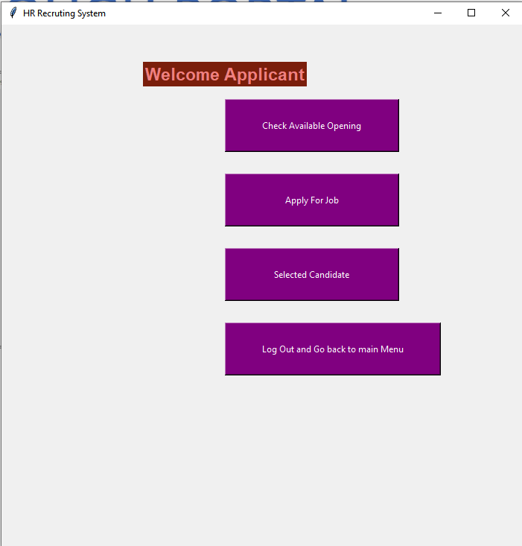
NAVIGATING THROUGH PORTAL

Slide 6
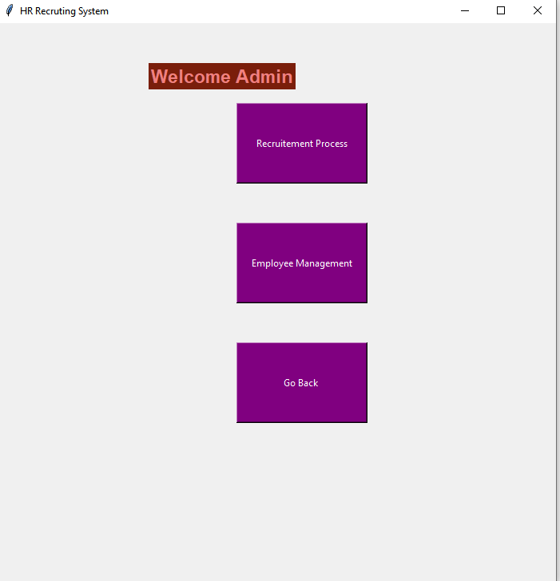
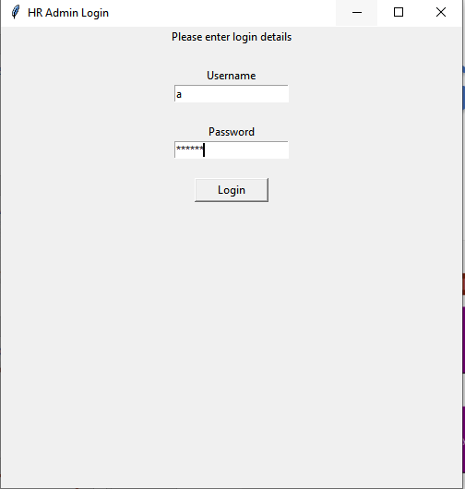
HR ADMIN LOGIN PAGE

Slide 7
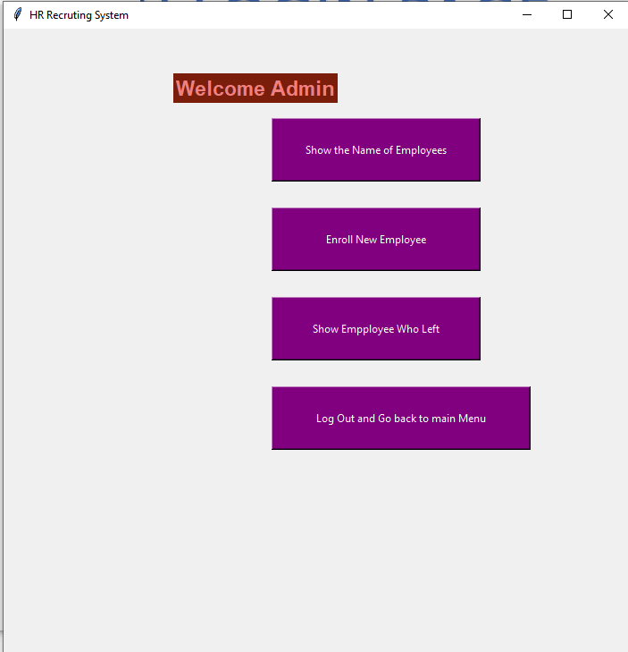
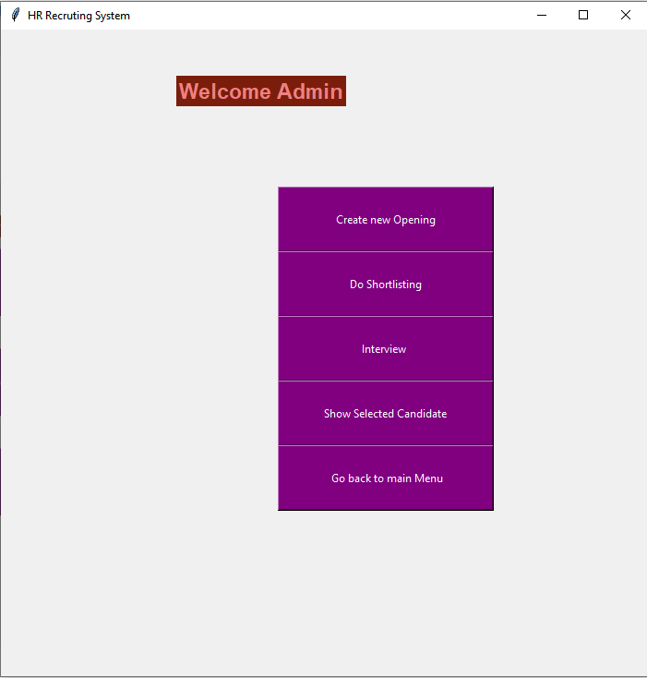
ADMN LOGIN PAGE HAS
Recruitment process
Employee management

Slide 8
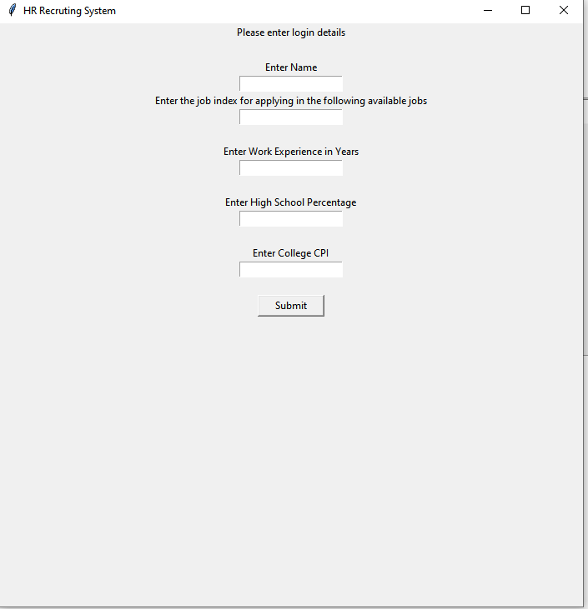
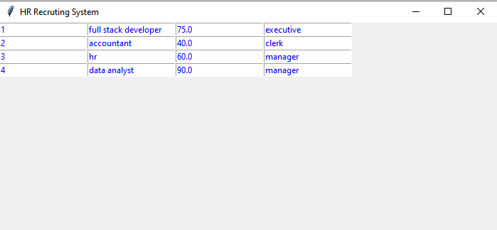
APPLICANT LOGIN PAGE

Slide 9
SAMPLE DEMONSTRATION
An applicant named Vatsal will apply for a job from the available jobs
HR admin will check the applied jobs
HR admin will do the shortlisting and interview process
Vatsal will check for the selected list from the portal

Slide 10
→Vatsal goes to the HR portal and applies for new job

Slide 11
→He checks the available job openings

Slide 12
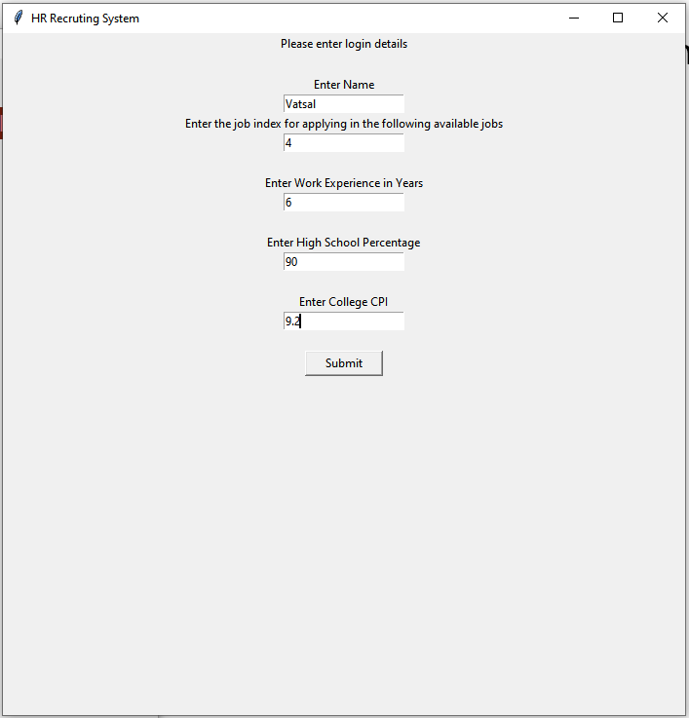
→He decides to apply for manager post in data analysis which is job no 4

Slide 13
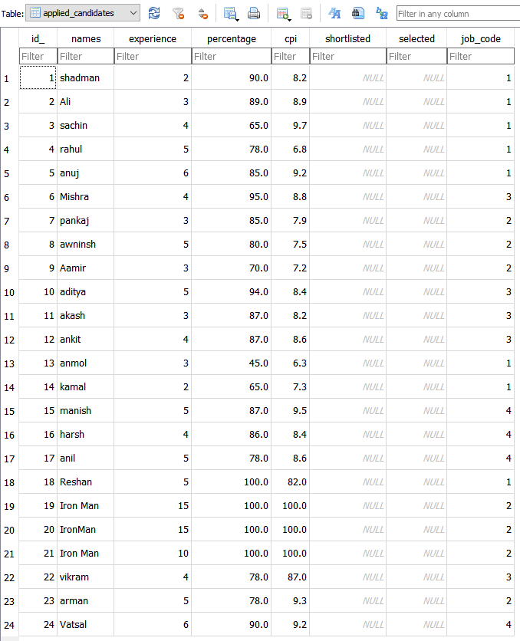
DATABASE VIEW
→Vatsals name has been added to the data base
→There are 24 people who have applied for 4 different jobs. Vatsals job code is 4

Slide 14
→HR Admin will login to the portal

Slide 15
→HR will go to the Recruitment process

Slide 16
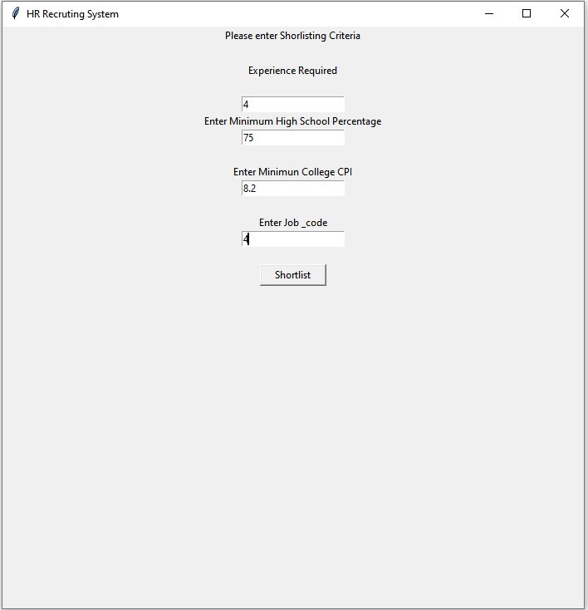
→HR Admin will set the shortlisting criteria for job code 4 which Vatsal has applied for

Slide 17
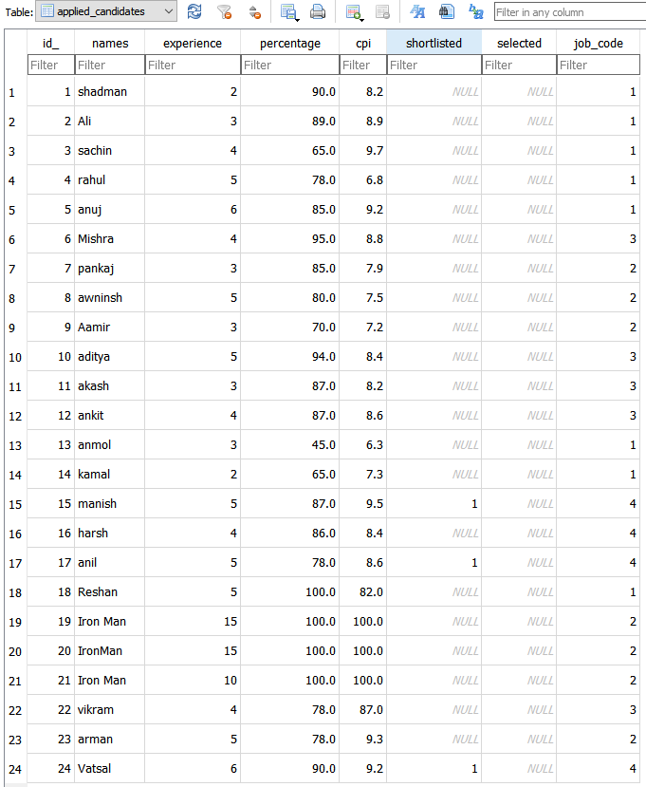
DATABASE VIEW
→A database view for shortlisted candidates for job code 4
→Vatsal has been shortlisted along with two other candidates

Slide 18
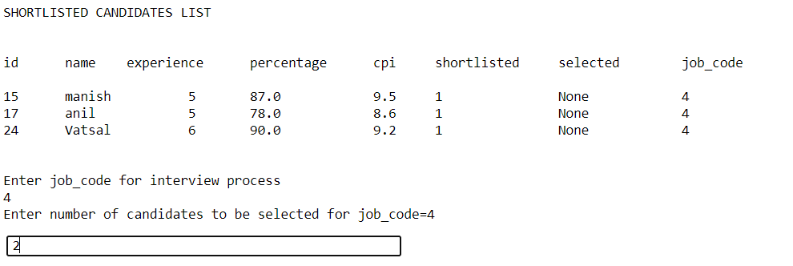
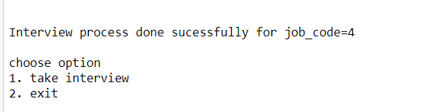
→HR admin will do the Interview process for job code 4
→Two candidates is to be selected in the interview round

Slide 19
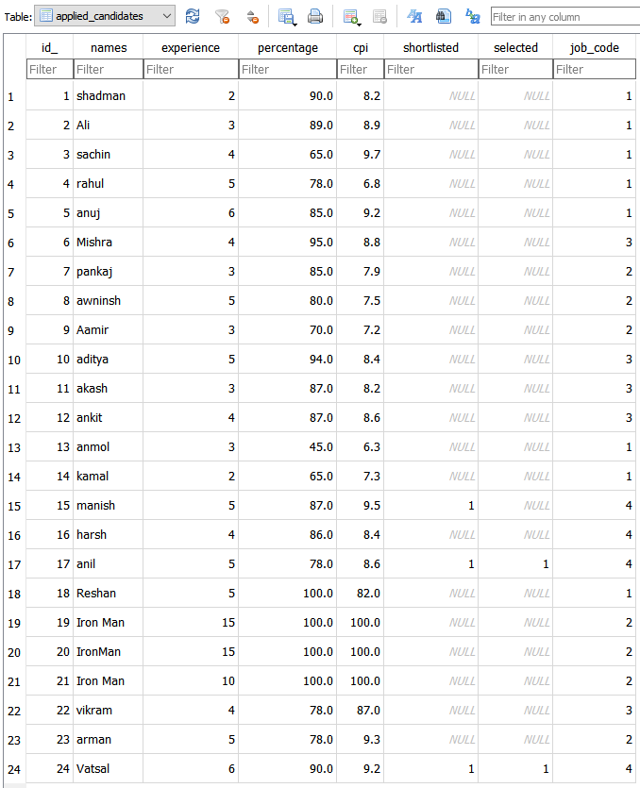
DATABASE VIEW
→Vatsal and anil has been selected for the job

Slide 20
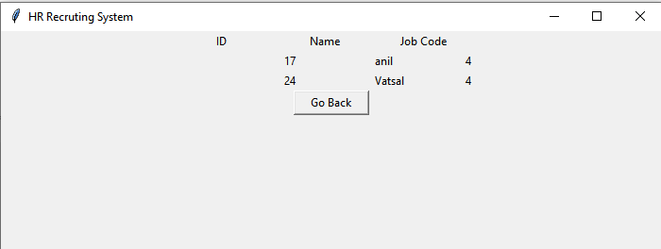
→Vatsal visits the website to check the result
→He has been selected for the job!

