Slide 1

BEARCAT ONLINE BOOKSTORE
Presenters :
Shilpa Rani
Jahnavi Galla
Samipya Pamuru
Reshma Punukollu

Slide 2
Business Idea
An online bookstore
Customers can search for/order books as per their preference and have access to media reviews
Acts as a connecting medium between customers and publishers

Slide 3
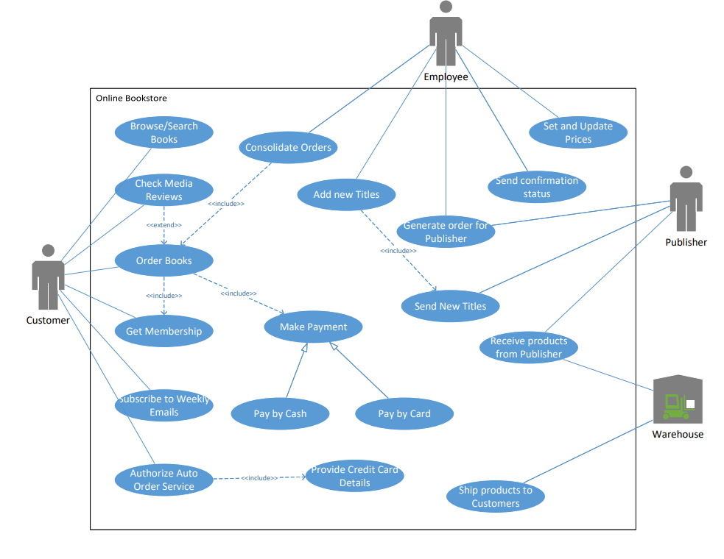
Use-Case Diagram

Slide 4

How does the store function
Membership :
Membership is optional for customers
Non-members can browse books and check reviews
Placing order automatically adds them to member list
Members get additional benefits

Slide 5

How does the store function
Relationship with Publishers :
Maintain strong relationships with publishers
Gain access to trending titles, new releases and bestselling authors which are mailed to us on a regular basis
New titles are incorporated into our database

Slide 6

How does the store function
Warehouse :
No physical inventory
Acts as a logistics centre
Receives books from publishers and distributes to customers

Slide 7

What makes us unique?
Access to extensive reviews :
Customers get access to reviews from top media sources such as Business Week, Fortune, ComputerWorld etc.

Slide 8

What makes us unique?
Dynamic Pricing:
Books are discounted based on reviews
Default discount of 10% over publisher recommended retail price on all books
Titles which are a part of the NYT Bestsellers list get 25% extra discount

Slide 9

What makes us unique?
Personalized Recommendations:
Customers have an option to add their preferred genres/authors
Weekly email is sent to customers curating a personalized recommendation list based on new arrivals

Slide 10

What makes us unique?
Automatic Order Authorization:
Customers have an option to authorize automatic ordering for their preferred authors
New books from those authors when released, are auto-shipped to customers

Slide 11
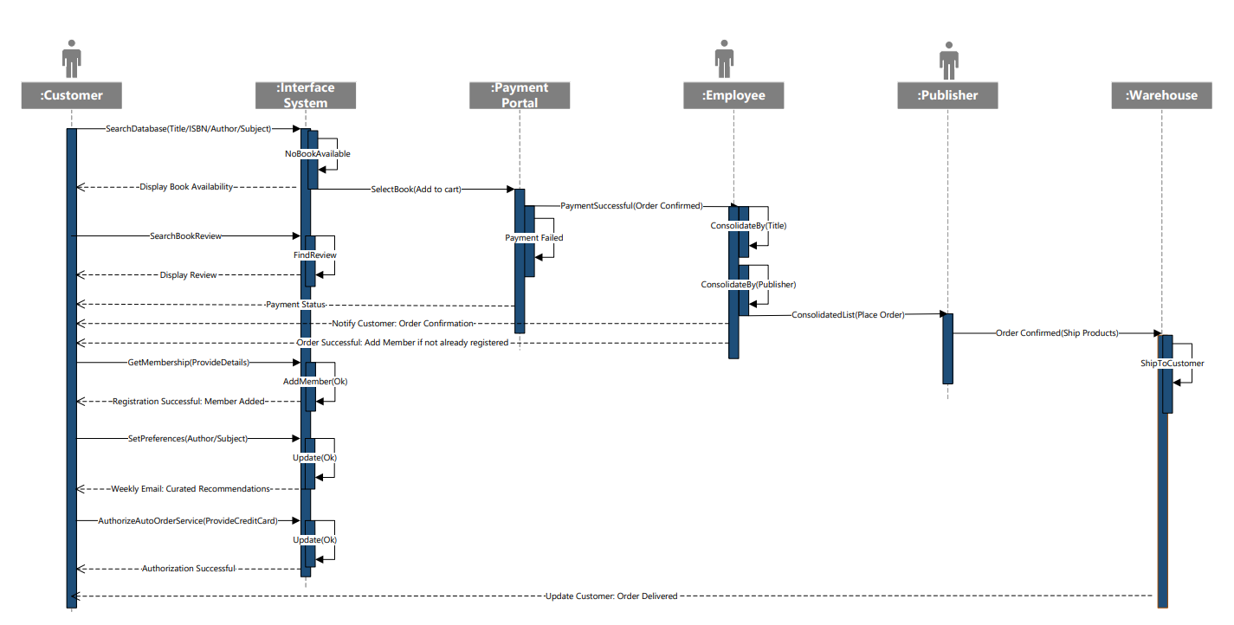
Sequence Diagram

Slide 12

Thank you!
Any Questions?

