Slide 1
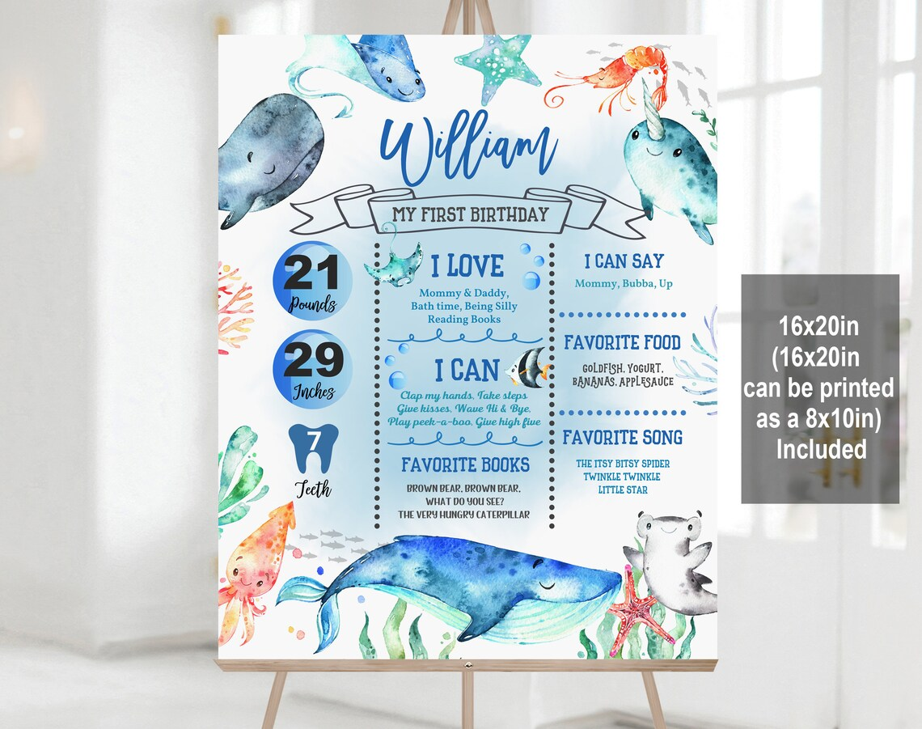
Amma, Nana, Amamma, Go
Peach, Bananas, Avocado
8
TWINKLE TWINKLE LITTLE STAR,
WHEELS ON THE BUS
I love you, Go dog go!

Slide 2
8
I love you, Go dog go!

