Slide 1
Collections By Reshma

Slide 2
Why Collections?
Not Fixed in size.
Accepts Heterogeneous data.

Slide 3
Collections In Java-
The Collection in Java is a Framework that provides an architecture to store and manipulate the group of objects.
Java Collections can achieve all the operations that you perform on a data such as searching, sorting, insertion, manipulation, and deletion.
A Collection represents a single unit of objects, i.e., a group.

Slide 4
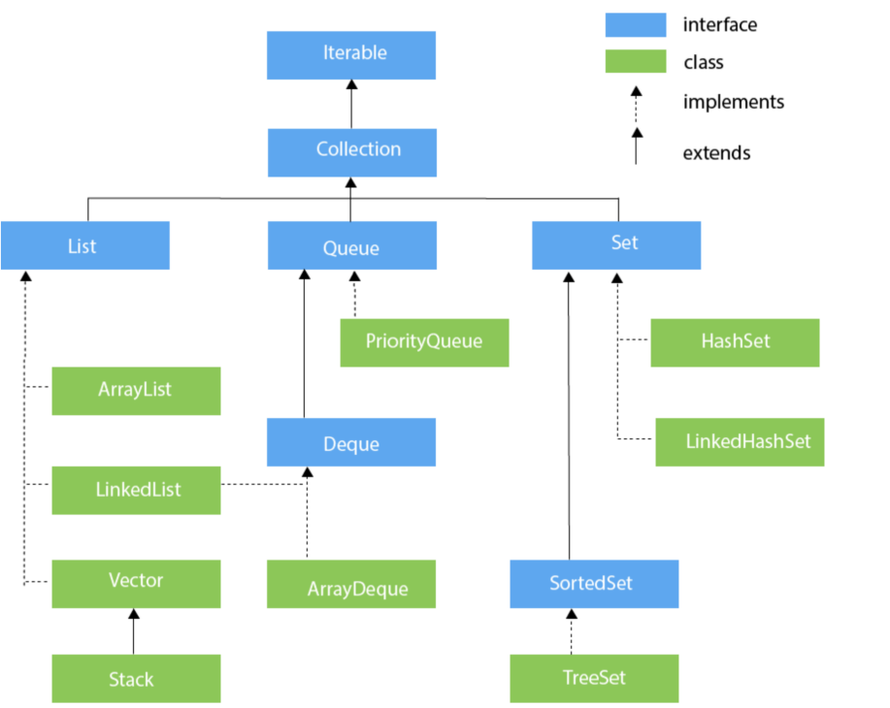

Slide 5
List Interface
List interface is the child interface of Collection interface.
It inhibits a list type data structure in which we can store the ordered collection of objects. It can have duplicate values.
List interface is implemented by the classes ArrayList, LinkedList, Vector, and Stack.

Slide 6
Instantiating List
To instantiate the List interface, we must use :
1. List list1= new ArrayList();
2. List list2 = new LinkedList();
3. List list3 = new Vector();
4. List list4 = new Stack();

Slide 7
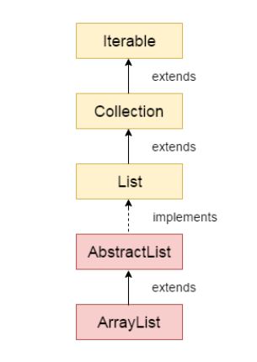
ArrayList
The ArrayList class implements the List interface.
It uses a dynamic array to store the duplicate element of different data types.
It is like an array, but there is no size limit. We can add or remove elements anytime. So, it is much more flexible than the traditional array.

Slide 8
ArrayList
It is found in the java.util package.
The ArrayList class maintains the insertion order and is non-synchronized.
The elements stored in the ArrayList class can be randomly accessed
In ArrayList, manipulation is a little bit slower than the LinkedList in Java because a lot of shifting needs to occur if any element is removed from the array list.

Slide 9
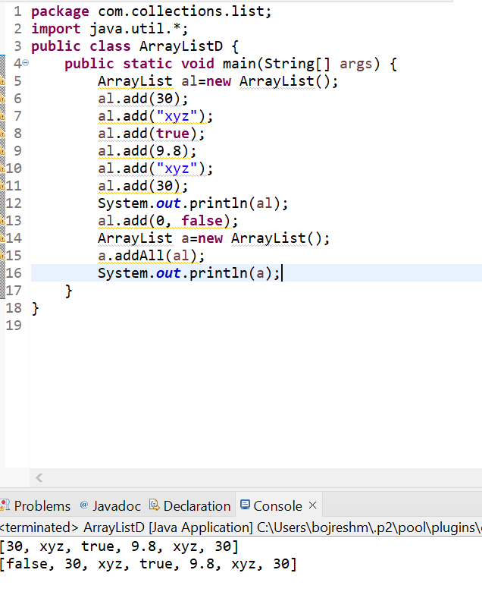

Slide 10
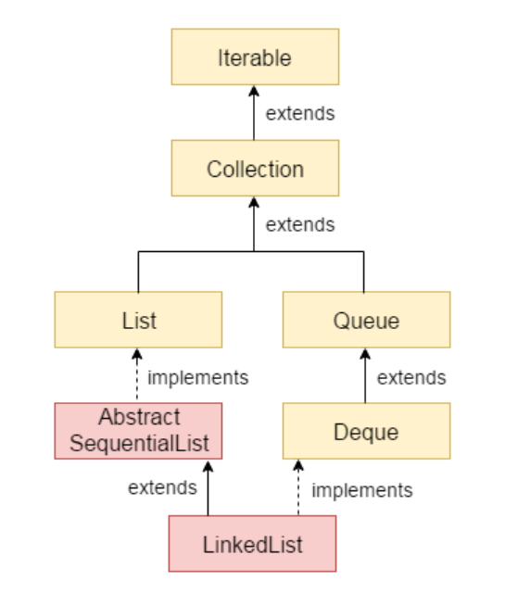
LinkedList
Java LinkedList class uses a doubly linked list to store the elements.
It provides a linked-list data structure.
It inherits the AbstractList class and implements List and Deque interfaces.

Slide 11
LinkedList
Java LinkedList class can contain duplicate elements.
Java LinkedList class maintains insertion order.
Java LinkedList class is non synchronized.
In Java LinkedList class, manipulation is fast because no shifting needs to occur.
Java LinkedList class can be used as a list, stack or queue.

Slide 12
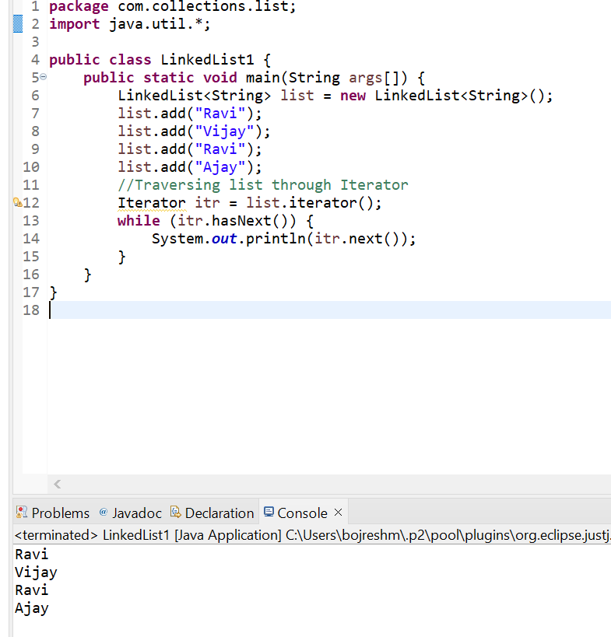

Slide 13
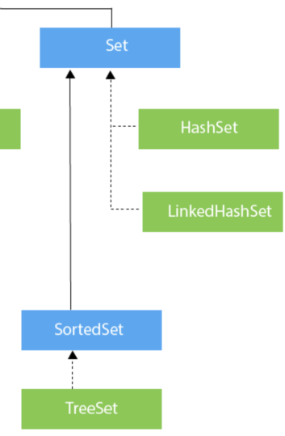
Set Interface
Set interface is the child interface of Collection interface.
It doesn’t maintain insertion order.
It won’t allow duplicates.

Slide 14
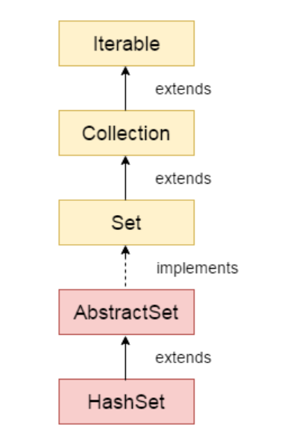
HashSet
HashSet stores the elements by using a mechanism called hashing.
HashSet contains unique elements only.
HashSet allows null value.
HashSet class is non synchronized.
HashSet doesn't maintain the insertion order.
HashSet is the best approach for search operations

Slide 15
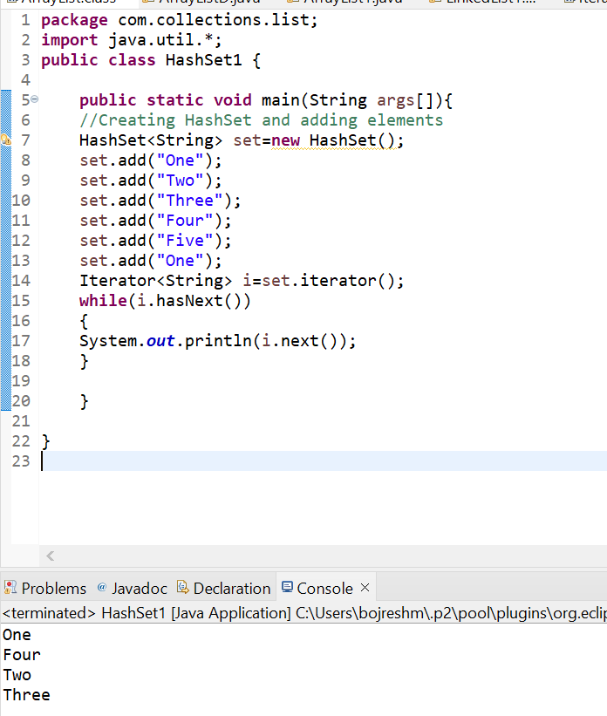

Slide 16
LinkedHashSet
Java LinkedHashSet class is a Hashtable and Linked list implementation of the Set interface.
It inherits the HashSet class and implements the Set interface.
Java LinkedHashSet class contains unique elements only like HashSet.

Slide 17
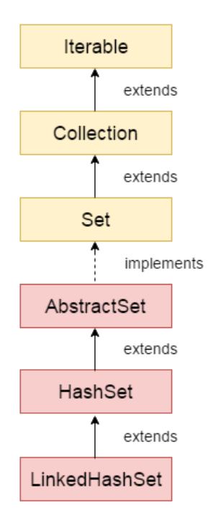
LinkedHashSet
Java LinkedHashSet class provides all optional set operations and permits null elements.
Java LinkedHashSet class is non-synchronized.
Java LinkedHashSet class maintains insertion order(Keeping the insertion order in the LinkedHashset has some additional costs).

Slide 18
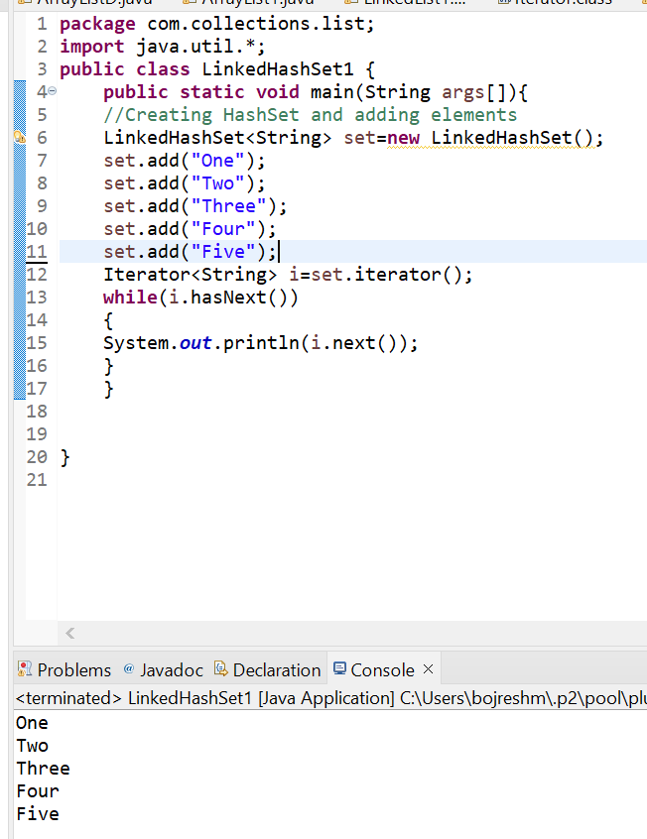

Slide 19
TreeSet
Java TreeSet class implements the Set interface that uses a tree for storage.
Java TreeSet class contains unique elements only like HashSet.
Java TreeSet class access and retrieval times are quiet fast.

Slide 20
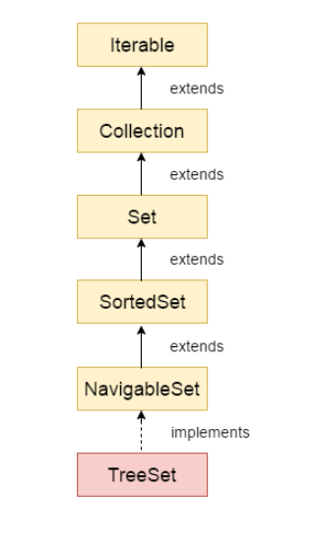
TreeSet
Java TreeSet class doesn't allow null element.
Java TreeSet class is non synchronized.
Java TreeSet class maintains ascending order.

Slide 21
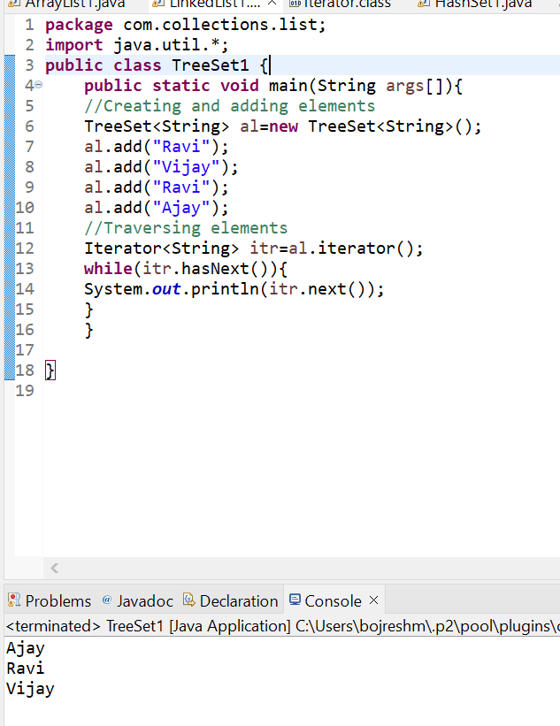
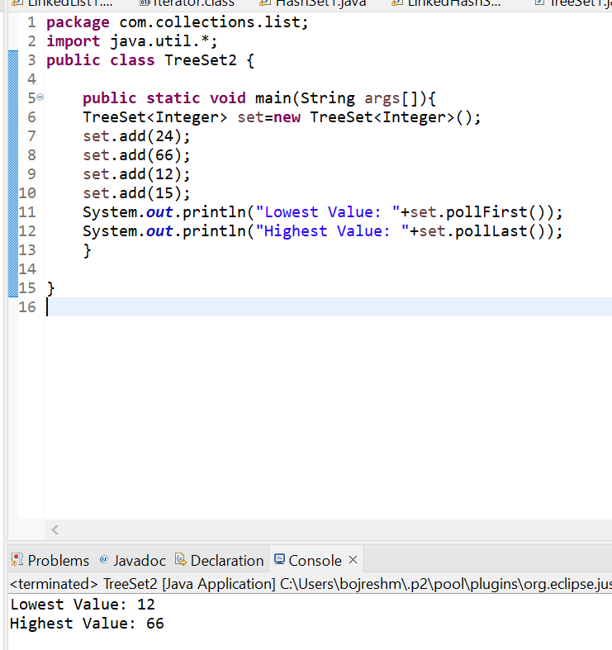

Slide 22
Thank you

