Slide 1

Smart Surveillance System for Weapon Detection and Warning
by
D.RESHMA
Roll No: 224G1A0583
N.PAVITHRA
Roll No: 224G1A0569
K.ROHITH NAIK
Roll No: 224G1A0585
Under the guidance of
Mr. C. Sudheer Kumar, M.Tech., (Ph. D)
Assistant Professor
Department of Computer Science and Engineering
Srinivasa Ramanujan Institute of Technology
Autonomous
Rotarypuram Village, B K Samudram Mandal, Ananthapuramu – 515701.
2025-2026
B - 08

Slide 2
Contents
Smart Surveillance System for Weapon Detection and Warning
Title Justification
Abstract
Problem statement
Objectives of Project
Literature survey
Proposed Work
References
GitHub Link
Queries
SRINIVASA RAMANUJAN INSTITUTE OF TECHNOLOGY

Slide 3
Title Justification
Smart Surveillance System for Weapon Detection and Warning
Title: Smart Surveillance System for Weapon Detection and Warning
“Smart” - Uses AI & deep learning techniques
“Surveillance System” - Continuous monitoring using live camera feed
“Weapon Detection” - Identifies harmful objects (knife, gun, etc.)
“Warning” - Sends instant alerts and emails to responsible authorities
Srinivasa Ramanujan Institute of Technology

Slide 4
Smart Surveillance System for Weapon Detection and Warning
Abstract
Real-time detection of weapons using deep learning
Analyzes CCTV video frames continuously
Detects harmful objects like guns & knives
Triggers an alert sound or message when a weapon is found
Helps prevent criminal activities in public areas
Reduces dependency on human monitoring
SRINIVASA RAMANUJAN INSTITUTE OF TECHNOLOGY

Slide 5
Problem Statement
Smart Surveillance System for Weapon Detection and Warning
Security threats increase significantly when weapons go unnoticed due to the limitations of manual monitoring. Human operators may overlook critical moments, causing delayed responses during high-risk situations. The lack of automated real-time weapon detection systems makes existing surveillance ineffective in preventing violent incidents. Therefore, there is a need for an intelligent, fast, and accurate system that can automatically detect weapons and trigger immediate alerts to support proactive security measures.
SRINIVASA RAMANUJAN INSTITUTE OF TECHNOLOGY

Slide 6
Objectives of Project
Smart Surveillance System for Weapon Detection and Warning
Real-time detection of weapons from camera input
Utilize YOLO-v9 for high-speed accurate detection
Provide automated alerts through buzzer + email
Build an interactive live monitoring interface
Improve safety and reduce manual surveillance load
SRINIVASA RAMANUJAN INSTITUTE OF TECHNOLOGY

Slide 7
Smart Surveillance System for Weapon Detection and Warning
Literature Survey
Method | Pros | Cons
Template matching, Edge detection | Simple | Poor performance in real environments
Faster-R CNN, Mask-R CNN | High accuracy | Slow processing
SSD | Good efficiency | Lower accuracy on complex objects
YOLO models | Fast + accurate | Requires GPU for best performance
YOLO-v9 selected for real-time superior performance
SRINIVASA RAMANUJAN INSTITUTE OF TECHNOLOGY

Slide 8
Proposed Work
Smart Surveillance System for Weapon Detection and Warning
Camera captures live video frames
YOLO-v9 model detects weapon types
Alerts are triggered automatically
System dashboard through Streamlit
Communication: Email + buzzer alarm
SRINIVASA RAMANUJAN INSTITUTE OF TECHNOLOGY

Slide 9
References
Smart Surveillance System for Weapon Detection and Warning
Weapon Identification using YOLO V5 Algorithm - Divyamsh Reddy Asani et al., IJSR, 2023.
Weapon Detection in Surveillance Videos Using Deep Neural Networks - Quyyum & Abdullah, 2022.
Real-Time Weapon Detection Using YOLOv8 for Enhanced Safety - Thakur, Shrivastav, Sharma, et al., 2024.
AI-Based Weapon Detection for Security Surveillance - Murugan et al., 2025.
SRINIVASA RAMANUJAN INSTITUTE OF TECHNOLOGY

Slide 10
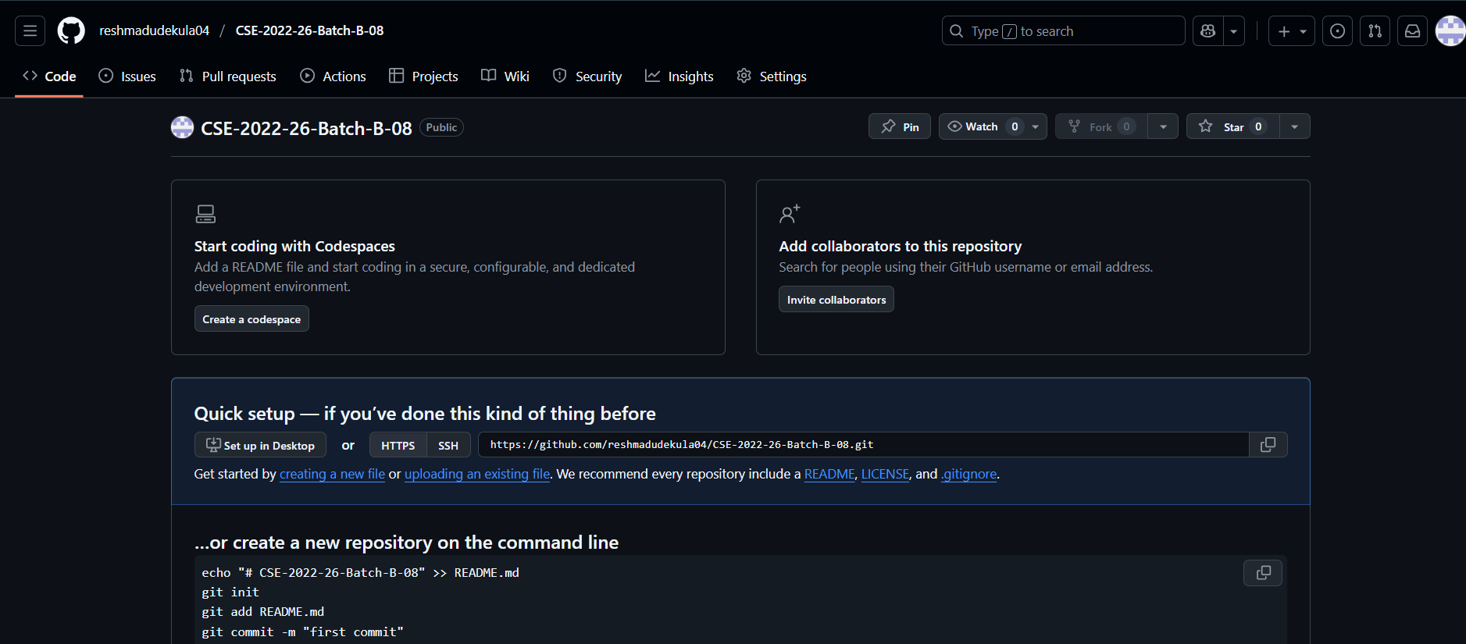
Git Hub Dashboards of each student
Smart Surveillance System for Weapon Detection and Warning
GitHub link: https://github.com/reshmadudekula04/CSE-2022-26-Batch-B-08

Slide 11
Any Queries?
Smart Surveillance System for Weapon Detection and Warning
DEPT. OF COMPUTER SCIENCE AND ENGINEERING

