Slide 1
ToDo List View

Slide 2
Add the Due Date

Slide 3
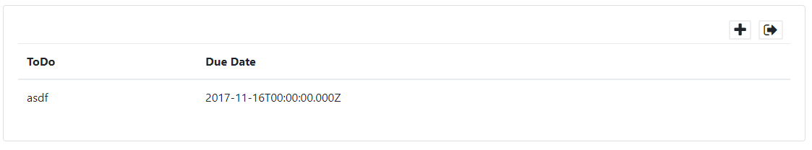
Due Date: todoList.html
<table class="table">
<thead>
<tr>
<th>ToDo</th>
<th>Due Date</th>
</tr>
</thead>
<tbody>
<tr repeat.for="todo of todos.todosArray">
<td>${todo.todo}</td>
<td>${todo.dateDue}</td>
</tr>
</tbody>
</table>

Slide 4
Due Date: Value Converters
Value converters are used to pre-process/post-process data before/after it is used to create the interface
Examples include formatting data for presentation, filtering arrays, looking up values (e.g. a name instead of a primary key for a person)
Value converters are created in the resources/value-converters folder and then referenced in the resources/index.js file

Slide 5
Due Date: date-format.js value converter
Install moment.js JavaScript date library: npm insall moment
Update the aurelia.json file:
{
"name": "aurelia-auth",
"path": "../node_modules/aurelia-auth/dist/amd",
"main": "aurelia-auth"
},
"moment"
https://momentjs.com/

Slide 6
Due Date: date-format.js value converter
Create a file called date-format.js in the resources/value-converters folder
The toView() function executes before the HTML is generated
The fromView() function executes when data is transferred from the HTML to the model (e.g. data input by a user in an input element)
The parameter value is the data that is being converted
import moment from 'moment';
export class DateFormatValueConverter {
toView(value, format=‘MMM Do YYY’) {
if(value === undefined || value === null){
return;
}
return moment(value).format(format);
}
}
Moment date formats: https://momentjs.com/docs/#/displaying/
Notes:
Value converters

Slide 7
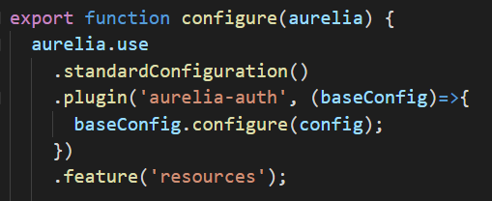
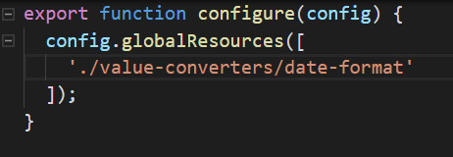
Due Date: date-format.js value converter
In main.js the project is configured to load files in the resources folder.
You don’t need to change anything.
To make sure your value converter is loaded, edit the resources/index.js file as shown:
Notes:
completed

Slide 8
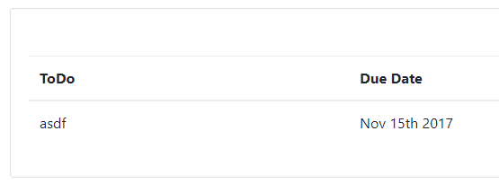
Due Date: date-format.js value converter
<tbody>
<tr repeat.for="todo of todos.todosArray">
<td>${todo.todo}</td>
<td>${todo.dateDue | dateFormat}</td>
</tr>
</tbody>
To use the value converter, insert a vertical bar ( | ) and the value converter name in camel case.

Slide 9
Add Priority

Slide 10
Priority: todoList.html
<table class="table">
<thead>
<tr>
<th>ToDo</th>
<th>Due Date</th>
<th>Priority</th>
</tr>
</thead>
<tbody>
<tr repeat.for = "todo of todos.todosArray">
<td>${todo.todo}</td>
<td>${todo.dateDue | formatDate}</td>
<td>${todo.priority}</td>
</tr>
</tbody>
</table>

Slide 11
Priority: todoList.html
<tbody>
<tr class="${todo.priority === 'Critical' ? 'table-secondary' : ' '} " repeat.for="todo of todos.todosArray">
<td>${todo.todo}</td>
This code uses a JavaScript statement to insert a class called table-secondary if the priority of the current todo is Critical
var variable = condition ? value if condition is true : value if condition is false
http://getbootstrap.com/docs/4.0/content/tables/

Slide 12
Add Edit Buttons

Slide 13
Add Edit Button: todoList.html
In this section we’ll add buttons to the table that allow you to edit, delete, complete and uncomplete todos. Update the table:
<tr>
<th>ToDo</th>
<th>Due Date</th>
<th>Priority</th>
<th>Edit</th>
</tr>
</thead>
<tbody>
<tr class="${todo.priority === 'Critical' ? 'table-secondary' : ‘’}” repeat.for="todo of todos.todosArray">
<td>${todo.todo}</td>
<td>${todo.dateDue | dateFormat}</td>
<td>${todo.priority}</td>
<td>
<i click.trigger="editTodo(todo)" class="fa fa-pencil rightMargin" aria-hidden="true"></i>
</td>
</tr>
Passes current todo to the function as a parameter

Slide 14
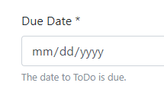
Add Edit Button: list.js
Add this function to the list.js file
editTodo(todo){
this.todoObj = todo;
this. showList = false;
}
Sets this.todoObj to the selected todo and shows todoForm.html
This is a problem we’ll fix later

Slide 15
Add Edit Button: todos.js
Update the save in the todo data object file so that it checks to see if a todo passed to it has an _id property meaning it was retrieved from the database. If so, then call a put instead of a post.
async save(todo){
if(todo){
if(!todo._id){
let response = await this.data.post(todo, this.TODOS_SERVICE);
if(!response.error){
this.todosArray.push(response);
}
return response;
} else {
let response = await this.data.put(todo, this.TODOS_SERVICE + "/" + todo._id);
if(!response.error){
// this.updateArray(response);
}
return response;
}
}
}
Notes:
If(todo._id === serverresponse._id

Slide 16
Add delete button: todoList.html
<td>
<i click.trigger="editTodo(todo)" class="fa fa-pencil rightMargin"
aria-hidden="true"></i>
<i click.trigger="deleteTodo(todo)"class="fa fa-trash rightMargin"
aria-hidden="true"></i>
</td>
Add this to the list.js file
deleteTodo(todo){
this.todos.deleteTodo(todo._id);
}

Slide 17
Add delete button: todos.js
Add this to the todos.js data object file
Make sure this matches your variable name
async deleteTodo(id){
let response = await this.data.delete(this.TODOS_SERVICE + "/" + id);
if(!response.error){
for(let i = 0; i < this.todosArray.length; i++){
if(this.todosArray[i]._id === id){
this.todosArray.splice(i,1);
}
}
}
}
This function calls the delete function and, if the response returns without an error, it searches for the item in the todosArray an deletes it

Slide 18
Add complete buttons: todoList.html
Update the table
<td>
<i click.trigger="editTodo(todo)" class="fa fa-pencil rightMargin"
aria-hidden="true"></i>
<i click.trigger="deleteTodo(todo)"class="fa fa-trash rightMargin"
aria-hidden="true"></i>
<i show.bind="!todo.completed" click.trigger="completeTodo(todo)"
class="fa fa-square-o" aria-hidden="true"></i>
<i show.bind="todo.completed " click.trigger="completeTodo(todo)"
class="fa fa-check " aria-hidden="true "></i>
</td>
The fa-square-o icon will show if the todo is not completed and the fa-check icon will show if the todo is completed

Slide 19
Add completed buttons: list.js
Add this to the list.js file
completeTodo(todo){
todo.completed = !todo.completed;
this.todoObj = todo;
this.saveTodo();
}
First, toggle the completed property then set todoObj equal to the selected todo and call the saveTodo() function.

Slide 20
Add completed buttons: todoList.html and list.js
To hide completed todos we can use a value converter to filter the todosArray. Update the table as shown:
<tr class="${todo.priority === 'Critical' ? 'table-secondary' : ‘’}”
repeat.for = "todo of todos.todosArray | completed:showCompleted">
Update the constructor in list.js to initialize the showCompleted variable
constructor(todos, auth){
this.todos = todos;
this.auth = auth;
this.user = JSON.parse(sessionStorage.getItem('user'));
this.title = "Ross Has Things ToDo!"
this.showList = true;
this.showCompleted = false;
this.priorities = ['Low', 'Medium', 'High', 'Critical'];
}

Slide 21
Add completed buttons: value converter
Create a file called completed.js in the resources/value-converters folder and paste in this code:
export class CompletedValueConverter {
toView(array, value) {
if(!value){
return array.filter(item => {
return !item.completed;
})
} else {
return array;
}
}
}
The array parameter is the todos. todosArray and value is the showCompleted variable
array.filter is how you filter an array using JavaScript. Only items in the array for which the filter function returns true are kept
Make sure you add this to the resources/index.js file
Notes:
‘.

Slide 22
Add completed buttons: todoList.html
To show/hide completed todos, add a check box to the toolbar above the table. Edit the card code as shown
<div class="row">
<span class="col">
<div class="form-check">
<label class="form-check-label">
<input change.trigger="toggleShowCompleted()" type="checkbox"
class="form-check-input">
Show completed
</label>
</div>
</span>
<span class="col">
<span class="rightMargin pull-right"><i click.trigger="logout()"
class="fa fa-sign-out fa-lg" aria-hidden="true"></i></span>
<span class=" rightMargin pull-right"><i click.trigger="createTodo()"
class="fa fa-plus fa-lg" aria-hidden="true"></i></span>
</span>
</div>
</div>
</div>

Slide 23
Add completed buttons: list.js
Add this to list.js
toggleShowCompleted(){
this.showCompleted = !this.showCompleted;
}
Each time the value of showCompleted is changed the completed value converter is processed, updating the table

Slide 24
Add File Uploads

Slide 25
Add File Upload
In order to upload files we have to:
Add the upload routes to the todos.js controller file on the server
Add a file selection control on the todoForm.html view
Add the upload code to list.js and add an upload function in todos.js
Add the column to the table

Slide 26
Add File Upload : todos.js controller
We’ll use a module called multer to handle the file uploads on the server and a module called mkdirp to handle creating folders:
multer = require('multer'),
mkdirp = require('mkdirp’);
…
var storage = multer.diskStorage({
destination: function (req, file, cb) {
var path = config.uploads + req.params.userId + "/";
mkdirp(path, function(err) {
if(err){
res.status(500).json(err);
} else {
cb(null, path);
}
});
},
filename: function (req, file, cb) {
let fileName = file.originalname.split('.');
cb(null, fileName[0] + new Date().getTime() + "." + fileName[fileName.length - 1]);
}
});
Set the path to the folder using a value in the config file and the user’s _id. Mkdirp creates the folder if it doesn’t exist
Create the file name using the original file name and the current time to ensure the name is unique

Slide 27
Add File Upload : config.js
development: {
root: rootPath,
app: { name: 'ToDo' },
port: 5000,
db: 'mongodb://127.0.0.1/todo-dev',
uploads: rootPath + "/public/uploads/",
secret: "cayennedlikeshistreats",
},
Notes:
Add in dev , production

Slide 28
Add File Upload: todos.js controller
The actual service calls the multer middleware. If the file is saved, the todo document is retrieved and updated with the file name
var upload = multer({ storage: storage });
router.post('/todos/upload/:userId/:todoId', upload.any(), function(req, res, next){
logger.log('Upload file for todo ' + req.params.todoId + ' and ' + req.params.userId, 'verbose');
Todo.findById(req.params.todoId, function(err, todo){
if(err){
return next(err);
} else {
if(req.files){
todo.file = {
filename : req.files[0].filename,
originalName : req.files[0].originalname,
dateUploaded : new Date()
};
}
todo.save()
.then(todo => {
res.status(200).json(todo);
})
.catch(error => {
return next(error);
});
}
});
});
Make sure you use the property names for filename and orginal file name specific to your todo schema

Slide 29
Add File Upload: todoForm.html
Add this to the bottom of the todo form. It adds a file selector element and a list of selected files
<div class="row">
<div class="col">
<label class="btn btn-secondary">
Browse for files&hellip; <input type="file"
style="display: none;"
change.delegate="changeFiles()" files.bind="files">
</label>
<small id="fileHelp" class="form-text text-muted">
Upload any files that will be useful.</small>
</div>
<div class="col-8">
<ul>
<li repeat.for="file of filesToUpload" class="list-group-item">
${file.name}<span click.delegate="removeFile($index)"
class="pull-right"><i class="fa fa-trash" aria-hidden="true">
</i></span></li>
</ul>
</div>
</div>
Notes:
Top code – creates button for dile

Slide 30
Add File Upload: list.js
When the user selects a file this function adds it to an array of files to upload
changeFiles(){
this.filesToUpload = new Array();
this.filesToUpload.push(this.files[0]);
}
removeFile(index){
this.filesToUpload.splice(index,1);
}
User can also remove a file from the list

Slide 31
Add File Upload: list.js
Update the saveTodo() function so, if the todo is saved successfully, any selected files are uploaded.
async saveTodo(){
if(this.todoObj){
let response = await this.todos.save(this.todoObj);
if(response.error){
alert("There was an error creating the ToDo");
} else {
var todoId = response._id;
if(this.filesToUpload && this.filesToUpload.length){
await this.todos.uploadFile(this.filesToUpload, this.user._id, todoId);
this.filesToUpload = [];
}
}
this.showList = true;
}
}

Slide 32
Add File Upload: todo.js
Add a function in the todos.js data object file. Files are added to a form data object which will bundle the file data in a format that the server can parse it
async uploadFile(files, userId, todoId){
let formData = new FormData();
files.forEach((item, index) => {
formData.append("file" + index, item);
});
let response = await this.data.uploadFiles(formData, this.TODO_SERVICE + "/upload/" + userId + "/" + todoId);
return response;
}

Slide 33
Add File Upload: data-services.js
uploadFiles(files, url){
return this.httpClient
.fetch(url, {
method: 'post',
body: files
})
.then(response => response.json())
.then(object => {
return object;
})
.catch(error => {
return error;
});
}
We need a different post services in the data-services.js file because the content is not JSON

Slide 34
Add File Upload: todoList.html
<tr>
<th>ToDo</th>
<th>Due Date</th>
<th>Priority</th>
<th>File</th>
<th>Edit</th>
</tr>
</thead>
<tbody>
<tr class="${todo.priority === 'Critical' ? 'table-secondary' : ' ‘}” repeat.for="todo of todos.todosArray | completed:showCompleted">
<td>${todo.todo}</td>
<td>${todo.dateDue | dateFormat}</td>
<td>${todo.priority}</td>
<td><a href="http://localhost:5000/uploads/${user._id}/${todo.file.filename}" target="_blank">${todo.file.originalName}</a></td>
Make sure you use the property names specific to your todo schema for the filename and original file name.

Slide 35
Add File Upload: express.js
Change the bodyParser configuration to increase the allow upload size
app.use(bodyParser.json({limit: '1000mb'}));
app.use(bodyParser.urlencoded({limit: '1000mb', extended: true}));

