Slide 1

Authentication and Authorization
Implementation

Slide 2
Authentication Strategy
User logs in with email and password using basic authentication
Only route that uses basic authentication is /login
Once the server authenticates the user, it responds with a token
User sends the token in the authorization header with each request

Slide 3
Update User Model

Slide 4
Password Encryption
The first step in implementing authentication is to encrypt user passwords
Passwords should be stored in the database in encrypted form
We will use a node module called bcryptjs to encrypt passwords
To encrypt passwords, we will add some schema functions to the user schema

Slide 5
Update User Model
npm install bcryptjs --save
Insert after the UserSchema is defined
var Bcrypt = require('bcryptjs'); …
UserSchema.pre('save', function (next) {
var person = this;
if (this.isModified('password') || this.isNew) {
Bcrypt.genSalt(10, function (err, salt) {
if (err) {
return next(err);
}
Bcrypt.hash(person.password, salt, function (err, hash) {
if (err) {
return next(err);
}
person.password = hash;
next();
});
});
} else {
return next();
}
});
Executes before a document is saved
If the user is new or password is modified
Generate the salt
Then ecrypt the password

Slide 6
Update User Model
Password submitted by user
Add after previous function
UserSchema.methods.comparePassword = function (passw, cb) {
Bcrypt.compare(passw, this.password, function (err, isMatch) {
if (err) {
return cb(err);
}
cb(null, isMatch);
});
};
Password in database

Slide 7
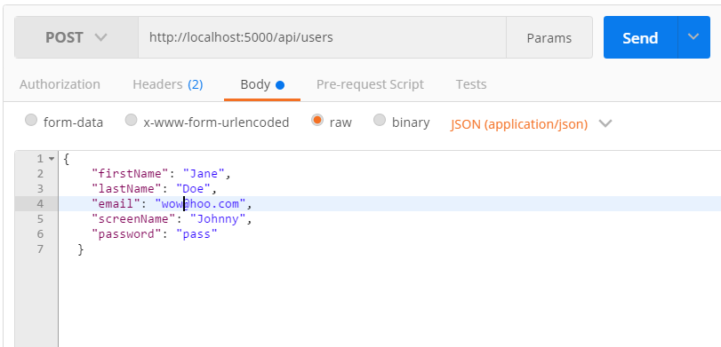
Encrypting Passwords - POST

Slide 8
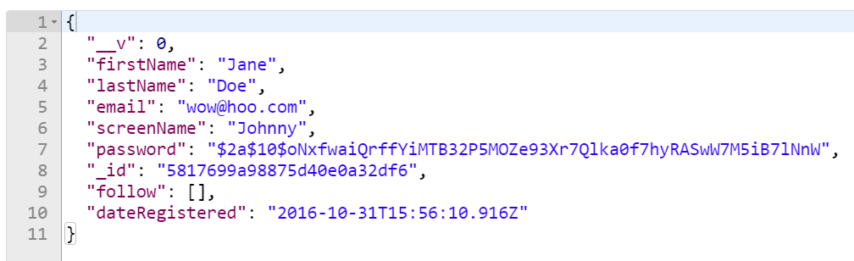
Encrypting Passwords - POST

Slide 9
router.put('/users/password/:userId', function(req, res, next){
logger.log('Update user ' + req.params.userId, 'verbose');
User.findById(req.params.userId)
.exec()
.then(function (user) {
if (req.body.password !== undefined) {
user.password = req.body.password;
}
user.save()
.then(function (user) {
res.status(200).json(user);
})
.catch(function (err) {
return next(err);
});
})
.catch(function (err) {
return next(err);
});
});
Need a route to update the password because the pre save hook function doesn’t run with update methods

Slide 10
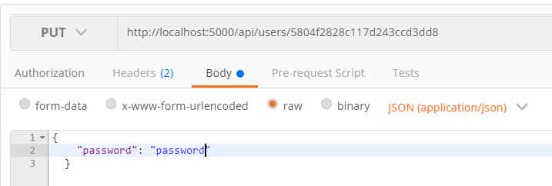
Encrypting Passwords - PUT
Only property we update is the password property

Slide 11
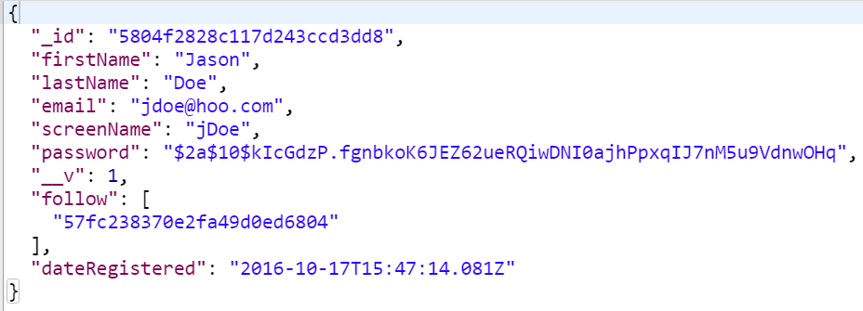
Encrypting Passwords - PUT

Slide 12
Basic Authentication

Slide 13
Basic Authentication
We will use a module called Passport which provide various authentication strategies for node applications
Passport provides strategies for many oAuth providers such as Facebook and Twitter but we will only use local (basic authentication) and jwt strategies
npm install --save passport passport-local passport-jwt jsonwebtoken

Slide 14
Requiring Modules
Create a file called passport.js in the config folder
var passport = require('passport'),
jwt = require('jsonwebtoken'),
User = require('../app/models/users'),
config = require('./config'),
jwtStrategy = require('passport-jwt').Strategy,
extractJwt = require('passport-jwt').ExtractJwt,
localStrategy = require('passport-local');

Slide 15
var localOptions = { usernameField: 'email' };
var localLogin = new localStrategy(localOptions, function(email, password, next){
User.findOne({email: email}).exec()
.then(function(user){
if(!user){
return next({status: "404", message: "Email not found."});
} else {
user.comparePassword(password, function (err, isMatch) {
if (err) {
return next(err);
} else if(!isMatch){
return next({status: 401, message: 'Invalid username or password'});
} else {
return next(null, user);
}
});
}
})
.catch(function(err){return next(err);});
});

Slide 16
generateToken = function(user){
return jwt.sign(user, config.secret, {
expiresIn: 10000
});
};
setUserInfo = function(req){
return {
_id: req._id,
firstName: req.firstName,
lastName: req.lastName,
email: req.email,
issuer: "edu.uwm"
};
};
login = function(req, res, next) {
var userInfo = setUserInfo(req.user);
res.status(200).json({ token: generateToken(userInfo), user: req.user });
};
passport.use(localLogin);

Slide 17
Update config.js
development: {
root: rootPath,
app: { name: 'Chirps' },
port: 5000,
db: 'mongodb://127.0.0.1/chirps-dev',
secret: "cayennedlikedhistreats"
}
Secret can be any string, the longer, the more secure.
Make sure to add one to test and production as well

Slide 18
Refine the Error Handler in Express.js
app.use(function (err, req, res, next) {
console.log(err)
if (process.env.NODE_ENV !== 'test') logger.log(err.stack,'error');
res.type('text/plan');
if(err.status){
res.status(err.status).send(err.message);
} else {
res.status(500).send('500 Sever Error');
}
});

Slide 19
Update Users Controller
Add to top of file
passportService = require('../../config/passport')
passport = require('passport')
var requireLogin = passport.authenticate('local', { session: false });
…
router.route('/users/login').post(requireLogin, login);
Login route

Slide 20
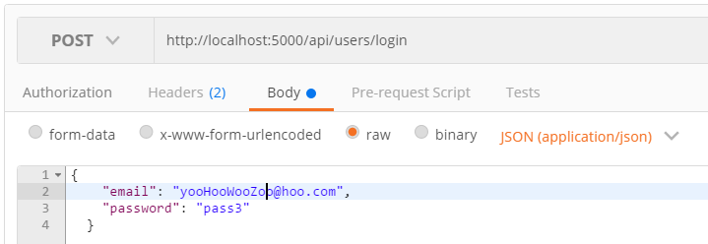
Logging In in Postman

Slide 21
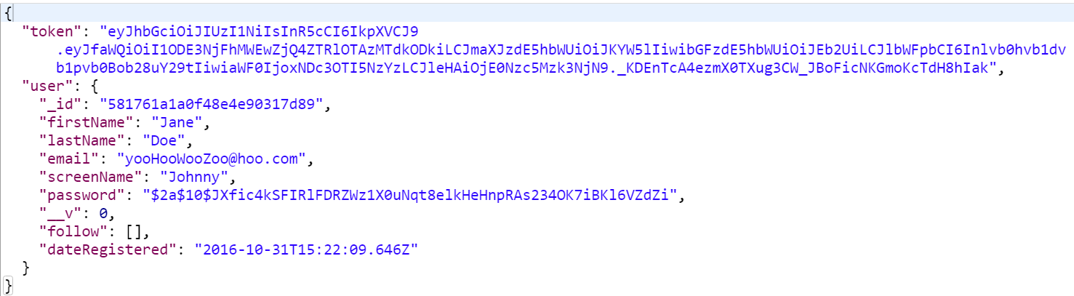
Logging In in Postman

Slide 22
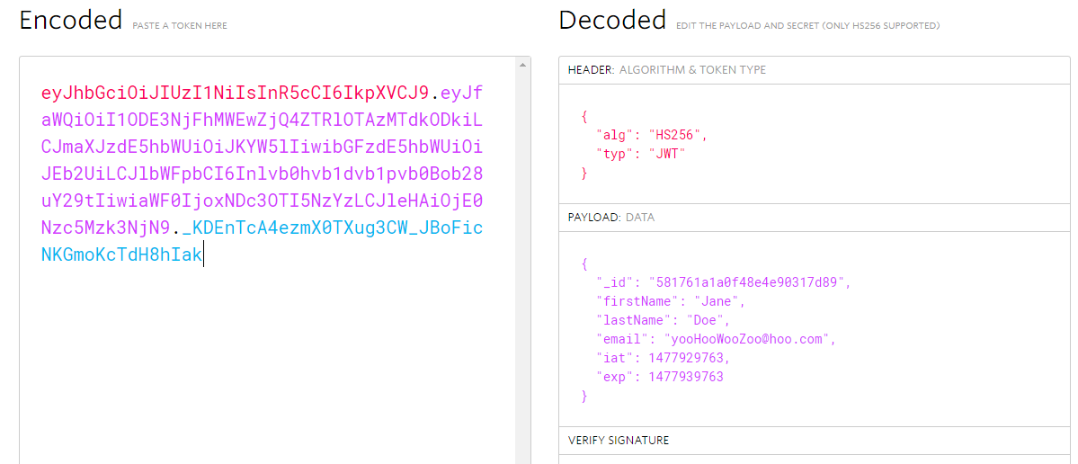
Token Decoded
https://jwt.io/

Slide 23
Token Authentication

Slide 24
var jwtOptions = {
jwtFromRequest: extractJwt. fromAuthHeaderAsBearerToken(),
secretOrKey: config.secret,
issuer : 'com.microsoft.example',
audience : "com.chirps.www"
};
var jwtLogin = new jwtStrategy(jwtOptions, function(payload, next){
User.findById(payload._id).exec()
.then(function(user){
if (user){
return next(null, user);
} else {
return next(null, false);
}
})
.catch(function(err){ return next(err);});
});
passport.use(jwtLogin);

Slide 25
Update Controller Files
Remember to add passport = require('passport’) to the top of the todo.js controller.
Add to top of the files
var requireAuth = passport.authenticate('jwt', { session: false });
…
router.get('/users', requireAuth, function(req, res, next){
logger.log('Get all uses', 'verbose');
Add to each route

Slide 26
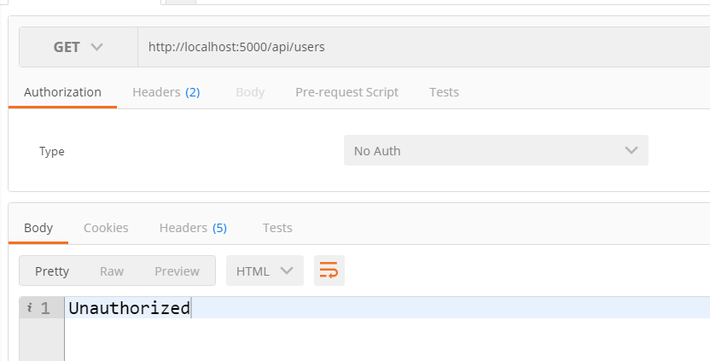
GET Without Token

Slide 27
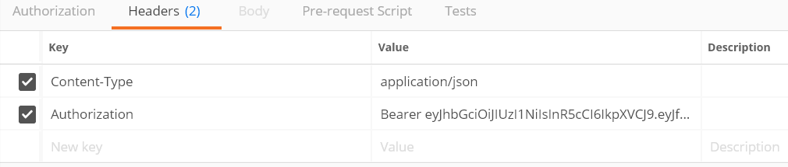
Authorization Header
Notes:
Copy the token and copy it under authorization
Get http:localhost:5000/api/users

