Slide 1

ON JOB TRANING
(INTERSHIP)PROJECT
PRESENTATION

Slide 2





Slide 3
PRESENTED BY:-
Miss. Salunkhe Pranita
Miss. Jadhav Reshma
Miss .Yadav Pratiksha
Miss. Yadav Shreya
Miss.Vibhute Priti
TULJARAM CHATURCHAND COLLEGE OF
ARTS,SCIENCE AND COMMERSE,BARAMATI
INTERNAL GUIDE EXTERNAL GUIDE
Mrs. Pooja Gaikwad Mr.Prajot Patil

Slide 4

Introduction
In the realm of education, understanding and predicting student performance plays a pivotal role in shaping effective teaching strategies and fostering academic success. This project, apply named "Student Performance Prediction," aims to leverage the power of machine learning to forecast students' grades based on various academic and demographic factors. The primary target variable in this project is the grade class. By analyzing historical data encompassing student demographics, past academic records, Extracurricular Activities, and Study habits variables, machine learning models can be trained to predict the future performance of students.

Slide 5
Data Description
This dataset contains comprehensive information on 2,392 high school students, detailing their demographics, study habits, parental involvement, extracurricular activities, and academic performance .The target variable grade class classifies students grades into distinct categories
Student information
Student ID
Demographic Details
Study Habits
2.Parental Involvement
3.Extracurricular Activities
4. Target Variable : Grade class

Slide 6
1 Student ID
2 Demographic Details
Age
Gender
Ethinicity : The ethinicity of the students,coded as follow :
0: Caucassian 1: African American 2:Assian 3 : other
Parental Education : The education level of the parents , coded as follow :
0: none 1: high school 2: Some college 3: Bachelor’s 4.Higher
Study Habits :
Study time weekly
Absences
Tutoring : Tutoring Status ,where 0 indicates No and 1 indicates Yes
Parental Support: The level of parental support, coded as follows:
0: None 1: Low 2: Moderate 3: High 4: Very High
Extracurricular Activities
Extracurricular: Participation in extracurricular activities, where 0 indicates No and 1 indicates Yes.

Slide 7
Sports: Participation in sports, where 0 indicates No and 1 indicates Yes.
Music: Participation in music activities, where 0 indicates No and 1 indicates Yes.
Volunteering: Participation in volunteering, where 0 indicates No and 1 indicates Yes.
Target Variable: Grade Class
GradeClass: Classification of students' grades based on GPA:
0: 'A' (GPA >= 3.5)
1: 'B' (3.0 <= GPA < 3.5)
2: 'C' (2.5 <= GPA < 3.0)
3: 'D' (2.0 <= GPA < 2.5)
4: 'F' (GPA < 2.0)

Slide 8

Objectives
Find which algorithm gives more accurate result in students performance prediction.
Find which factor affect the grade of the student .
Find important feature in grade of student.

Slide 9

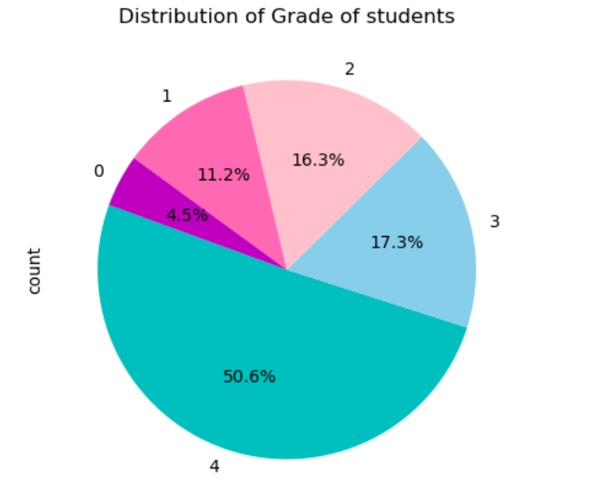
Exploratory Data Analysis

Slide 10
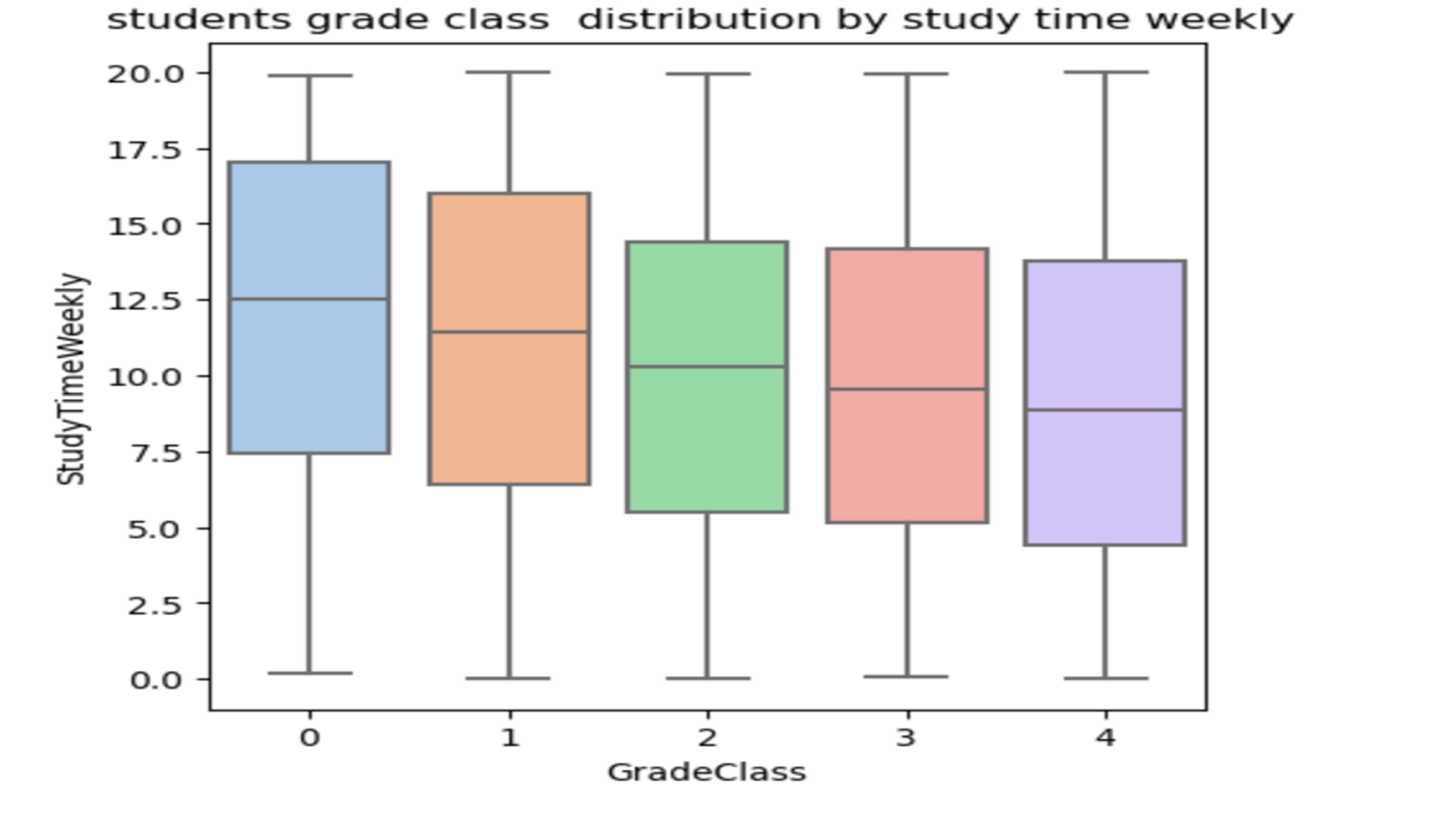
Box plot

Slide 11
From the pie chart we observe that maximum i.e 50.6 %student get “E grade” . And minimum i.e 4.5% student get “ A grade”
From the box plot A grade students study time is larger than E grade students

Slide 12
Model Building
Naïve Bayes algorithm
KNN algorithm
Decision tree classifier
Support vector machine
Logistic regression
Random Forest Classifier
Gradient Boosting Classifier
Bagging Classifier
Linear Discriminant Analysis

Slide 13
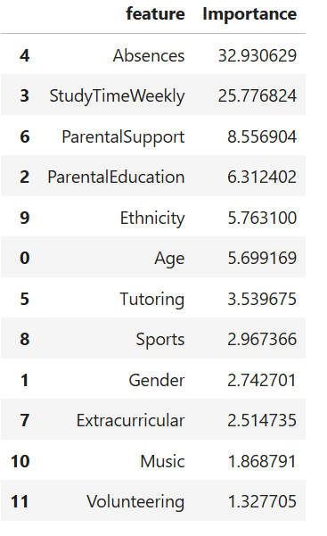
Finding Features Importance :
From the above table we say that Sports , Gender , Extracurricular ,Music , Volunteering is less important features . Therefore we drop this variable and refit the models

Slide 14
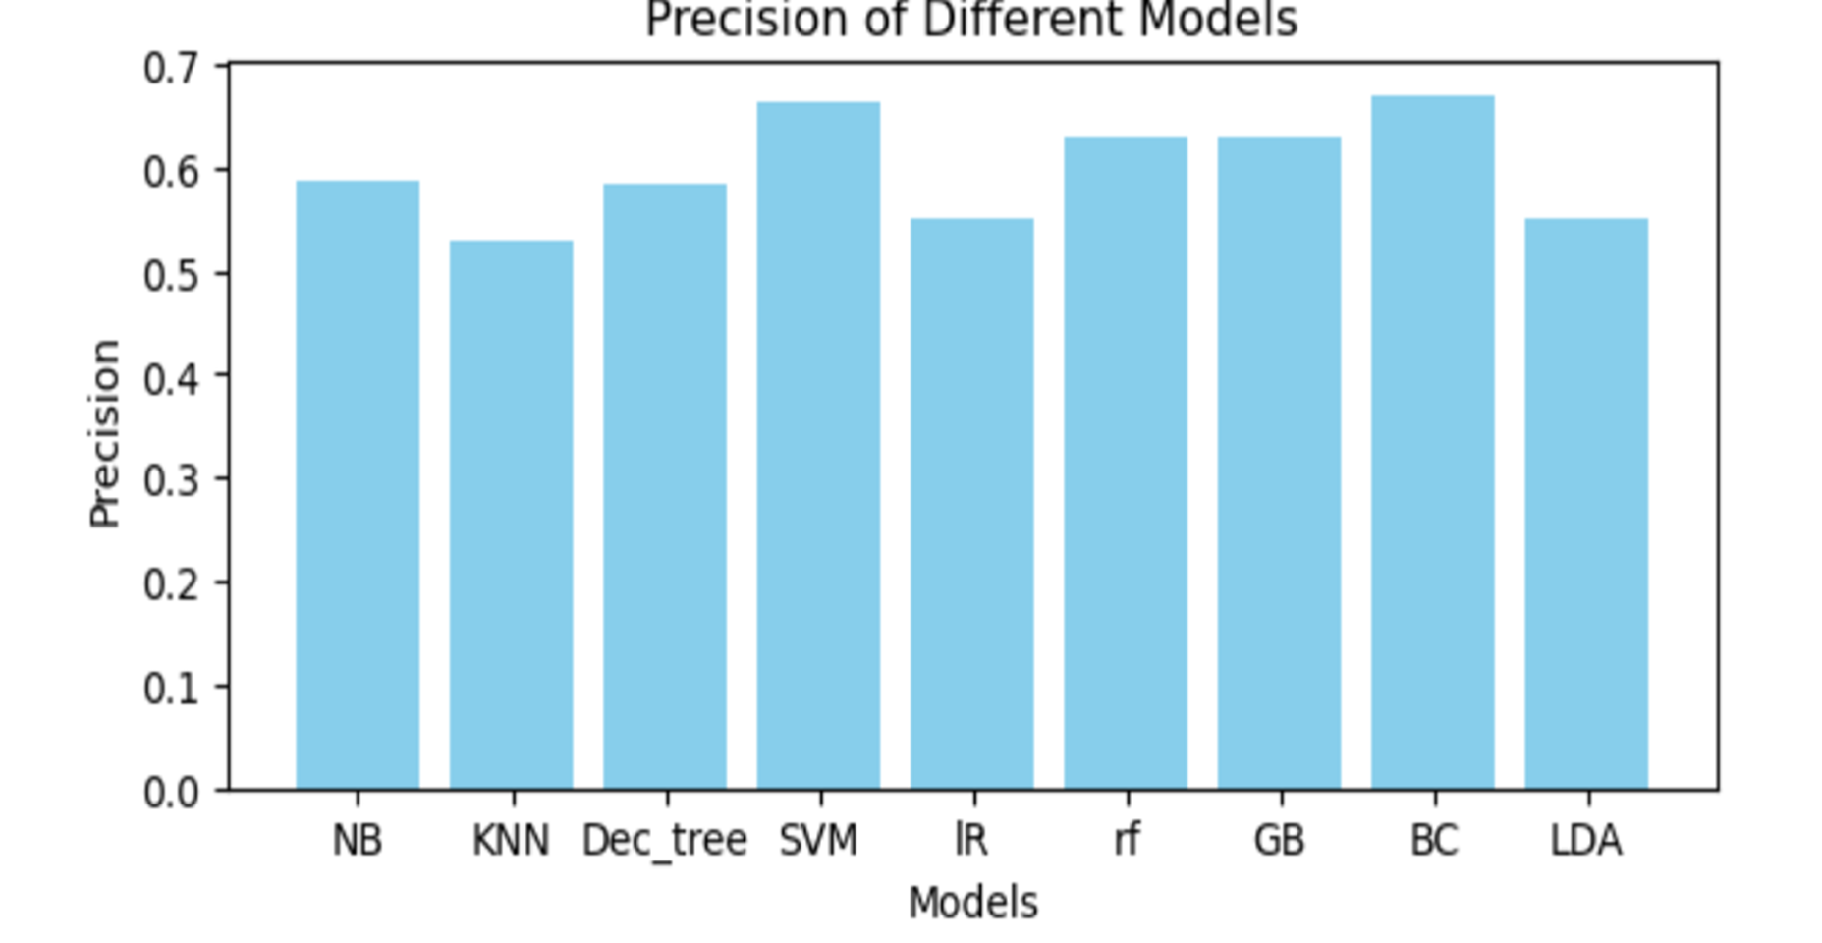
selecting all variable in the data

Slide 15
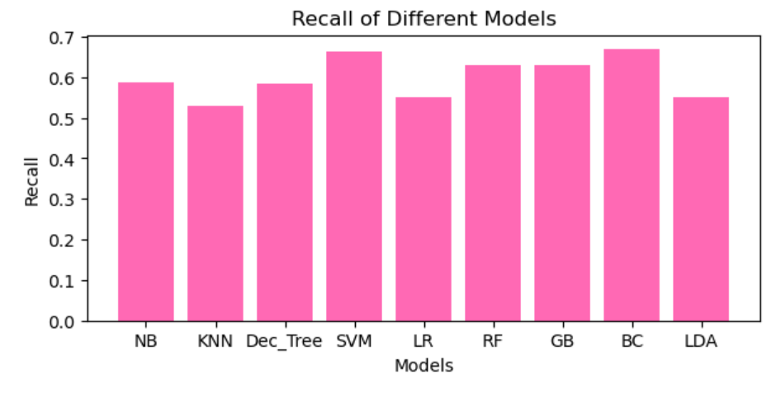

Slide 16
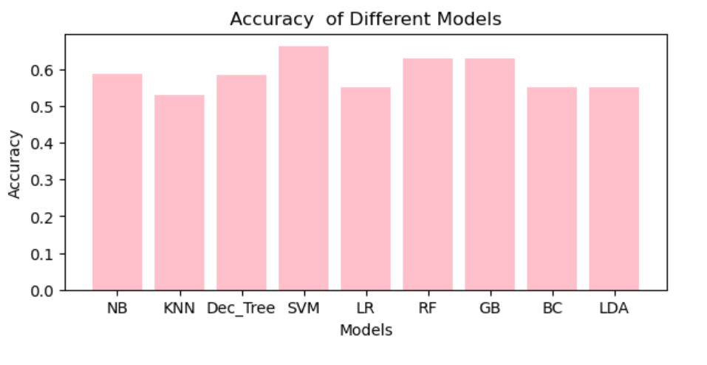

Slide 17
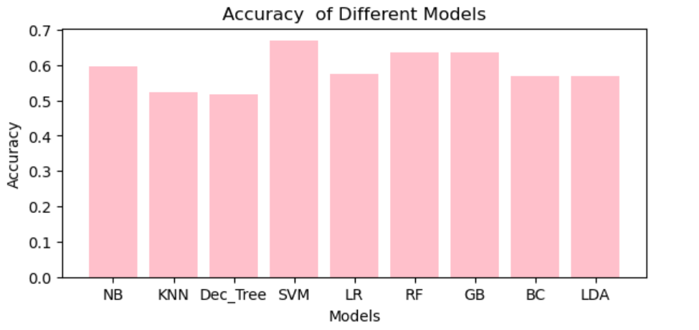
After removing insignificant variable

Slide 18
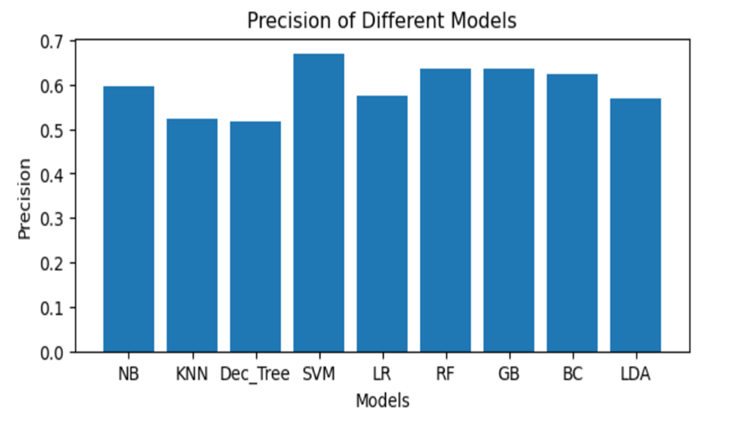

Slide 19
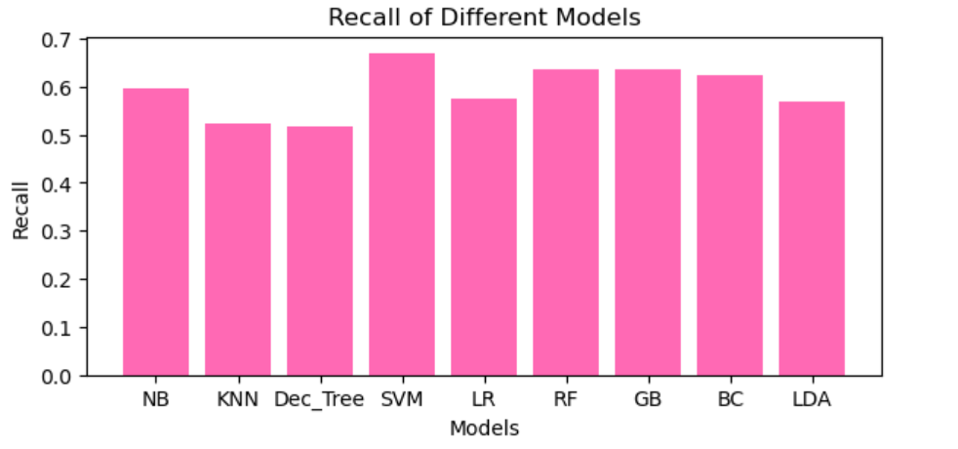

Slide 20
Conclusion
1 CASE : All variable selection
From the Accuracy of different models graph we conclude that Accuracy of SVM model is more accurate than other models
From the Precision of different models graph and Precision of different models graph we conclude that Precision and Recall of SVM and Bagging classifier model is larger than other models
2 CASE : Selecting only significant variable
From the Accuracy of different models graph we conclude that Accuracy of SVM model is more accurate than other models
From the Precision of different models graph and Precision of different models graph we conclude that Precision and Recall of SVM model is larger than other models

Slide 21
THANK
YOU

