Slide 1
Socket Programming
Socket Programming Overview
Java Socket Programming
Python Socket Programming
Readings: Chapter 2: Sections 2.7
Project I Description
CSci4211: Socket API
Notes:
Hello everyone. Now I’m gonna introduce something about socket programming. First we will try to get a general idea about what socket is. Then we will introduce socket programming with Java and socket programming with Python. The corresponding reading material is the Section 2.7 in Chapter 2, and the project 1 description.

Slide 2





Refreshing: Client/Server Communication Paradigm
Typical network app has two pieces: client and server
application
transport
network
data link
physical
request
Client:
initiates contact with server (“speaks first”)
typically requests service from server
reply
application
transport
network
data link
physical
Server:
provides requested service to client
e.g., Web server sends requested Web page, mail server delivers e-mail
CSci4211: Socket API
Notes:
Before we talk about socket programming, let us recall some materials that we learned before. We know that, the most common network communication model is the client/server model, where clients initiate a conversation with a server by sending some requests. Servers sit on certain machine and provide certain services.

Slide 3
Recall …
Host (NIC card) identified by unique IP address
Network application/process identified by port number
Network connection identified by a 5-tuple (src ip, src port, dst ip, dst port, protocol)
Two kinds of Internet transport services provided to applications
  Connection-oriented TCP
  Connectionless UDP
CSci4211: Socket API
Notes:
And here is something we learned. Again, we know that there are two kinds of transport services.

Slide 4
Socket Programming API
API: Application Programming Interface
Socket analogous to door
  sending process shoves message out door
  sending process assumes transport infrastructure on other side of door which brings message to socket at receiving process
  host-local, application created/owned, OS-controlled
  connection between sockets set-up/managed by OS
host or
server
host or
server
controlled by
app developer
process
process
socket
socket
TCP with
buffers,
variables
TCP with
buffers,
variables
Internet
controlled
by OS
CSci4211: Socket API
Notes:
Socket API is the programming interface you need to use for transmitting and receiving messages. It is almost like a kind of door, a door to transport layer (note that we are in application layer).

Slide 5
What APIs Needed?
Connection-Oriented TCP
Connectionless UDP
How to send/recv data
How to establish connection
  Client connects to a server
  Server accepts client req.
How to create socket (door)
How to close socket (door)
How to identify socket
  Bind to local address/port
How to send/recv data
How to create socket
How to close socket
How to identify socket
CSci4211: Socket API
Notes:
If you are developing a network program, what services you would like the transport layer to provide? Of course, possibly the first thing come into your mind is that, you want to be able to send something to another party, or receive something from another party. If you want to use connection-oriented TCP, you would also possibly want the system to take care of the connection establishment procedure.

Slide 6
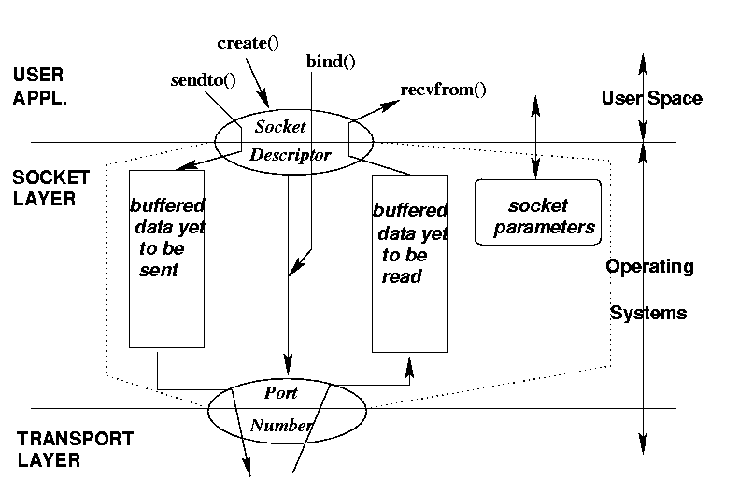
Socket: Conceptual View
socket()
CSci4211: Socket API
Notes:
This figure shows what socket can help you. It can send and receive messages, and act as a buffer, and also an interface between user and lower layers.

Slide 7
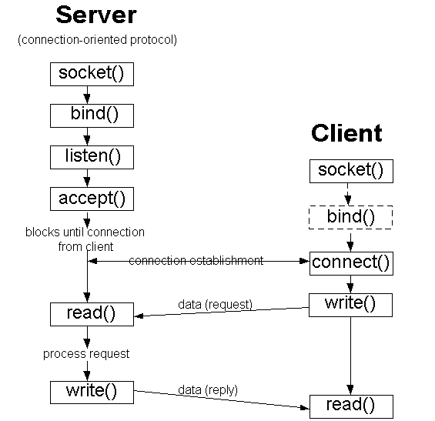
BSD Socket Programming Flows (connection-oriented)
CSci4211: Socket API

Slide 8
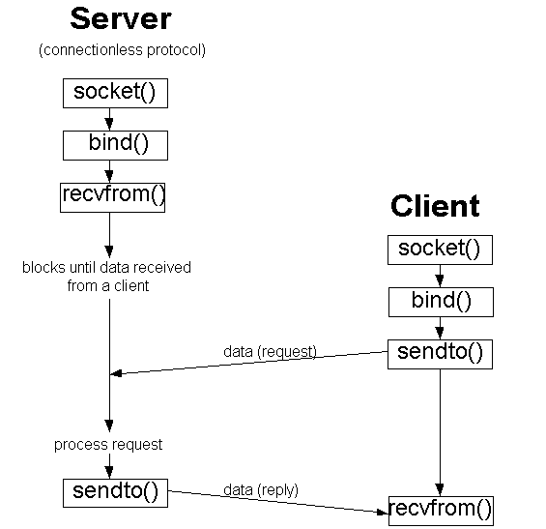
BSD Socket Programming (connectionless)
CSci4211: Socket API

Slide 9
Socket Programming: Basics
The server application must be running before the client can send anything.
The server must have a socket through which it sends and receives messages. The client also need a socket.
Locally, a socket is identified by a port number.
In order to send messages to the server, the client needs to know the IP address and the port number of the server.
Port number is analogous to an apartment number. All doors (sockets) lead into the building, but the client only has access to one of them, located at the provided number.
CSci4211: Socket API

Slide 10
Java Socket Programming API
Class ServerSocket
  Connection-oriented server side socket
Class Socket
  Regular connection-oriented socket (client)
Class DatagramSocket
  Connectionless socket
Class InetAddress
  Encapsulates Internet IP address structure
CSci4211: Socket API

Slide 11
TCP Socket
Create a server side TCP socket (class ServerSocket)
  ServerSocket(int localPort)
  ServerSocket(int localPort, int queueLimit)
  ServerSocket(int localPort, int queueLimit, InetAddress localAddress)
Accept incoming TCP client request
  Socket serverSocket.accept()
Close an existing TCP socket
  socket.close()
CSci4211: Socket API

Slide 12
TCP Socket (Cont’d)
Create a (client side) TCP socket (class Socket)
  Socket(InetAddress remoteAddr, int remotePort)
  Socket(String remoteHost, int remotePort)
  Socket(InetAddress remoteAddress, int remotePort,
  InetAddress localAddress, int localPort)
Read from/write to a socket through stream
  InputStream socket.getInputStream()
  OutputStream socket.getOutputStream()
Close an existing socket
  socket.close()
CSci4211: Socket API

Slide 13
UDP Socket
Create a UDP socket (class DatagramSocket)
  DatagramSocket()
  DatagramSocket(int localPort)
  DatagramSocket(int localPort, InetAddress localAddress)
Receive/send data
  void receive(DatagramPacket packet)
  void send(DatagramPacket packet)
Close a UDP socket
  datagramSocket.close()
CSci4211: Socket API

Slide 14
UDP DatagramPacket
UDP endpoints exchange self-contained message (class DatagramPacket)
  DatagramPacket(byte[] buffer, int length)
  DatagramPacket(byte[] buffer, int length, InetAddress remoteAddress, int remotePort)
import java.net.*;
DatagramPacket sendPacket = new DatagramPacket(
byteToSend, byteToSend.length, serverAddress, serverPort);
CSci4211: Socket API

Slide 15
A summary of Java Socket
protocol
localAddr,localPort
remoteAddr, remotePort
conn-oriented server
ServerSocket()
accept()
conn-oriented client
Socket()
connectionless server
DatagramSocket()
receive()
connectionless client
DatagramSocket()
send()
CSci4211: Socket API

Slide 16
Java Socket Programming Flows (TCP)
Server (running on hostid)
Client
create socket,
port=x, for
incoming request:
welcomeSocket =
ServerSocket()
wait for incoming
connection request
create socket,
connect to hostid, port=x
connectionSocket =
welcomeSocket.accept()
clientSocket =
Socket()
TCP
connection setup
send request using
clientSocket
read request from
connectionSocket
write reply to
connectionSocket
read reply from
clientSocket
close
connectionSocket
close
clientSocket
CSci4211: Socket API

Slide 17
Java Socket Programming (UDP)
Server (running on hostid)
Client
create socket,
port=x, for
incoming request:
welcomeSocket =
DatagramSocket()
create socket
welcomeSocket.receive()
clientSocket = DatagramSocket()
Blocks until data
received from a client
Data (request)
send request using
clientSocket.send()
Process request
Data (reply)
read reply from
clientSocket.receive()
welcomeSocket.send()
close
clientSocket
CSci4211: Socket API

Slide 18
Example: Java Client (TCP)
import java.io.*;
import java.net.*;
class TCPClient {
public static void main(String argv[]) throws Exception
{
String sentence;
String modifiedSentence;
BufferedReader inFromUser =
new BufferedReader(new InputStreamReader(System.in));
Socket clientSocket = new Socket("hostname", 6789);
DataOutputStream outToServer =
new DataOutputStream(clientSocket.getOutputStream());
Create
input stream
Create
client socket,
connect to server
Create
output stream
attached to socket
CSci4211: Socket API

Slide 19
Example: Java Client (TCP), cont.
BufferedReader inFromServer =
new BufferedReader(new
InputStreamReader(clientSocket.getInputStream()));
sentence = inFromUser.readLine();
outToServer.writeBytes(sentence + '\n');
modifiedSentence = inFromServer.readLine();
System.out.println("FROM SERVER: " + modifiedSentence);
clientSocket.close();
}
}
Create
input stream
attached to socket
Send line
to server
Read line
from server
CSci4211: Socket API

Slide 20
Example: Java Server (TCP)
import java.io.*;
import java.net.*;
class TCPServer {
public static void main(String argv[]) throws Exception
{
String clientSentence;
String capitalizedSentence;
ServerSocket welcomeSocket = new ServerSocket(6789);
while(true) {
Socket connectionSocket = welcomeSocket.accept();
BufferedReader inFromClient =
new BufferedReader(new
InputStreamReader(connectionSocket.getInputStream()));
Create
welcoming socket
at port 6789
Wait, on welcoming
socket for contact
by client
Create input
stream, attached
to socket
CSci4211: Socket API

Slide 21
Example: Java Server (TCP), cont
Create output
stream, attached
to socket
DataOutputStream outToClient =
new DataOutputStream(connectionSocket.getOutputStream());
clientSentence = inFromClient.readLine();
capitalizedSentence = clientSentence.toUpperCase() + '\n';
outToClient.writeBytes(capitalizedSentence);
}
}
}
Read in line
from socket
Write out line
to socket
End of while loop,
loop back and wait for
another client connection
CSci4211: Socket API

Slide 22
Compiling and Running
To compile
  javac TCPServer.java
  javac TCPClient.java
To run
  java TCPServer
  java TCPClient
CSci4211: Socket API

Slide 23
Example: Java client (UDP)
import java.io.*;
import java.net.*;
class UDPClient {
public static void main(String args[]) throws Exception
{
BufferedReader inFromUser =
new BufferedReader(new InputStreamReader(System.in));
DatagramSocket clientSocket = new DatagramSocket();
InetAddress IPAddress = InetAddress.getByName("hostname");
byte[] sendData = new byte[1024];
byte[] receiveData = new byte[1024];
String sentence = inFromUser.readLine();
sendData = sentence.getBytes();
Create
input stream
Create
client socket
Translate
hostname to IP
address using DNS
CSci4211: Socket API

Slide 24
Example: Java client (UDP), cont.
Create datagram with data-to-send,
length, IP addr, port
DatagramPacket sendPacket =
new DatagramPacket(sendData, sendData.length, IPAddress, 9876);
clientSocket.send(sendPacket);
DatagramPacket receivePacket =
new DatagramPacket(receiveData, receiveData.length);
clientSocket.receive(receivePacket);
String modifiedSentence =
new String(receivePacket.getData());
System.out.println("FROM SERVER:" + modifiedSentence);
clientSocket.close();
}
}
Send datagram
to server
Read datagram
from server
CSci4211: Socket API

Slide 25
Example: Java server (UDP)
import java.io.*;
import java.net.*;
class UDPServer {
public static void main(String args[]) throws Exception
{
DatagramSocket serverSocket = new DatagramSocket(9876);
byte[] receiveData = new byte[1024];
byte[] sendData = new byte[1024];
while(true)
{
DatagramPacket receivePacket =
new DatagramPacket(receiveData, receiveData.length);
serverSocket.receive(receivePacket);
Create
datagram socket
at port 9876
Create space for
received datagram
Receive
datagram
CSci4211: Socket API

Slide 26
Example: Java server (UDP), cont
String sentence = new String(receivePacket.getData());
InetAddress IPAddress = receivePacket.getAddress();
int port = receivePacket.getPort();
String capitalizedSentence = sentence.toUpperCase();
sendData = capitalizedSentence.getBytes();
DatagramPacket sendPacket =
new DatagramPacket(sendData, sendData.length, IPAddress,
port);
serverSocket.send(sendPacket);
}
}
}
Get IP addr
port #, of
sender
Create datagram
to send to client
Write out
datagram
to socket
End of while loop,
loop back and wait for
another datagram
CSci4211: Socket API

Slide 27
Example: Python Client (TCP)
from socket import *
serverName = ’servername’
serverPort = 12000
clientSocket = socket(AF_INET, SOCK_STREAM)
clientSocket.connect((serverName,serverPort))
sentence = raw_input(‘Input lowercase sentence:’)
clientSocket.send(sentence)
modifiedSentence = clientSocket.recv(1024)
print ‘From Server:’, modifiedSentence
clientSocket.close()
create TCP socket for server, remote port 12000
No need to attach server name, port
CSci4211: Socket API

Slide 28
Example: Python Server (TCP)
from socket import *
serverPort = 12000
serverSocket = socket(AF_INET,SOCK_STREAM)
serverSocket.bind((‘’,serverPort))
serverSocket.listen(1)
print ‘The server is ready to receive’
while 1:
connectionSocket, addr = serverSocket.accept()
sentence = connectionSocket.recv(1024)
capitalizedSentence = sentence.upper()
connectionSocket.send(capitalizedSentence)
connectionSocket.close()
create TCP welcoming
socket
server begins listening for incoming TCP requests
loop forever
server waits on accept()
for incoming requests, new socket created on return
read bytes from socket (but not address as in UDP)
close connection to this client (but not welcoming socket)
CSci4211: Socket API

Slide 29
Example: Python Client (UDP)
include Python’s socket
library
from socket import *
serverName = ‘hostname’
serverPort = 12000
clientSocket = socket(socket.AF_INET,
socket.SOCK_DGRAM)
message = raw_input(’Input lowercase sentence:’)
clientSocket.sendto(message,(serverName, serverPort))
modifiedMessage, serverAddress =
clientSocket.recvfrom(2048)
print modifiedMessage
clientSocket.close()
create UDP socket for server
get user keyboard
input
Attach server name, port to message; send into socket
read reply characters from
socket into string
print out received string and close socket
CSci4211: Socket API

Slide 30
Example: Python Server (UDP)
create UDP socket
from socket import *
serverPort = 12000
serverSocket = socket(AF_INET, SOCK_DGRAM)
serverSocket.bind(('', serverPort))
print “The server is ready to receive”
while 1:
message, clientAddress = serverSocket.recvfrom(2048)
modifiedMessage = message.upper()
serverSocket.sendto(modifiedMessage, clientAddress)
bind socket to local port number 12000
loop forever
Read from UDP socket into message, getting client’s address (client IP and port)
send upper case string back to this client
CSci4211: Socket API

Slide 31
Running Python Program
python TCPClient.py
python TCPServer.py
CSci4211: Socket API

Slide 32
Two Different Server Behaviors
Iterative server
  At any time, only handles one client request
Concurrent server
  Multiple client requests can be handled simultaneously
  create a new process/thread to handle each request
for (;;) {
accept a client request;
handle it
}
for (;;) {
accept a client request;
create a new process / thread to handle request;
parent process / thread continues
}
CSci4211: Socket API

Slide 33
Example of Concurrent Server
Python
import threading
def main():
…….
cx, addr = s.accept()
server = threading.Thread(target=dns, name=“…” args=[cx, str(n)+str(addr)] )
server.start()
…….
……
def dns(cx,n):
…….
CSci4211: Socket API

Slide 34
Example of Concurrent Server
Java
public class DNSServer{
public static void main(String[]args) throws IOException {
……
new QueryThread(sSock.accept()).start();
……
}
}
class QueryThread extends Thread{
@Override
public void run(){
}
}
CSci4211: Socket API

Slide 35
Helpful Resources
Java Socket Tutorial
  http://download.oracle.com/javase/tutorial/networking/sockets/
‎Python Socket Tutorial
  http://docs.python.org/2/howto/sockets.html
  http://docs.python.org/3.1/howto/sockets.html
Computer Networking: A Top-Down Approach, 6th Edition. Section 2.7 (Python)
Computer Networking: A Top-Down Approach, 5th Edition. Section 2.7-2.8 (Java)
CSci4211: Socket API

