Slide 1

Big Game Census
The Big Game Census is a comprehensive dataset analyzing the performance of footballers across the world. This presentation will delve into key insights derived from the data, providing a detailed look at player demographics, performance trends, and other important metrics.
by Reshma Rajan

Slide 2
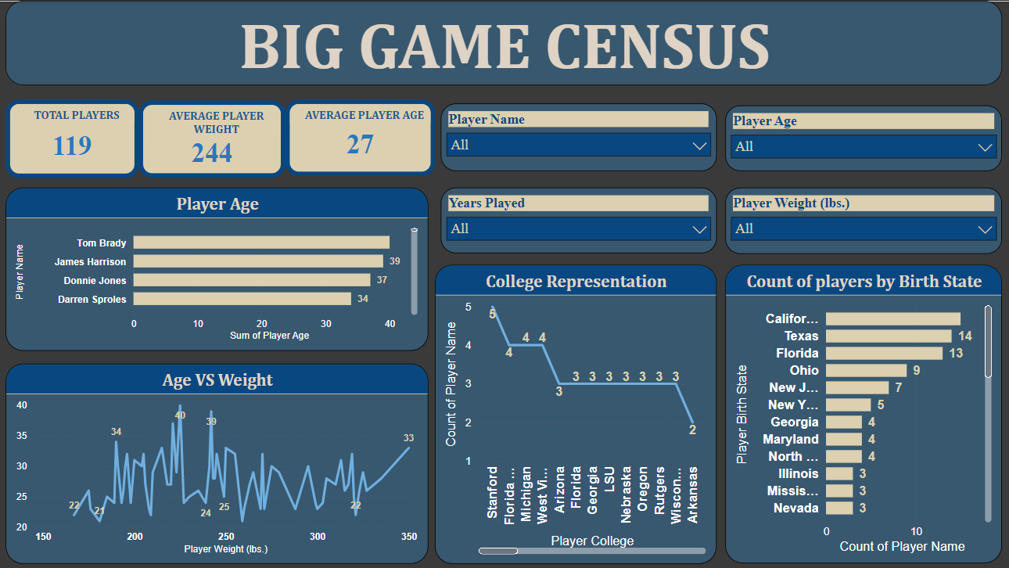

Slide 3

Key Metrics
1
Total Players
2
Average Weight
This dataset contains 119 players.
The average player weight is 244 lbs.
3
Average Age
The average player age is 27 years.

Slide 4



Some Key Insights
College Representation
Player Birth State
Age vs. Height Correlation
Colleges such as Stanford, Florida State and Michigan have the highest number of players.
These institutions likely have strong recruitment programs and player development pipelines.
California, Texas and Florida are the top states producing players.
These states are critical regions for scouting and development programs
Younger players tend to weigh between 150-200 lbs., while older players weigh more.
This reflects typical growth patterns or the impact of professional training over time.

Slide 5




Conclusion and Key Takeaways
The dashboard provides valuable insights into player demographics, physical attributes, and educational backgrounds .
Key trends identified include the dominance of certain age groups, top colleges for player development and regional hotspots for talent.
The age vs. weight correlation highlights how physical traits evolve with age, useful for recruitment and player development strategies.

