Slide 1
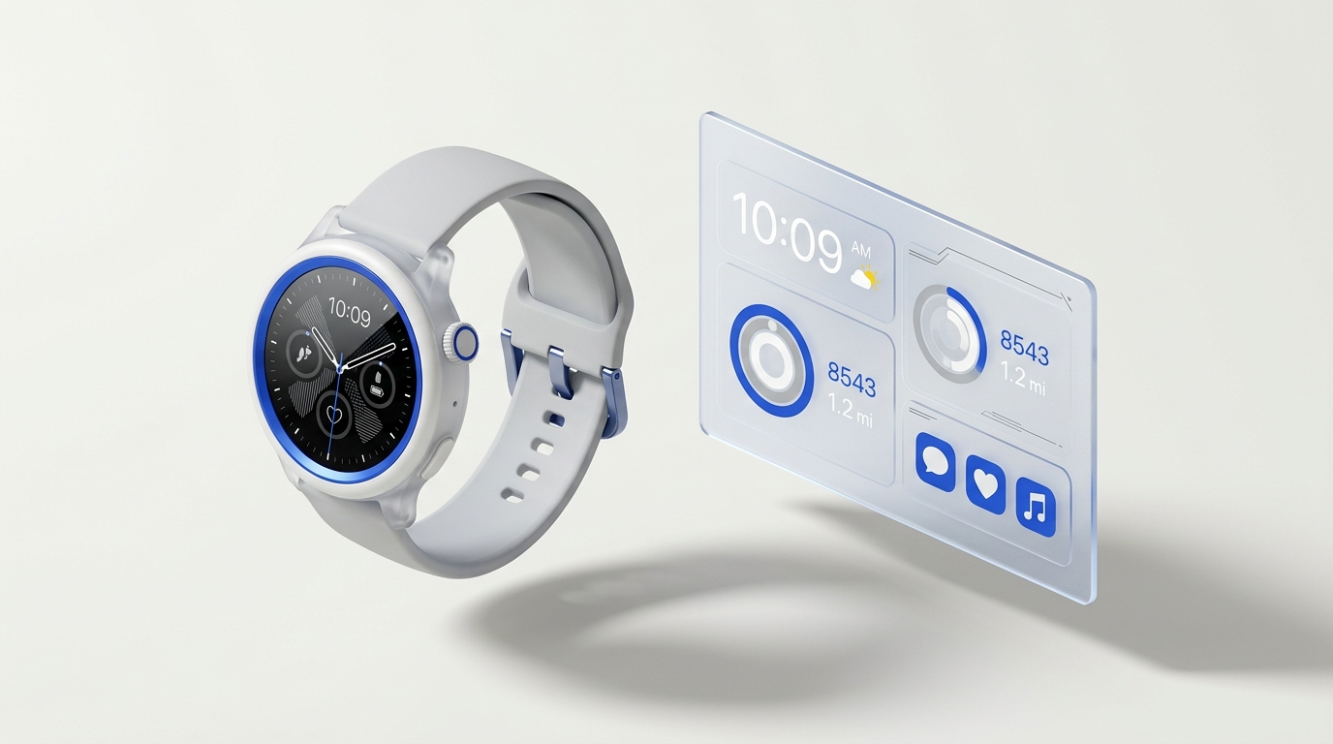
// ACADEMIC PROJECT VIVA • PHASE-I EVALUATION • SCOPE
RESEARCH DOMAIN: COGNITIVE ERGONOMICS & CLOSED-LOOP HCI
FLOWSTATE
A Multimodal, Context-Aware System for Personalized Adaptive Web Interfaces
Closed-loop cognitive workload estimation and non-intrusive biocybernetic adaptation using consumer wearables and browser interaction telemetry.
HARDWARE BOUNDARY: Consumer BLE Smartwatch (PPG 0x180D) + Browser Telemetry | TEMPORAL: 30s Sliding Windows
TARGET CONSTRUCTS: Workload • Fatigue • Engagement (Tri-State) | SAFEGUARDS: 7-Step Provenance Trace
STUDENT RESEARCH TEAM
• Naidu Reshmanth Sai — 25BCE1112
• Sri Priyan D — 25BCE1074
• Vinayak V — 25BCExxxx
FACULTY PROJECT SUPERVISION
Dr. Sudheer Kumar
School of Computer Science & Engineering (SCOPE)
Faculty Project Supervisor • Phase-I Capstone Review
FLOWSTATE RESEARCH PLATFORM | PHASE-I EVALUATION | SUPERVISOR: DR. SUDHEER KUMAR SLIDE 01 / 08

Slide 2
// 02 // PRESENTATION ROADMAP
Agenda & Research Progression
Structured trajectory from theoretical cognitive foundations to a functioning prototype
01
04
INTRODUCTION & PROBLEM MOTIVATION
Cognitive overload in digital workspaces, human-computer friction, and limitations of static interfaces.
PROJECT OBJECTIVES & SCOPE BOUNDARIES
Five verifiable engineering milestones: dual-stream ingestion, baseline deltas, tri-state inference, explainability, adaptation.
02
05
LITERATURE SURVEY & THEORETICAL BASELINE
Critical analysis of 5 foundational studies in physiological computing, WESAD stress detection, and CLT.
SYSTEM ARCHITECTURE & PROPOSED METHODOLOGY
Full 6-tier pipeline: canonical ingestion → quality gating → 30s window sync → multimodal fusion → adaptation.
03
06
CHALLENGES & TECHNICAL RESEARCH GAP
Hardware invasiveness, inter-subject baseline drift, wrist sensor noise, and biocybernetic UI oscillation.
RESULTS & INITIAL IMPLEMENTATION (38% DONE)
Verified vertical slice: 37 passing unit tests, 5-phase deterministic scenario, and interactive cognitive task.
FLOWSTATE RESEARCH PLATFORM | PHASE-I EVALUATION | SUPERVISOR: DR. SUDHEER KUMAR SLIDE 02 / 08

Slide 3
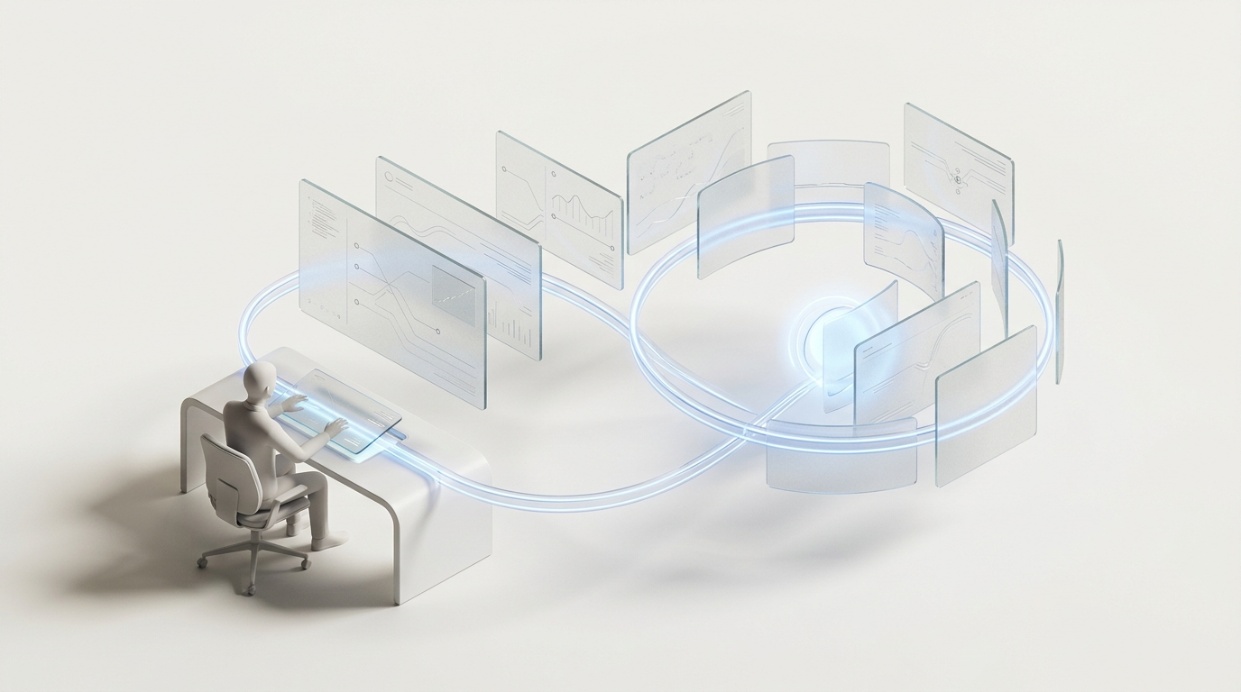
// 03 // PROBLEM CONTEXT & MOTIVATION
Cognitive Friction in Modern Digital Workspaces
Bridging the sensory disconnect between static web interfaces and human mental capacity
01 THE PROBLEM: UNNOTICED COGNITIVE OVERLOAD
• Mental exhaustion accumulates invisibly during high-density web work.
• Task error rates escalate by up to 40% when cognitive limits are exceeded.
• Users fail to self-regulate early enough because the brain lacks explicit feedback.
02 EXISTING LIMITATIONS: INVASIVE OR OBLIVIOUS TOOLS
• Traditional Web UIs are completely static—treating exhausted users identically to rested ones.
• Past physiological computing mandates invasive EEG caps or fNIRS headbands.
• Conventional timers (e.g. Pomodoro) rely on rigid clocks without biological awareness.
03 OUR SOLUTION: CLOSED-LOOP BIOCYBERNETICS
• Fuses consumer smartwatch PPG signals with natural browser interaction telemetry.
• Dynamic baseline calibration calculates individualized resting deltas (ΔHR, RMSSD).
• Drives explainable, bounded UI adaptations (pacing, micro-breaks) to preserve flow state.
THE BIOCYBERNETIC ADAPTATION LOOP (HCI)
[Operator] ──► [PPG + Telemetry Ingestion] ──► [30s Window Sync] ──► [Tri-State Inference] ──► [Bounded Adaptive UI] ──► [Cognitive Relief]
FLOWSTATE RESEARCH PLATFORM | PHASE-I EVALUATION | SUPERVISOR: DR. SUDHEER KUMAR SLIDE 03 / 08

Slide 4
// 04 // THEORETICAL FOUNDATIONS
Academic Literature Survey
Synthesis of five foundational studies establishing the physiological computing baseline and research gap
# | Paper & Authors | Year | Methodology & Key Findings | Limitation & Relevance to Flowstate
01 | Schmidt et al. (ACM IMWUT / UbiComp) | 2018 | WESAD dataset: Wrist PPG + Chest ECG under controlled affective stress induction (15 subjects). | Limitation: Lab-only; lacks real-time web UI integration. Relevance: Reference external dataset for physiological validation.
02 | Fairclough, S. H. (Int. J. Human-Comp. Stud.) | 2009 | Theoretical biocybernetic loop model connecting physiological signals to automation. | Limitation: Purely theoretical; omits sensor noise & UI thrashing. Relevance: Mathematical foundation for closed-loop hysteresis control.
03 | Charles & Nixon (Theor. Issues Ergon. Sci.) | 2019 | Meta-survey of cardiac measures (HRV, PPG) for mental workload quantification. | Limitation: Universal static thresholds fail due to baseline diversity. Relevance: Justifies our 30s sliding-window baseline delta (ΔHR).
04 | Kosch et al. (ACM Computing Surveys) | 2023 | Systematic analysis of consumer smartwatch biosensors in everyday desktop HCI tasks. | Limitation: Wrist motion artifacts and Bluetooth packet drops. Relevance: Motivates our dual-stream wearable + task telemetry fusion.
05 | Sweller / Paas et al. (Cognitive Science) | 2003 | Cognitive Load Theory: Intrinsic, extraneous, and germane cognitive load dimensions. | Limitation: Pure behavioral metrics cannot detect hidden internal strain. Relevance: Defines our tri-state target constructs (Workload, Fatigue, Engagement).
CRITICAL SYNTHESIS: Prior work establishes physiological sensitivity, but leaves a critical gap in non-invasive, noise-tolerant consumer deployment with backward explainability and biocybernetic stability.
FLOWSTATE RESEARCH PLATFORM | PHASE-I EVALUATION | SUPERVISOR: DR. SUDHEER KUMAR SLIDE 04 / 08

Slide 5
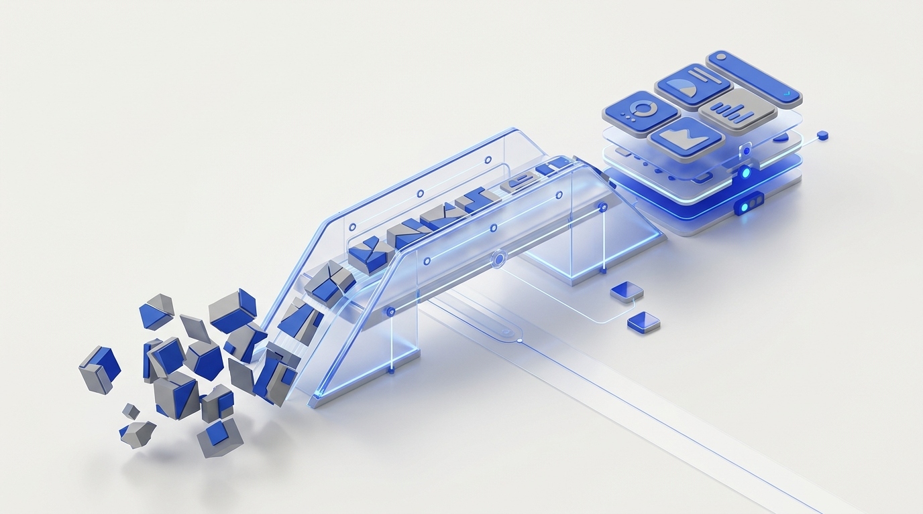
// 05 // CRITICAL ANALYSIS
Challenges & Formulated Research Gap
Overcoming four core bottlenecks that prevent laboratory physiological computing from reaching consumer web systems
01 HARDWARE INVASIVENESS
Barrier: Mandates clinical EEG caps or chest straps unacceptable for daily work.
Solution: Strict consumer boundary (standard browser + BLE smartwatch PPG 0x180D).
02 INTER-SUBJECT VARIABILITY
Barrier: Resting HR varies from 50 to 90 bpm; universal static thresholds trigger false alarms.
Solution: Continuous personalized calibration computing resting deltas (ΔHR = HR - HR_rest).
03 SENSOR NOISE & DROPOUTS
Barrier: Wrist motion causes packet drops; zero-filling missing streams corrupts models.
Solution: Explicit availability_mask routing with tri-branch fallback (Wearable, Task, Fused).
THE CORE FORMULATED RESEARCH GAP:
"The absence of an explainable, noise-tolerant biocybernetic framework that reliably estimates multidimensional cognitive states from consumer-grade wearables and desktop telemetry without requiring clinical invasiveness, zero-filled signal corruption, or disruptive interface oscillation."
04 UI OSCILLATION & BLACK-BOX AI
Barrier: Black-box AI causes biocybernetic thrashing without explainability.
Solution: 7-step Follow-the-Signal audit trace + bounded hysteresis with cooldowns.
FLOWSTATE RESEARCH PLATFORM | PHASE-I EVALUATION | SUPERVISOR: DR. SUDHEER KUMAR SLIDE 05 / 08

Slide 6
// 06 // SCOPE & DELIVERABLES
Project Objectives & Technical Scope
Five precise, measurable, and implementation-oriented engineering milestones
OBJ 01
ENGINEER DUAL-STREAM INGESTION & SYNCHRONIZATION PIPELINE
Ingest consumer BLE smartwatch PPG (Bluetooth GATT Service 0x180D) and browser task interaction telemetry, synchronizing data into non-leaking 30-second sliding windows with timestamp verification and gap handling.
OBJ 02
IMPLEMENT INDIVIDUALIZED BASELINE CALIBRATION & DELTA EXTRACTION
Compute normalized physiological deltas (ΔHR = HR_curr - HR_rest) against personalized resting baselines to neutralize inter-subject variance, supported by an explicit missing-modality mask (availability_mask).
OBJ 03
DEVELOP TRI-STATE MULTIMODAL INFERENCE & CONFIDENCE GATING
Implement baseline classification models estimating three independent cognitive constructs—Workload, Fatigue, and Engagement—accompanied by quality gating (PASS, DEGRADED, INSUFFICIENT) rather than ungrounded black-box predictions.
OBJ 04
ARCHITECT 7-STAGE 'FOLLOW-THE-SIGNAL' EXPLANATION PIPELINE
Establish a transparent, non-causal evidence attribution audit trail allowing users to trace any UI intervention backwards through 7 verification stages to the exact raw sensor events that triggered it.
OBJ 05
DEPLOY CLOSED-LOOP ADAPTIVE WEB INTERFACE WITH HYSTERESIS
Deliver bounded, non-disruptive web UI interventions (micro-break prompts, task difficulty modulation, notification throttling) governed by hysteresis thresholds and cooldown timers to prevent interface thrashing.
FLOWSTATE RESEARCH PLATFORM | PHASE-I EVALUATION | SUPERVISOR: DR. SUDHEER KUMAR SLIDE 06 / 08

Slide 7
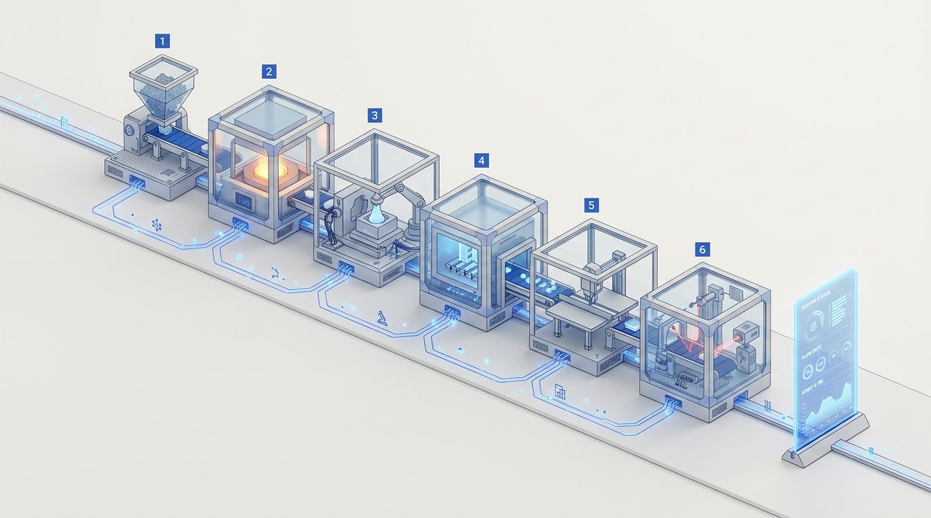
// 07 // SYSTEM ARCHITECTURE & METHODOLOGY
End-to-End Multimodal Pipeline Architecture
Dual-stream ingestion, 30s window synchronization, tri-state inference, and closed-loop adaptation
STAGE 01
Dual Inputs
• BLE Smartwatch (PPG 0x180D, RR)
• Browser Task Telemetry (Latency, Errors)
STAGE 02
Quality Gating
• Plausibility Checks (40–200 bpm)
• Explicit availability_mask
STAGE 03
30s Windows
• 30s Sliding Windows (5s step)
• Zero future-data leakage
STAGE 04
Personalization
• Baseline Delta (ΔHR = HR - HR_rest)
• Tri-Branch Fusion (Wearable, Task, Fused)
STAGE 05
Tri-State ML
• Confidence Gating: PASS/DEGRADED
• Workload, Fatigue, Engagement
STAGE 06
Adaptive UI
• 7-Step Evidence Trace
• Bounded UI Interventions & Cooldowns
FLOWSTATE RESEARCH PLATFORM | PHASE-I EVALUATION | SUPERVISOR: DR. SUDHEER KUMAR SLIDE 07 / 08

Slide 8
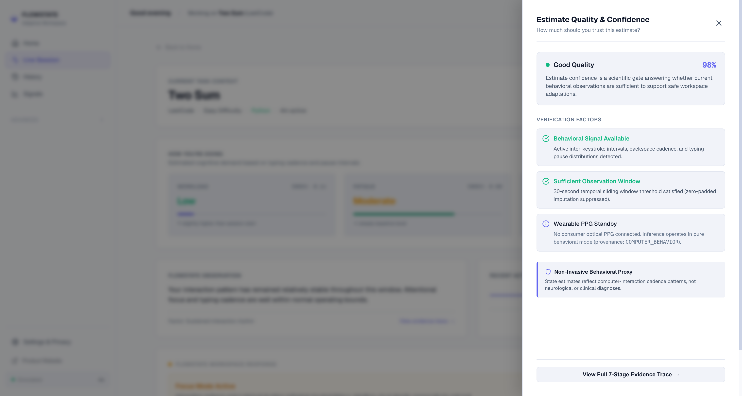
// 08 // PHASE-I IMPLEMENTATION STATUS
Initial Implementation & Preliminary Verification
Demonstrating verified 38% project milestone completion across core architecture and functional modules
PHASE-I COMPLETION STATUS
38% COMPLETED
Minimum Target: 20% [SURPASSED]
37/37 Unit Tests Passed in 0.52s
MODULE STATUS CHECKLIST:
✓ M01–M20 Architecture Specification (100%)
✓ Ingestion & Quality Service (100%)
✓ 30s Window Sync & Features (100%)
✓ 37/37 Automated Unit Tests Passing (100%)
✓ Deterministic 5-Phase Simulator (100%)
✓ Interactive Arithmetic Task Telemetry (100%)
→ Physical BLE Smartwatch GATT Pairing (40%)
○ External Benchmark (WESAD Mapping - Planned)
PROTOTYPE VERIFICATION & SCIENTIFIC SAFEGUARDS
• 5-Phase Scenario Validated: Baseline (72 bpm) → Demand Escalation → High Workload (88% Conf) → Bounded Intervention → Recovery.
• Zero Fabricated Metrics: Benchmarks labeled VALIDATION_PENDING until external WESAD construct mapping completes.
FLOWSTATE RESEARCH PLATFORM | PHASE-I EVALUATION | SUPERVISOR: DR. SUDHEER KUMAR SLIDE 08 / 08

