Slide 1
✦ TAMPER-EVIDENT CREDENTIAL RECORDS
PROVENANCE
Verifiable Academic & Professional Credentials with Zero Doubt
Deterministic Forensics
6-stage multi-layered file inspection analyzing metadata gaps, tool signatures, OCR, and pHash templates.
Per-Issuer Hash Chain
Append-only SHA-256 cryptographic ledger with PostgreSQL advisory locks guaranteeing tamper-evidence.
Anti-SSRF Connectors
Strict constant-host public registry lookups (e.g. Coursera) with zero arbitrary OCR link crawling.
Zero Data Leakage
Public verifiers and candidate showcases surface verified signals while protecting sensitive PII and keys.
Provenance Platform Overview • Full-Stack Monorepo (Next.js App Router + Express + PostgreSQL + Prisma)
Notes:
Welcome to the Provenance platform presentation.
Provenance is a high-assurance, tamper-evident credential verification platform designed to eliminate academic and professional credential fraud.
Unlike traditional background check services that rely on slow phone calls, opaque black-box AI scores, or insecure PDF scrapers, Provenance pairs deterministic self-upload document forensics with an append-only per-issuer cryptographic hash chain.
In this deck, we will explore the crisis in credential integrity, the 6-stage forensics pipeline, the cryptographic hash ledger, architectural anti-SSRF protections, and the multi-role user experience.

Slide 2
✦ PLATFORM VISION & VALUE PROPOSITION
Restoring Absolute Trust in Academic & Professional Records
Provenance eliminates the friction, insecurity, and ambiguity of modern background checks.
The Provenance Trust Paradigm
• Signals, Not Arbitrary Verdicts
Rather than issuing a subjective 'pass/fail' AI probability, Provenance executes 6 deterministic forensic checks, presenting recruiters with hard, verifiable facts (e.g. metadata editing timestamps, pHash layout comparison).
• Immutable Per-Issuer Ledgers
Confirmed diplomas and certificates are committed to an append-only SHA-256 hash chain with PostgreSQL transaction-level concurrency locking. Records cannot be silently altered or deleted.
• Clear Separation of Trust States
Self-uploaded documents are explicitly marked as self-submitted evidence. Only institutional attestations committed to the hash chain attain verified status.
Key System Impact & Value Drivers
✔ 100% Tamper-Evident
Cryptographic prevHash chaining makes retroactive record manipulation mathematically impossible without breaking the downstream chain.
✔ < 500ms Instant Verification
Sub-second public verification via credential ID lookup or QR code scanning replaces 2-4 week registrar turnaround times.
✔ Zero-Knowledge Anti-SSRF
Outbound institution registry queries use hardcoded hosts, strict token regex, and SHA-256 hashed recipient identities to guarantee security and privacy.
PROVENANCE | Tamper-Evident Credential-Verification Platform
Notes:
Slide 2 establishes the core mission of Provenance.
In today's hiring and academic landscapes, background checks are slow, manual, and unreliable.
Provenance introduces three revolutionary tenets:
First, 'Signals, Not Verdicts'—we provide clear, factual document inspection data rather than opaque probabilistic verdicts.
Second, immutable per-issuer ledgers—universities maintain an append-only SHA-256 chain where every issuance, verification, or revocation is cryptographically linked.
Third, clear separation of trust states—recruiters can instantly distinguish self-submitted resumes from institutionally certified diplomas.

Slide 3
✦ INDUSTRY LANDSCAPE & VULNERABILITIES
The Growing Crisis in Credential Fraud & Legacy Verification
Modern editing tools and vulnerable automated scrapers have broken the legacy trust model.
Sophisticated PDF Forgery
Consumer software (Canva, Photoshop, Acrobat Pro) allows malicious actors to alter recipient names, GPA, and graduation dates with pixel-level precision, leaving visual inspectors completely oblivious.
2 to 4 Week Verification Lag
Recruiters and hiring managers spend weeks waiting for registrar responses via phone calls, emails, and physical mail, resulting in lost candidates and inflated operational overhead.
Black-Box AI False Positives
Heuristic-based AI verification systems produce opaque 'fraud risk scores' without audit trails, leading to wrongful disqualifications and legal liability for enterprises.
Severe SSRF & Scraper Vulnerabilities
Naive automated verification tools blindly follow URLs extracted from uploaded QR codes, opening corporate networks to Server-Side Request Forgery, DNS rebinding, and IP exfiltration.
PROVENANCE | Tamper-Evident Credential-Verification Platform
Notes:
Slide 3 outlines why existing verification approaches fail.
1. PDF forgery has become accessible to everyone. Editing tools allow undetectable text replacement.
2. Legacy manual verification is painfully slow, taking up to 4 weeks.
3. Black-box AI systems are dangerous because they make opaque accusations without transparent proof.
4. Naive verification tools that scan QR codes from uploaded PDFs are susceptible to SSRF attacks if they fetch arbitrary URLs. Provenance solves every single one of these problems.

Slide 4
✦ SYSTEM ARCHITECTURE & ENGINEERING
End-to-End Modern Monorepo Architecture
Clean separation of concerns built on TypeScript, Next.js 14, Express, PostgreSQL, and native forensic engines.
1. Presentation Tier
Next.js 14 App Router
─────────────────
• Tailwind CSS Responsive Design
• Lucide React Icons & Dynamic UI
• Role-Based Navigation (Candidate, Issuer, Admin)
• Public Verifier & Candidate Portfolio Showcase
• Client-side State & Auth Context
2. API & Services Tier
Express + TypeScript REST API
─────────────────
• Multer Multi-Part Storage Pipeline
• JWT Authentication & RBAC Middleware
• Deterministic JSON Canonicalizer
• PostgreSQL Advisory Lock Orchestration
• Safe Logger & Sanitized API Responses
3. Forensics & Native Engines
System-Level Analysis
─────────────────
• Poppler (pdftoppm) Page Rasterization
• Tesseract OCR Spatial Extraction
• Sharp Perceptual Hash (pHash) 64-bit
• C2PA Content Authenticity Parser
• Anti-SSRF Constant-Host Connectors
4. Storage & Ledger Tier
PostgreSQL 16 + Prisma
─────────────────
• Prisma ORM Strongly Typed Client
• Append-Only CredentialEvent Chain
• pg_advisory_xact_lock Concurrency
• Indexed Lookup & Deduplication Hashes
• Comprehensive System AuditLog Table
PROVENANCE | Tamper-Evident Credential-Verification Platform
Notes:
Slide 4 showcases the full-stack architecture of Provenance.
The repository is structured as an npm monorepo with clean workspaces:
- apps/web: Next.js App Router with Tailwind CSS, providing high-performance server and client rendering.
- apps/api: Express TypeScript API hosting authentication, file storage, and pipeline orchestration.
- packages/db: Shared Prisma schema and client managing PostgreSQL 16.
- Native Forensics: System-level binaries including Poppler for rasterization and Tesseract OCR for text extraction.

Slide 5
✦ FORENSIC INSPECTION ENGINE
The 6-Stage Deterministic Document Analysis Pipeline
Every uploaded certificate undergoes deep automated inspection to extract objective structural evidence.
01
Raw & Canonical Hashing
Computes SHA-256 raw file hash for instant deduplication. Generates canonical hash of normalized title, issuer, recipient, and issue date.
02
PDF Metadata & Time Delta
Parses low-level PDF /Producer, /Creator, /CreationDate, /ModDate. Flags anomalies where creation date postdates modification date.
03
Editing Tool Signatures
Inspects metadata dictionaries for signatures of known editing software: Photoshop, Canva, Illustrator, GIMP, Acrobat Pro.
04
OCR Text & Recipient Match
Runs Tesseract OCR with character-folding ('0'/'O', '1'/'I'). Evaluates Levenshtein distance against claimed candidate name and title.
05
Perceptual Hash (pHash)
Computes 64-bit DCT perceptual hash on rasterized pages. Compares Hamming distance against known issuer certificate templates.
06
C2PA Authenticity Manifest
Scans binary for Coalition for Content Provenance and Authenticity (C2PA) metadata, extracting hardware/cryptographic signing trails.
PROVENANCE | Tamper-Evident Credential-Verification Platform
Notes:
Slide 5 details our 6-stage deterministic document analysis pipeline.
When a student or professional uploads a credential:
1. We compute both raw and canonical SHA-256 hashes.
2. We inspect PDF internal dictionaries for metadata gaps and timestamp anomalies.
3. We detect digital editing tool signatures like Photoshop or Canva.
4. Tesseract OCR extracts text and performs fuzzy Levenshtein matching against the user's name.
5. Perceptual hashing (pHash) fingerprints the visual certificate layout.
6. C2PA manifest analysis checks for hardware and cryptographic provenance signatures.
All results are stored in the DocumentAnalysis database table.

Slide 6
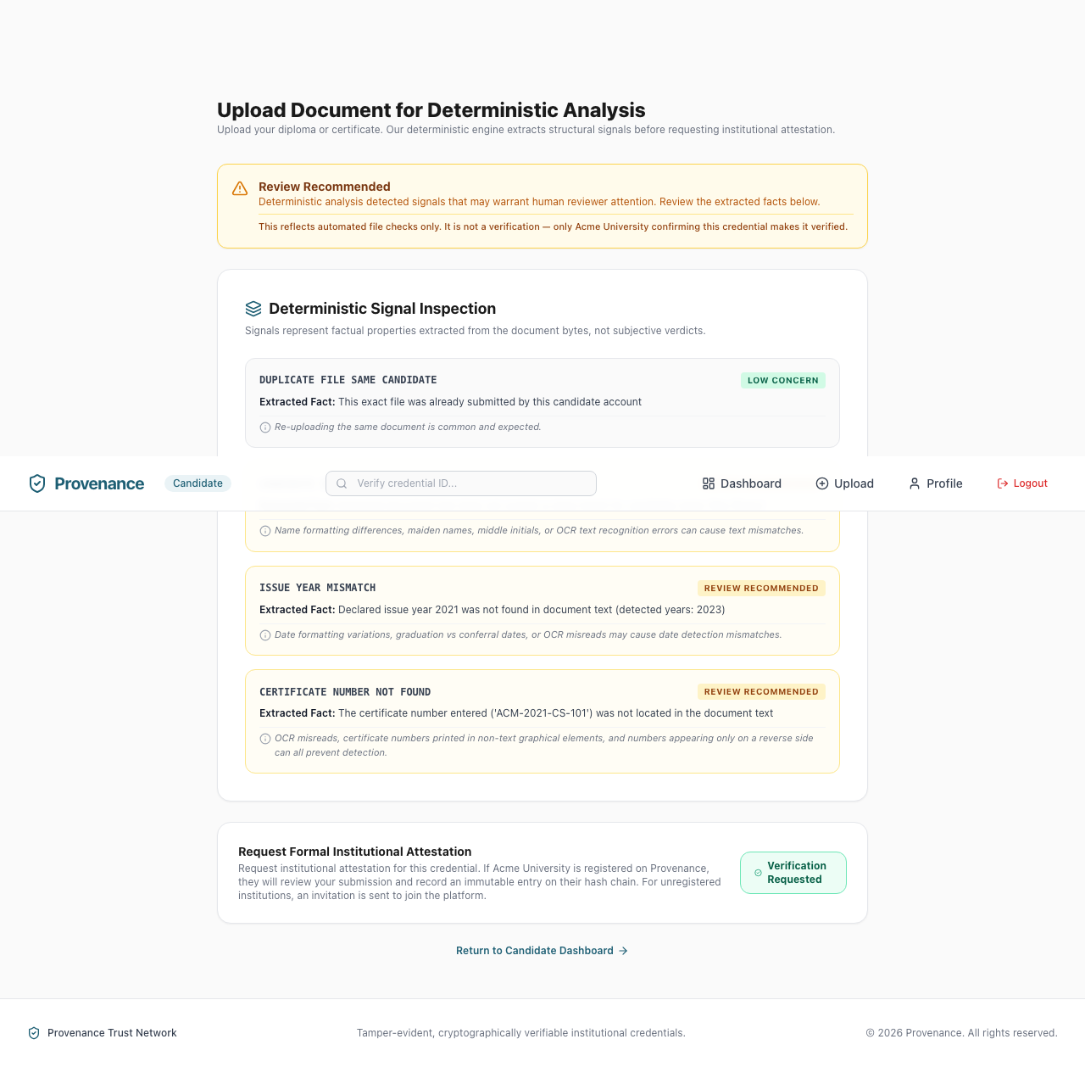
✦ CANDIDATE EXPERIENCE & FORENSICS IN ACTION
Live Document Ingestion & Transparent Signal Breakdown
Candidates receive immediate factual feedback upon uploading credentials, with one-click attestation requests.
Key UI & Workflow Highlights
✦ Instant Forensic Diagnostic
Displays overall status ('Low Concern' vs 'Review Recommended') along with OCR Confidence (e.g. 92.4%) and character count.
✦ Transparent Signal Cards
Each inspection metric shows the raw fact (e.g. 'Created by LaTeX, Producer: pdfTeX-1.40.24') and an explicit explanation.
✦ One-Click University Attestation
Candidates can link their upload directly to registered issuing universities (e.g. Stanford, MIT) to trigger formal institutional review.
✦ Public Profile Integration
Uploaded credentials appear immediately on the candidate's public profile (`/u/[username]`), accurately marked as self-submitted.
PROVENANCE | Tamper-Evident Credential-Verification Platform
Notes:
Slide 6 demonstrates the live candidate upload interface, captured directly from the running web application.
As seen on the left:
- The candidate uploads a diploma PDF.
- The system immediately rasterizes and analyzes the document, computing an OCR confidence score (e.g. 92.4%).
- Forensic signals are surfaced with clear badges (Low Concern in green, Review Recommended in amber).
- The candidate can then click 'Request Attestation' to send the document to the university's verification queue.

Slide 7
✦ CRYPTOGRAPHIC INTEGRITY ENGINE
The Per-Issuer Tamper-Evident Hash Chain
An append-only cryptographic ledger providing mathematical proof of record immutability.
Append-Only Cryptographic Mechanics
✔ Deterministic Canonicalization
All event payloads are recursively key-sorted and serialized into stable JSON strings before hashing, eliminating JSON key-ordering discrepancies.
✔ Cryptographic Event Linkage
Every block contains SHA-256(canonicalData) as contentHash and references the previous block's contentHash as prevHash.
✔ PostgreSQL Advisory Concurrency Lock
`SELECT pg_advisory_xact_lock(hashtext(issuerId))` serializes concurrent writes per institution, preventing race conditions or chain forks.
✔ Mathematical Auditability
Any verifier can re-execute `verifyChain(issuerId)`. If a malicious actor alters any row in PostgreSQL, the contentHash and downstream prevHash links fail instantly.
Cryptographic Chain Data Structure
┌─── Genesis Event (issued) ───
│ prevHash: null
│ contentHash: 8a4f...e3b1
└── Result: Status: Valid Genesis
┌─── Verification Event (verified) ───
│ prevHash: 8a4f...e3b1
│ contentHash: d92c...7f04
└── Result: Status: Linked & Verified
┌─── Attestation Event (verified) ───
│ prevHash: d92c...7f04
│ contentHash: 3c1a...9b82
└── Result: Status: Chain Tip Locked
PROVENANCE | Tamper-Evident Credential-Verification Platform
Notes:
Slide 7 explains the mathematical core of Provenance: the per-issuer tamper-evident hash chain.
In apps/api/src/services/hash-chain.ts:
- Each event (issued, verified, rejected, revoked) is canonically serialized with deterministicSerialize().
- We acquire a PostgreSQL advisory lock on hashtext(issuerId) so that simultaneous operations cannot create race conditions.
- The new block links to the previous tip via prevHash.
- Anyone can audit the entire chain at runtime with verifyChain(). If any byte in PostgreSQL is maliciously altered, verifyChain() pinpoints the exact broken block and marks subsequent blocks as 'depends_on_invalid'.

Slide 8
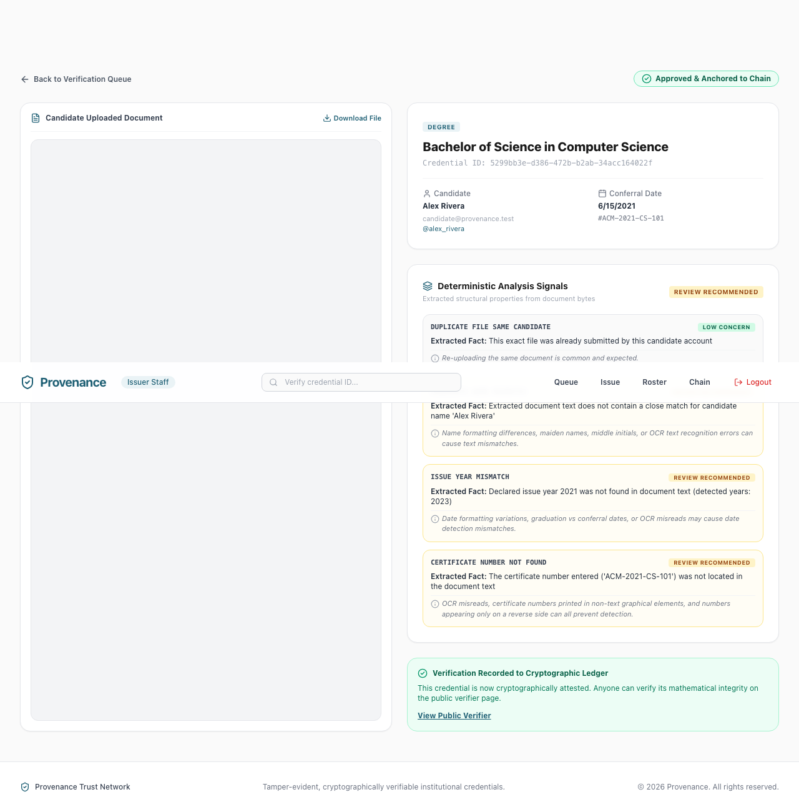
✦ INSTITUTIONAL ISSUER PORTAL
University Review Queue & Batch Issuance
Institutions review candidate requests, inspect forensic signals, and commit attestations to the ledger.
Issuer Capabilities & Audit Trails
✔ Review Queue Workflow
Centralized queue displaying incoming student attestation requests with extracted metadata, claimed credentials, and timestamps.
✔ Side-by-Side Forensic Review
Inspect PDF document preview, OCR text extracted by Tesseract, and metadata analysis signals side-by-side with student records.
✔ One-Click Chain Commitment
Approving a request atomically creates a `verified` CredentialEvent on the issuer's hash chain, immediately upgrading the credential status.
✔ Institutional Roster & Revocation
Searchable roster of all active credentials with instant revocation capabilities if academic misconduct or administrative error occurs.
PROVENANCE | Tamper-Evident Credential-Verification Platform
Notes:
Slide 8 showcases the Institutional Review Portal, captured directly from our running issuer staff portal.
University registrars and department staff can:
- View incoming attestation requests from candidates.
- Review forensic signals and verify extracted student names against their internal SIS records.
- Approve with one click, which invokes appendChainEvent() in PostgreSQL to cryptographically mint the attestation.
- Manage active diplomas and execute instant revocations if necessary.

Slide 9
✦ PUBLIC VERIFICATION & TRUST SHOWCASE
Zero-Friction Recruiter Audit & Public Portfolios
Instant QR and Credential ID lookup backed by privacy-preserving trust badges.
1. Instant Public Verifier
Accessible via `/verify/[credentialId]`
──────────────────────────
• QR Code Direct Scanning: Hiring managers scan physical/digital QR codes to open verification instantly.
• No Login Required: Public recruiters can verify legitimacy without creating an account or paying fees.
• Trust Status Badges: Verified (Green), Self-Submitted (Amber), Revoked (Red).
• Proof Integrity Stamp: Displays cryptographic contentHash and issuing university verification date.
2. Candidate Public Portfolio
Accessible via `/u/[publicUsername]`
──────────────────────────
• Shareable Web Profile: Clean, professional link for LinkedIn, resumes, and portfolios.
• Visual Distinction: Verified institutional diplomas are clearly differentiated from self-submitted uploads.
• Direct Verification Links: Each credential card links directly to its underlying cryptographic audit proof.
• Privacy Shield: Sensitive emails, raw file paths, and declined items are strictly omitted.
3. Privacy-Preserving Guardrails
Zero Data Leakage Architecture
──────────────────────────
• PII Isolation: Candidate contact info and internal storage keys are never exposed on public routes.
• Safe Error Handling: Missing credentials return generic 404 without revealing private system existence.
• Hashed Public Connectors: Issuer registry lookups store only SHA-256 name hashes (`rawNameHash`).
• Revocation Honesty: Revoked credentials display explicit timestamp and reason without data deletion.
PROVENANCE | Tamper-Evident Credential-Verification Platform
Notes:
Slide 9 covers the public verification and candidate portfolio experience.
- The verifier page (/verify/[id]) allows any hiring manager or recruiter to audit a credential in under a second.
- The candidate public profile (/u/[username]) provides a beautiful, verifiable portfolio showcasing confirmed credentials.
- Security and privacy are strictly preserved: no PII, internal IDs, or private document storage keys are exposed on public endpoints.

Slide 10
✦ ZERO-TRUST SECURITY DISCIPLINE
Architectural Safety: Anti-SSRF Public Issuer Connectors
Rigorous defense-in-depth controls preventing Server-Side Request Forgery and data exfiltration.
Strictly Prohibited Practices (SSRF Vectors)
✖ No Arbitrary URL Fetching
Provenance never extracts a URL or QR code payload from uploaded documents to fetch it. Allowing document contents to dictate host, port, or path is textbook SSRF.
✖ No Open Network Scrapers
OCR text is never used to determine outbound network destinations or dynamic HTTP endpoints.
✖ No Plaintext Third-Party Storage
Extracted recipient names from public issuer verification pages are never stored in plaintext in any table or API response. Only a SHA-256 hash is persisted.
Concrete Anti-SSRF Defense Controls
✔ Decoupled Host Registry
Connector selection is steered exclusively by candidate's self-declared institution name matched against a static alias registry.
✔ Constant Destination Hosts
Destination host ('www.coursera.org') is a hardcoded module constant. Target URL host and 'https:' protocol are asserted before dispatch.
✔ Strict Whitelist Regex
Tokens are validated against /^[A-Z0-9]{8,20}$/. Slashes, dots, and queries are rejected with zero network requests.
✔ Same-Host Redirect Policy
Redirects (max 2 hops) strictly assert targetUrl.host === connector.host and HTTPS at every hop. Any discrepancy immediately aborts.
✔ Resource Bounds & 24h Cache
5-second AbortController timeout, 512KB response body cap, and 24-hour IssuerLookup database caching prevent resource exhaustion.
PROVENANCE | Tamper-Evident Credential-Verification Platform
Notes:
Slide 10 details our strict Anti-SSRF architectural policy.
When integrating external public verification registries (such as Coursera):
- Many naive systems crawl URLs found inside PDFs, creating massive SSRF vulnerabilities.
- Provenance strictly prohibits arbitrary URL fetching.
- We use constant hostnames, strict alphanumeric token whitelists, same-host redirect verification, 5-second timeouts, and 512KB payload limits.
- Furthermore, if external HTML parsing fails, our discipline produces 'issuer_lookup_unavailable' (inconclusive), never a false accusation of forgery.

Slide 11
✦ ROLE-BASED ACCESS CONTROL & USER JOURNEYS
Multi-Role Ecosystem: Seamless Personas & Workflows
Tailored experiences for Candidates, Issuer Staff, Recruiters, and Platform Administrators.
Candidate
Upload & Manage Portfolio
─────────────────
• Upload certificates & view instant forensics
• Request attestation from universities
• Curate shareable public portfolio link
• Monitor verification request progress
Issuer Staff
Review & Cryptographic Issuance
─────────────────
• Manage incoming student attestation queue
• Side-by-side OCR & forensic inspection
• Commit approved credentials to hash chain
• Search institutional roster & revoke records
Recruiter / Verifier
Audit & Verify Trust
─────────────────
• Zero-friction ID search & QR scanning
• Audit tamper-evident SHA-256 proofs
• Inspect raw forensic inspection signals
• Confirm active vs revoked diploma status
Platform Admin
Governance & Infrastructure
─────────────────
• Approve & onboard issuing universities
• Verify institution domains and staff accounts
• Inspect system-wide actor Audit Logs
• Monitor server health & database backups
PROVENANCE | Tamper-Evident Credential-Verification Platform
Notes:
Slide 11 highlights our comprehensive Role-Based Access Control architecture.
Provenance supports four primary actors:
1. Candidates who upload credentials and showcase verified public portfolios.
2. Issuer Staff (registrars, university admins) who review queues and commit records to their cryptographic ledger.
3. Recruiters and Verifiers who audit authenticity in sub-seconds via QR codes or credential IDs.
4. Platform Admins who oversee institutional vetting, domain verification, and system-wide audit logging.

Slide 12
✦ DATA ARCHITECTURE & PRISMA SCHEMA
Relational Data Model & Cryptographic Entities
Prisma schema designed for transactional consistency, auditability, and tamper-detection.
Identity & Institutions
Core User & Issuer Models
──────────────────────────
• User: id, email, passwordHash, role (candidate | issuer_staff | platform_admin).
• CandidateProfile: userId, publicUsername, name, headline, bio, avatarUrl.
• Issuer: id, name, domain (unique), status (pending | approved | rejected), approvedBy.
• IssuerUser: id, issuerId, userId, role (staff | admin).
Forensics & Analysis
Document & Inspection Models
──────────────────────────
• Document: id, candidateId, storageKey, rawFileHash, canonicalContentHash, phash, ocrText, ocrConfidence, c2paPresent.
• DocumentAnalysis: id, documentId, signalType, signalValue (JSON), severity (low_concern | review_recommended | inconclusive).
• IssuerLookup: id, documentId, connectorId, code, outcome, rawNameHash, checkedAt.
Credentials & Hash Ledger
Immutable Ledger Models
──────────────────────────
• Credential: id, candidateId, issuerId, source, status (unverified | pending | verified | rejected | revoked), credentialType, title.
• VerificationRequest: id, credentialId, candidateId, issuerId, status, requestedAt, resolvedAt, resolvedBy.
• CredentialEvent: id, credentialId, issuerId, eventType, canonicalData (JSON), contentHash, prevHash, createdAt, createdBy.
• AuditLog: id, actorId, action, targetType, targetId, metadata (JSON), createdAt.
PROVENANCE | Tamper-Evident Credential-Verification Platform
Notes:
Slide 12 reviews our database schema defined in packages/db/prisma/schema.prisma.
- Identity tables link Users, Profiles, and Issuers with domain verification.
- Forensics tables persist raw hashes, OCR output, and individual DocumentAnalysis signals.
- Ledger tables contain the Credential records and the append-only CredentialEvent chain, which maintains the prevHash-contentHash sequence.
- All write actions are recorded in the AuditLog table for enterprise compliance.

Slide 13
✦ ENTERPRISE SECURITY & COMPLIANCE
Defense-in-Depth Security & Privacy Architecture
Engineered from the ground up for strict confidentiality, data minimization, and auditability.
Cryptographic Integrity
SHA-256 content hashes, deterministic JSON canonicalization, and PostgreSQL transaction advisory locking prevent data corruption and tampering.
Auth & Access Control
Stateless JWT authentication, bcrypt (12 rounds) password hashing, and strict role-based route middleware protect all internal endpoints.
Zero PII Leakage
Candidate emails, phone numbers, and physical storage paths are completely omitted from public API payloads and verifier views.
Immutable Audit Logs
Every platform action (login, upload, verification, approval, rejection, issuer creation) is immutably logged with actorId, timestamps, and metadata.
PROVENANCE | Tamper-Evident Credential-Verification Platform
Notes:
Slide 13 details our defense-in-depth security and privacy model.
- Cryptographic integrity ensures that no record can be forged or tampered with.
- Authentication enforces industry-standard JWTs and bcrypt hashing.
- Candidate PII is protected under strict data minimization rules: public verifiers only receive verified trust signals and metadata hashes.
- Comprehensive audit logging provides an unbroken chain of accountability for enterprise compliance.

Slide 14
✦ PRODUCT ROADMAP & STRATEGIC HORIZON
Strategic Roadmap: The Future of Verifiable Credentials
Expanding Provenance across decentralized identity, AI forgery detection, and global issuer networks.
Phase 1: W3C Decentralized Identity (DIDs)
Integration with W3C Verifiable Credentials (VC) standard, allowing candidates to export cryptographically signed credentials directly to Apple Wallet & Google Wallet.
Phase 2: Deep Learning GAN Forgery Detection
Advanced computer vision models detecting subtle generative AI visual inpainting, font boundary irregularities, and digital certificate stamp manipulations.
Phase 3: Enterprise HRIS & ATS Integrations
Direct API connectors and webhooks for Workday, Greenhouse, Lever, and SAP SuccessFactors for automated candidate verification upon job application.
Phase 4: Global Federated Issuer Consortium
Decentralized consensus verification network connecting international universities, accreditation boards, and professional licensing bodies worldwide.
PROVENANCE | Tamper-Evident Credential-Verification Platform
Notes:
Slide 14 outlines our future product vision:
1. Phase 1 brings W3C Decentralized Identifier (DID) and Verifiable Credential support, enabling mobile wallet exports.
2. Phase 2 introduces visual deep learning models to detect generative AI image inpainting.
3. Phase 3 creates seamless enterprise integrations with major ATS platforms like Workday and Greenhouse.
4. Phase 4 expands into a global consortium connecting universities and licensing bodies across international borders.

Slide 15
✦ THE FUTURE OF CREDENTIAL TRUST
Proven Integrity. Zero Doubt. Instant Trust.
Provenance bridges candidates, issuing institutions, and verifiers into an unforgeable trust ecosystem.
Deterministic Forensics
6-stage file analysis providing objective evidence rather than opaque probabilistic guesses.
Tamper-Evident Ledger
Append-only cryptographic hash chain guaranteeing mathematical record immutability.
Enterprise Architecture
Next.js App Router, Express, PostgreSQL, Anti-SSRF connectors, and privacy-preserving APIs.
⚡ Get Started with Provenance in 3 Steps:
1. Clone repo & run `npm install` • 2. Start DB with `docker-compose up -d` & run migrations • 3. Launch `npm run dev:api` & `npm run dev:web`
Notes:
Slide 15 concludes our presentation.
Provenance is a fully realized, production-ready platform combining forensic intelligence, cryptographic certainty, and intuitive user experiences.
With our clean monorepo architecture, getting started takes only three simple steps.
Thank you for your time. We welcome your questions and invite you to explore the Provenance repository!

